Slide 1
MCP and Agent Skills
Hackathon for Earth Science
A first guide for Earth scientists
github.com/midatm1234/earth-science-mcp-hackathon
Notes:
The workshop is for Earth scientists who are new to MCP. Participants can describe their scientific needs in plain words and use an AI coding assistant to help write code. They remain responsible for checking the scientific choices and results.
Sources (reviewed November 12, 2026):
https://github.com/midatm1234/earth-science-mcp-hackathon/blob/main/README.md

Slide 2
What we will do today
Call a ready-made MCP tool and check its answer.
Find useful data and existing tools before building anything.
Create a MCP tool and write instructions (Agent Skill) for using it.
Ask another team to repeat the work and record what happened.
Workshop materials
2
Notes:
The finished contribution includes an MCP tool or small set of tools, a related skill, instructions, and evidence from another team's checks. The tutorials provide the detailed steps. Keep enough time for teams to try each other's work.
Sources (reviewed November 12, 2026):
https://github.com/midatm1234/earth-science-mcp-hackathon/blob/main/README.md
https://github.com/midatm1234/earth-science-mcp-hackathon/blob/main/tutorials/05-submit-and-test-a-peer.md

Slide 3
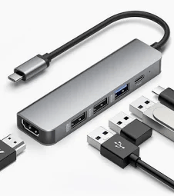
MCP: A Universal Adapter for AI
AI Applications
(Claude, GPT, Gemini…)
MCP
Tools and Services
MCP stands for Model Context Protocol.
It gives an AI assistant a common way to ask a program for data or a calculation.
A tool does one job, such as downloading data and making a plot.
An MCP server is the program that offers these tools. It can run on your laptop.
You ask a question. The assistant calls a tool and explains the result.
MCP and skills explained
3
Notes:
In this workshop, an AI assistant means Copilot, Claude Code or Codex running in VS Code. MCP is the shared connection between the assistant and a program that provides tools. The starter runs on the laptop. Earthdata provides a separate service over the internet. A tool still needs correct code and scientific checks. MCP alone does not guarantee correct science.
Sources (reviewed November 12, 2026):
https://github.com/midatm1234/earth-science-mcp-hackathon/blob/main/docs/mcp-and-skills.md
https://github.com/midatm1234/earth-science-mcp-hackathon/blob/main/tutorials/00-first-tool-call.md

Slide 4
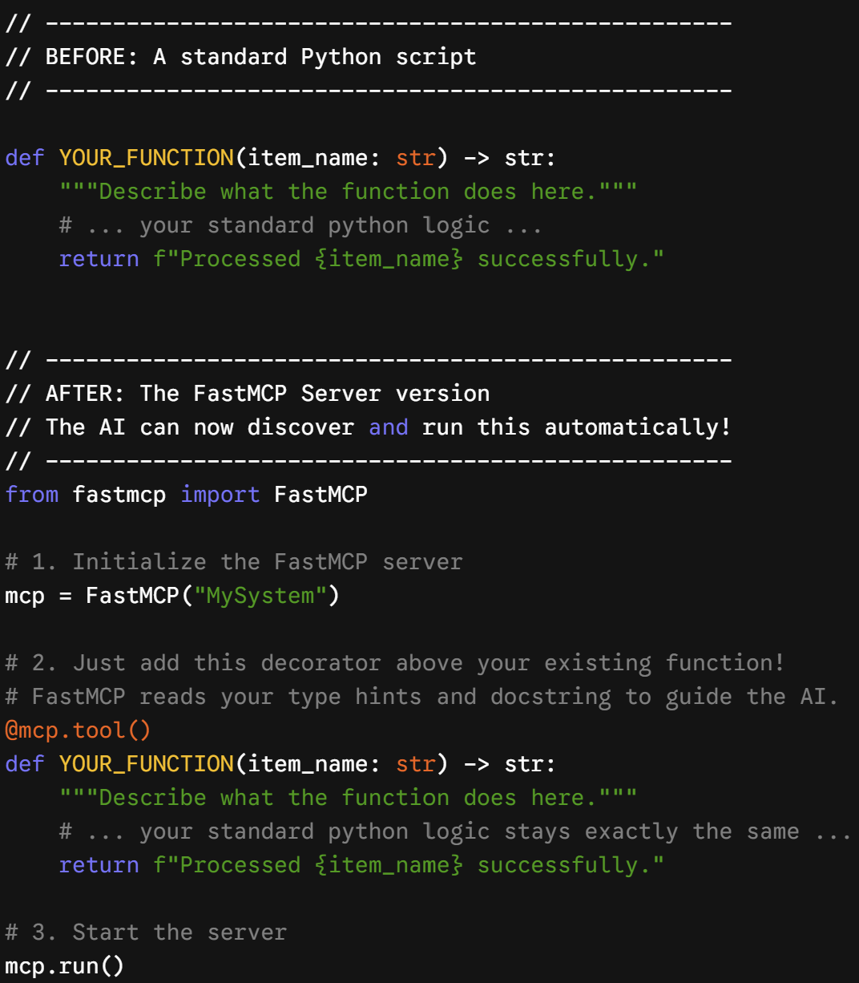
Reuse your existing Python code, such as a function that reads a data file, calculates indices, or creates a plot.
Create an MCP server with FastMCP to make your function available to an AI assistant.
Add @mcp.tool() above the function to register it as a tool.
Describe what the function does and what inputs it needs so the assistant can choose and use it correctly.
Run the server and connect your AI assistant. The assistant can then find the tool, call it and explain the result.

Slide 5
Skills in plain language
A skill is a set of reusable instructions for your AI assistant.
The instructions live in a text file called SKILL.md.
For a temperature comparison between observations and models, a skill can ask the assistant to check units and dates before calling the tool.
It also says when to stop and what the answer should include.
The tool does the task. The skill guides the steps.
MCP and skills explained
4
Notes:
An agent is an AI assistant that can work through steps and call tools. A skill captures a procedure that a scientist can review. For example: inspect both datasets, confirm units and dates, call the comparison tool, and report the result with the source and limits. A skill can also say which questions it should not handle. Installing a skill does not connect or start its required tools.
Sources (reviewed November 12, 2026):
https://github.com/midatm1234/earth-science-mcp-hackathon/blob/main/docs/mcp-and-skills.md
https://github.com/midatm1234/earth-science-mcp-hackathon/blob/main/tutorials/03-create-an-agent-skill.md

Slide 6
Before you start
github.com/midatm1234/earth-science-mcp-hackathon
Open START_HERE.md in the workshop repository.
Install VS Code and uv. The setup guide shows how uv installs Python and the needed packages.
Open the project folder in VS Code.
Sign in to one approved coding assistant: Copilot, Claude Code or Codex. Then follow the setup checks.
Use the setup guide for the exact commands for your computer.
Open START_HERE.md
5
Notes:
A terminal is the text window where you enter commands. In VS Code, open Terminal > New Terminal. After opening the project folder, run:
uv sync
uv run python scripts/install_skills.py
Then run:
uv run python scripts/first_call.py
Follow the assistant-specific connection steps in START_HERE.md and docs/setup.md. Use the approved sign-in route available to your participant group. Restart VS Code after installing uv if the command is not found. The basic comparison runs on the laptop. Ask a mentor for setup help.
Sources (reviewed November 12, 2026):
https://github.com/midatm1234/earth-science-mcp-hackathon/blob/main/START_HERE.md
https://github.com/midatm1234/earth-science-mcp-hackathon/blob/main/README.md

Slide 7
Tutorial 00: Your first tool call
Run: uv run python scripts/first_call.py
Ask your assistant: “Compare model A with the station observations at SYN-VALLEY.”
Check that the assistant actually calls the MCP tool.
Expect 23 monthly pairs and an average model minus observation difference of about −1.05 °C.
This example uses made-up practice data.
Open tutorial 00
6
Notes:
The script makes an MCP call without using AI. The assistant then makes the same call through MCP. The two results should agree. At SYN-VALLEY, model A has 23 valid monthly pairs, mean model minus observation difference −1.054 °C, and root mean square error 1.212 °C. The tool converts model A from kelvin to degrees Celsius and excludes July 2020 because the observation is missing. These are synthetic teaching data, not measurements from an actual station. Ask participants to look for the recorded MCP tool call. An assistant running a Python command instead does not demonstrate its MCP connection. Optional exercise: compare models A and B at SYN-MOUNTAIN using the tutorial's expected values.
Sources (reviewed November 12, 2026):
https://github.com/midatm1234/earth-science-mcp-hackathon/blob/main/tutorials/00-first-tool-call.md
https://github.com/midatm1234/earth-science-mcp-hackathon/blob/main/START_HERE.md

Slide 8
Tutorial 01: Find data and existing tools
Choose a variable, region and time period.
Ask your assistant to use Earthdata to find suitable datasets and files.
Check the units, dates and source details.
Search the workshop catalog for tools to reuse or extend.
Finding a file does not download or analyse its measurements.
Open tutorial 01
7
Notes:
The discovery record is a short form for the question, available data, tools considered, and the team's decision to reuse, extend or build. A catalog is a list of available tools and skills. Example request: Is monthly near-surface air temperature from MERRA-2 available for central California in 2020? Earthdata searches information about datasets and individual files. This exercise does not download data and does not require Earthdata Login. Data outside Earthdata can be used if the team records the source, version, units, grid and dates and checks that the files exist. If the live search fails, use the dated saved example for practice and mark the live check as blocked.
Sources (reviewed November 12, 2026):
https://github.com/midatm1234/earth-science-mcp-hackathon/blob/main/tutorials/01-discover-existing-capabilities.md

Slide 9
A small question for your team
Choose one question that you can check with a small example.
For example: How recent are the available sea surface temperature files?
Write down the inputs, the answer you need and how you will check it.
A clear question gives the assistant a clear job.
Project ideas and challenge cards
8
Notes:
Keep the first task small. One team may check the date of the latest file. Another may extend the model and observation comparison. Participants supply the scientific purpose and a way to check the answer. They can ask the coding assistant to propose how many tools are needed. The discovery step comes before building. If a useful tool already exists, consider reusing or extending it.
Sources (reviewed November 12, 2026):
https://github.com/midatm1234/earth-science-mcp-hackathon/blob/main/tutorials/01-discover-existing-capabilities.md
https://github.com/midatm1234/earth-science-mcp-hackathon/blob/main/tutorials/02-build-an-mcp-tool.md
https://github.com/midatm1234/earth-science-mcp-hackathon/blob/main/docs/challenge-cards.md

Slide 10
Tutorial 02: Build a tool
Describe the scientific question, the data and an answer you can check.
Ask your assistant to propose the tools and write the code and tests.
Review the results and try one incorrect input.
Start a new chat so the new tools appear. Ask your question and watch the tool call.
Success means a clear result and a helpful response.
Open tutorial 02
9
Notes:
Participants decide what the tool should answer and how to judge it. The assistant helps write the code, tests and catalog entry. Read its plan and ask for changes if the proposed tools do not fit the scientific question. Ask for short outputs that include source and date checked, plus units and excluded values when relevant. Check a known answer, such as a calculation you can confirm by hand or a saved service response. The assistant should show what checks actually ran and say what remains unverified. A new MCP server normally appears only after starting a new chat or session.
Sources (reviewed November 12, 2026):
https://github.com/midatm1234/earth-science-mcp-hackathon/blob/main/tutorials/02-build-an-mcp-tool.md

Slide 11
An example request you can copy
Build an MCP server called sst-latest for team <team-name>.
(ex) Find a suitable global sea surface temperature dataset in Earthdata, then its newest file. Return the dataset name and ID, the file name, the date it covers and the date checked. Do not download the data.
Propose the tools needed, then build and test them without internet access using a saved example. Follow AGENTS.md and show which checks passed.
Replace <team-name> with your team’s name.
Full example in tutorial 02
10
Notes:
This prompt is a shorter version of the tutorial's example. AGENTS.md is the file containing this project's instructions for coding assistants. The example reports which data are available, not the water temperature itself. Ask the assistant to use a suitable sea surface temperature collection, such as the example in the tutorial, and verify the newest file date. Tests should work without the network by using a saved sample response. After building, begin a new session and ask the same question in ordinary language. Compare the tool's answer with a direct Earthdata check.
Sources (reviewed November 12, 2026):
https://github.com/midatm1234/earth-science-mcp-hackathon/blob/main/tutorials/02-build-an-mcp-tool.md

Slide 12
Tutorial 03: Create a skill
Describe when to use your tool, what to check and what the answer should include.
Ask your assistant to write and install SKILL.md.
In new chats, test a request that names the skill and an ordinary science question.
Try a similar question that should leave the skill unused.
Success means the assistant uses the right tool and explains its source and limits.
Open tutorial 03
11
Notes:
A skill is a short set of instructions. For the latest sea surface temperature file example, ask: How up to date are the sea surface temperature data? Then ask: What does SST stand for? The first question should use the skill and tool. The second should not need them. Direct skill requests use /skill-name in Copilot and Claude Code, and $skill-name in Codex. Start a new chat after installing or changing the skill and use a fresh chat for each test. Check the actual tool calls. If the needed tool is missing, the skill should explain the problem and stop. Record the prompts, assistant used and results. The tutorial also offers an optional map and animation example after the basic exercise.
Sources (reviewed November 12, 2026):
https://github.com/midatm1234/earth-science-mcp-hackathon/blob/main/tutorials/03-create-an-agent-skill.md

Slide 13
Tutorial 04: Use tools and skills together
Choose one question, dataset and region.
Ask your assistant to check Earthdata, then run your team’s skill and tools.
Compare the results and explain any differences.
Keep the source and date with each result. Clearly label saved examples.
Success means an answer that says what each MCP tool did.
Open tutorial 04
12
Notes:
Example: Find the newest sea surface temperature file date in the NASA catalog. Run our team's tool. Do the two dates agree? Earthdata supplies information about datasets and files. Your team's result may come from a different service or from a practice file. Keep these sources separate in the answer and explain any differences in timing, region or data product. The core Earthdata check does not download files. If Earthdata is unavailable, continue with the team's tools and mark the live discovery check as blocked. The tutorial's optional SWOT download activity requires Earthdata Login and is separate from the core path.
Sources (reviewed November 12, 2026):
https://github.com/midatm1234/earth-science-mcp-hackathon/blob/main/tutorials/04-combine-tools-and-skills.md

Slide 14
Tutorial 05: Share and test a team’s work
Save a fixed version with setup steps and a small example.
Submit it for review, with a mentor’s help if needed.
In a new chat, another team follows the instructions without the authors’ help.
Run the example, a new input and an incorrect input.
Record passed, failed or blocked checks. Retest any repairs.
Success means another team has used the skill and MCP tools.
Open tutorial 05
13
Notes:
A fixed or frozen version is an exact saved version that reviewers can test and identify. The tutorial describes submission through a GitHub pull request, which is a request to review and add a contribution. Ask a mentor for help if needed. Authors step away while another team follows the instructions independently. Reviewers record the version, assistant used, expected and actual results, and sources, units and limitations. They test the skill directly, through an ordinary question, and with a question it should not handle. A demonstration by the authors is not an independent test. Record a network or account limit as blocked. Give repairs a new version and retest them. Accepting the submission does not automatically put the tool online.
Sources (reviewed November 12, 2026):
https://github.com/midatm1234/earth-science-mcp-hackathon/blob/main/tutorials/05-submit-and-test-a-peer.md
https://github.com/midatm1234/earth-science-mcp-hackathon/blob/main/docs/peer-testing.md

Slide 15
If something does not work
Tool missing? Open the project folder and start a new chat.
Tool failed? Ask the assistant to show the error and run its checks.
Troubleshooting guide
15
Notes:
If a new tool or skill is missing, confirm that the repository folder is open and trusted and that the assistant can see the server. Restart VS Code after installing uv if necessary. If the assistant answers without calling a tool, ask it to use the intended MCP tools and inspect the actual call. If it runs a separate script, the MCP connection still needs checking. The script example can demonstrate MCP without an AI assistant. A saved Earthdata response is useful for practice but does not verify current data availability. Mark a check blocked when you could not run it.
Sources (reviewed November 12, 2026):
https://github.com/midatm1234/earth-science-mcp-hackathon/blob/main/START_HERE.md
https://github.com/midatm1234/earth-science-mcp-hackathon/blob/main/tutorials/00-first-tool-call.md
https://github.com/midatm1234/earth-science-mcp-hackathon/blob/main/tutorials/01-discover-existing-capabilities.md
https://github.com/midatm1234/earth-science-mcp-hackathon/blob/main/tutorials/02-build-an-mcp-tool.md

