Slide 1

Building Intelligent Next Generation Network for
DEN

Slide 2
Company Overview
Innovative provider of integrated solutions for major Cable & Telecom companies
Providing services since 1994
Headquartered in Atlanta, GA and Delivery center in India
Specialized in:
HFC Design
Field Engineering and Mapping
Network Engineering and Integration
GIS
Software development
Project management

Slide 3








Clients

Slide 4
IMMCO’s Value
Sharing best design and GIS practices learnt through delivering services to MSO’s like Time Warner, Cox, Comcast and equipment mfrs. like CISCO
In house resources with knowledge of in-country and offshore MSO operations and delivery challenges

Slide 5
Proposed Workflow for DEN
Preparation of GIS Landbase
Field Survey
Creation of Spec
Planning & Design
Implementation, Activation & Testing
Hosting

Slide 6
GIS Landbase - Benefits
Efficient planning and design
Reference for building Geo spatial design data
OSP Assets , Pole utilization , ROW permit reports
Enables corporate tracking of facilities
Network outage root cause analysis
Customer service enhancement
Upgradation & node splits made easy
Target marketing based on location information

Slide 7
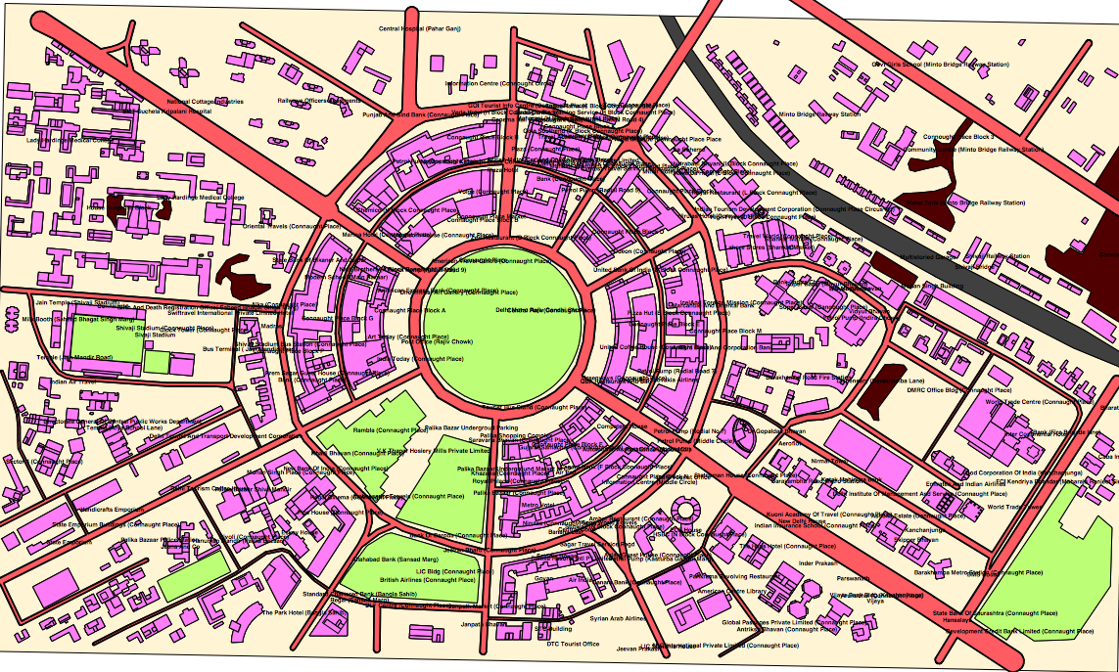
GIS Landbase sample

Slide 8
Survey – Why?
Capture existing plant information
Capturing Street names if missing in Landbase
Identification of existing Pole location and pole type
Identification of existing underground construction and risers
Identification of existing Node location and type
Identification of existing Power Supply location and type
Identification of existing Amplifier location and type
Identification of existing Tap / Splitter / Coupler location
Connection count on existing Taps
Identification of existing Cable type
Identification of Long drops
Identify MDU cable entry point, number of floors, design required or not , number of units
Capture missing address location in Landbase
Maximum utilization of existing infrastructure
Improve overall design efficiency to reduce cost
Locate construction obstacles, select alternate route
Identify new opportunities (especially SMBs)

Slide 9
Creation of Spec
What is a Spec?
Defines how the design software behaves based on equipment specification as published by manufacturer and SCTE standards
Benefits
Simulate
Analyze
Standardize
Calculate
Our expertise
Expertise creating Specs for various equipment from multiple vendors
32,000 KM during last 5 years

Slide 10
Design
Strand
Draft existing features over landbase
Like - Poles , Strand , Residential vs Commercial
RF
RF design over strand
Includes - Actives , Passives , Power , Terminators , Signal levels for Actives, EQs , PADs, EOL signal levels
Fiber
Design optimum route over strand
Propose Splicing points
Our Expertise
32,000 KMs of RF Design during last 5 years

Slide 11

GIS Landbase

Slide 12
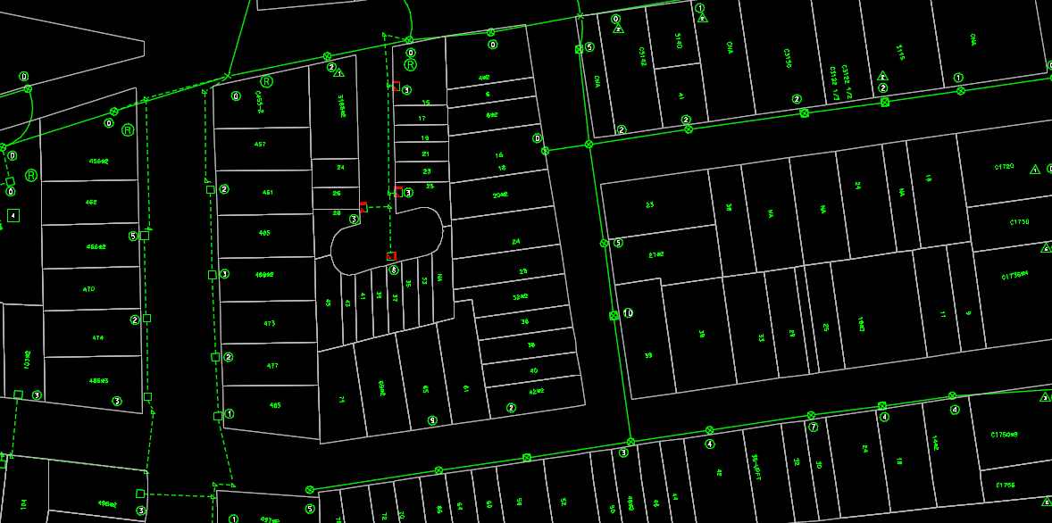
Strand

Slide 13
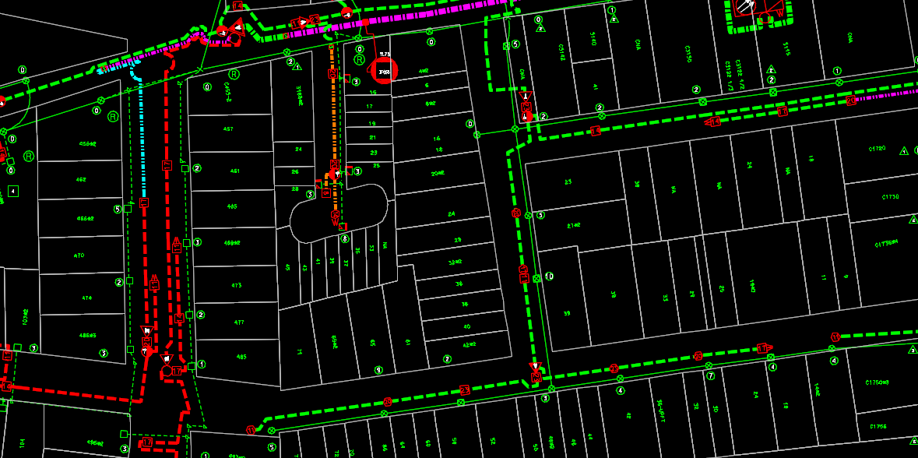
RF Design

Slide 14
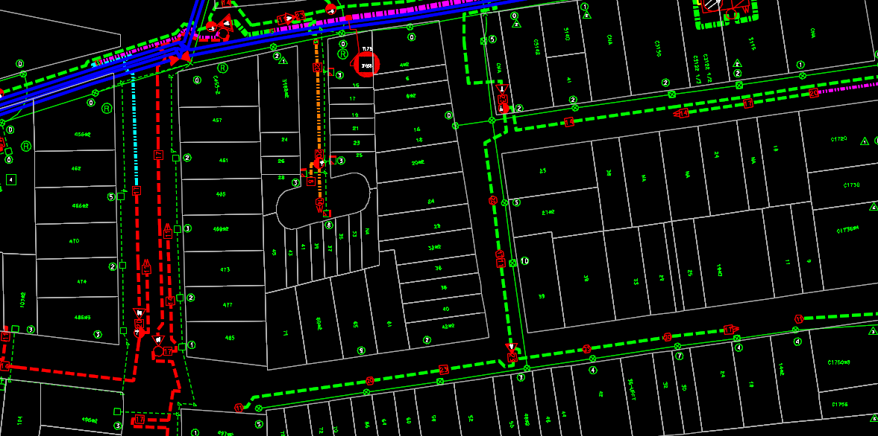
Fiber routing

Slide 15
Implementation, Activation &Testing
Project tracking
Configuring network from CMTS to Modem
Balancing Forward and Reverse Signal levels

Slide 16
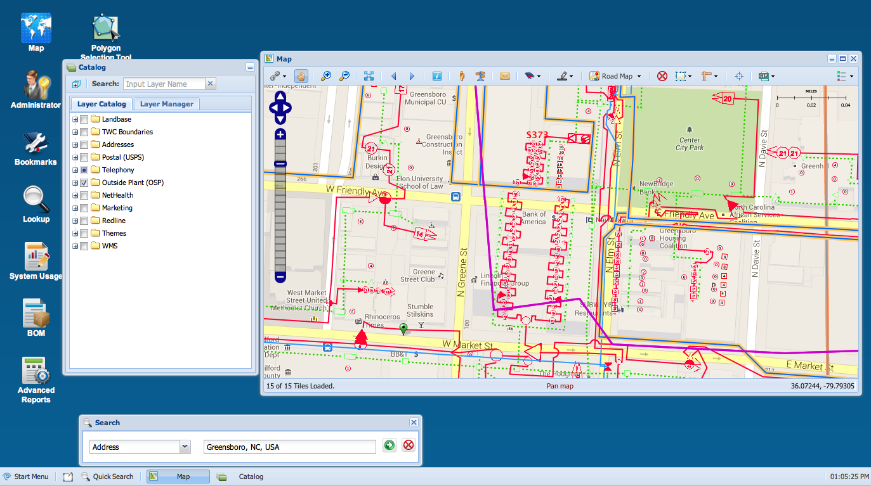
Hosting
Publishing Outside plant network using IMMCO’s iBISS platform

Slide 17
Demo
Demo of a sample area from Time Warner Network
Overlay of OSP on Google maps
Network equipment information
Commercial services
NMS and other application integration

