Slide 1
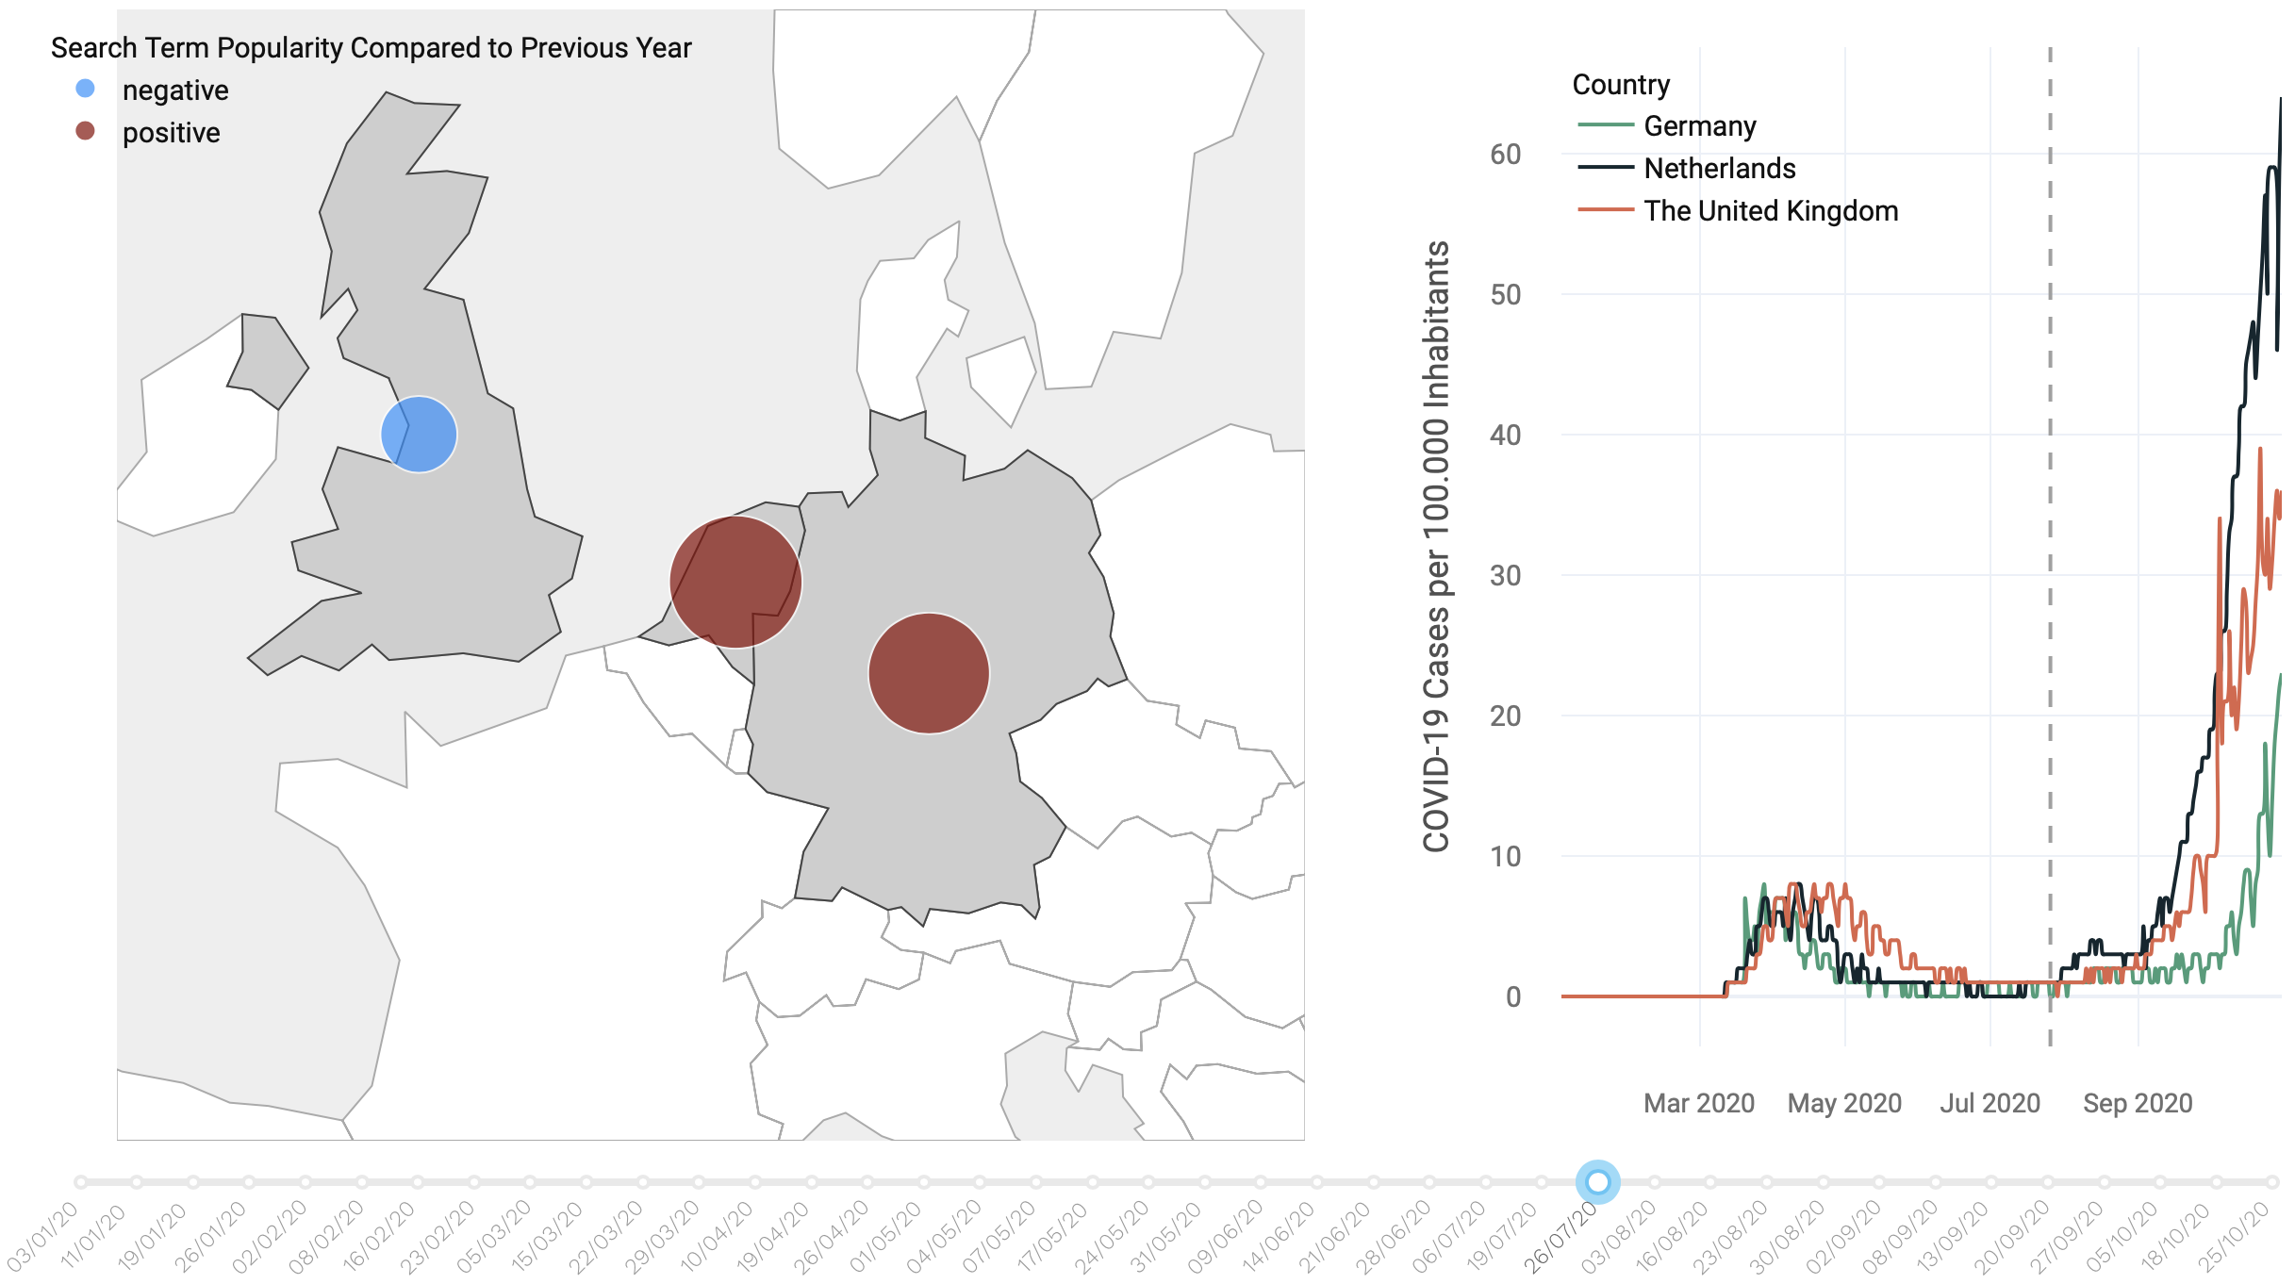
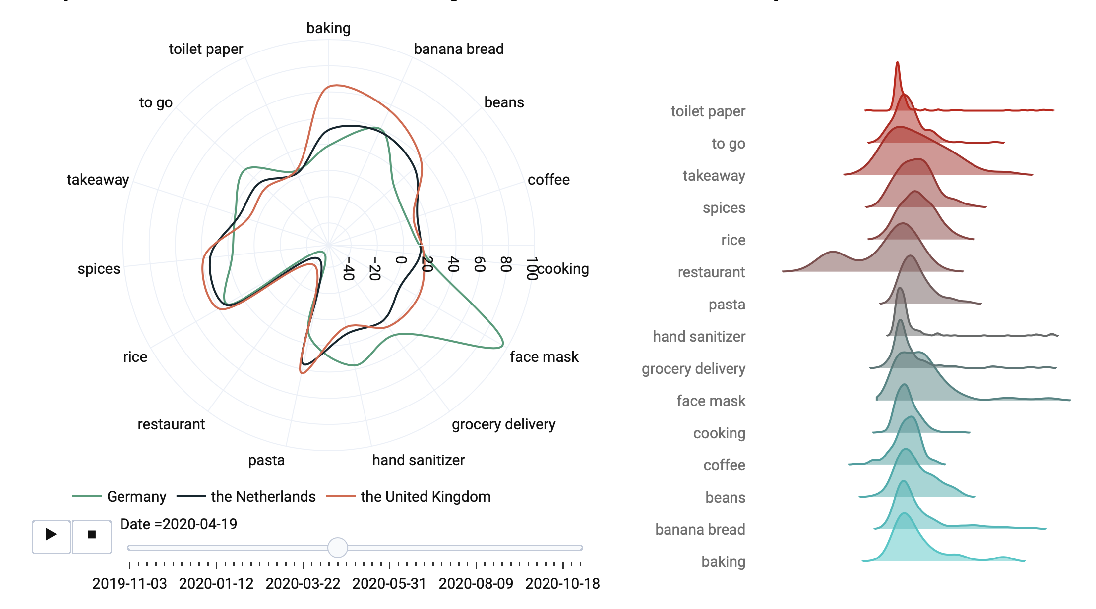
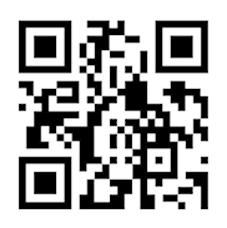
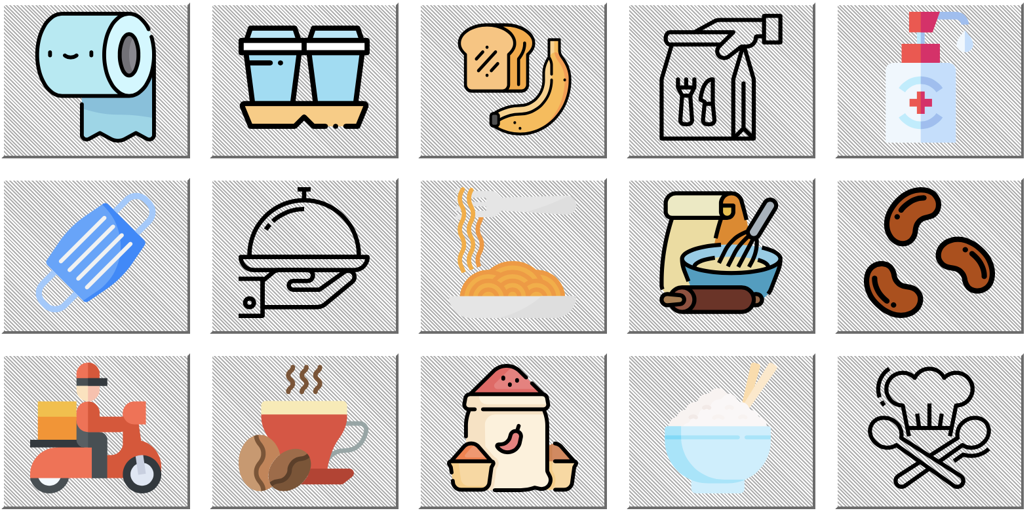
Searching for the Essentials Impacts of COVID-19 on Web Searches for Food & Other Necessities
When the COVID-19 pandemic hit the world, nearly every aspect of daily life was affected. The food industry, normally functioning smoothly and unobtrusively, was shaken as people began hoarding products like pasta, toilet paper or rice. Our interactive web map application aims to visualize the impact of COVID-19 on interests in food and other essential items in three European countries based on Google Trends data [1] of specific products.
Focus
Our interactive web application has two focuses: A main divergent proportional symbol map where the visitor can select one search term and compare the trend among Germany, the Netherlands and the United Kingdom; and a radar chart allowing the visitor to discover differences between 15 selected search terms for the three countries.
Symbol MAP
When opening the web application or clicking on the navigation button FOOD, the user gets to select a search term by clicking on the respective icon (Fig. 1). The map visualizes the Search Trend Popularity for the selected term during 2020 compared to the previous year without COVID-19 impact (Fig. 2). We selected a conic conformal map projection that is suitable for our area of interest extending from east to west.
(…)
Imprint
Mapping Project Winter Semester 2020/2021 Technische Universität München
Esmé Middaugh
Nele Peschel
Vivien van Dongen
Supervisors
Juliane Cron, M.Sc.
Dr.-Ing. Mathias Jahnke
Keywords
Google Search Terms, COVID-19, pandemic, Web Searches, essentials
Link
https://searching-for-the-essentials.herokuapp.com
Fig. 2 Close-up of the FOOD site displaying the map showing the search trend popularity for the term restaurant in the week of July 26. The daily COVID-19 cases are shown on the right.
References
[1] Google Trends (2020). Google Trends. Retrieved Nov 11, 2020, https://trends.google.com/trends/?geo=US
[2] World Health Organization (2020). WHO Coronavirus Disease (COVID-19) Dashboard. Retrieved Nov 11, 2020, from https://covid19.who.int/
Fig. 3 Close-up of the COUNTRY site displaying the radar chart and ...
Radar chart
Clicking the navigation button COUNTRY the radar chart pops up comparing the 15 search terms across the countries selected in the dropdown menu (Fig. 3). A timeline animation can be started or the time can be selected individually. Negative and positive values indicate lower or higher searches compared to the previous year.
Data collection
The Search Term data is available on the Google Trends website [1]. We used the Google data from November 2018 to November 2020 and calculated the Search Trends differences between the first year (11/2018-11/2019) and the second year with COVID-19 impact (11/2019-11/2020). For the daily COVID-19 cases we used the data from the WHO [2].
Tools
The web application was designed with Plotly, an interactive graphing library and deployed with Dash. Both are Python libraries. The data cleaning was done in R.
html?
Conclusion
As can be seen in the Figures, the search terms changed during the Corona pandemic. Web searches for banana bread and toilet paper increased, while restaurants were searched less often. Here we need another take home message that inspires peeps
Fig. 1 Search trends visualized by icon buttons

