Slide 1
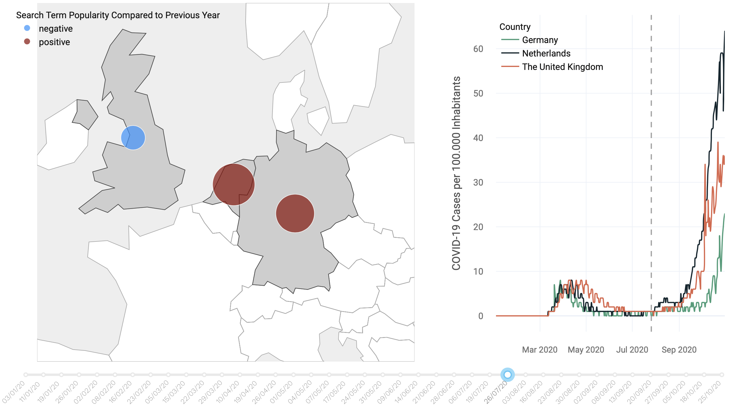
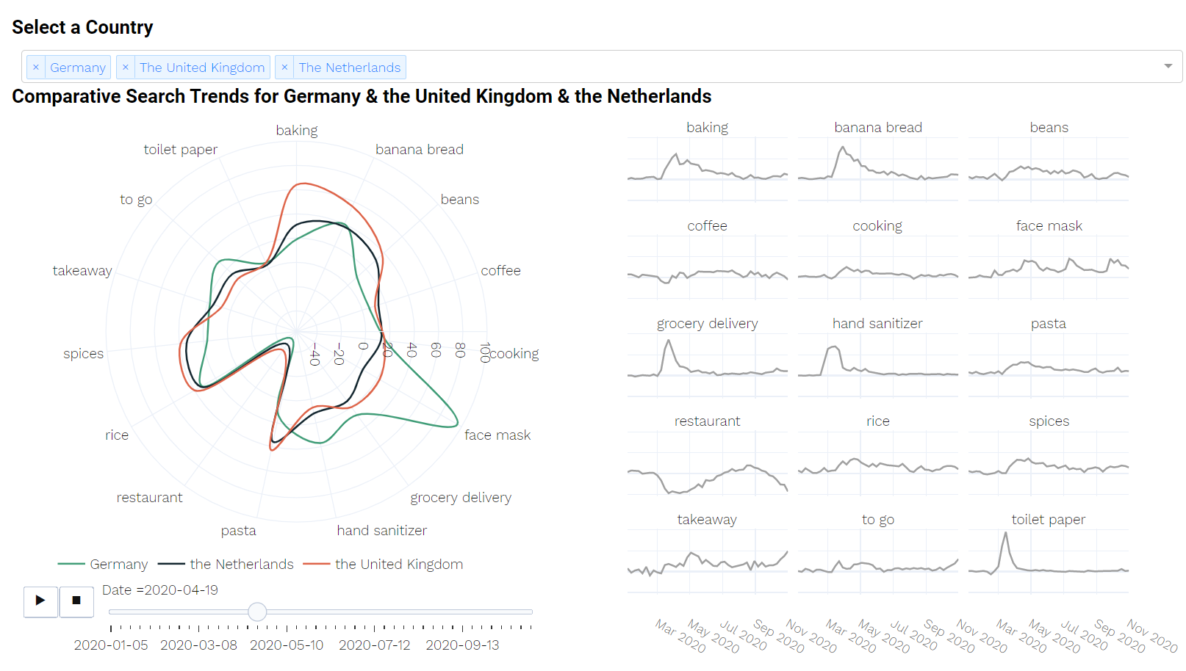
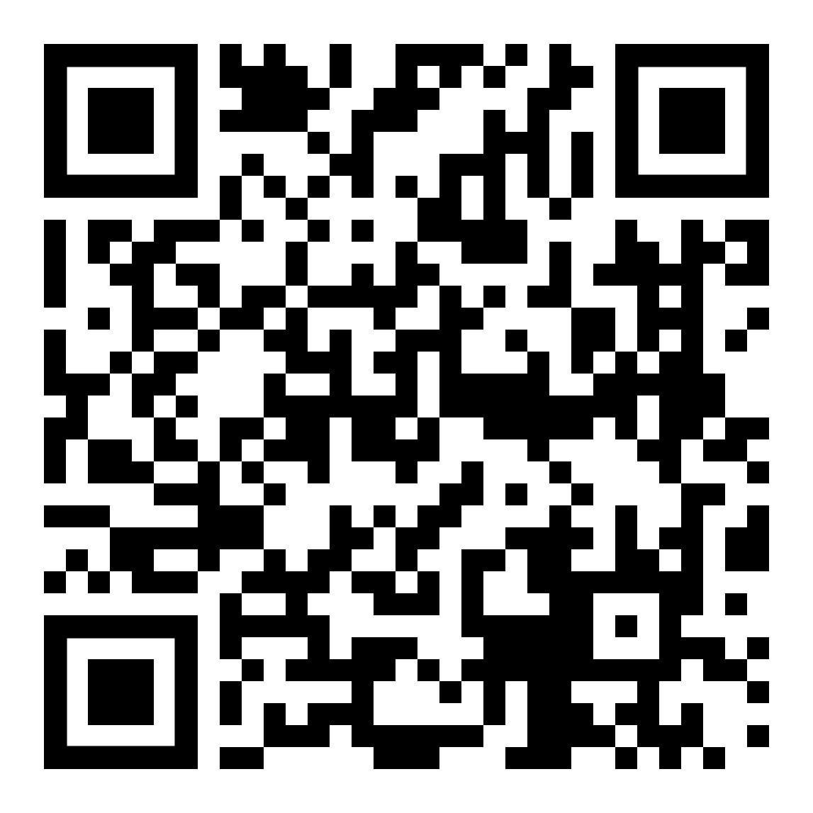
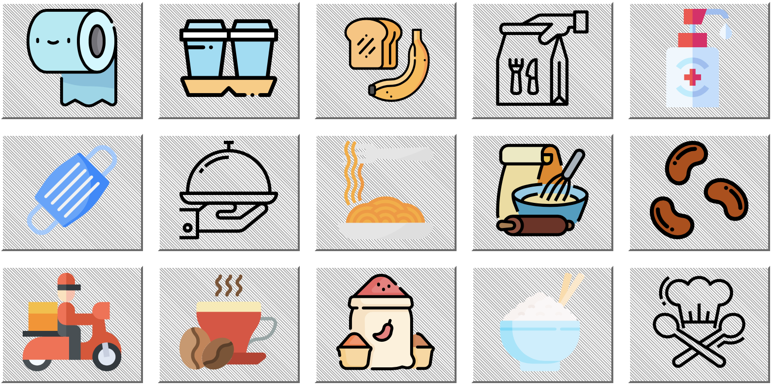
Searching for the Essentials Impacts of COVID-19 on Web Searches for Food & Other Necessities
When the COVID-19 pandemic hit the world, nearly every aspect of daily life was affected. The food industry, normally functioning smoothly and unobtrusively, was shaken as people began hoarding products like pasta or toilet paper. Our interactive web map application aims to visualize the impact of COVID-19 on interests in food and other essential items in three European countries—Germany, the Netherlands, and the United Kingdom—based on Google Trends data [1] of specific products.
Focus
Our web application is divided into two sections: the FOOD and the COUNTRY section. The former shows a divergent proportional symbol map comparing the evolution of one search term among Germany, the Netherlands and the United Kingdom, along with a line chart of World Health Organization (WHO) data on COVID-19 infection rates with an orienting vertical line. The latter contains a radar chart allowing the visitor to discover differences between all 15 search terms across the countries, as well as a small multiple time series plot displaying the changes over the study time period.
Symbol MAP
When opening the web application homepage (or by clicking on the navigation button FOOD), the user selects a search term by clicking on the respective icon (Fig. 1). The map visualizes the Search Trend Popularity for the selected term during 2020 compared to the previous year without COVID-19 impact (Fig. 2). Blue circles indicate a higher search frequency during the pandemic while red circles show a lower search query. We chose a conic conformal map projection as it is suitable for our area of interest extending from east to west.
Imprint
Mapping Project Winter Semester 2020/2021 Technische Universität München
Esmé Middaugh
Nele Peschel
Vivien van Dongen
Supervisors
Juliane Cron, M.Sc.
Dr.-Ing. Mathias Jahnke
Keywords
Google Trends, COVID-19, pandemic, web searches, search data, hoarding, pandemic behavior, World Health Organization (WHO)
Link
https://searching-for-the-essentials. herokuapp.com
Fig. 2 Close-up of the FOOD section showing the daily COVID-19 cases on the right and the symbol map displaying the search trend popularity for “restaurant” in the week of July 26.
References
[1] Google Trends (2020). Google Trends. Retrieved Nov 11, 2020, https://trends.google.com/trends/?geo=US
[2] World Health Organization (2020). WHO Coronavirus Disease (COVID-19) Dashboard. Retrieved Nov 11, 2020, from https://covid19.who.int/
Fig. 3 Close-up of the COUNTRY section displaying the radar chart and the line plots.
Radar chart
Clicking on the navigation button COUNTRY a radar chart pops up comparing the 15 search terms across the countries selected in the dropdown menu (Fig. 3). A timeline animation can be started, or the date can be selected individually. Negative and positive values indicate lower or higher searches compared to the year before. Additional context is given by line plots presenting the evolution of each search term and the COVID-19 infection rate.
Data collection
We used the Google Trends data from January 2019 to November 2020 and calculated the differences between the first and the second year [1]. For the daily COVID-19 cases we used the data from the WHO [2]. The WHO data starts on 1/2020.
Tools
The interactive web application was built with Dash, an open-source Python library. Plotly, a scientific graphing Python library, was used to create the individual maps and graphs. The project is hosted on Heroku, a cloud platform which allows for deployment of Flask applications.
Conclusion
The search term popularities noticeably changed during the COVID-19 break-out in 2020. Web searches for banana bread and toilet paper largely increased, while restaurants were searched less often. During the first wave people especially started looking for hand sanitizer and toilet paper, while the search for face masks was staggered for the countries due to regulations starting to apply at different times. These trends and more can be explored with our interactive web map application.
Fig. 1 Search trends visualized by icon buttons.

