Slide 1
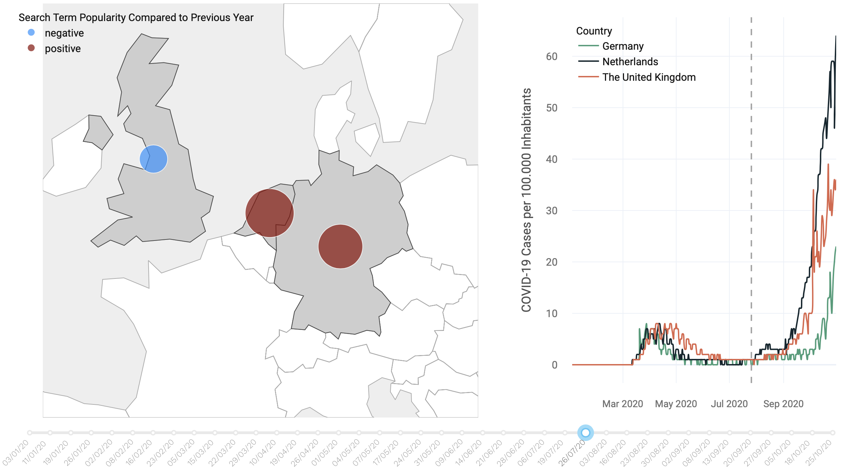
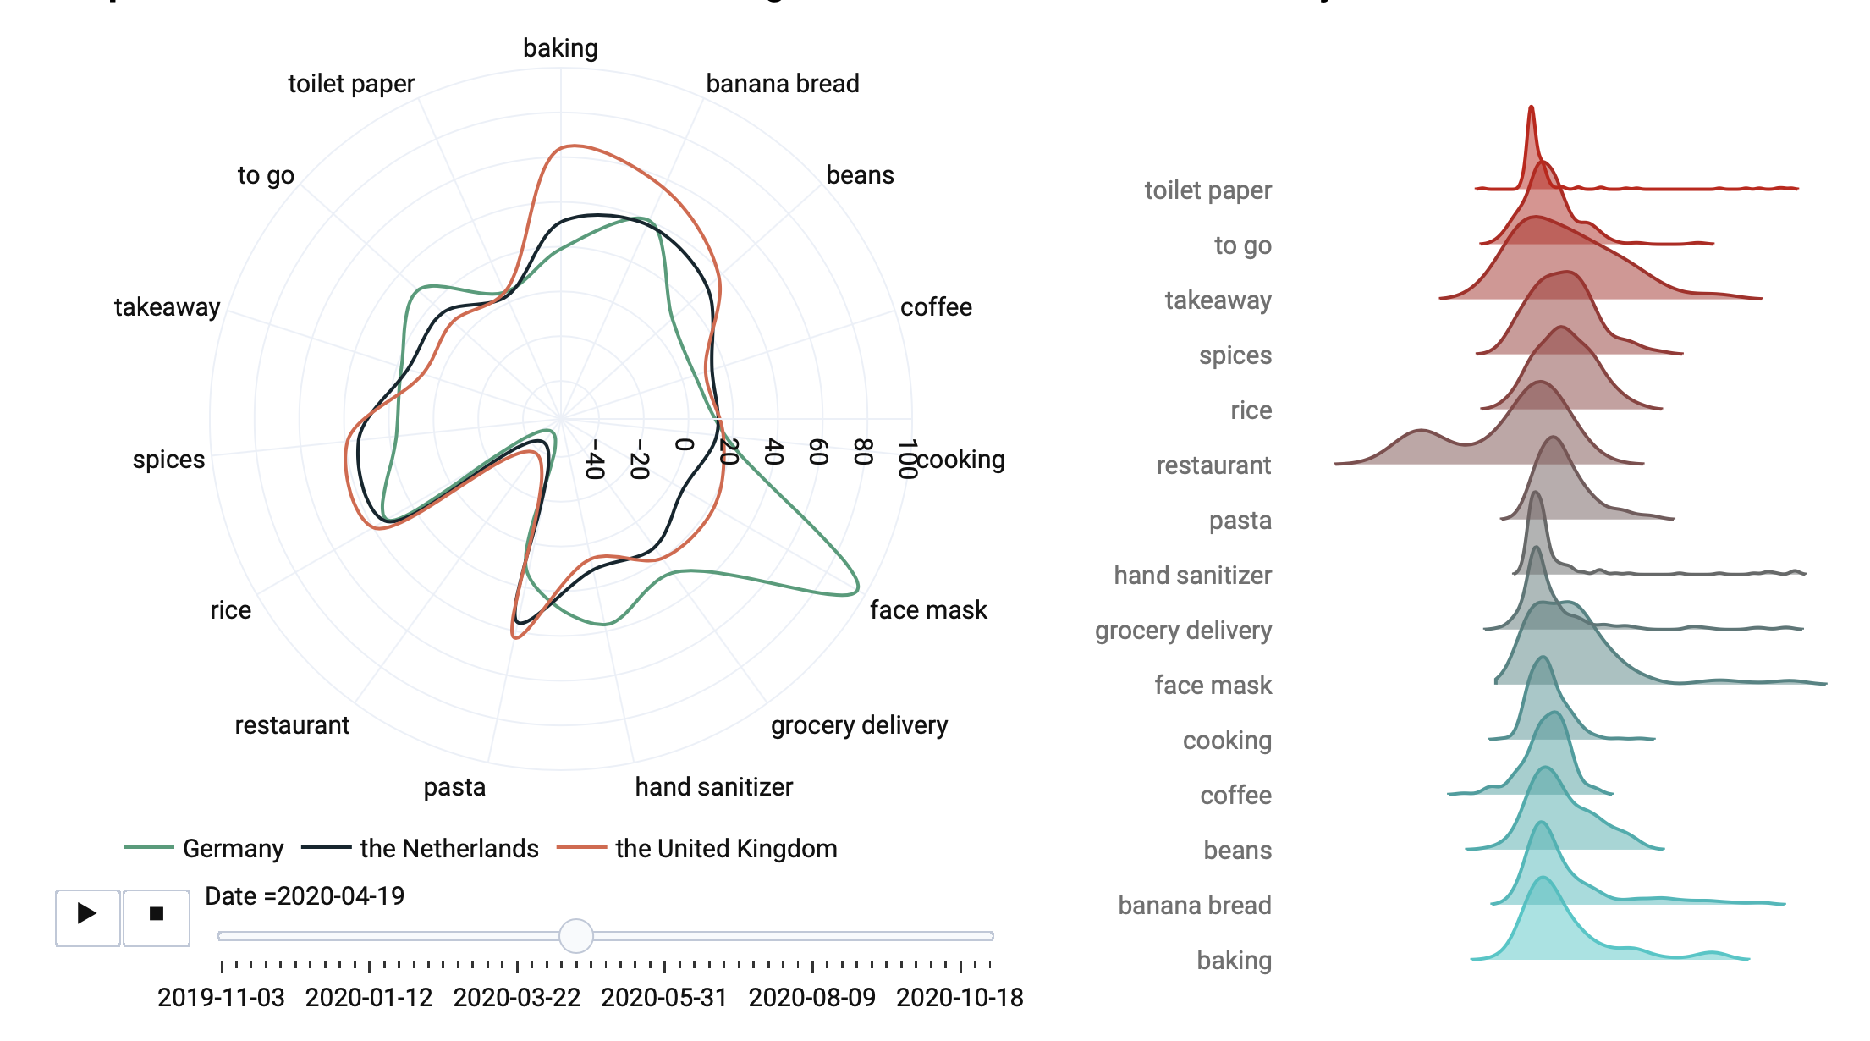
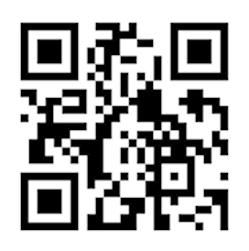
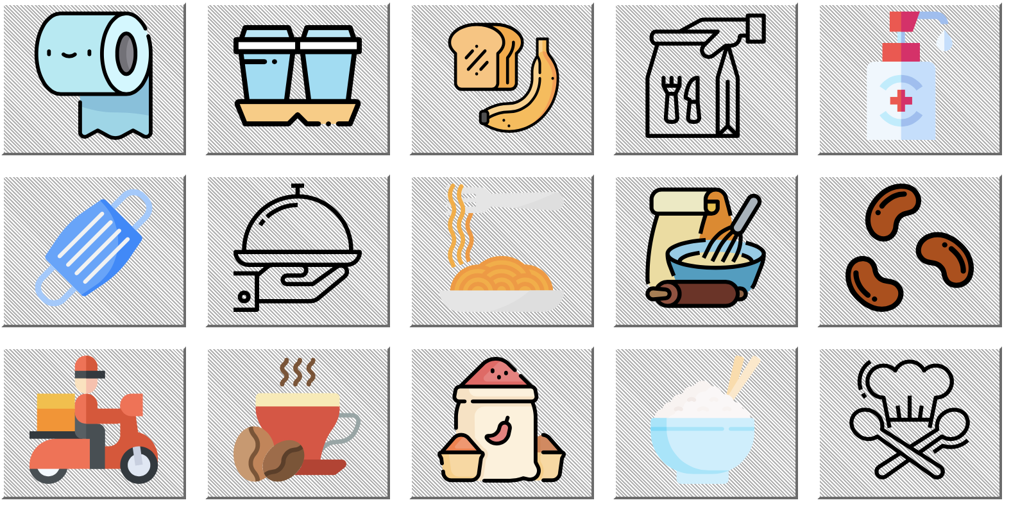
Searching for the Essentials; Impacts of COVID-19 on Web Searches for Food & Other necessities
When the COVID-19 pandemic hit the world, nearly every aspect of daily life was affected. The food industry, normally functioning smoothly and unobtrusively, was shaken as people began hoarding products like pasta, toilet paper, dried beans, and canned vegetables. We would like to visualise the impact of COVID-19 on interests in food and other essential items in an interactive web map, based on the Google Trends data [1] of specific products.
General?
We have created an interactive website with two focuses. A main divergent proportional symbol map where the visitor can select one search term and compare the trend between the countries Germany, the Netherlands and the United Kingdom, and radar chart where the visitor can see the difference across all search terms of the three countries, with the .
Symbol MAP
To visualize one Search Term across the three countries, we made the map that can be seen in Figure 2. The user can select the search term by clicking one of the icons displayed in Figure 1. We used the Google data from November 2018 through November 2020 and calculated the Search Trends differences between the first year (11/2018-11/2019) and the second year with COVID-19 impact (11/2019-11/2020) The Projection of the map is the Conic Projection, as this projection is good for smaller areas, extending from east to west.
Imprint
Mapping Project Winter Semester 2020/2021 Technische Universität München
Esmé Middaugh
Nele Peschel
Vivien van Dongen
Supervisors
Juliane Cron, M.Sc.
Dr.-Ing. Mathias Jahnke
Keywords
Google search terms, COVID-19, keyword 3
Link
https://searching-for-the-essentials.herokuapp.com/country
Fig. 1 On the left is the map with the search trend data compared to the previous year for one specific search term. In this case, Restaurant is used as search term, for the week of 26 July. On the right it the new COVID-19 cases per day per country displayed.
References
[1] Google Trends (2020). Google Trends. Retrieved 11 Nov, 2020, https://trends.google.com/trends/?geo=US
[2] World Health Organization (2020). WHO Coronavirus Disease (COVID-19) Dashboard. Retrieved 11 Nov 2020, from https://covid19.who.int/
[5] Thanks for reading these guidelines. Have fun with designing your poster!
Fig. 2 On the left is the radar chart where the all the search terms searches can be compared between the three countries. On the right the….
Radar chart
In the radar chart of Figure 2, the fifteen search terms are displayed. The countries can be selected, and the slider can be played from the first of November 2019. The radar chart includes negative and positive values indicating a lower or higher search frequency than in the previous year.
Data collection
The Search Term data was available on Google Trends data [1]. For the new Covid-19 cases per day we exploited the data from the WHO [2].
Tools
We have designed the interactive map and radar chart with the interactive map with Plotly, an interactive graphing library for Python. This is deployed with Dash, another Python library. The data cleaning was done in R.
Conclusion
As can be seen in the Figures, the search terms changed during the Corona pandemic. Search terms like banana bread and toilet paper increased, while restaurants were searched less often. Here we need another take home message that inspires peeps
Fig. 1 All possible search trends, visualized with icons

