Slide 1
Use Cilium and MLops on K3s

Slide 2
Cilium

Slide 3
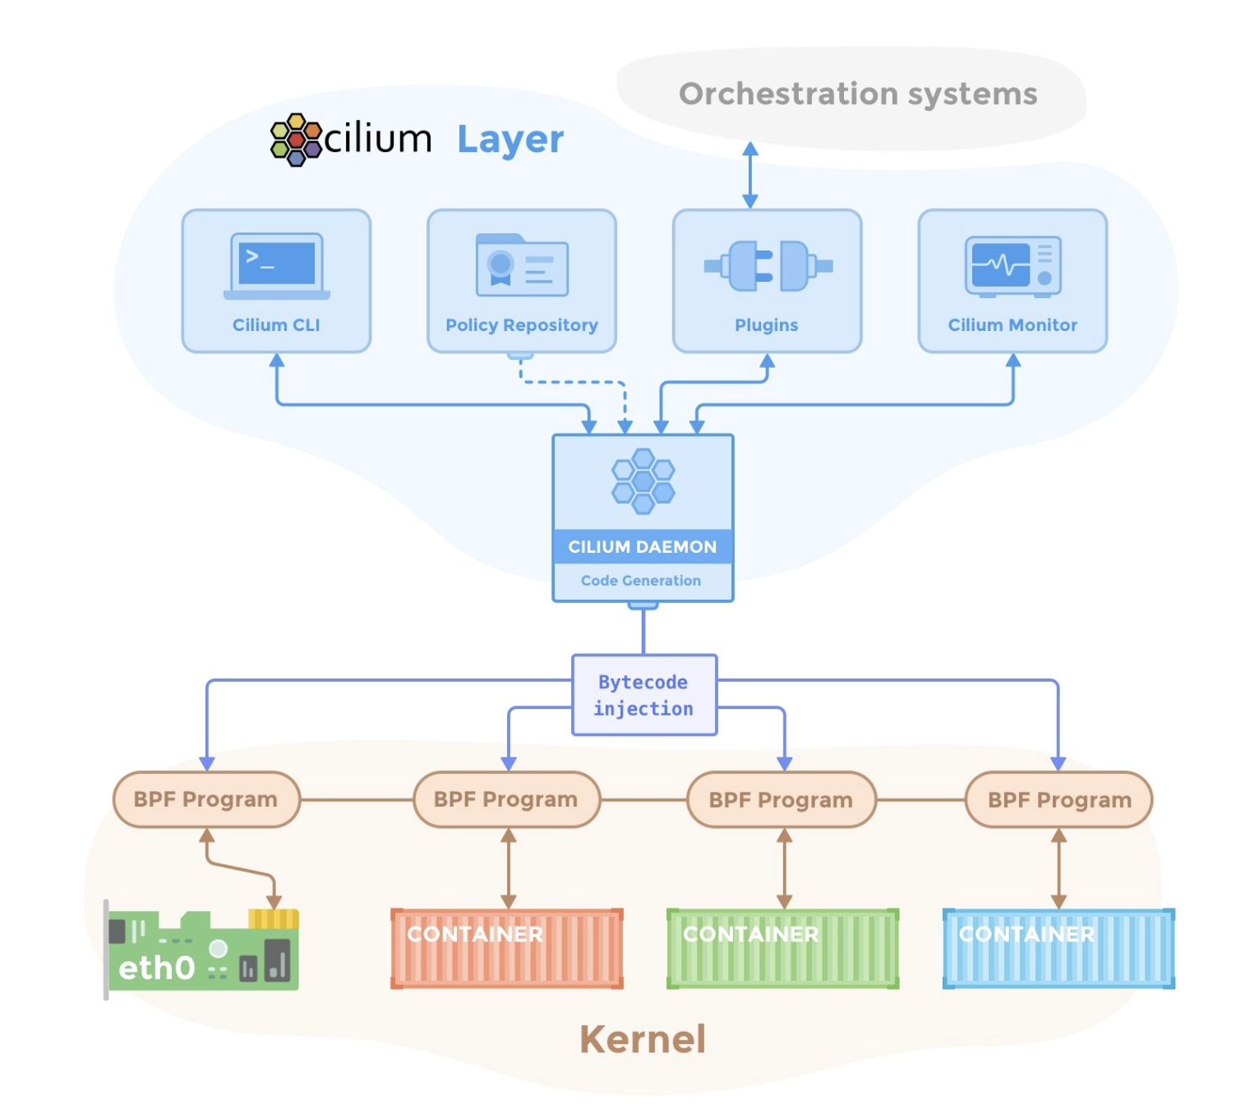
Cilium（CNI）
Position : between Linux kernel and Orchestration systems
Up : control container’s network
Down : generate ebpf in linux kernel and protect security

Slide 4
Set Policy
We will use yaml file to set up network policy.

Slide 5
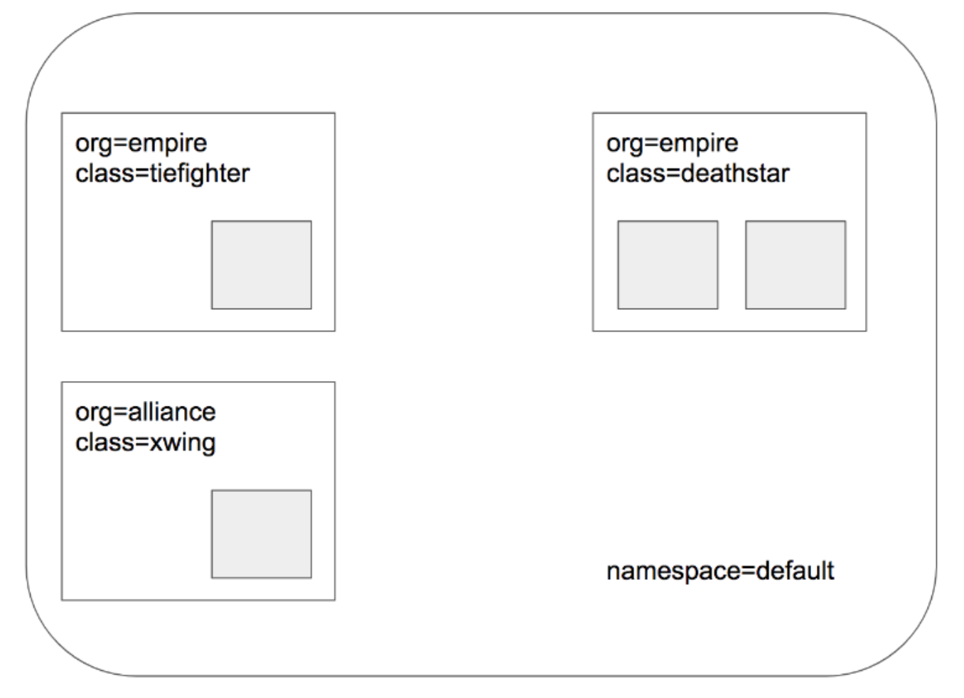
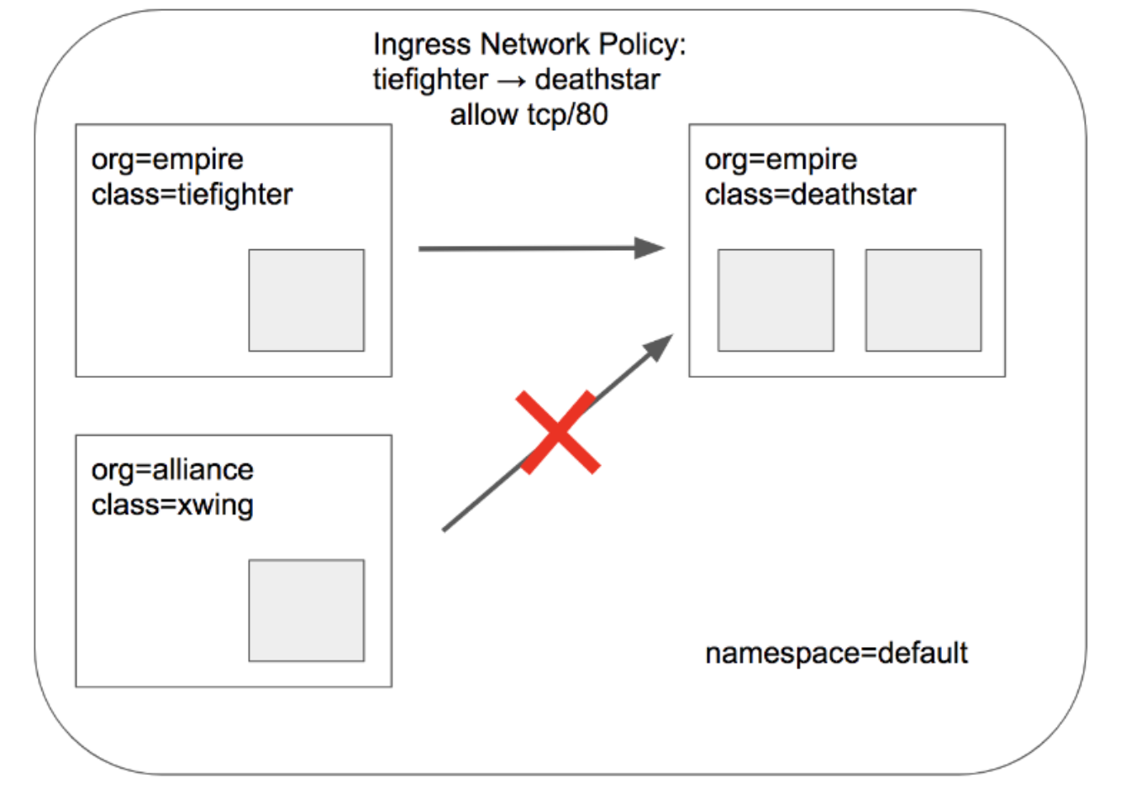
Experiment

Slide 6
Policy
apiVersion: "cilium.io/v2"
kind: CiliumNetworkPolicy
metadata:
name: "rule1"
spec:
description: "L3-L4 policy to restrict deathstar access to empire ships only"
endpointSelector:
matchLabels:
org: empire
class: deathstar
ingress:
- fromEndpoints:
- matchLabels:
org: empire
toPorts:
- ports:
- port: "80"
protocol: TCP

Slide 7
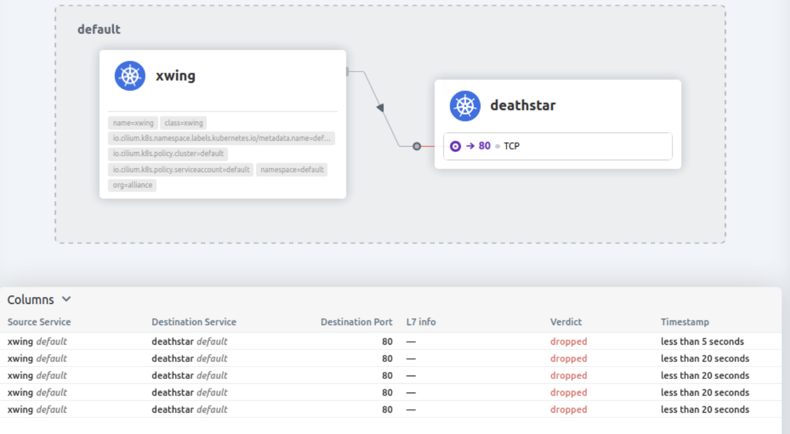
Hubble ui
Notes:
Expect

Slide 8
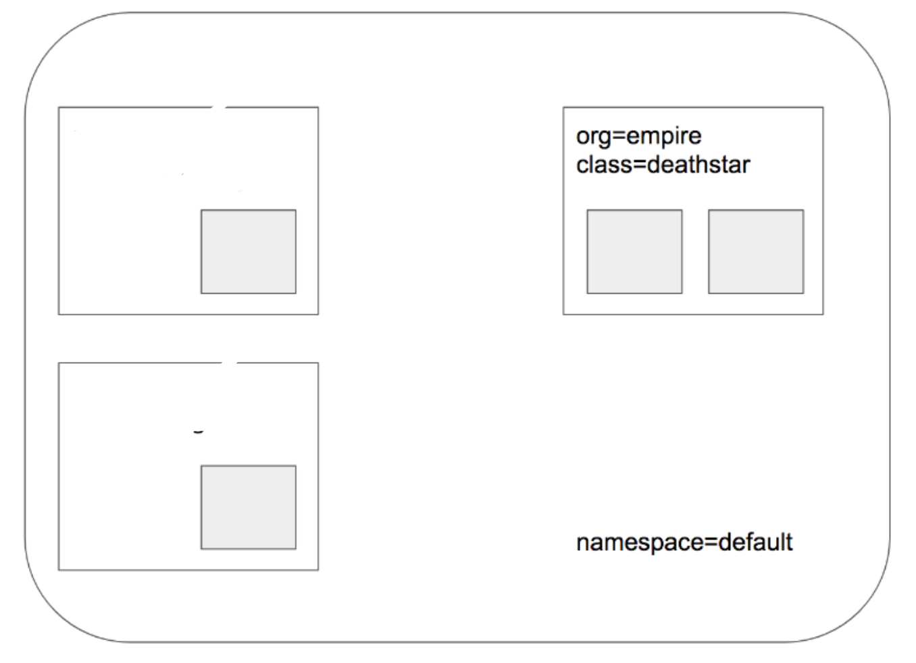
DDOS attack
We will use two pod to request deathstar pod
One is hello_pod
the other is myddos_pod
hello_pod
myddos_pod

Slide 9
DDOS attack pod yaml
apiVersion: v1
kind: Pod
metadata:
name: hello-kubernetes-client-pod
labels:
app: webserver
spec:
containers:
- name: hello-kubernetes-client
image: wrre/hello-kubernetes-client:v1
ports:
- containerPort: 3000
apiVersion: v1
kind: Pod
metadata:
name: myddos
labels:
org: python
class: ddos
app.kubernetes.io/name: myddos
spec:
containers:
- name: pod
image: docker.io/chriskewis/my_ddos
command: ["/bin/bash", "-ce", "tail -f /dev/null"]

Slide 10
DDOS attack policy yaml
apiVersion: "cilium.io/v2"
kind: CiliumNetworkPolicy
metadata:
name: "rule1"
spec:
description: "L3-L4 policy to restrict unknown pod(ddos_pod)"
endpointSelector:
matchLabels:
org: empire
class: deathstar
ingress:
- fromEndpoints:
- matchLabels:
app: webserver
toPorts:
- ports:
- port: "80"
protocol: TCP

Slide 11
MLFlow

Slide 12
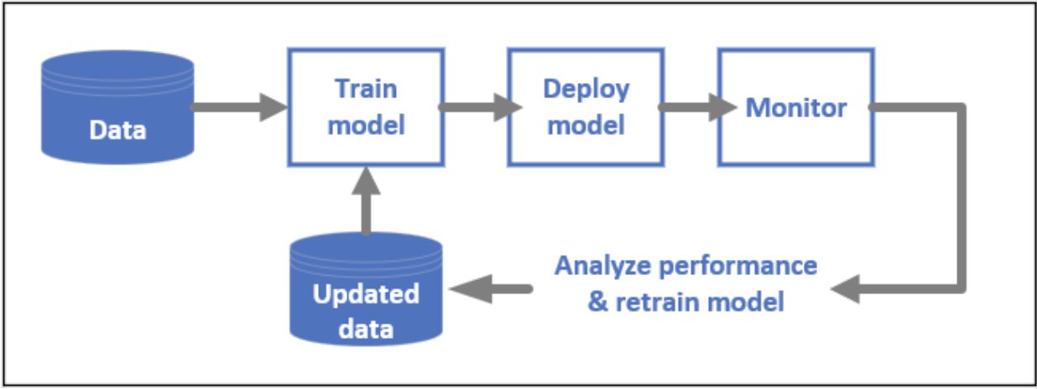
ML LifeCycle

Slide 13
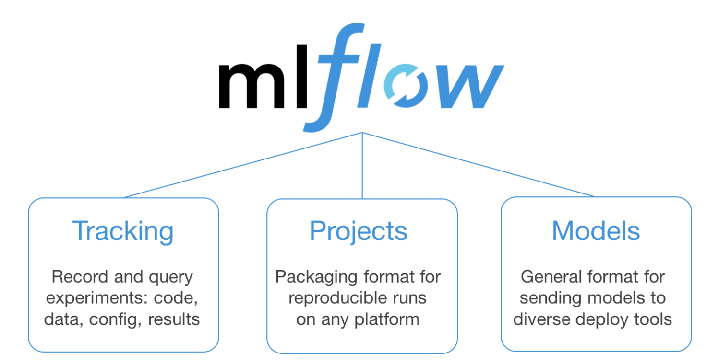
MLFlow
MLFlow is a model training system
Solve ML lifecycle
Feature
Tracking
Project
Models

Slide 14
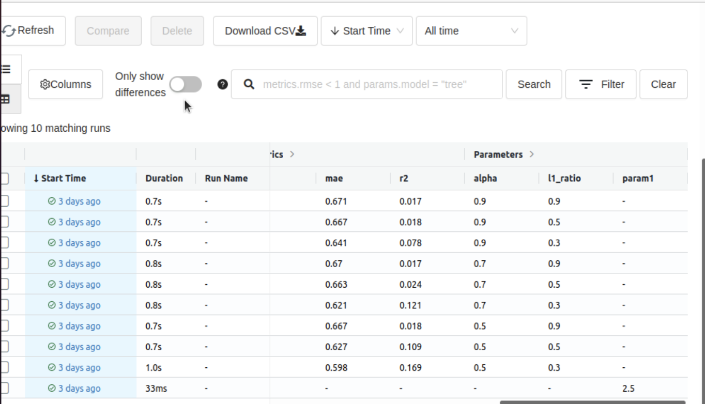
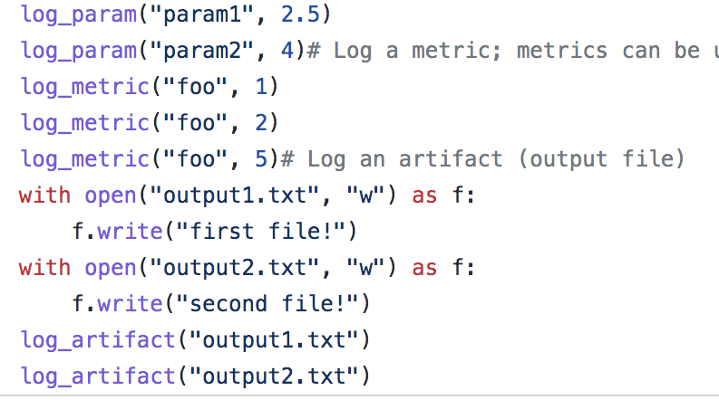
MLFlow ui
record param and metric

Slide 15
ML LifeCycle

Slide 16
Kserve

Slide 17
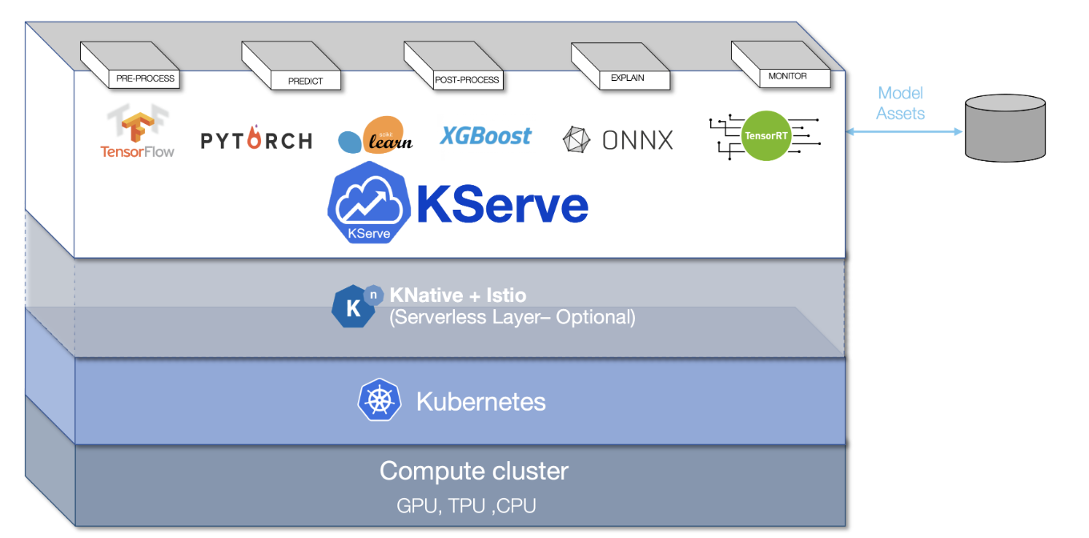
kserve
Kserve provide k8s CRD for serving model.
Support k8s deployment or serverless

Slide 18
kserve CRD yaml
use CRD to set up serving for ML
apiVersion: serving.kserve.io/v1beta1
kind: InferenceService
metadata:
name: custom-model
spec:
predictor:
containers:
- name: kserve-container
image: YourImages.
Notes:
diff knative

Slide 19
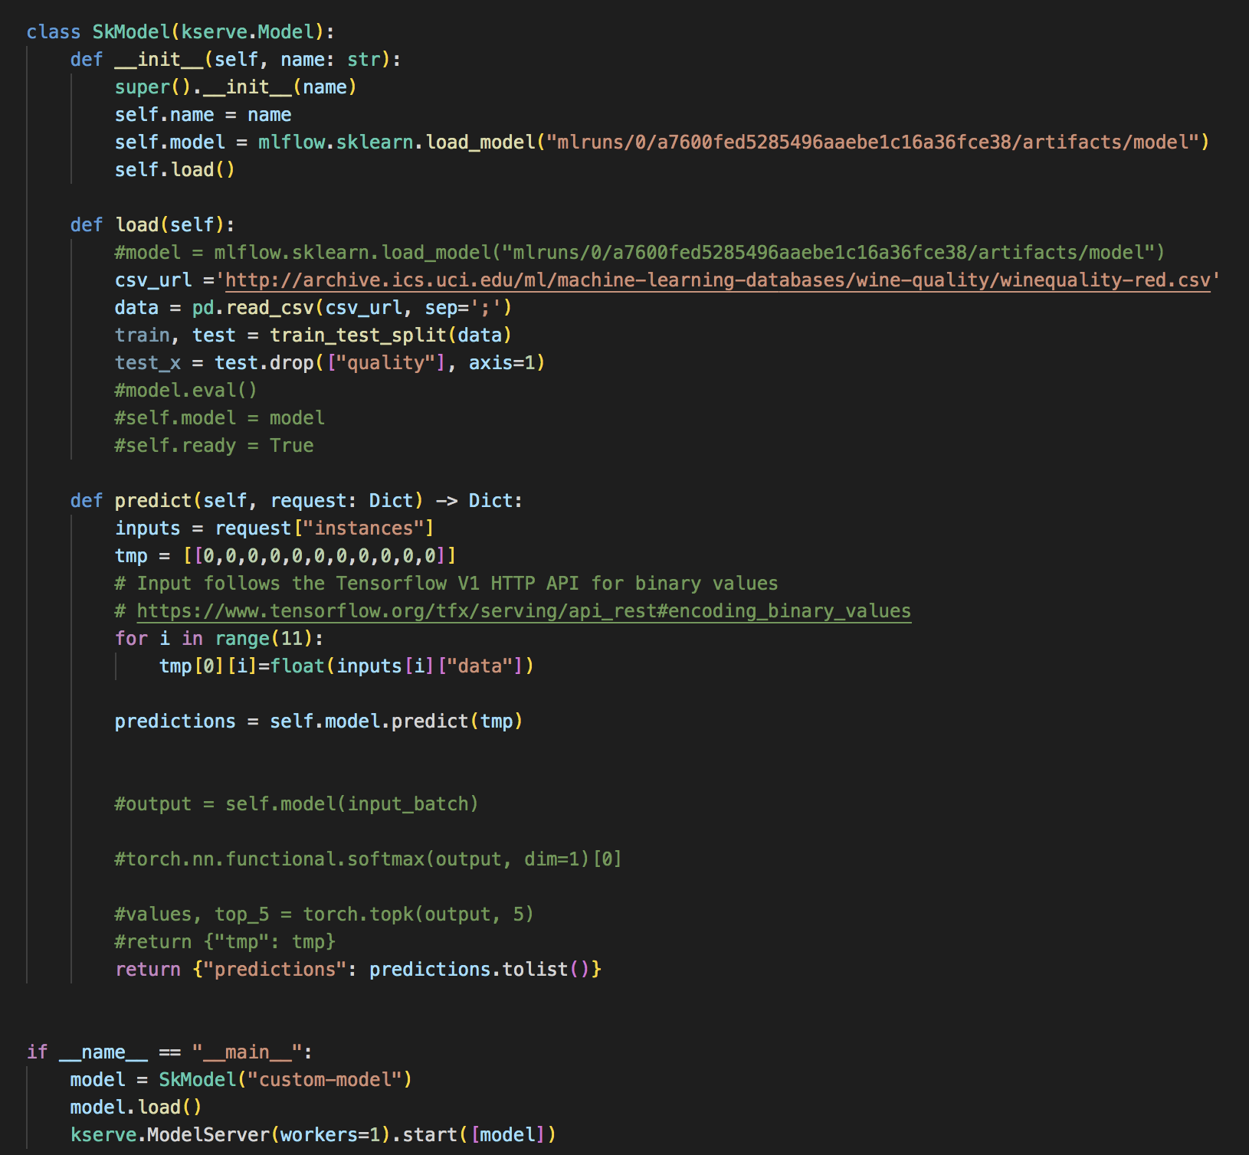
Python file
We will use this file to build image

Slide 20
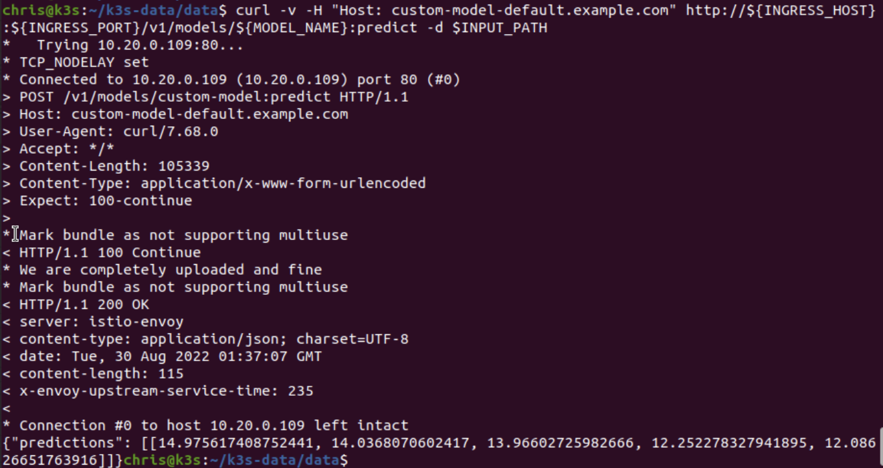
kserve Predict

Slide 21
Thank You. 簡報完畢

