Slide 1



Meeting the Challenges of Ultra-Large-Scale Distributed Real-time & Embedded Systems with QoS-enabled Middleware &
Model-Driven Engineering
Saturday, November 7, 2026, Middleware 2007
Dr. Douglas C. Schmidt
d.schmidt@vanderbilt.edu
www.dre.vanderbilt.edu/~schmidt
Institute for Software Integrated Systems
Vanderbilt University Nashville, Tennessee

Slide 2

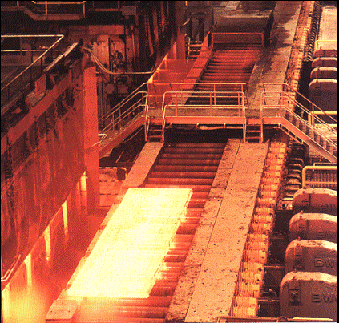
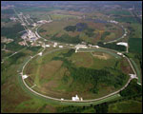
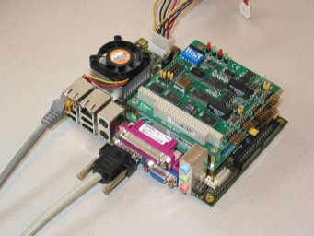
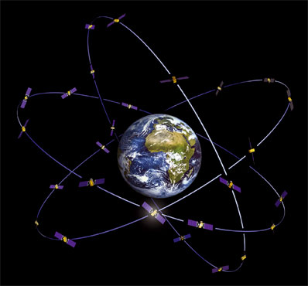


Evolution in Distributed Real-time & Embedded (DRE) Systems
The Past
The Future
Stand-alone real-time & embedded systems
  Stringent quality of service (QoS) demands
    e.g., latency, jitter, footprint
  Resource constrained
Enterprise distributed real-time & embedded (DRE) systems
  Network-centric “systems of systems”
  Stringent simultaneous QoS demands
    e.g., dependability, security, scalability, etc.
  Dynamic context
This talk focuses on technologies for enhancing DRE system QoS, productivity, & quality

Slide 3

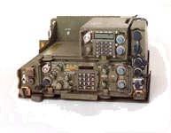

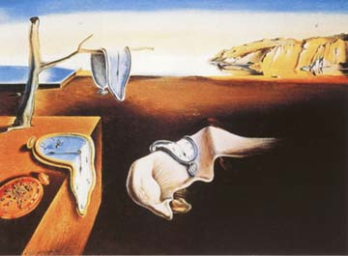
Evolution of DRE Systems Development
Technology Problems
Legacy DRE systems often tend to be:
  Stovepiped
  Proprietary
  Brittle & non-adaptive
  Expensive
  Vulnerable
Air
Frame
CLI
Nav
HUD
SM
CM
AP
FLIR
SS7
IP
GPS
IFF
RX
TX
Cyclic
Exec
RTOS
Mission-critical DRE systems have historically been built directly atop hardware
  Tedious
  Error-prone
  Costly over lifecycles
Consequence: Small changes to legacy software often have big (negative) impact on DRE system QoS & maintenance

Slide 4
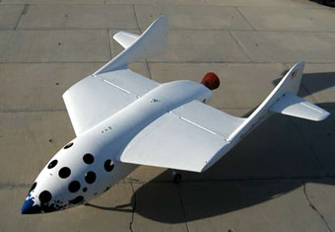
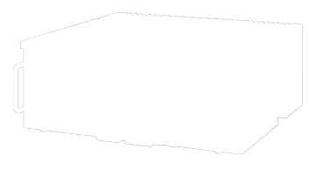
Evolution of DRE Systems Development
Technology Problems
Legacy DRE systems often tend to be:
  Stovepiped
  Proprietary
  Brittle & non-adaptive
  Expensive
  Vulnerable
DRE
Applications
DRE
Applications
Middleware
Services
Middleware
Services
Middleware
Middleware
Operating Sys
& Protocols
Operating Sys
& Protocols
Hardware &
Networks
Hardware &
Networks
Mission-critical DRE systems have historically been built directly atop hardware
  Tedious
  Error-prone
  Costly over lifecycles
Middleware has effectively factored out many reusable services from traditional DRE application responsibility
  Essential for product-line architectures
Middleware is no longer the primary DRE system performance bottleneck

Slide 5
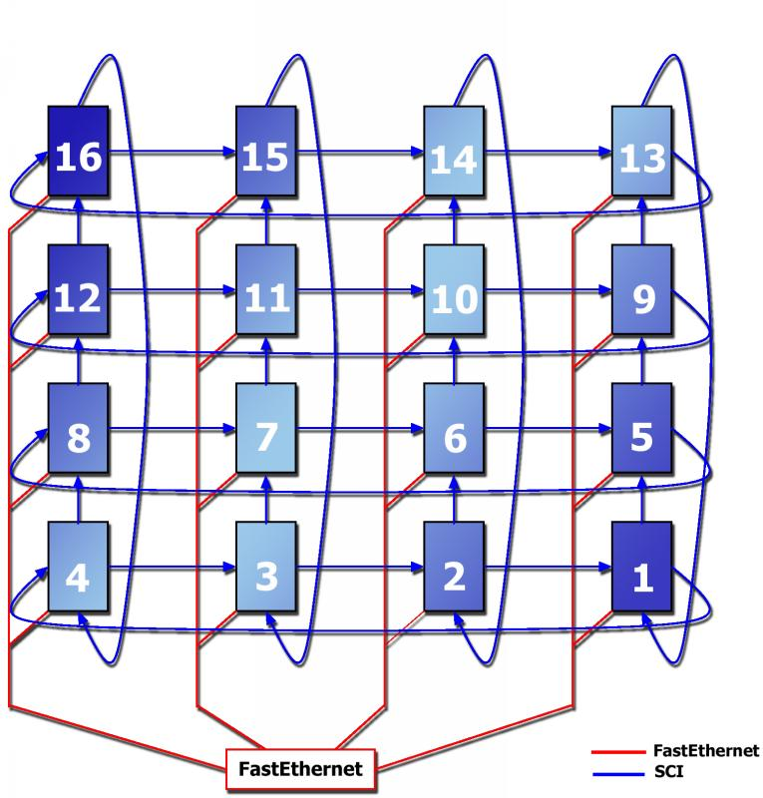
DRE Systems: The Challenges Ahead
Limit to how much application functionality can be refactored into reusable COTS middleware
Middleware itself has become very hard to use & provision statically & dynamically
Gigabit Ethernet
DRE Applications
RT-CORBA
Apps
J2ME
Apps
DRTSJ
Apps
Middleware
Services
Load Balancer
FT CORBA
RT-CORBA
Services
J2ME
Services
DRTSJ
Services
Workload &
Replicas
RT/DP CORBA + DRTSJ
Connections &
priority bands
Middleware
RTOS + RT Java
CPU & memory
RT-CORBA
J2ME
DRTSJ
IntServ + Diffserv
Network latency
& bandwidth
Operating System
& Protocols
Component-based DRE systems are also very hard to deploy & configure
There are many middleware platform technologies to choose from
Hardware &
Networks
Middleware alone cannot solve large-scale DRE system challenges!

Slide 6
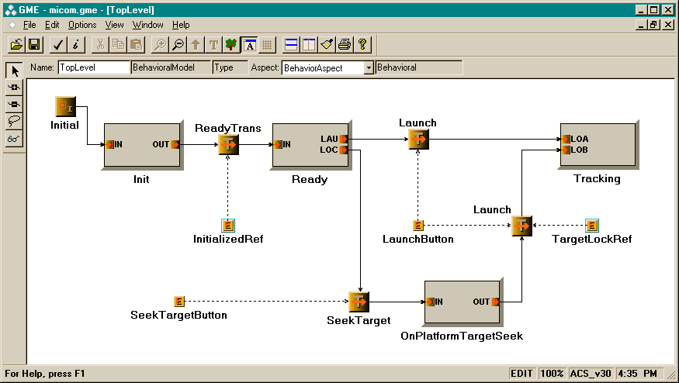
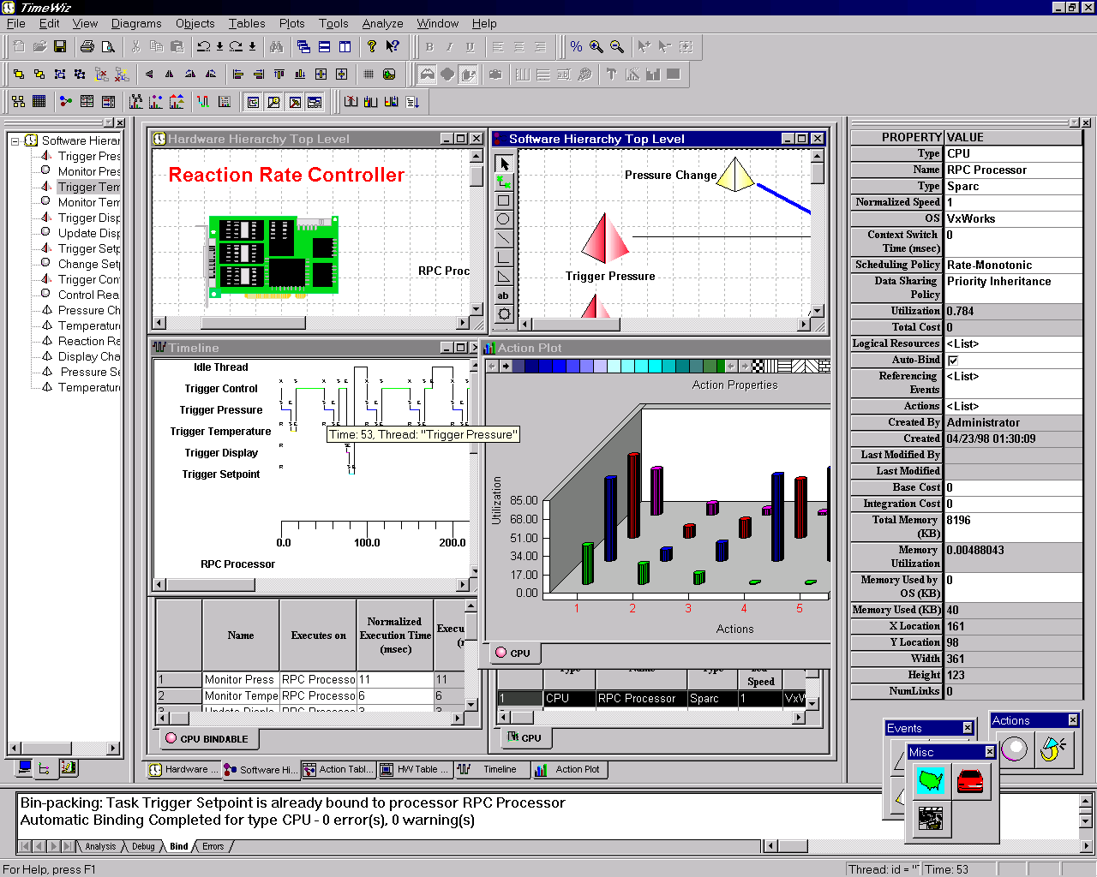
Promising Solution: Model-based Software Development
Develop, validate, & standardize generative software technologies that:
  Model
  Analyze
  Synthesize &
  Provision
multiple layers of middleware & application components that require simultaneous control of multiple QoS properties end-to-end
Partial specialization is essential for inter-/intra-layer optimization & advanced product-line architectures
Gigabit Ethernet
DRE Applications
RT-CORBA
Apps
J2ME
Apps
DRTSJ
Apps
Middleware
Services
RT-CORBA
Services
J2ME
Services
DRTSJ
Services
<CONFIGURATION_PASS>
<HOME>
<…>
<COMPONENT>
<ID> <…></ID>
<EVENT_SUPPLIER>
<…events this
component supplies…>
</EVENT_SUPPLIER>
</COMPONENT>
</HOME>
</CONFIGURATION_PASS>
Middleware
RT-CORBA
J2ME
DRTSJ
Operating System
& Protocols
Hardware &
Networks
Goal is to enhance developer productivity & software quality by providing higher-level languages & tools for middleware/application developers & users

Slide 7
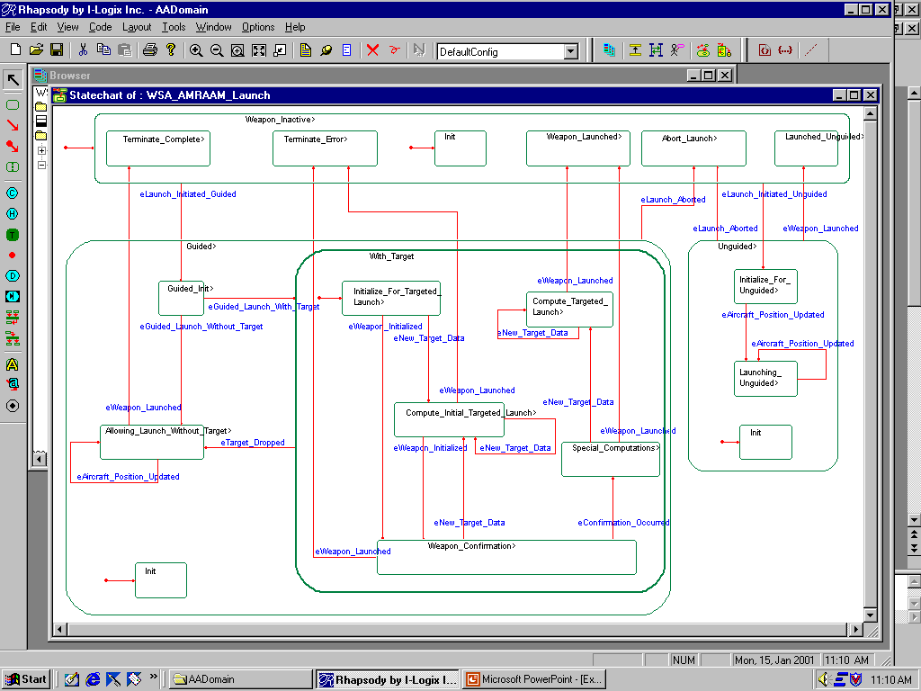
Technology Evolution (1/4)
Programming Languages & Platforms
Model-Driven Engineering (MDE)
Level of Abstraction
Model
Model
Model
Model
Model
Model
Generated
Code
Model
Code
Model
Translation
Code
Code
Code
Code
Code
Translation
Platform
Translation
State chart
Data & process flow
Petri Nets
Large Semantic Gap
Operating
Systems
C/Fortran
Assembly
Hardware
Machine code
Notes:
Over the past 40-50 years, researchers and developers have been creating software abstractions that enable them to program more in terms of their design intent rather than in terms of the underlying computing environment (e.g., CPU, memory, and network devices) and shield them from accidental complexities of this environment. From the early days of computing, these abstractions have included both language- and platform-centric technologies. For example, early programming languages, such as assembly and FORTRAN, shielded developers from complexities of programming in machine code. Likewise, early operating system platforms, such as OS/360 and MULTICS, shielded developers from complexities of programming to the hardware directly. Despite raising the level of abstraction, however, these early languages and platforms still had a distinct “computing-oriented” focus, i.e., the emphasis was on abstractions of the solution space (i.e., the domain of computing technologies themselves), rather than the problem space (i.e., enabling developers to express designs in terms of abstractions from application domains, such as financial services, telecom, aerospace, health care, etc.).
There have been various attempts over the past 20-30 years to develop technologies that elevated the level of abstraction used to develop software. An earlier attempt occurred during the Computer Aided Software Engineering (CASE) movement in the 80s, which was a concerted Sensorort to develop software methods and tools that enabled developers to express their designs in terms of higher-level abstractions, such as state machines, structure diagrams, and dataflow diagrams. Some goals of CASE were to incur less accidental complexity than lower-level programming languages (e.g., avoid memory corruption and leaks), enable more thorough analysis of programs by using notations that have less accidental complexities than languages like C++ or C, and synthesize implementation artifacts from models to reduce the Sensorort of coding, debugging, and porting programs written in lower-level languages.
Although CASE tools attracted considerable attention in the research and trade literature, this approach was widely deemed as a commercial failure. A key problem with CASE was the large semantic gap between (1) the types of language representations available to program in the tools (e.g., finite state machines or simple structure diagrams) and (2) the underlying platforms, which were largely single node operating systems (such as UNIX or DOS). Not only were the language representations too generic to capture application domain design intent Sensorectively, but the amount and complexity of code needed to compensate for the paucity of the underlying platforms was simply too much for the available model-to-code translation technologies. As a result, CASE tools had a relatively little impact on commercial software practice during the 80’s and 90’s, focusing primarily on a few limited domains, such as telecom call processing, that mapped nicely onto state machine abstractions.

Slide 8
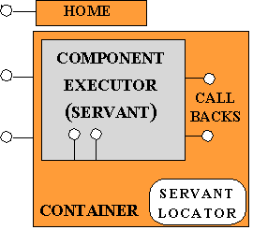
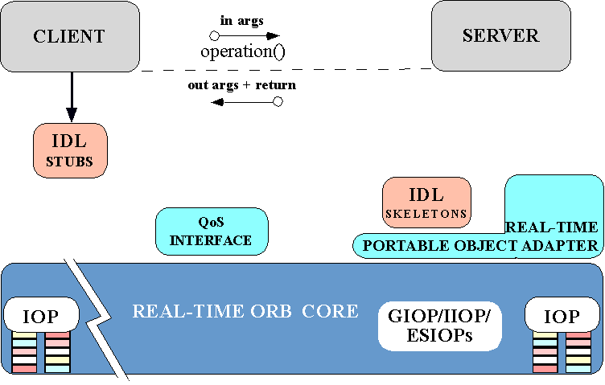
Technology Evolution (2/4)
Programming Languages & Platforms
Newer 3rd-generation languages & platforms have raised abstraction level significantly
  “Horizontal” platform reuse alleviates the need to redevelop common services
There are two problems, however:
  Platform complexity evolved faster than 3rd-generation languages
  Much application/platform code still (unnecessarily) written manually
Level of Abstraction
Model
Model
Model
Model
Model
Model
Model
Application Code
Application Code
Application Code
Application Code
Generated Code
Generated Code
Generated Code
Framework
Framework
Framework
Framework
Domain Specific
Domain Specific
Domain Specific
Domain Specific
Pattern Language
Pattern Language
Pattern Language
Pattern Language
Framework
Framework
Framework
Framework
Platform
Platform
Platform
Platform
Platform
Platform
Platform
Platform
Frameworks
Frameworks
Frameworks
Frameworks
Components
Frameworks
Class Libraries
C++/Java
Operating
Systems
C/Fortran
Assembly
Hardware
Machine code
Notes:
During the past 20 years, advances in languages and platforms have raised the level of software abstractions available to developers. For example, many developers today use third-generation object-oriented languages, such as C++, Java, or C#, rather than FORTRAN or C. Likewise, reuseable class libraries, frameworks, and service-oriented middleware platforms have emerged in many domains that alleviate the need to redevelop common services, such as transactions, discovery, fault tolerance, event notification, security, and dynamic resource management. As a result of these “horizontally” reusable platforms and higher-level languages, software developers are now much better equipped to shield themselves from accidental and inherent complexities associated with developing applications using lower-level technologies from previous generations.
Despite these advances, however, several vexing problems remain
The complexity of platforms has evolved faster than the ability of third-generation languages to mask this complexity. For example, popular service-oriented architecture platforms, such as J2EE, CORBA, and Web Services, contain thousands of classes that require considerable Sensorort to program and tune properly using third-generation languages. Moreover, since these platforms tend to evolve rapidly – and go in and out of vogue quickly – a considerable amount of Sensorort is spent porting application code to different platforms or newer versions of the same platform.
Much application and platform code is still written and maintained manually, which is unnecessarily tedious and error-prone – particularly for key integration-related activities, such as system deployment, configuration, and quality assurance. For example, writing C++ or Java code that deploys and configures a large-scale distributed system with thousands of components correctly and Sensoriciently is very hard. Even using newer notations, such as XML-based deployment and configuration descriptors, is fraught with much accidental complexity due to the large gap between the design intent (i.e., “deploy components 1-50 onto nodes a-c, 51-100 onto nodes d-g, …”) and the expression of this intent in hundreds or thousands of lines of XML, which does not reflect any domain semantics in its structure.
As a consequence, it appears that we have reached a saturation point with current platform technologies, i.e., they have become so complex that developers are having a hard time evolving existing platforms and writing applications that run correctly on these platforms.

Slide 9
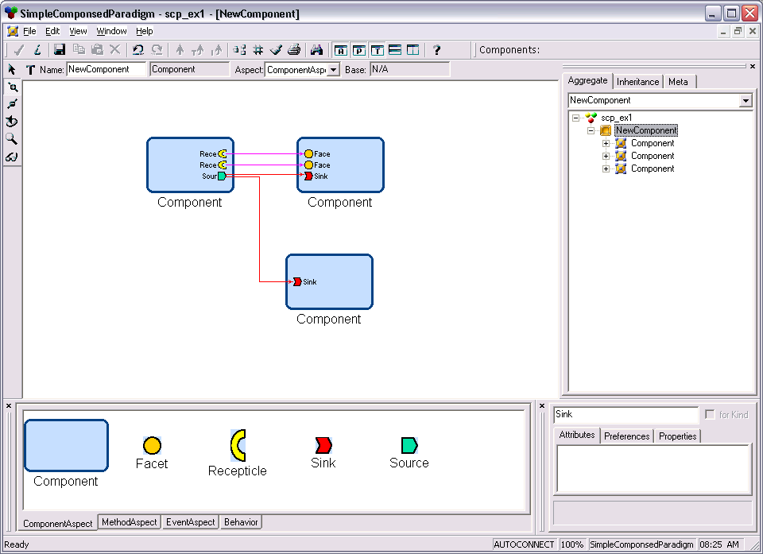
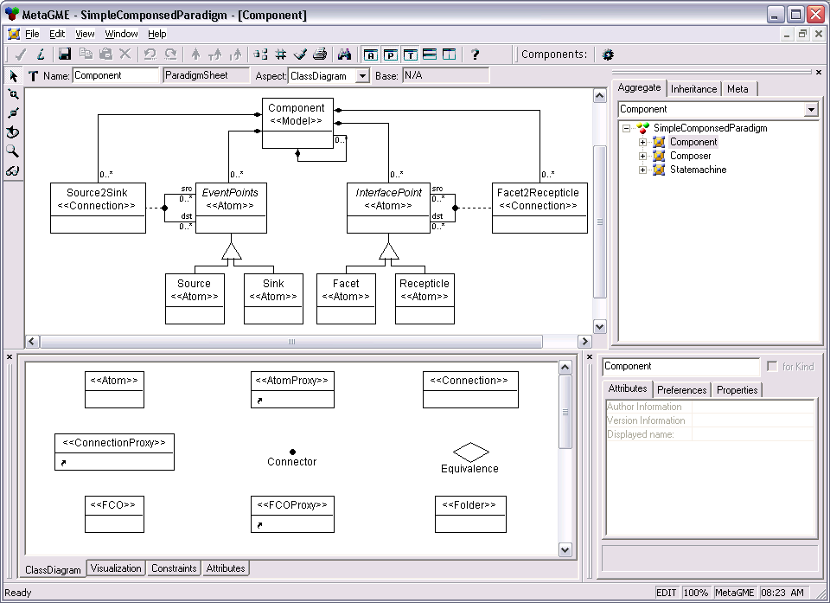
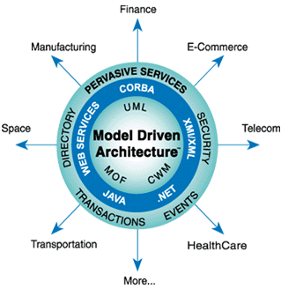
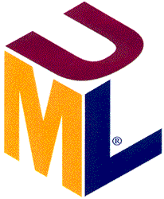
Technology Evolution (3/4)
Programming Languages & Platforms
Model-Driven Engineering (MDE)
Level of Abstraction
Domain-specific modeling languages
  ESML
  PICML
  Mathematica
  Excel
  Metamodels
Manual translation
Saturation!!!!
Domain-independent modeling languages
  State Charts
  Interaction Diagrams
  Activity Diagrams
Components
Frameworks
Class Libraries
C++/Java
Semi-automated
Operating
Systems
C/Fortran
Assembly
Hardware
Machine code
Notes:
A promising approach to addressing the complexity of existing platforms and languages is to develop model-driven development (MDE) technologies that combine
Metamodeling, which defines type systems that precisely express key abstract syntax characteristics and semantic constraints associated with particular application domains, such as software defined radios, avionics mission computing, or inventory tracking.
Domain-specific modeling languages (DSMLs), which provide programming notations that are guided by and extend metamodels to formalize the process of specifying application structure, behavior, and requirements in a particular domain and
Model transformations and generators that synthesize various types of artifacts (e.g., third-generation code, simulations, or deployment descriptions) and ensure the consistency of application implementations with analysis information associated with functional and quality of service (QoS) requirements captured by structural and behavioral models.
MDE approaches have several characteristics than address deficiencies with the earlier failed attempts with CASE. For example, domain-specific modeling languages can be tailored to precisely the semantics and syntax expected by subject matter experts (such as software architects, system engineers, or users) in a domain. Moreover, since today’s platforms are far more powerful than the ones available during the 80’s and 90’s the generators for MDE tools need not be as complicated, which makes them easier to develop, understand, and evolve.

Slide 10
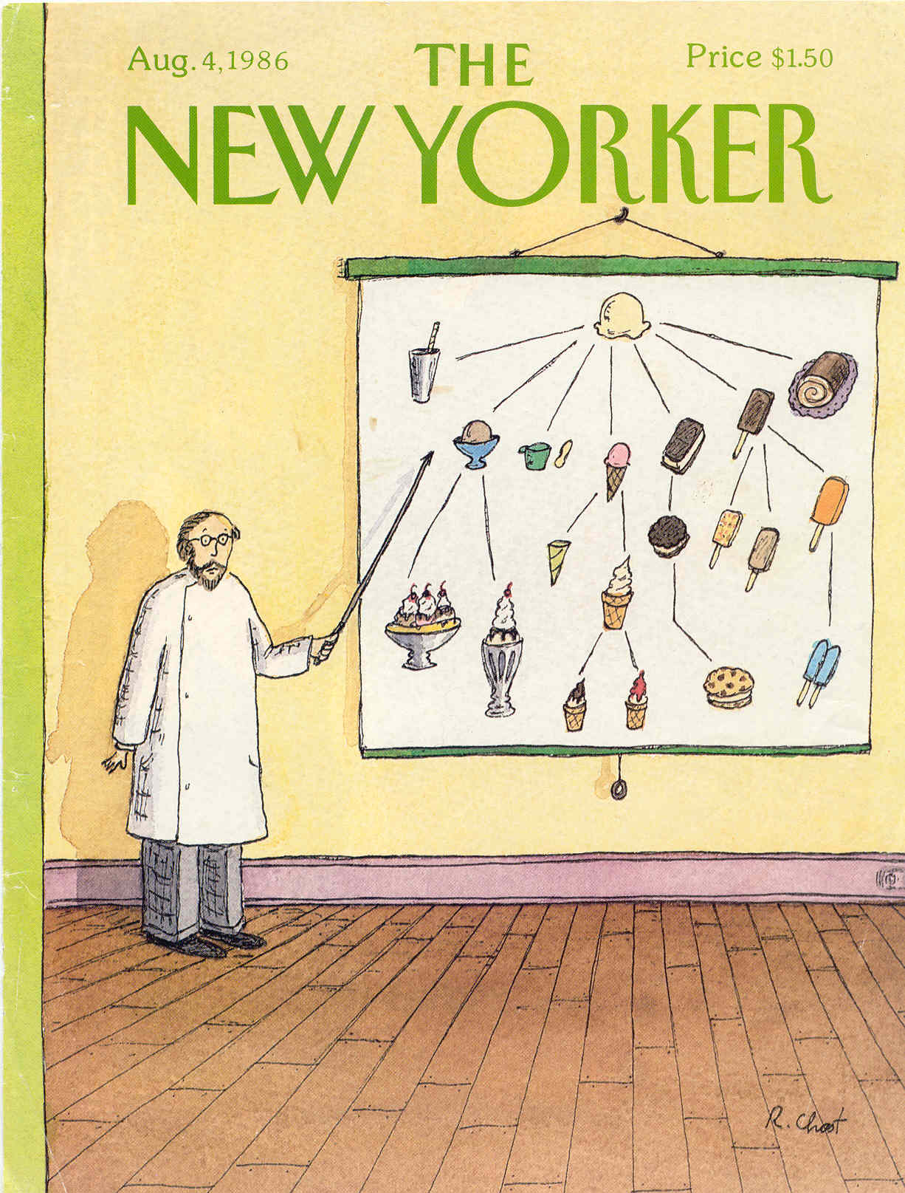
Technology Evolution (3/4)
Programming Languages & Platforms
Model-Driven Engineering (MDE)
Level of Abstraction
Domain-specific modeling languages
  ESML
  PICML
  Mathematica
  Excel
  Metamodels
Manual translation
Domain-independent modeling languages
  State Charts
  Interaction Diagrams
  Activity Diagrams
Semi-automated
OMG is standardizing MDE via MIC PSIG
  mic.omg.org
Notes:
A promising approach to addressing the complexity of existing platforms and languages is to develop model-driven development (MDE) technologies that combine
Metamodeling, which defines type systems that precisely express key abstract syntax characteristics and semantic constraints associated with particular application domains, such as software defined radios, avionics mission computing, or inventory tracking.
Domain-specific modeling languages (DSMLs), which provide programming notations that are guided by and extend metamodels to formalize the process of specifying application structure, behavior, and requirements in a particular domain and
Model transformations and generators that synthesize various types of artifacts (e.g., third-generation code, simulations, or deployment descriptions) and ensure the consistency of application implementations with analysis information associated with functional and quality of service (QoS) requirements captured by structural and behavioral models.
MDE approaches have several characteristics than address deficiencies with the earlier failed attempts with CASE. For example, domain-specific modeling languages can be tailored to precisely the semantics and syntax expected by subject matter experts (such as software architects, system engineers, or users) in a domain. Moreover, since today’s platforms are far more powerful than the ones available during the 80’s and 90’s the generators for MDE tools need not be as complicated, which makes them easier to develop, understand, and evolve.

Slide 11
Technology Evolution (3/4)
Programming Languages & Platforms
Model-Driven Engineering (MDE)
Level of Abstraction
Domain-specific modeling languages
  ESML
  PICML
  Mathematica
  Excel
  Metamodels
Model
Model
Model
Model
Model
Model
Model
Model
Generated Code
Generated Code
Generated Code
Generated Code
Application Code
Application Code
Application Code
Application Code
Framework
Framework
Framework
Framework
Domain Specific
Domain Specific
Domain Specific
Domain Specific
Pattern Language
Pattern Language
Pattern Language
Pattern Language
Framework
Framework
Framework
Framework
Platform
Platform
Platform
Platform
Platform
Platform
Platform
Platform
Manual translation
Frameworks
Frameworks
Frameworks
Frameworks
Domain-independent modeling languages
  State Charts
  Interaction Diagrams
  Activity Diagrams
Components
Frameworks
Class Libraries
C++/Java
Semi-automated
Operating
Systems
C/Fortran
OMG is standardizing MDE via MIC PSIG
  mic.omg.org
Assembly
Hardware
Machine code
Notes:
A promising approach to addressing the complexity of existing platforms and languages is to develop model-driven development (MDE) technologies that combine
Metamodeling, which defines type systems that precisely express key abstract syntax characteristics and semantic constraints associated with particular application domains, such as software defined radios, avionics mission computing, or inventory tracking.
Domain-specific modeling languages (DSMLs), which provide programming notations that are guided by and extend metamodels to formalize the process of specifying application structure, behavior, and requirements in a particular domain and
Model transformations and generators that synthesize various types of artifacts (e.g., third-generation code, simulations, or deployment descriptions) and ensure the consistency of application implementations with analysis information associated with functional and quality of service (QoS) requirements captured by structural and behavioral models.
MDE approaches have several characteristics than address deficiencies with the earlier failed attempts with CASE. For example, domain-specific modeling languages can be tailored to precisely the semantics and syntax expected by subject matter experts (such as software architects, system engineers, or users) in a domain. Moreover, since today’s platforms are far more powerful than the ones available during the 80’s and 90’s the generators for MDE tools need not be as complicated, which makes them easier to develop, understand, and evolve.

Slide 12
Technology Evolution (4/4)
Programming Languages & Platforms
Model-Driven Engineering (MDE)
Level of Abstraction
Domain-specific modeling languages
  ESML
  PICML
  Mathematica
  Excel
  Metamodels
Needs
Automation
Model
Model
Model
Model
Model
Model
Model
Model
Generated Code
Generated Code
Generated Code
Generated Code
Application Code
Application Code
Application Code
Application Code
Needs Automation
Platform
Platform
Platform
Platform
Platform
Platform
Platform
Platform
Frameworks
Frameworks
Frameworks
Frameworks
Domain-independent modeling languages
  State Charts
  Interaction Diagrams
  Activity Diagrams
Components
Frameworks
Class Libraries
C++/Java
Needs Automation
Operating
Systems
C/Fortran
Assembly
Research is needed to automate DSMLs & model translators
Hardware
Machine code
See February 2006 IEEE Computer special issue on MDE techniques & tools

Slide 13
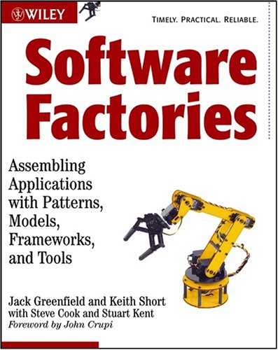


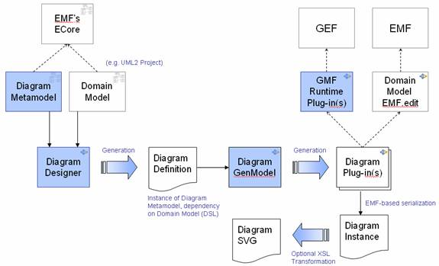
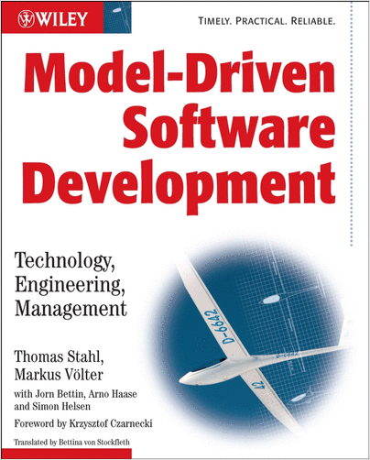
Crossing the Chasm
Software Factories go beyond “models as documentation” by
  Using highly-tuned DSL & XML as source artifacts &
  Capturing life cycle metadata to support high-fidelity model transformation, code generation & other forms of automation
www.softwarefactories.com
The Graphical Modeling Framework (GMF) forms a generative bridge between EMF & GEF, which linkes diagram definitions to domain models as input to generation of visual editors
GMF provides this framework, in addition to tools for select domain models that illustrate its capabilities
www.eclipse.org/gmf/
openArchitectureWare (oAW) is a modular MDA/MDE generator framework implemented in Java
It supports parsing of arbitrary models & a language family to check & transform models, as well as generate code based on them
www.openarchitectureware.org

Slide 14
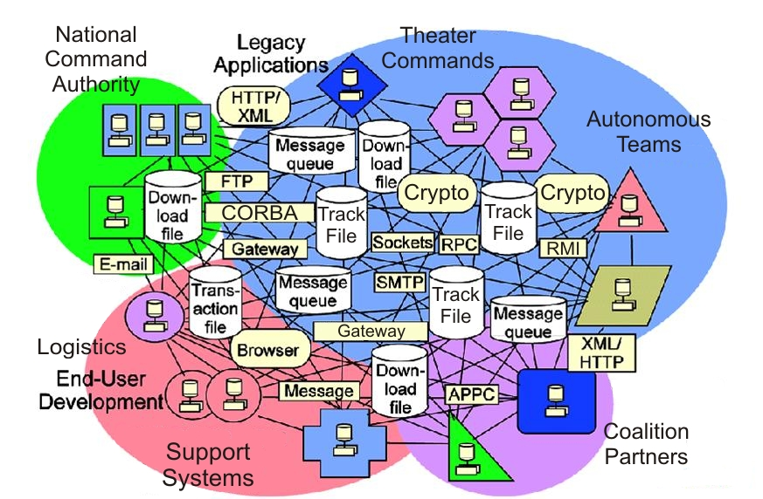
New Challenges: Ultra-Large-Scale (ULS) Systems
Key ULS problem space challenges
Highly dynamic & distributed development & operational environments
Stringent simultaneous quality of service (QoS) demands
Very diverse & complex network-centric application domains
Key ULS solution space challenges
Enormous accidental & inherent complexities
Continuous evolution & change
Highly heterogeneous platform, language, & tool environments
Mapping problem space requirements to solution space artifacts is very hard

Slide 15
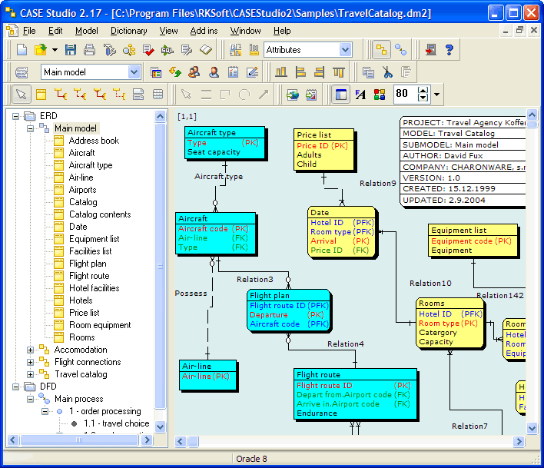
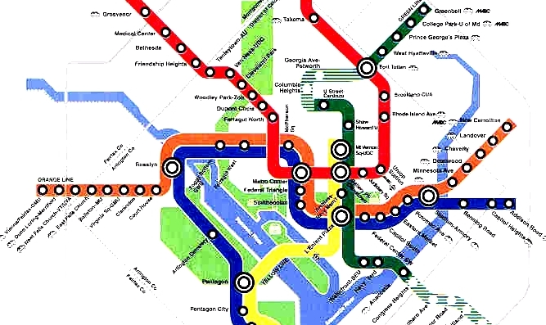
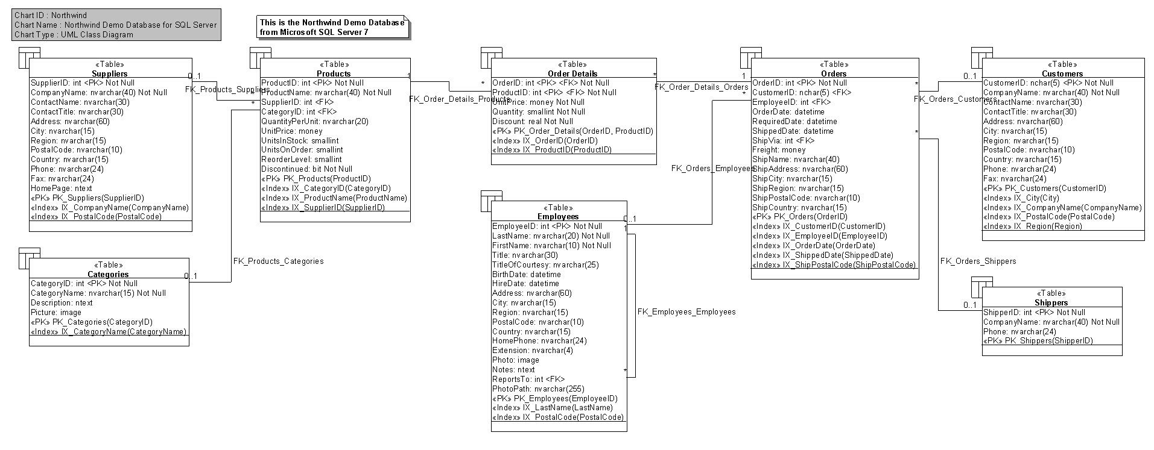
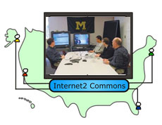
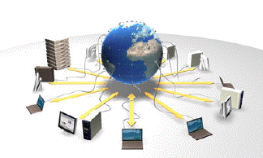
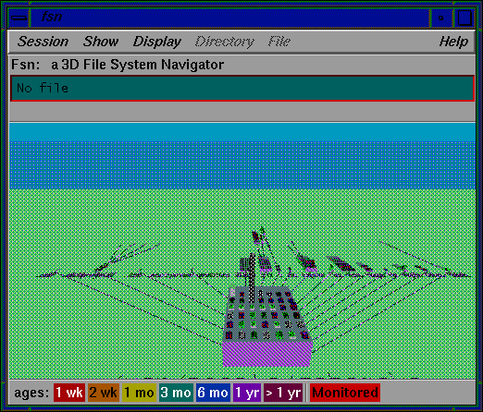
Key R&D Challenges for ULS Systems
Developers & users of ULS systems face challenges in multiple dimensions
Logical
View
Process
View
Use Case
View
Physical
View
Development
View
Of course, developers of today’s large-scale DRE systems also face these challenges, but they can often “brute force” solutions…

Slide 16

Key R&D Challenges for ULS Systems
Developers & users of ULS systems face challenges in multiple dimensions
Logical
View
Process
View
Use Case
View
Physical
View
Development
View
Solving these challenges requires much more than simply retrofitting our current tools, platforms, & processes!

Slide 17
Key R&D Challenges for ULS Systems
Developers & users of ULS systems face challenges in multiple dimensions
Logical
View
Process
View
Use Case
View
Physical
View
Development
View

Slide 18
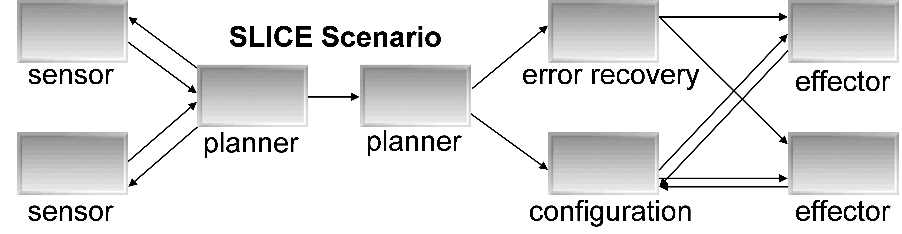
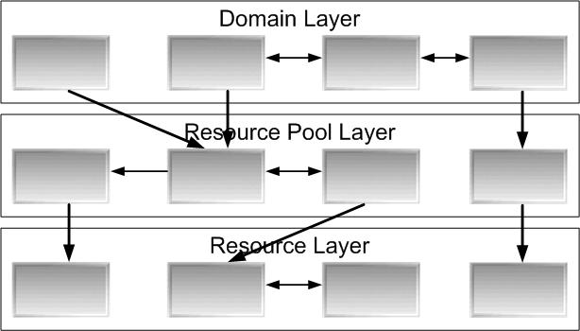
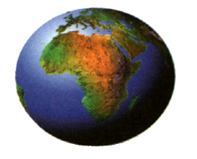
Serialized Phasing is Common in ULS Systems
System infrastructure components developed first
Application components developed after infrastructure is sufficiently mature
Level of Abstraction
Development Timeline

Slide 19

Serialized Phasing is Common in ULS Systems
System integration & testing is performed after application development is finished
Integration Surprises!!!
Level of Abstraction
Development Timeline

Slide 20
Complexities of Serialized Phasing
Still in development
Ready for testing
Complexities
System infrastructure cannot be tested adequately until applications are done
Level of Abstraction
Development Timeline

Slide 21
Complexities of Serialized Phasing
End-to-end performance of critical path?
System bottleneck?
Complexities
System infrastructure cannot be tested adequately until applications are done
Entire system must be deployed & configured (D&C) properly to meet end-to-end QoS requirements
Existing tools & platforms have poor support for realistic “what if” evaluation
Level of Abstraction
Development Timeline
QoS needs of components in ULS systems often unknown until late in lifecycle

Slide 22
Unresolved QoS Concerns with Serialized Phasing
Meet QoS requirements?
Key QoS concerns
Which D&C’s meet the QoS requirements?
Level of Abstraction
Development Timeline

Slide 23
Unresolved QoS Concerns with Serialized Phasing
Performance metrics?
Key QoS concerns
Which D&C’s meet the QoS requirements?
What is the worse/average run-time for various workloads under various D&C’s & processing models?
Level of Abstraction
Development Timeline

Slide 24
Unresolved QoS Concerns with Serialized Phasing
System overload?
Key QoS concerns
Which D&C’s meet the QoS requirements?
What is the worse/average run-time for various workloads under various D&C’s & processing models?
How much workload can the system handle until its end-to-end QoS requirements are compromised?
Level of Abstraction
Development Timeline
It can take a long time (years) to address QoS concerns with serialized phasing

Slide 25
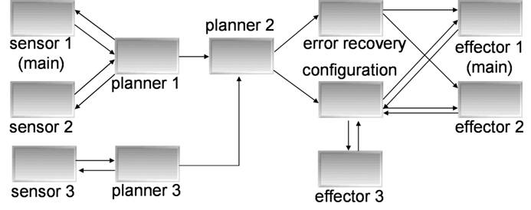
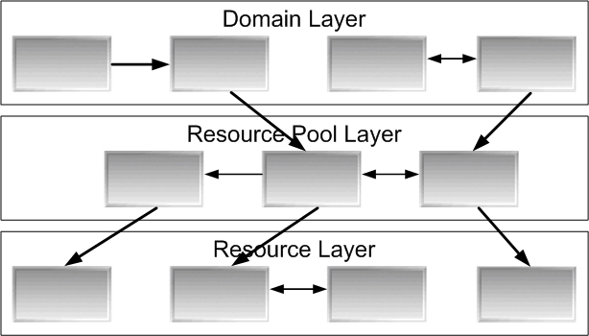
Related ULS System Development Problems
Release X
Release X+1
Level of Abstraction
New hardware, networks, operating systems, middleware, application components, etc.
Development Timeline
Notes:
James, can you please redraw the various diagrams on the *right hand side* of this figure so that they look different from what’s on the left hand side somehow?!

Slide 26
Related ULS System Development Problems
Evolution Surprises!!!
Release X
Release X+1
Level of Abstraction
New hardware, networks, operating systems, middleware, application components, etc.
Development Timeline
Notes:
James, can you please redraw the various diagrams on the *right hand side* of this figure so that they look different from what’s on the left hand side somehow?!

Slide 27
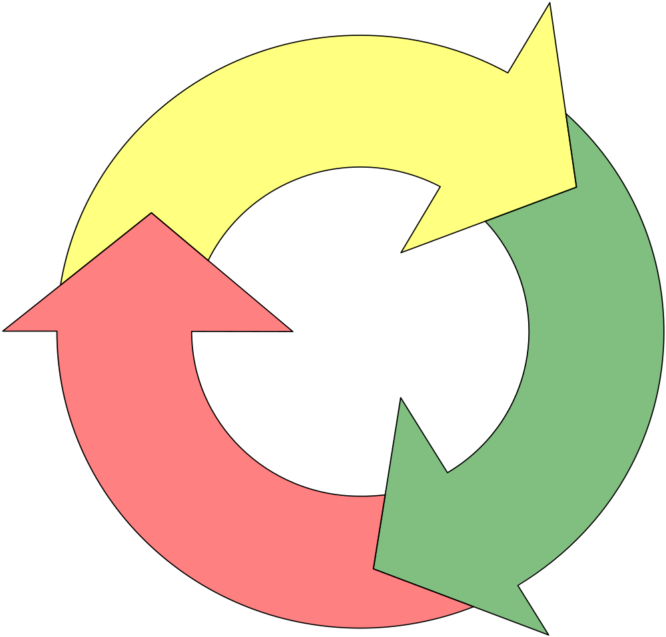
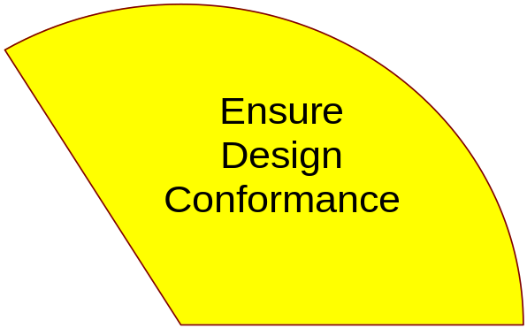
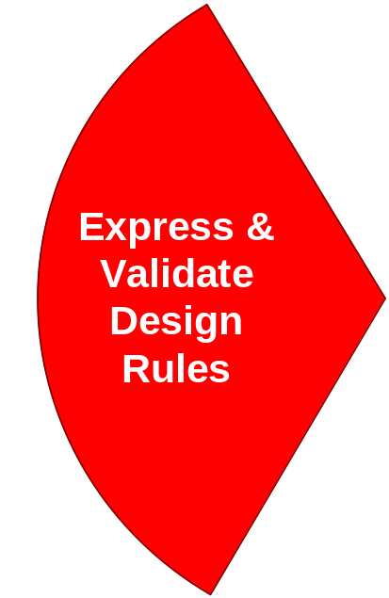
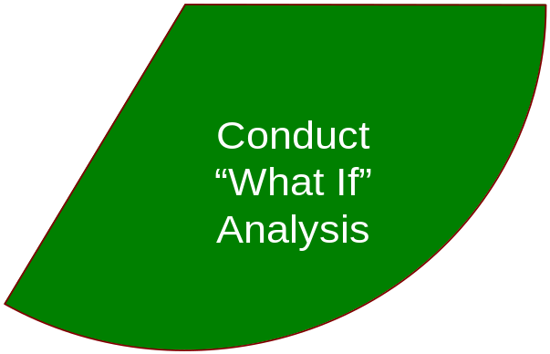
Promising Approach for ULS System Challenges:
System Execution Modeling (SEM) Tools
Tools to express & validate design rules
  Help applications & developers adhere to system specifications at design-time
Tools to ensure design rule conformance
  Help properly deploy & configure applications to enforce design rules throughout system lifecycle
Tools to conduct “what if” analysis
  Help analyze QoS concerns prior to completing the entire system, i.e., before system integration phase
SEM tools should be applied continuously when developing software elements

Slide 28


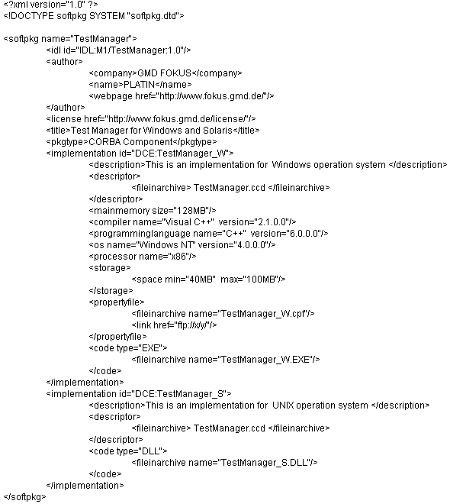

SEM Tool Example: Component Deployment & Configuration
Deployment & configuration (D&C) Goals
  Promote component reuse
  Build complex applications by assembling existing components
  Automate configuration of common services
  Declaratively inject QoS policies into applications
  Dynamically deploy components to target heterogeneous domains
  Optimize systems via global component configuration & deployment settings
SW
Creator₁
SW
Creator₂
Infrastructure
Interfaces
A1
A2
Implementations
Deployment
requirements
Shipping
Deployment
Interfaces
Deployment Tools (generic)
Deployment
Infrastructure
SW Deployer

Slide 29
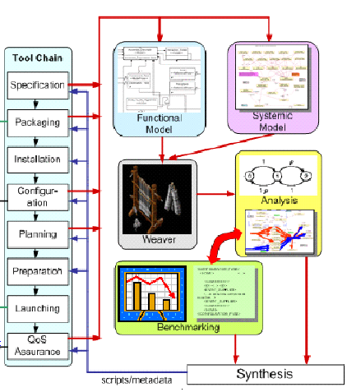
SEM Tool Example: Component Deployment & Configuration
Specification & Implementation
  Defining, partitioning, & implementing app functionality as standalone components
Packaging
  Bundling a suite of software binary modules & metadata representing app components
Installation
  Populating a repository with packages required by app
Configuration
  Configuring packages with appropriate parameters to satisfy functional & systemic requirements of an application without constraining to physical resources
Planning
  Making deployment decisions to identify nodes in target environment where packages will be deployed
Preparation
  Moving binaries to identified entities of target environment
Launching
  Triggering installed binaries & bringing app to ready state
QoS Assurance & Adaptation
  Runtime (re)configuration & resource management to maintain end-to-end QoS
Example D&C specifications include
  OMG Lightweight CORBA Component Model (CCM) &
  IBM Service Component Architecture (SCA)
All software is open-source at www.dre.vanderbilt.edu/cosmic

Slide 30
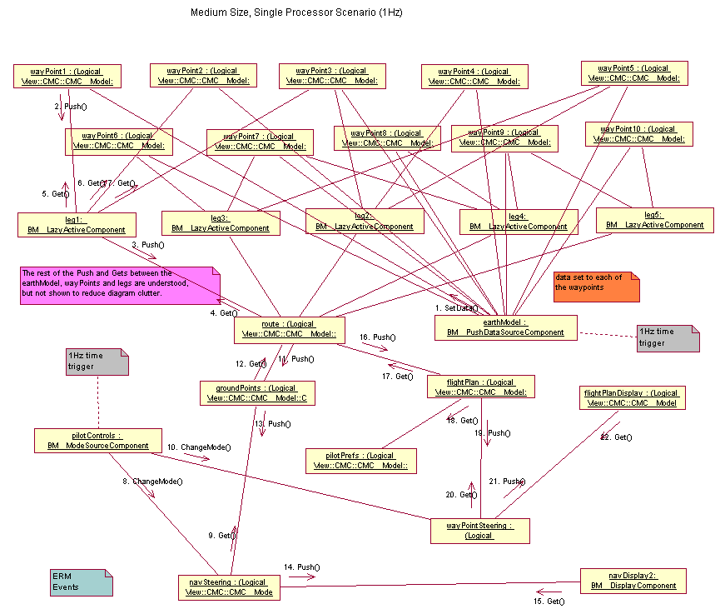
Challenge 1: The Packaging Aspect
Application components are bundled together into assemblies
Different assemblies tailored to deliver different end-to-end QoS and/or using different algorithms can be part of a package
ULS systems will require enormous # (10⁵-10⁷) of components
Packages describing assemblies can be scripted via XML descriptors
Notes:
Assembling tools are like composer. Modeling tools are one such example.

Slide 31
Packaging Aspect Problems (1/2)
Ad hoc techniques for ensuring component syntactic & semantic compatibility
Inherent Complexities
…
…
…
…
…
Container
…
Distribution & deployment done in ad hoc manner
Ad hoc means to determine pub/sub mechanisms
Notes:
Assembling tools are like composer. Modeling tools are one such example.

Slide 32
Packaging Aspect Problems (2/2)
Accidental Complexities
Existing practices involve handcrafting XML descriptors
<!– Associate components with impls -->
<assemblyImpl>
<instance xmi:id="Sensor">
<name>Sensor Subcomponent</name>
<package href="Sensor.cpd"/>
</instance>
<instance xmi:id="Planner">
<name>Planner Subcomponent</name>
<package href="Planner.cpd"/>
</instance>
<instance xmi:id="Effector">
<name>Effector Subcomponent</name>
<package href="Effector.cpd"/>
</instance>
</assemblyImpl>
XML file in excess of 3,000 lines, even for medium sized scenarios
Modifications to the assemblies requires modifying XML file
Notes:
Assembling tools are like composer. Modeling tools are one such example.

Slide 33
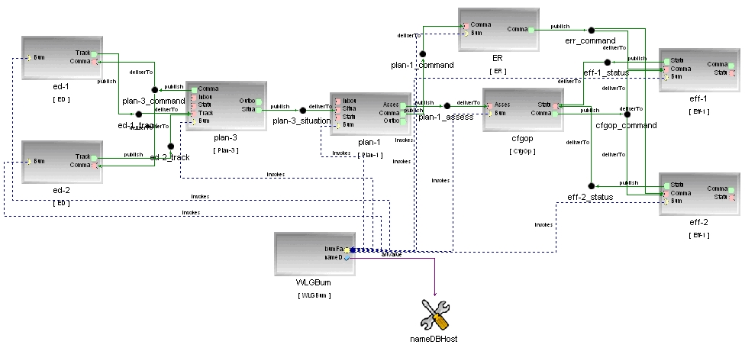
SEM Tool Approach for Packaging Aspect
Approach:
Develop the Platform-Independent Component Modeling Language (PICML) to address complexities of assembly packaging
Capture dependencies visually
Define semantic constraints using constraints
  e.g., Object Constraint Language (OCL)
Generate domain-specific artifacts from models
  e.g., metadata, code, simulations, etc.
Uses Generic Modeling Environment (GME) to meta-model & program
PICML helps to capture & validate design rules for assemblies

Slide 34
Example Metadata Generated by PICML
Component Interface Descriptor (.ccd)
  Describes the interface, ports, properties of a single component
Implementation Artifact Descriptor (.iad)
  Describes the implementation artifacts (e.g., DLLs, OS, etc.) of one component
Component Package Descriptor (.cpd)
  Describes multiple alternative implementations of a single component
Package Configuration Descriptor (.pcd)
  Describes a configuration of a component package
Top-level Package Descriptor (package.tpd)
  Describes the top-level component package in a package (.cpk)
Component Implementation Descriptor (.cid)
  Describes a specific implementation of a component interface
  Implementation can be either monolithic- or assembly-based
  Contains sub-component instantiations in case of assembly based implementations
  Contains inter-connection information between components
Component Packages (.cpk)
  A component package can contain a single component
  A component package can also contain an assembly
Component
Packaging
Component &
Home Properties
Component
Implementation
DLLs
Artifact
Descriptors
(.iad)
Packaging
Tools
Component
Component
Package
Interface
Descriptors
Descriptors
(.cpd)
(.ccd)
Assembly
Component
Tools
Implementation
Descriptor
(*.cid)
Component
Packages
(*.cpk)
Component &
Application
Home Properties
Assembly
  Based on OMG (D&C) specification (ptc/05-01-07)
www.cs.wustl.edu/~schmidt/PDF/RTAS-PICML.pdf

Slide 35
Example Output from PICML Model
A Component Implementation Descriptor (*.cid) file
Describes a specific implementation of a component interface
Describes component interconnections
<monolithicImpl> [...]
<deployRequirement>
<name>Planner</name>
<resourceType>Planner</resourceType>
<property><name>vendor</name>
<value>
<type> <kind>tk_string</kind> </type>
<value> <string>My Planner Vendor</string>
</value>
</property>
</deployRequirement> [... Requires VxWorks ...]
</monolithicImpl>
<connection> <name>Effector</name>
<internalEndpoint>
<portName>Ready</portName>
<instance href="#Planner"/>
</internalEndpoint>
<internalEndpoint>
<portName>Refresh</portName>
<instance href="#Effector"/>
</internalEndpoint>
</connection>
PICML supports better expression of domain intent & “correct-by-construction”

Slide 36
Challenge 2: The Configuration Aspect
ULS systems are characterized by a large configuration space that maps known variations in the application requirements space to known variations in the software solution space

Slide 37
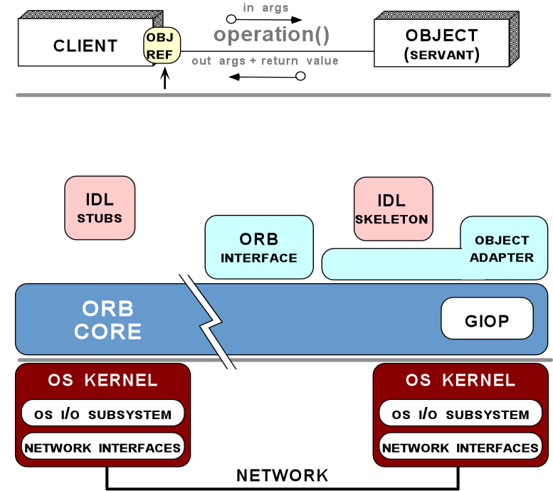
Challenge 2: The Configuration Aspect
ULS systems are characterized by a large configuration space that maps known variations in the application requirements space to known variations in the software solution space
Hook for marshaling strategy
Hook for the request demuxing strategy
Hook for the event demuxing strategy
Hook for the connection management strategy
Hook for the concurrency strategy
Hook for the underlying transport strategy

Slide 38
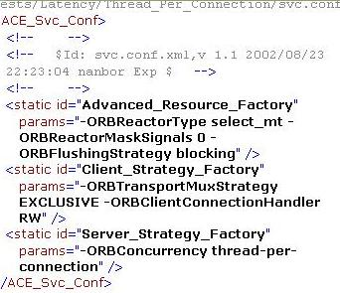



Configuration Aspect Problems
Middleware developers
  Documentation & capability synchronization
  Semantic constraints, design rules, & QoS evaluation of specific configurations
Application developers
  Must understand middleware constraints, rules, & semantics
    Increases accidental complexity
  Different middleware uses different configuration mechanisms
  e.g.
XML Configuration Files
XML Property Files
CIAO/CCM provides ~500 configuration options

Slide 39
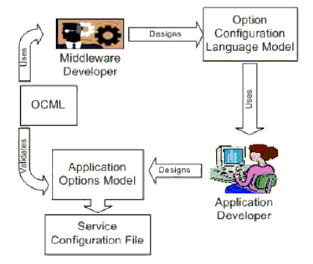
SEM Tool Approach for Configuration Aspect
Approach:
Develop an Options Configuration Modeling Language (OCML) to encode design rules & ensure semantic consistency of option configurations
OCML is used by
  Middleware developers to design the configuration model
  Application developers to configure the middleware for a specific application
OCML metamodel is platform-independent
OCML models are platform-specific
OCML helps to ensure design conformance

Slide 40
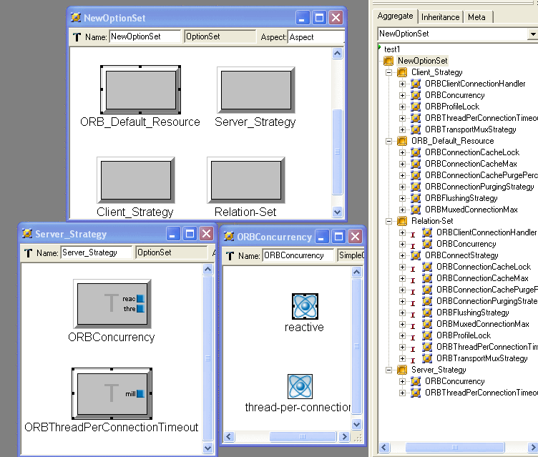
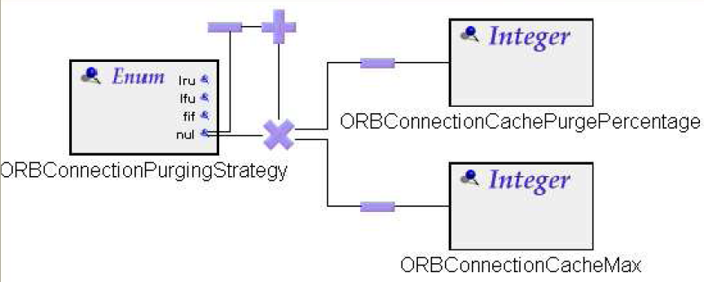
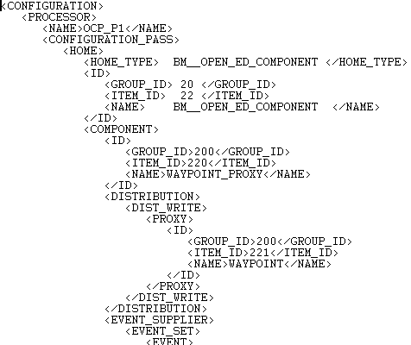
Applying OCML to CIAO+TAO
Middleware developers specify
  Configuration space
  Constraints
OCML generates config model
/**
* Return the last time the client sent a request associated
* session, as the number of ms since midnight, Jan 1, 1970
* GMT. Actions your application takes, such as get or set
* value associated with session, do not affect access time.
*/
public long getLastAccessedTime() {
return (this.lastAccessedTime);
}
/**
* Update the accessed time information for this session.
* Method is called by context when request comes in for a
* session, even if the application does not reference it.
*/
public void access() {
this.lastAccessedTime = this.thisAccessedTime;
}
www.cs.wustl.edu/~schmidt/PDF/RTAS-process.pdf

Slide 41
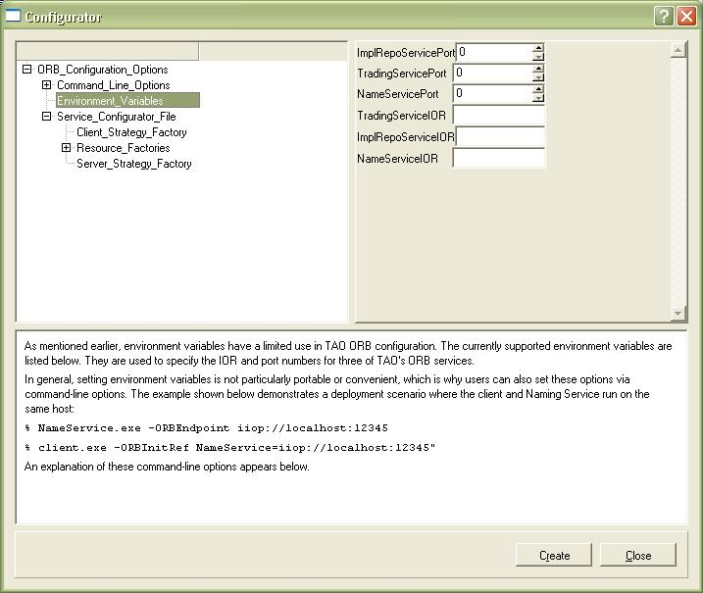
Applying OCML to CIAO+TAO
Middleware developers specify
  Configuration space
  Constraints
OCML generates config model
Application developers provide a model of desired options & their values, e.g.,
  Network resources
  Concurrency & connection management strategies
www.cs.wustl.edu/~schmidt/PDF/RTAS-process.pdf

Slide 42
Applying OCML to CIAO+TAO
Middleware developers specify
  Configuration space
  Constraints
OCML generates config model
Application developers provide a model of desired options & their values, e.g.,
  Network resources
  Concurrency & connection management strategies
OCML constraint checker flags incompatible options & then
  Synthesizes XML descriptors for middleware configuration
  Generates documentation for middleware configuration
  Validates the configurations
OCML automates activities that are very tedious & error-prone to do manually
www.cs.wustl.edu/~schmidt/PDF/RTAS-process.pdf

Slide 43
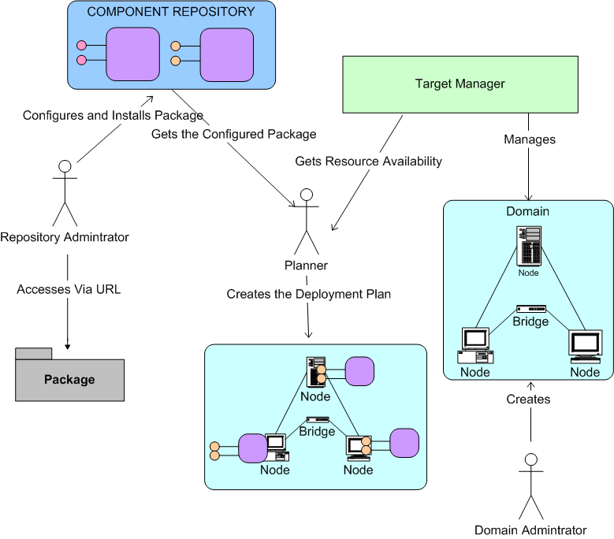
Challenge 3: Planning Aspect
System integrators must make appropriate deployment decisions, identifying nodes in target environment where packages will be deployed
Select the appropriate package to deploy on selected target
Determine current resource allocations on target platforms
Select appropriate target platform to deploy packages

Slide 44
Planning Aspect Problems
Ensuring deployment plans meet ULS system QoS requirements
How do you evaluate QoS of infrastructure before applications are completely built?
How do you correlate QoS requirements of packages to resource availability?
How do you determine current resource allocations?
How do you ensure that selected targets will deliver required QoS?

Slide 45







SEM Tool Approach for Planning Aspect
Approach
Develop Component Workload Emulator (CoWorkEr) Utilization Test Suite (CUTS) so architects & systems engineers can conduct “what if” analysis on evolving systems by
Composing scenarios to exercise critical system paths
Associating performance properties with scenarios & assign properties to components specific to paths
Configuring workload generators to run experiments, generate deployment plans, & measure performance along critical paths
Analyzing results to verify if deployment plan & configurations meet performance requirements
Model
Associate
Experiment
QoS
Experimenter
Characteristics
1
2
Component Interaction
CoWorkEr
4
3
Synthesize
&
IDL
Execute
Script
Feedback
Results
files
Test bed
Deployment
.
cpp
Plan
CUTS integrates nicely with continuous integration servers

Slide 46

Emulating Computational Components in CUTS
Application components are represented as Component Workload Emulators (CoWorkErs)
CoWorkErs can be interconnected by the PICML tool to form operational strings
Level of Abstraction
Development Timeline
www.cs.wustl.edu/~schmidt/PDF/CUTS.pdf

Slide 47


Representing Computational Components in CUTS
Level of Abstraction
Workload Modeling Language (WML) MDE tool defines behavior of CoWorkErs via “work sequences”
WML programs are translated into XML characterization files
These files then configure CoWorkErs
Development Timeline
www.cs.wustl.edu/~schmidt/PDF/QoSPML-WML.pdf

Slide 48
Visualizing Critical Path Performance in CUTS
Level of Abstraction
BenchmarkManagerWeb-interface (BMW) MDE tool generates statistics showing performance of actions in each CoWorkEr
Critical paths show end-to-end performance of mission-critical operational strings
Development Timeline
www.cs.wustl.edu/~schmidt/PDF/ECBS-2008.pdf

Slide 49
Open R&D Issues
Accidental Complexities
Round-trip engineering from models ↔ source
Mismatched abstraction levels for development vs. debugging
View integration
Tool chain vs. monolithic tools
Backward compatibility of modeling tools
Standard metamodeling languages & tools
Inherent Complexities
Capturing specificity of target domain
Automated specification & synthesis of
  Model interpreters
  Model transformations
  Broader range of application capabilities
  Static & dynamic QoS properties
Migration & version control of models
Scaling & performance
Verification of the DSMLs
Solutions require validation on large-scale, real-world ULS systems

Slide 50






Concluding Remarks
The emergence of ULS systems requires significant innovations & advances in tools & platforms
Not all technologies provide the precision we’re accustomed to in legacy real-time systems
Advances in Model-driven engineering (MDE) are needed to address ULS systems challenges
Significant MDE groundwork layed in various R&D programs
Much more R&D needed for ULS systems
  e.g., recent Software Engineering Institute study
ULS systems report available at www.sei.cmu.edu/uls

