Slide 1
eHealth Insights
Innovation Lab 1, Wintersemester 2024/25
Supervisor: Lukas Rohatsch
Team:
Erdem Mehdi, if22b202@technikum-wien.at - Teamleiter, Ansprechperson
Zehinovic Aldin, if22b130@technikum-wien.at - Stellvertretung
Dervisefendic Armin, if23b040@technikum-wien.at

Slide 2
Ideas and Aim of Our Project
Create structured databases for hospitals
Develop an analytics dashboard for healthcare data
Provide insights and visualizations for various healthcare metrics
Enable users to run custom queries on healthcare data
Visualize data using graphs for efficient analysis
Ensure high standards of security and data protection

Slide 3
Project Architecture
Frontend:
React & Vite
Backend:
Spring Boot
RESTful API
Database:
PostgreSQL
Communication:
Frontend to Backend via REST API
Security:
Spring Security
CORS Configuration

Slide 4
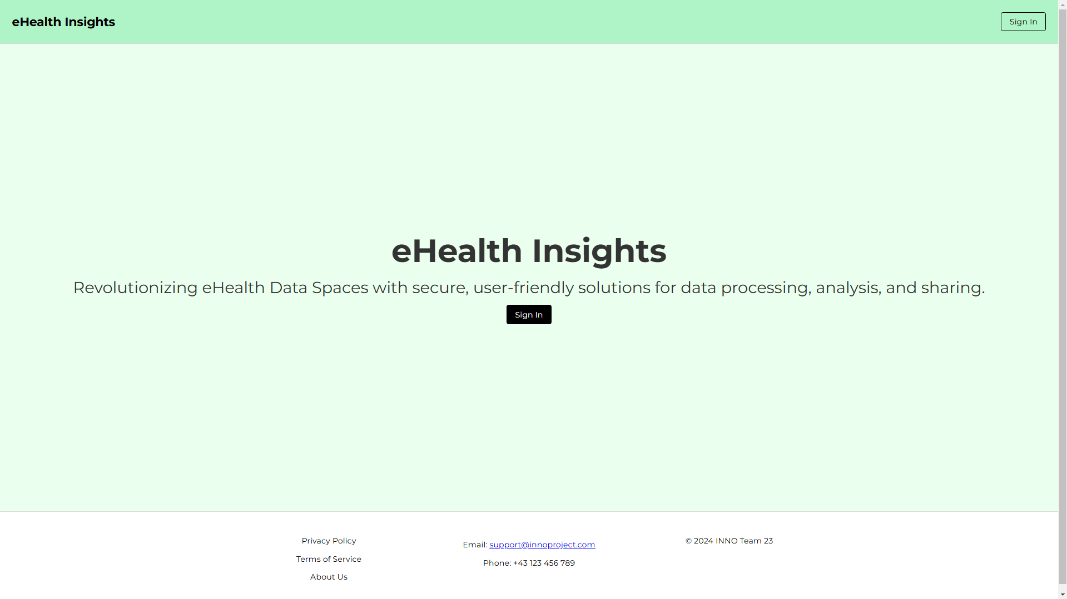

Slide 5
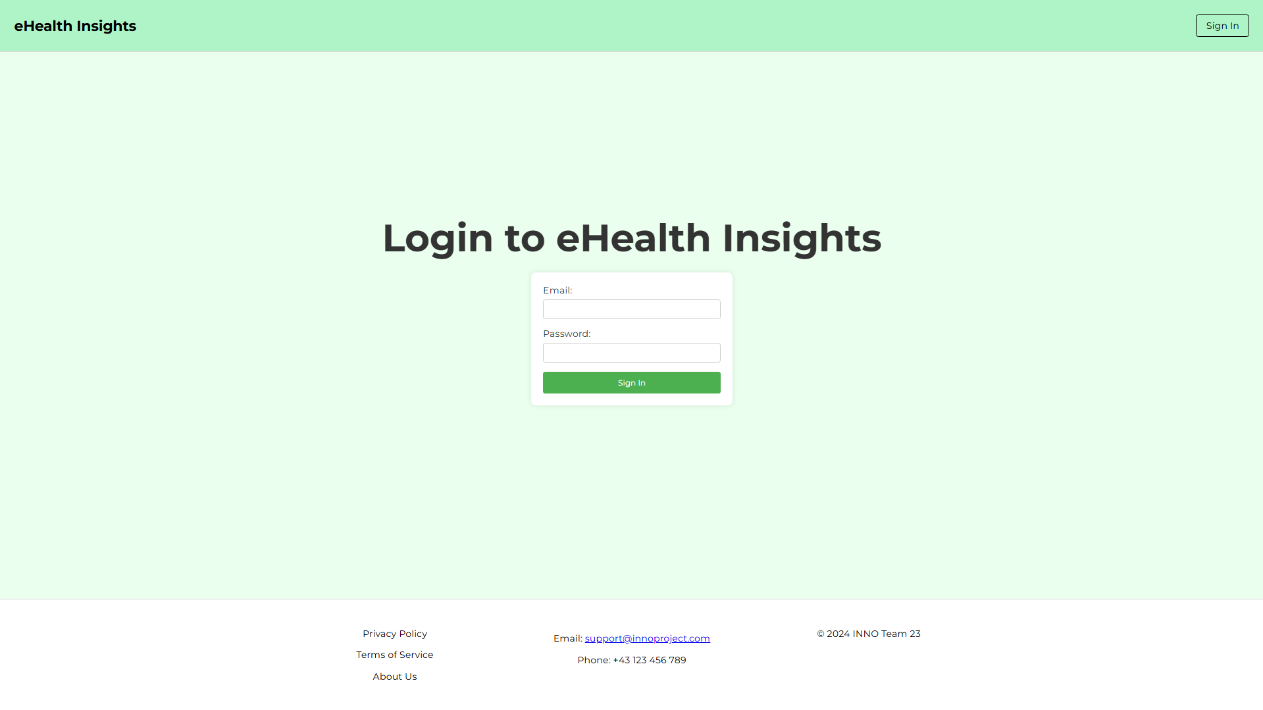

Slide 6
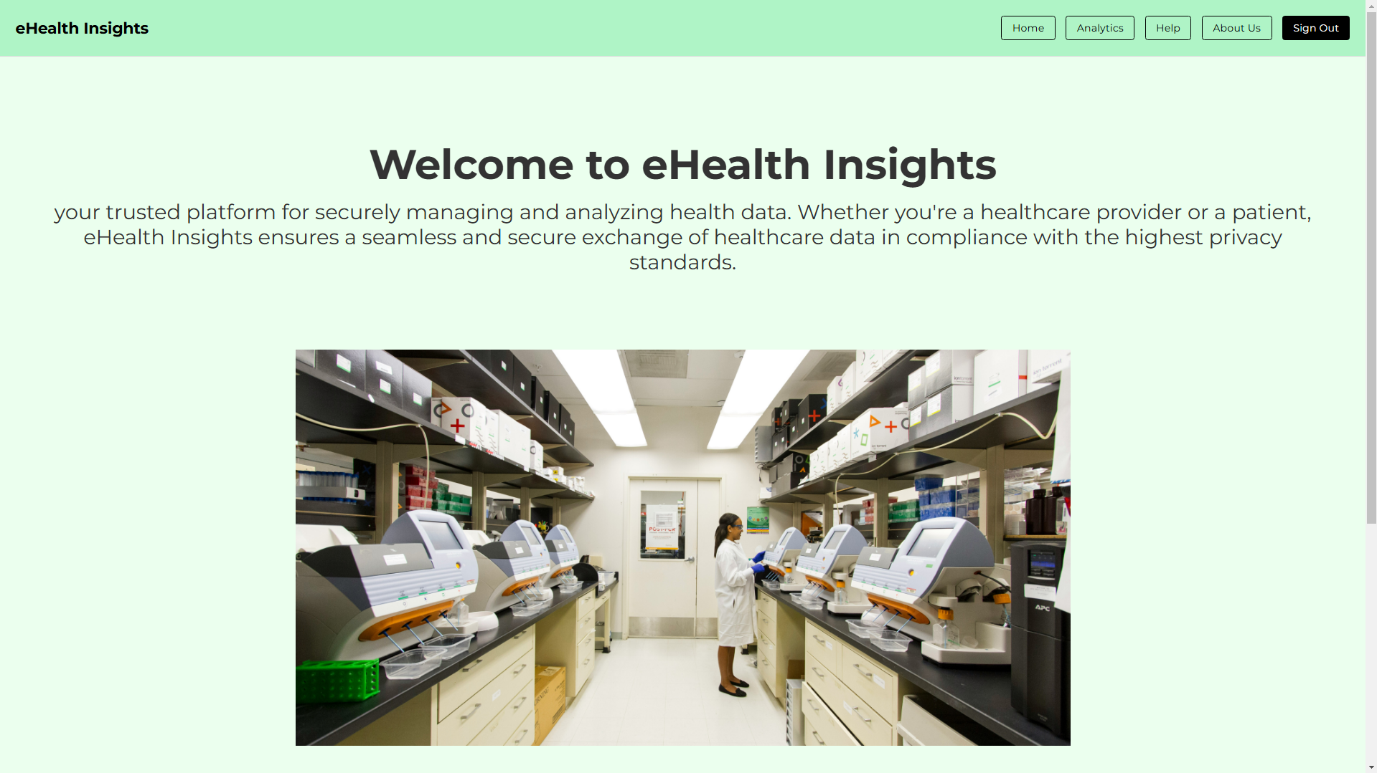

Slide 7
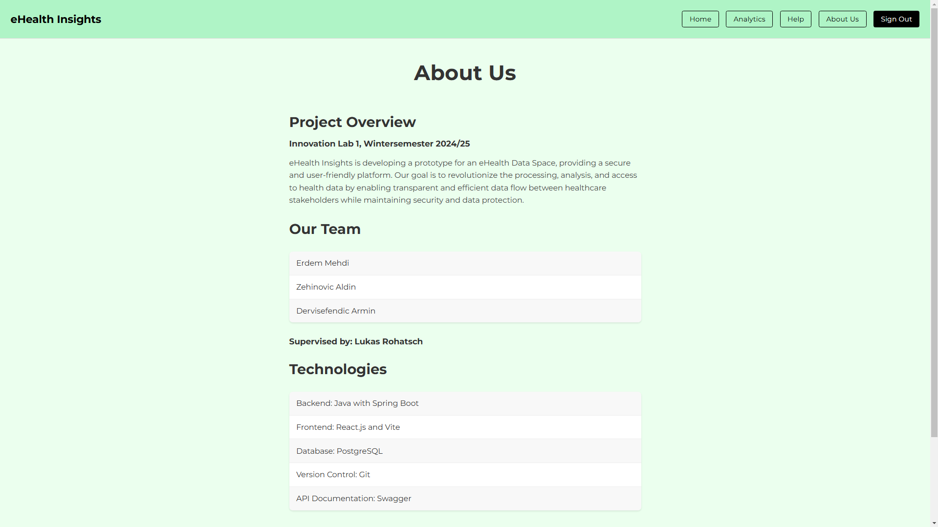

Slide 8
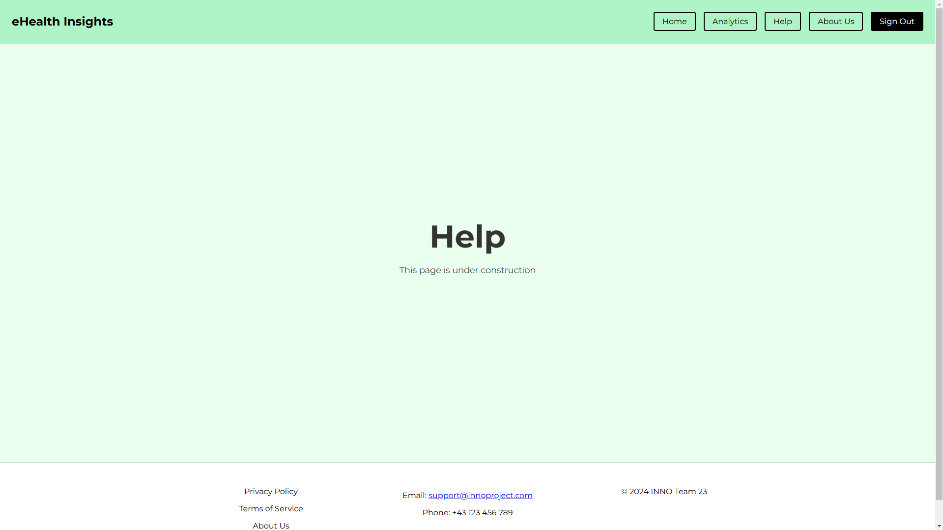

Slide 9
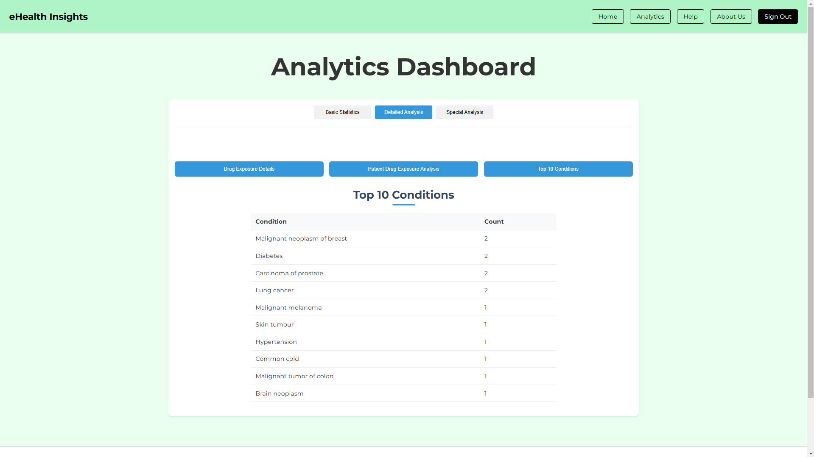

Slide 10
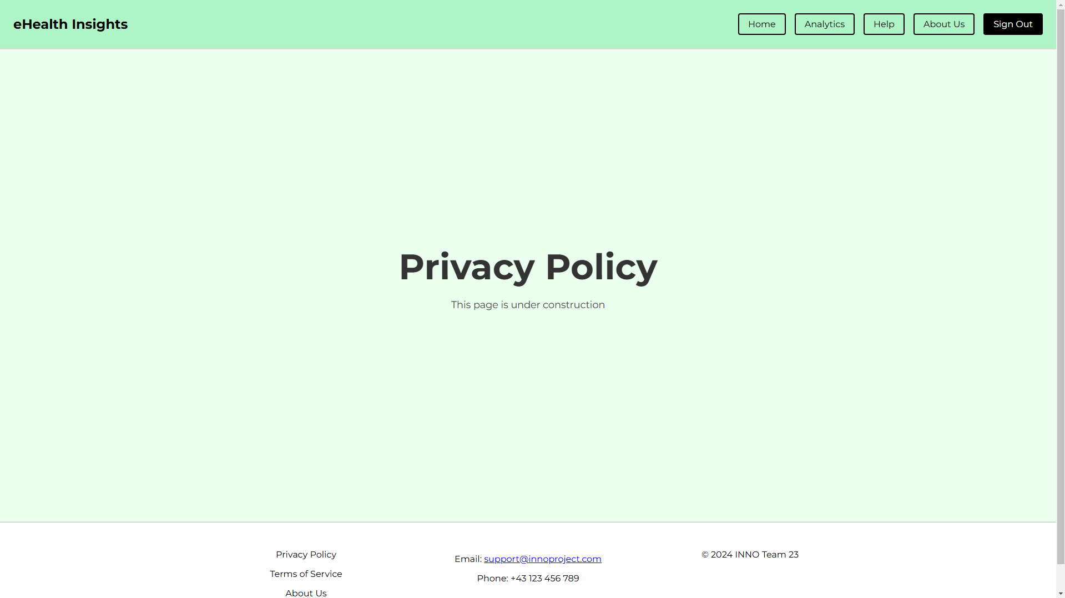

Slide 11
Future Work
Central Database Setup
Establish a central database without patient data.
Implement Docker containers for hospitals with patient data.
Enhanced Functionality
Advanced data visualization.
User authentication and role-based access control.
Performance optimization.
Support for Research and Analysis
Facilitate healthcare research with detailed analysis tools.
Collect user feedback for continuous improvement.

