Slide 1
eHealth Insights
Innovation Lab 3, Wintersemester 2025/26
Supervisor: Lukas Rohatsch
Team:
Zehinovic Aldin, if22b130@technikum-wien.at
Dervisefendic Armin, if23b040@technikum-wien.at

Slide 2
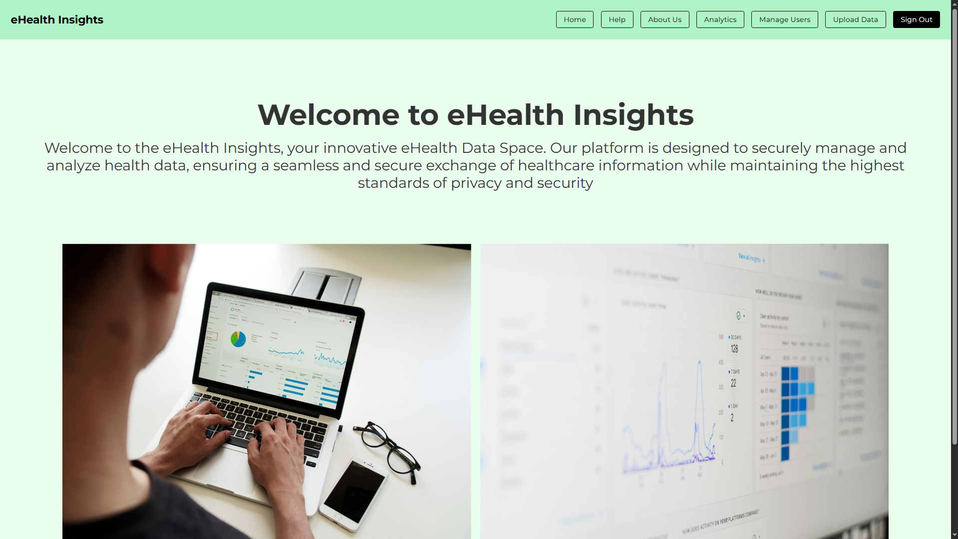

Slide 3




Key Features
Unified Analytics
Smart Export
Secure Access (BCrypt passwords & API keys)
Easy Hospital Onboarding

Slide 4






Technical Highlights
Backend
Frontend
Containerized Deployment

Slide 5
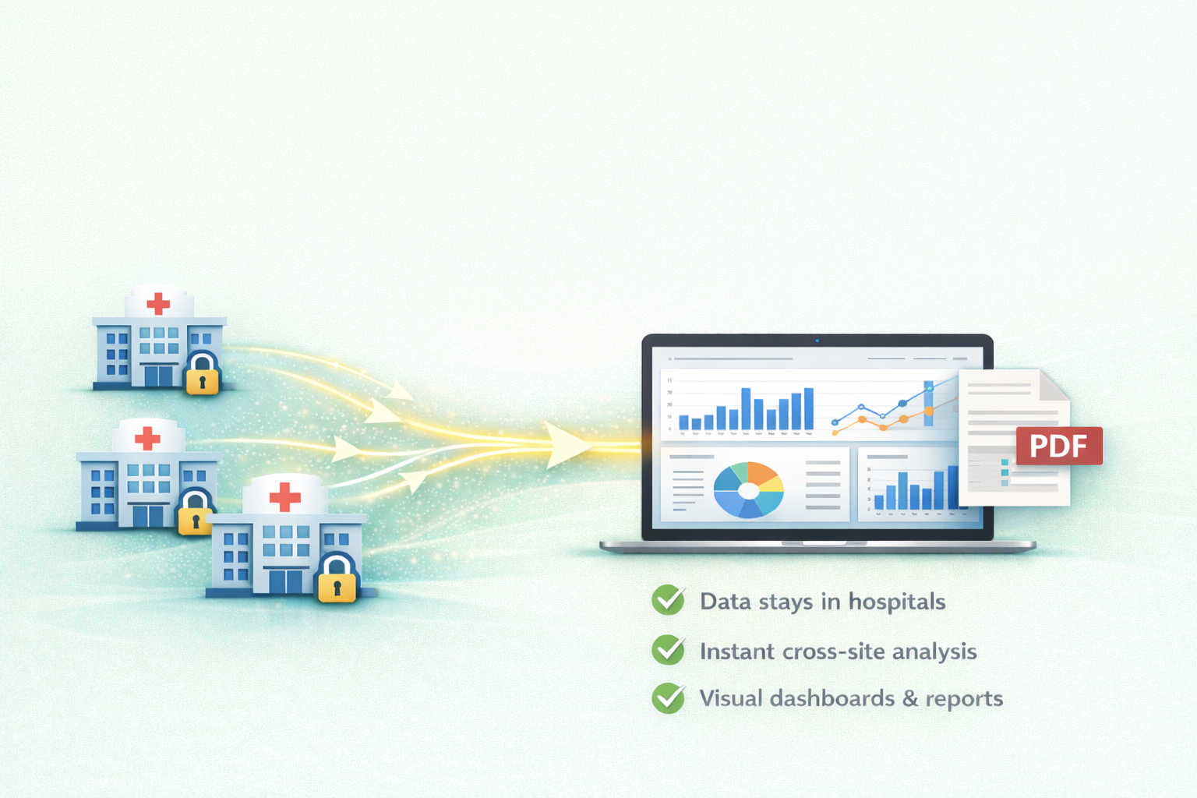
Overcoming the Challenges
Decentralized data storage
Federated analysis with FDW
Easy onboarding

Slide 6
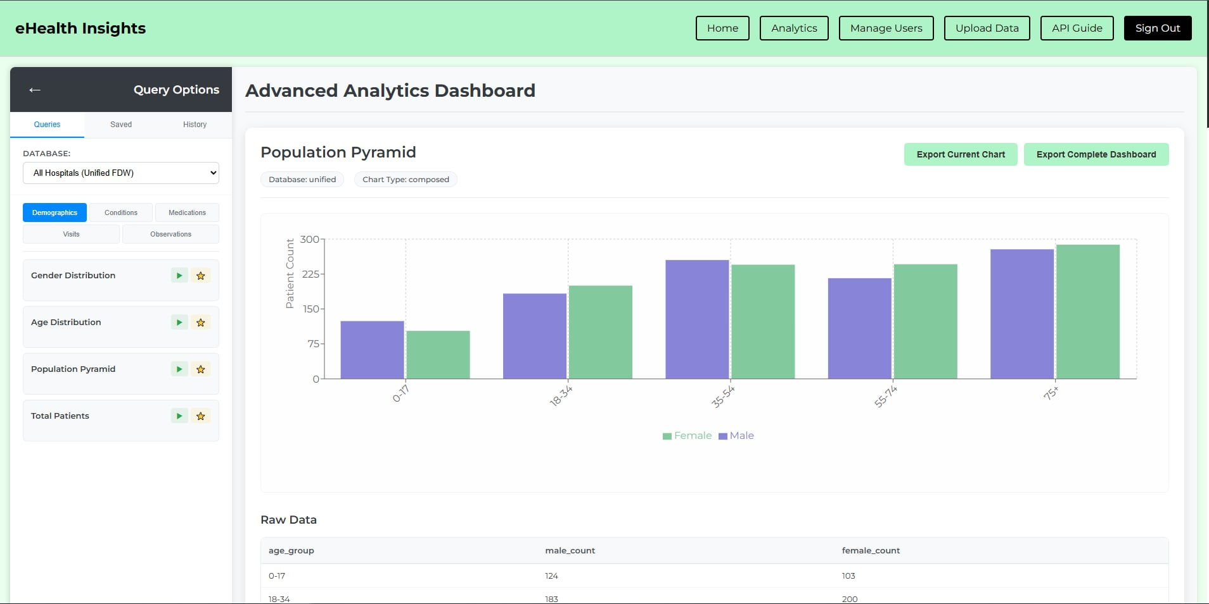
Analytics

Slide 7



Benefits
Hospitals
Enable research while keeping full control and ownership of their data.
Patients
Benefit from research without sacrificing privacy
Researchers
Discover medical trends across hospitals without accessing raw patient data

Slide 8
Unlock the Power of Medical Data Research
eHealth Insights
https://github.com/mide553/IDERHA

