Slide 1
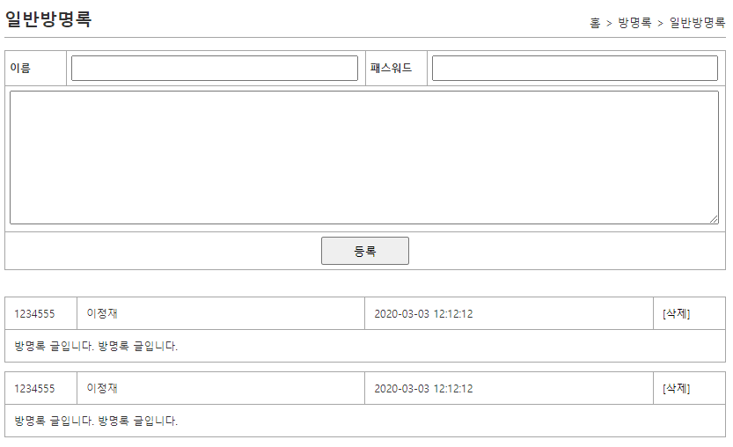
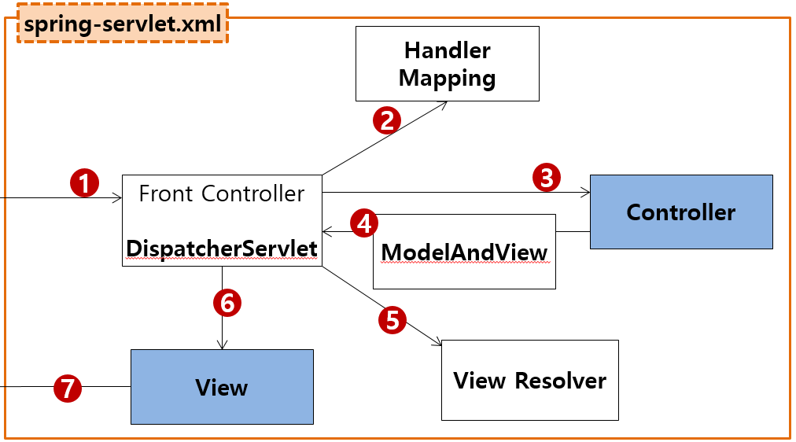
mysite4>ajax방명록>add
Controller
Service
Dao=Repository
sqlSession.insert(“person.insert", vo);
sqlSession.update("person.update", vo);
sqlSession.delete("person.delete", no);
sqlSession.selectOne("person.getbyno", no);
sqlSession.selectList("guestbook.getList");
Rqeust(요청)
웹서버
Request header
(파라미터)
name=황일영
password=1234
content=방명록입니다.
Request body
web.xml
http://localhost:8088/mysite4/api/guestbook/add
?name=황일영
&password=1234
&content=방명록입니다.
Tomcat
applicationContext.xml
jquery ajax통신(data요청) 저장버튼 클릭할때
mysite4
/api/guestbook/add get post → ApiGuestbookController.add()
request
*파라미터
name=황일영
password=1234
content=방명록입니다.
*어트리뷰트
com.javaex.controller
@Controller
@Service
@Repository
MyBatis
com.javaex.api.controller
ApiGuestbookController 객체
GuestbookService
GuestbookDao 객체
@Controller
/test
test()
:0x999
GuestbookVo
addGuest(vo)
:0x999
GuestbookVo
geustInsert(vo)
:0x999
GuestbookVo
SqlSession (sqlSessionTemplate)
Response(응답)
add(GuestbookVo)
:0x666
GusetbookVo
count=1
count=1
Response header
Response body (html)
response
view
no = 16
getGuest(no)
no = 16
SqlSessionFactioryBean
Oracle
javaScript 객체←문자열(JSON)
JSON
:0x666
GusetbookVo
:0x666
GusetbookVo
DataSource
configuration.xml
Pool
문자열(JSON) ←java 객체
Connection
mapper.xml
Connection
mapper.xml
Connection
…
Connection
GuestbookVo
JDBC Driver
0x999
0x666
GuestbookVo
<insert id="insert" parameterType="GuestbookVo">
<selectKey keyProperty="no" resultType=“int" order="BEFORE">
select seq_guestbook_no.nextval from dual
</selectKey>
<![CDATA[
insert
into guestbook
values ( #{no }, #{name }, #{password }, #{content }, SYSDATE )
]]>
</insert>
private int no; X → 16
private String name; 황일영
private string password; 1234
private String content; 안녕하세요
private string regDate;
private int no; 16
private String name; 황일영
private string password; 1234
private String content; 안녕하세요
private string regDate; 2022-07-07
<insert id="insert" parameterType="GuestbookVo">
<![CDATA[
insert into guestbook
values ( seq_guestbook_no.nextval, #{name }, #{password }, #{content }, SYSDATE )
]]>
</insert>

Slide 2
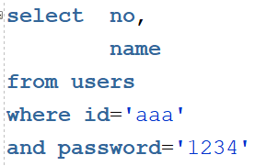

mysite4>ajax방명록>addList
Controller
Rqeust(요청)
웹서버
Request header
(파라미터)
Request body
web.xml
http://localhost:8088/mysite4/api/guestbook/addList
Tomcat
(화면이 준비되면 jquery 요청)→js작성됨
mysite4
/api/guestbook/addList get post → ApiGuestbookController.addList()
request
*파라미터
*어트리뷰트
com.javaex.controller
@Controller
com.javaex.api.controller
ApiGuestbookController 객체
@Controller
/test
test()
Response(응답)
addList()
로딩하지 않았음
Response header
Response body (html)
response
view
addList.jsp
html + css + js +(jstl el해석l)
sqlSession.insert(“person.insert", vo);
sqlSession.update("person.update", vo);
sqlSession.delete("person.delete", no);
sqlSession.selectOne("person.getbyno", no);
sqlSession.selectList("guestbook.getList");
로딩하지 않았음
http://localhost:8088/mysite4/api/guestbook/list
Rqeust(요청)
웹서버
Service
Dao=Repository
jquery ajax통신(data요청)
Request header
(파라미터)
Request body
web.xml
applicationContext.xml
Tomcat
mysite4
/api/guestbook/list get post → ApiGuestbookController.list()
com.javaex.controller
@Service
@Repository
MyBatis
request
*파라미터
*어트리뷰트
com.javaex.api.controller
@Controller
GuestbookService
GuestbookDao 객체
ApiGuestbookController 객체
getGuestList()
selectList()
SqlSession (sqlSessionTemplate)
@Controller
/test
test()
:0x999
List<Guestbook>
:0x999
List<Guestbook>
:0x999
List<Guestbook>
javaScript 객체←문자열(JSON)
Response(응답)
list()
Response header
Response body (html)
response
view
SqlSessionFactioryBean
Oracle
js객체 + 문자열 →그린다
JSON
DataSource
configuration.xml
Pool
Connection
문자열(JSON) ←java 객체
:0x999
List<Guestbook>
mapper.xml
Connection
mapper.xml
Connection
…
Connection
JDBC Driver
JSP
Controller
Service
Repository
(sqlSesson)
:0x999
List<Guestbook>
mysite4>ajax방명록>addList
사용자
/api/guestbook/addList
/api/guestbook/addList
addList()
addList.jsp

