Slide 1
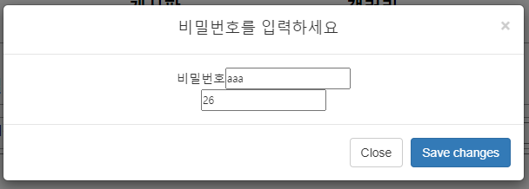
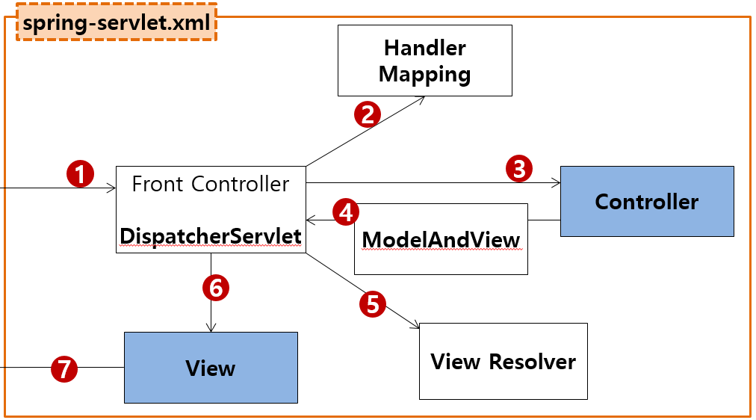
mysite4>ajax방명록>remove
Controller
Service
Dao=Repository
sqlSession.insert(“person.insert", vo);
sqlSession.update("person.update", vo);
sqlSession.delete("person.delete", no);
sqlSession.selectOne("person.getbyno", no);
sqlSession.selectList("guestbook.getList");
Rqeust(요청)
웹서버
Request header
(파라미터)
no=26
password=1234
Request body
web.xml
http://localhost:8088/mysite4/api/guestbook/remove
?no=26
&password=1234
Tomcat
applicationContext.xml
jquery ajax통신(data요청) 저장버튼 클릭할때
mysite4
/api/guestbook/remove get post → ApiGuestbookController.remove()
request
*파라미터
no=26
password=1234
*어트리뷰트
com.javaex.controller
@Controller
@Service
@Repository
MyBatis
com.javaex.api.controller
ApiGuestbookController 객체
GuestbookService
GuestbookDao 객체
@Controller
/test
test()
:0x999
GuestbookVo
removeGuest
(GuestbookVo)
1 이면 success
0 이면 fale
:0x999
GuestbookVo
geustDelete
(GuestbookVo)
:0x999
GuestbookVo
SqlSession (sqlSessionTemplate)
Response(응답)
remove(GuestbookVo)
count=1
count=1
Response header
Response body (html)
state = succeess
state = succeess
JSON
state = succeess
response
view
state = fale
SqlSessionFactioryBean
Oracle
state = fale
state = fale
DataSource
javaScript 객체←문자열(JSON)
configuration.xml
Pool
문자열(JSON) ←java 객체
Connection
mapper.xml
Connection
mapper.xml
Connection
…
Connection
0x999
GuestbookVo
JDBC Driver
private int no; 26
private String name;
private string password; 1234
private String content;
private string regDate;
<insert id="insert" parameterType="GuestbookVo">
<selectKey keyProperty="no" resultType=“int" order="BEFORE">
select seq_guestbook_no.nextval from dual
</selectKey>
<![CDATA[
insert
into guestbook
values ( #{no }, #{name }, #{password }, #{content }, SYSDATE )
]]>
</insert>
<insert id="insert" parameterType="GuestbookVo">
<![CDATA[
insert into guestbook
values ( seq_guestbook_no.nextval, #{name }, #{password }, #{content }, SYSDATE )
]]>
</insert>

