Slide 1
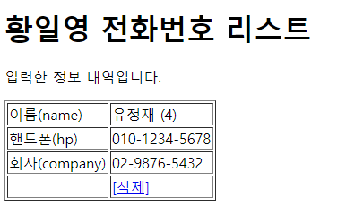
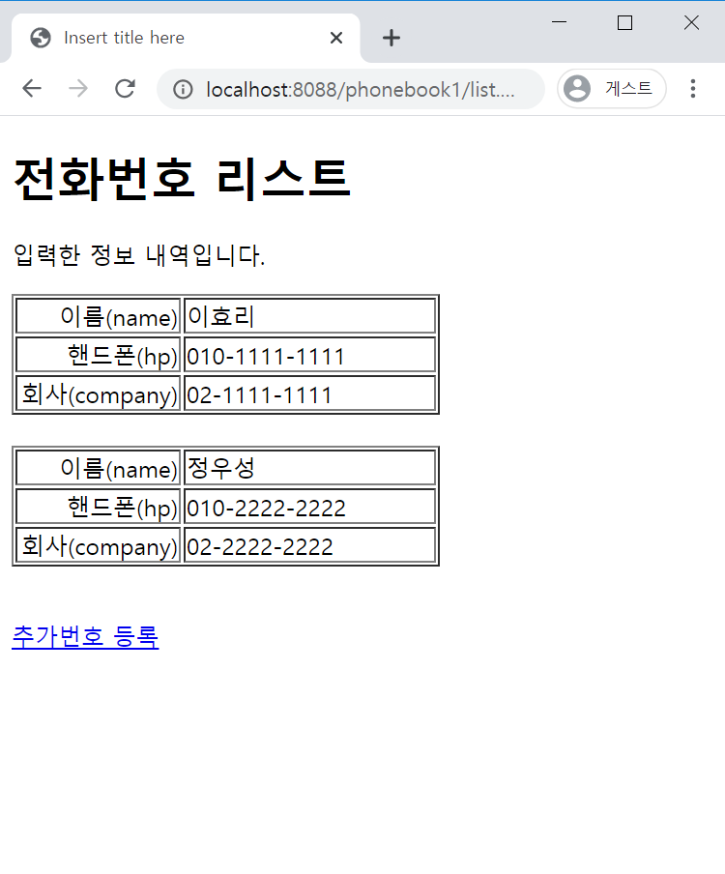
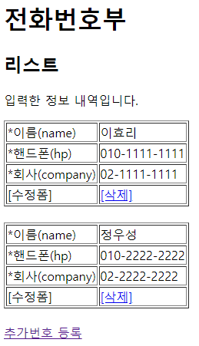
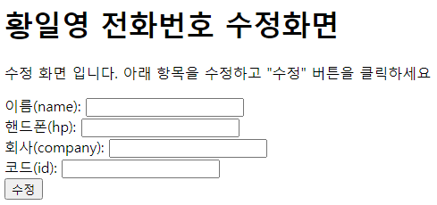
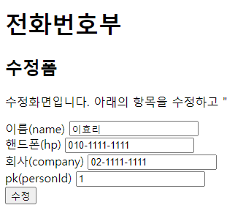
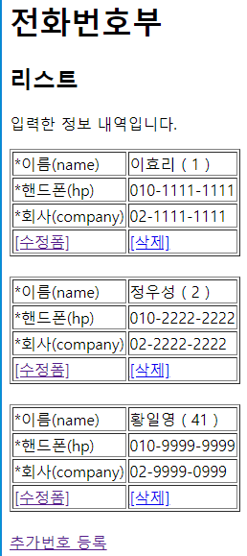
Rqeust(요청)
웹서버
DB서버
Request header
(파라미터) id=4
Request body
Tomcat
http://localhost:8088/phonebook1/delete.jsp?id=4
phonebook1
phoneDao 객체
Oracle
rquest
getParameter("id")
id=4
personDelete(int perosnId)
delete from person
where person_id = 4;
Response(응답)
delete.jsp
객체
1
jdbc
Response header
Response body (html)
response
sendRedirct("주소")
(http://localhost:8088/phonebook1/list.jsp)
리다이렉트
Rqeust(요청)
웹서버
DB서버
Request header
Request body
Tomcat
phonebook1
phoneDao 객체
Oracle
rquest
list.jsp
객체
getPersonList()
jdbc
select ....
Response(응답)
response
리스트+html
personList
리스트의 주소
Response header
Response body (html)
http://localhost:8088/phonebook1/updateForm.jsp?id=41
http://localhost:8088/phonebook1/updateForm.jsp?id=2
http://localhost:8088/phonebook1/updateForm.jsp?id=1
personList
리스트의 주소
Rqeust(요청)
웹서버
DB서버
Request header
(파라미터) id=2
Request body
Tomcat
phonebook1
phoneDao 객체
Oracle
rquest
getParameter("id")
id=4
getPerson(int personId)
select person_id,
name,
hp,
company
from person
where person_id = 2;
Response(응답)
response
updateForm.jsp
객체
personVo
jdbc
Response header
Response body (html)
personVo + html
이효리
010-222-2222
02-222-2222
1
이효리
010-222-2222
02-222-2222
1
http://localhost:8088/phonebook1/update.jsp?id=1&name='김효리'&hp='010'&company='02'
personList
리스트의 주소
id=4
Rqeust(요청)
웹서버
personList
리스트의 주소
DB서버
Request header
*파라미터
id=1
name=김효리
hp=010
company=02
Request body
Tomcat
phonebook1
phoneDao 객체
Oracle
rquest
getParameter("id")*4
personVo
personUpadate(
PersonVo personVo)
update person
set name = '정우성',
hp = '010',
company = '02'
where person_id = 1;
Response(응답)
response
update.jsp
객체
1
jdbc
Response header
Response body (html)
sendRedirct("주소")
personVo
(http://localhost:8088/phonebook1/list.jsp)
리다이렉트
Rqeust(요청)
웹서버
DB서버
Request header
Request body
Tomcat
phonebook1
phoneDao 객체
Oracle
rquest
list.jsp
객체
getPersonList()
jdbc
select ....
Response(응답)
response
리스트+html
personList
리스트의 주소
Response header
Response body (html)

