Slide 1
수정

Slide 2
수정폼

Slide 3
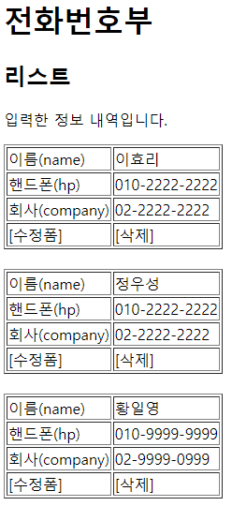
삭제
Rqeust(요청)
웹서버
DB서버
http://localhost:8088/phonebook2/pbc?action=delete
&id=3
Request header
(파라미터) action=delete
id=3
Request body
Tomcat
phonebook1
Oracle
rquest
*파라미터
action=delete
id=3
*어트리뷰트
PhoneController (Servlet)객체
phoneDao 객체
getParameter("action")
personDelete(id)
delete일때
리다이렉트
id=3
jdbc *2
Response(응답)
1
리스트 요청
Response header
Response body (html)
response
리다이렉트
(pbc?action=list)
http://localhost:8088/phonebook2/pbc?action=list

Slide 4
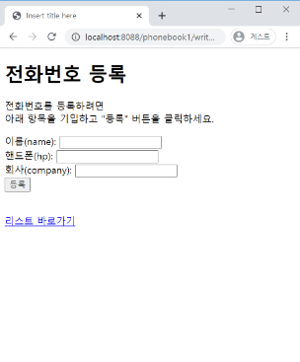
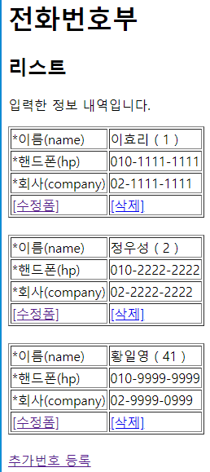
등록
Rqeust(요청)
웹서버
DB서버
http://localhost:8088/phonebook2/pbc?action=write
&name=유재석
&hp=010-2222-2222
&company=02-2222-2222
Request header
(파라미터) action=write
name=유재석
hp=010-2222-2222
company=02-2222-2222
Request body
Tomcat
phonebook1
Oracle
rquest
*파라미터
action=writeForm
name=유재석
hp=010-2222-2222
company=02-2222-2222
*어트리뷰트
"
PhoneController (Servlet)객체
phoneDao 객체
getParameter("action")
*4
personInsert(vo)
write일때
Vo
jdbc *2
Response(응답)
1
리스트 요청
Response header
Response body (html)
response
리다이렉트(pbc?action=list)
jsp가 DB연결하지 않는다
http://localhost:8088/phonebook2/pbc?action=list
jsp: html 작성하기 편함
a.jsp → a_jsp.java(servlet) → a.class
servlet: java 문법 작성하기 편함
a.java(servlet) → a.calss
action=write
pbc
action=list
list.jsp
리스트
action=list
등록

Slide 5
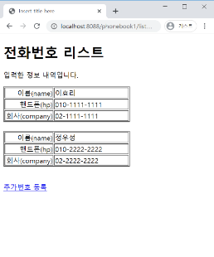
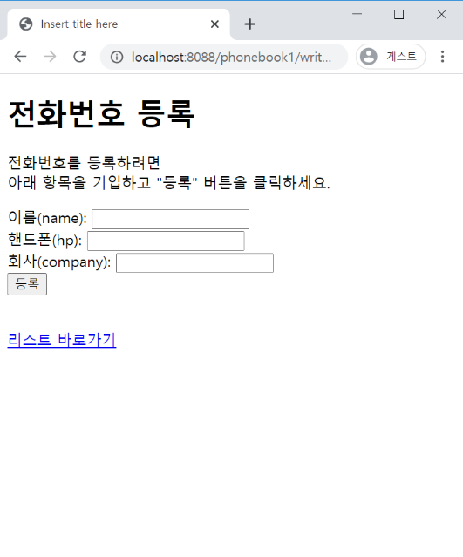
등록폼
Rqeust(요청)
웹서버
DB서버
http://localhost:8088/phonebook2/pbc?action=writeForm
Request header
(파라미터) action=writeForm
Request body
Tomcat
phonebook1
PhoneController (Servlet)객체
Oracle
getParameter("action")
writeFrom일때
Response(응답)
rquest
*파라미터
action=writeForm
*어트리뷰트
"
*포워드
Response header
Response body (html)
writeForm.jsp
response
html
jsp가 DB연결하지 않는다
wrtieForm.jsp
jsp: html 작성하기 편함
a.jsp → a_jsp.java(servlet) → a.class
servlet: java 문법 작성하기 편함
a.java(servlet) → a.calss
action=writeForm
pbc
action=list
list.jsp
리스트
등록

Slide 6
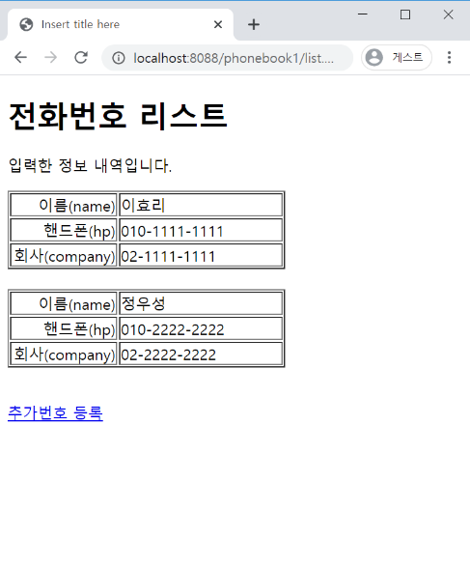
리스트
Rqeust(요청)
웹서버
DB서버
http://localhost:8088/phonebook2/pbc?action=list
Request header
(파라미터) action=list
Request body
Tomcat
phonebook1
Oracle
rquest
*파라미터
action=list
*어트리뷰트
"pList" personList
PhoneController (Servlet)객체
phoneDao 객체
getParameter("action")
getPersonList()
response
list일때
personList
List<PersonVo> personList
0x333
jdbc *2
Response(응답)
*포워드
Response header
Response body (html)
list.jsp
html+데이터
jsp가 DB연결하지 않는다
jsp: html 작성하기 편함
a.jsp → a_jsp.java(servlet) → a.class
servlet: java 문법 작성하기 편함
a.java(servlet) → a.calss
0x333
List<PersonVo>
List
PersonVo
PersonVo
PersonVo
리스트
등록

