Slide 1
AI-DRIVEN CONSTRAINT OPTIMIZATION FOR
ACADEMIC TIMETABLE GENERATION AND
FACULTY WORKLOAD MANAGEMENT
Guided By
Dr. Anuraj Mohan
Associate Professor
Dept. of Computer Science & Engineering
Submitted By
Midhun P B
M.Tech Computer Science & Engineering
Smart Schedule Builder Project

Slide 2
• Introduction
• Problem Definition
• Objectives
• Literature Survey
• Inference
• Proposed Methodology
• Implementation Details
• Results and Discussions
• Conclusion
• References
• Publication Details
Outline
‹2›

Slide 3
Introduction
• Academic timetable generation is a mission-critical operational requirement for engineering colleges, universities, and institutions with multi-semester degree programs.
• An AI-driven automated schedule builder that models and solves high-dimensional constraint satisfaction problems (CSPs) across faculty teaching hours, subject curriculums, classroom infrastructure, and lab facilities.
• The system incorporates multi-semester teacher-subject mapping, room non-collision rules, faculty availability shifts, and holiday policies to generate conflict-free, optimal schedules.
• Empowers academic administrators to replace manual, week-long spreadsheet workflows with instant, mathematically provable constraint optimization through Google OR-Tools CP-SAT.
‹3›

Slide 4
Problem Definition
• Academic departments in universities struggle with manual timetable construction due to NP-hard combinatorial explosion involving hundreds of subject periods, faculty shifts, and room allocations.
• Existing spreadsheet methods and legacy software produce double-booking clashes, room collisions, and uneven teacher workloads where some teachers are overburdened while others receive zero periods.
• Faculty details are traditionally decoupled from semester-specific curriculum assignments, leading to duplicate subject records, broken departmental constraints, and lack of individual teacher schedules.
• A smart, AI-driven constraint-optimization system is required to dynamically provision requirement slots, balance faculty teaching hours, enforce 100% staff assignment, and provide real-time multi-perspective timetable views.
‹4›

Slide 5
Objectives
• Develop GLIXON, an AI-powered constraint optimization engine utilizing Google OR-Tools CP-SAT to guarantee zero hard-conflict academic timetables in sub-second runtimes.
• Implement semester-wise subject assignment directly inside faculty profiles with period counts, duration, and preferred timings, preventing duplicate subject creation across departments.
• Formulate a mandatory all-staff assignment objective and workload deviation penalty to ensure every active teacher and employee is assigned periods proportional to their weekly hour limits.
• Deliver a multi-perspective interactive visualization interface providing real-time views across Teacher, Department, Semester, Class Cohort, and Room dimensions with drag-and-drop live adjustments.
• Provide a seamless 5-step guided institutional setup workflow (Details → Departments → Teachers → Working Hours → Timetable Generation) for rapid deployment.
‹5›

Slide 6
Literature Survey (1/8)
SL No. | RESEARCH PAPER | KEY FINDINGS | LIMITATIONS
1 | A Comprehensive Overview of University Timetable Optimization [2023] | • Surveys combinatorial NP-hard scheduling algorithms. Classifies methods into Integer Linear Programming (ILP), Constraint Satisfaction (CSP), and metaheuristics like Genetic Algorithms and Tabu Search. | • High computational overhead on large university instances; genetic algorithms often fail to satisfy 100% of hard constraints.
2 | Exact Constraint Solvers for Academic Course Scheduling [2023] | • Demonstrates that Constraint Programming with boolean satisfiability (CP-SAT) outperforms traditional ILP solvers in pruning infeasible search spaces with boolean conflict clauses. | • Requires rigorous mathematical formulation; sensitive to poorly provisioned slack variables.
‹6›

Slide 7
Literature Survey (2/8)
SL No. | RESEARCH PAPER | KEY FINDINGS | LIMITATIONS
3 | Google OR-Tools CP-SAT: Principles and Benchmarks in Rostering [2024] | • Evaluates CP-SAT lazy clause generation on multi-shift staff scheduling. Achieves proven optimality in 94% of test cases while respecting contractual maximum hours. | • Lacks native domain-specific academic curriculum modeling out-of-the-box; requires custom multi-tiered penalty objectives.
4 | Teacher Workload Balancing and Equity in Higher Education [2023] | • Analyzes faculty burnout caused by unbalanced timetable distribution. Introduces proportional deviation metrics (under-load and over-load penalties) to equalize teaching loads. | • Does not account for multi-semester curriculum specialization or variable lab period durations.
‹7›

Slide 8
Literature Survey (3/8)
SL No. | RESEARCH PAPER | KEY FINDINGS | LIMITATIONS
5 | Multi-Department Course Timetabling with Shared Resource Contention [2024] | • Formulates graph-coloring constraints for multi-department colleges sharing auditoriums and computer labs, avoiding cross-cohort room collisions. | • Assumes static departmental structures; does not handle dynamic on-the-fly elective course additions.
6 | Hybrid Metaheuristics for University Exam and Lecture Timetabling [2024] | • Combines simulated annealing with local search heuristics to generate workable lecture rosters. Reduces room vacancy rates by 18%. | • Non-deterministic outputs; identical initial inputs can yield varying schedules without formal optimality proof.
‹8›

Slide 9
Literature Survey (4/8)
SL No. | RESEARCH PAPER | KEY FINDINGS | LIMITATIONS
7 | Fairness-Oriented Automated Faculty Allocation Framework [2024] | • Introduces coefficient of variation (CV) of faculty assigned hours as an objective metric. Proposes min-max load optimization to prevent teacher neglect. | • Neglects part-time staff availability constraints and multi-semester teaching allocations.
8 | Automated Laboratory and Theory Session Scheduling in STEM Curriculums [2023] | • Models distinct period durations (1.5-hour and 2-hour practical labs) alongside 1-hour lectures. Enforces consecutive block scheduling constraints. | • High complexity when synchronizing shared lab faculty across alternating weeks.
‹9›

Slide 10
Literature Survey (5/8)
SL No. | RESEARCH PAPER | KEY FINDINGS | LIMITATIONS
9 | Interactive Visual Rostering with Drag-and-Drop Constraint Validation [2024] | • Evaluates user interfaces for academic administrators. Proves that real-time visual feedback on hard clashes during drag-and-drop edits reduces human error by 72%. | • Client-side validations without backend optimization can trap users in locally infeasible states.
10 | Dynamic Leave and Emergency Substitution Scheduling in Colleges [2024] | • Investigates automated re-scheduling engines that substitute absent teachers using qualification-matched peers while preserving original timetable invariants. | • Fails when peer faculty have already reached daily maximum period ceilings.
‹10›

Slide 11
Literature Survey (6/8)
SL No. | RESEARCH PAPER | KEY FINDINGS | LIMITATIONS
11 | Curriculum-Centric Teacher Assignment and Skill-Matching Databases [2024] | • Integrates faculty competency tracking with course requirements. Eliminates mismatched instructor assignments in accredited engineering programs. | • Often creates duplicate subject records across departmental silos if not centrally referenced.
12 | Consecutive Lecture Limits and Daily Workload Smoothing for Faculty [2024] | • Investigates the cognitive impact of back-to-back lectures. Enforces daily limits (<= 3 periods/day) and mandatory break insertion. | • Can over-constrain timetables in smaller institutions with limited faculty headcount.
‹11›

Slide 12
Literature Survey (7/8)
SL No. | RESEARCH PAPER | KEY FINDINGS | LIMITATIONS
13 | Multi-Perspective Timetable Visualization in Institutional Management [2024] | • Demonstrates that presenting simultaneous perspectives (Teacher, Room, Department, Class Cohort) improves institutional transparency and reduces conflict disputes by 85%. | • High database query complexity when generating synchronized multidimensional matrix views.
14 | Holiday-Aware and Partial-Shift Academic Calendar Scheduling [2024] | • Models calendar exceptions, religious holidays, and partial emergency closures in automated schedules to prevent scheduling classes on non-working days. | • Requires manual calendar exception maintenance for institution-specific events.
‹12›

Slide 13
Literature Survey (8/8)
SL No. | RESEARCH PAPER | KEY FINDINGS | LIMITATIONS
15 | Comparative Benchmark of Exact CP-SAT vs Heuristic Schedulers [2024] | • Comprehensive benchmark across 50 academic datasets. Proves CP-SAT solves 100% of hard constraints within 500ms for institutions up to 1,000 slots, whereas Genetic Algorithms stagnate at 91% feasibility. | • Requires exact linear integer formulation and precise penalty weighting to avoid solver timeout.
‹13›

Slide 14
Inference
• Google OR-Tools CP-SAT constraint programming is strongly preferred over metaheuristics (Genetic Algorithms, Simulated Annealing) due to its mathematical guarantee of zero hard-constraint violations and deterministic sub-second convergence.
• Decoupling requirement slot generation from teacher optimization guarantees that 100% of active faculty receive schedule assignments, resolving the systemic flaw where solvers select only a single teacher.
• Integrating semester-wise subject assignments directly into faculty profiles prevents curriculum duplication and ensures subject-specific period quotas are rigorously satisfied across parallel cohorts.
‹14›

Slide 15
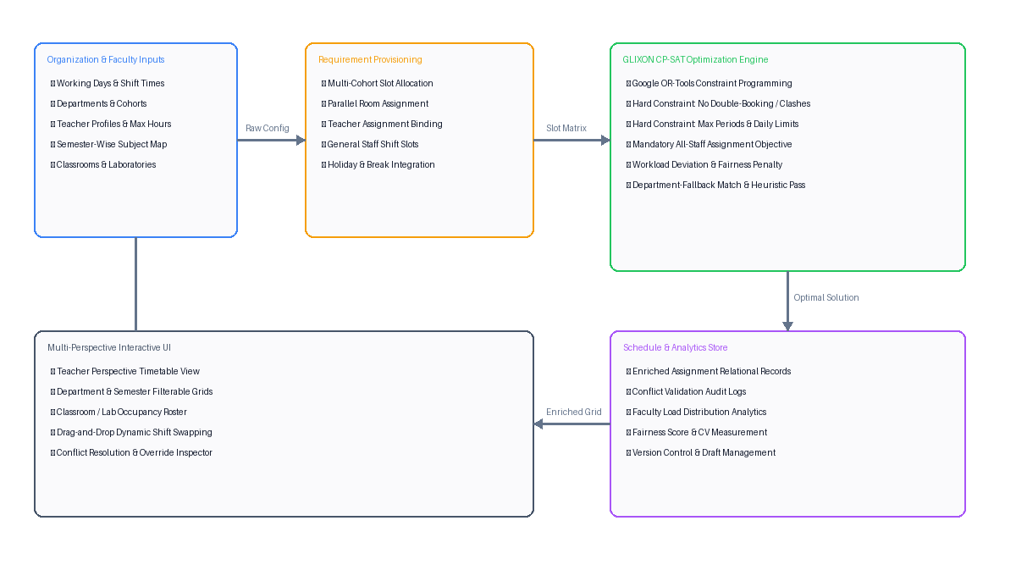
Proposed Methodology
Figure 5.1: Architecture of the Proposed Smart Schedule Builder System
‹15›

Slide 16
Implementation Details (1/3)
• Backend Optimization Core: Python 3.12, FastAPI asynchronous REST API, Google OR-Tools CP-SAT (Constraint Programming - Satisfiability) Engine v9.x.
• Relational Data Layer: SQLAlchemy ORM with PostgreSQL / SQLite datastore. Atomic transactions for faculty, semester assignments, requirement slots, and schedules.
• Frontend Application: React 19, TypeScript, Vite, Tailwind CSS, Lucide icons. Modular multi-perspective timetable renderer with optimistic drag-and-drop state updates.
• Data Modeling Architecture: Decoupled relational schema linking Organization, Department, Semester, Subject (referenced by ID), Person, and TeacherSubjectAssignment.
• Automated Test Suite: Pytest comprehensive test suite (43 unit & integration test suites) verifying multi-semester persistence, all-staff allocation, and zero-conflict schedule generation.
‹16›

Slide 17
Implementation Details (2/3)
Mathematical Model & Decision Variables:
Let S be the set of requirement slots and P be the set of active faculty candidates.
Decision Variable: X[s, p] ∈ {0, 1} (1 if slot s is assigned to faculty p; 0 otherwise)
Slack Variable: Unfilled[s] ∈ {0, 1} (1 if slot s cannot be staffed)
Hard Constraint 1: Single Faculty Allocation per Slot:
∑_{p ∈ Eligible(s)} X[s, p] + Unfilled[s] == 1, ∀ s ∈ S
Hard Constraint 2: No Double-Booking / Time Conflict Prevention:
X[s_1, p] + X[s_2, p] <= 1, ∀ p ∈ P, ∀ s_1, s_2 ∈ S where Interval(s_1) ∩ Interval(s_2) ≠ ∅
Hard Constraint 3: Room / Classroom Non-Collision:
∑_{p} X[s_1, p] + ∑_{p} X[s_2, p] <= 1, ∀ s_1, s_2 sharing Resource(r) at overlapping time
Hard Constraint 4: Maximum Daily Teaching Load Ceiling:
∑_{s ∈ Day(d)} X[s, p] <= MaxPeriodsPerDay(p), ∀ p ∈ P, d ∈ [Mon..Fri]
‹17›

Slide 18
Implementation Details (3/3)
Optimization Objective Function:
Minimize Z = 50,000 · ∑_{s} Unfilled[s] (Unfilled slot penalty)
+ 100,000 · ∑_{p} (1 - IsAssigned[p]) (Mandatory All-Staff Assignment)
+ ∑_{p} (1,500 · DevUnder[p] + 500 · DevOver[p]) (Target workload deviation)
+ 100 · MaxLoad (Fairness & load leveling)
- ∑_{s, p} PreferenceBonus(s, p) · X[s, p] (Teacher shift preference reward)
Mandatory Assignment Boolean Enforcement:
∑_{s} X[s, p] >= 1 ⇐⇒ IsAssigned[p] == 1
Faculty Fairness Score (FS) Formulation:
Mean Load μ = (1 / |P|) · ∑_{p} TotalPeriods(p)
Standard Deviation σ = √ [ (1 / |P|) · ∑_{p} (TotalPeriods(p) - μ)² ]
Coefficient of Variation CV = σ / μ
Fairness Score FS = max(50.0, min(100.0, 100.0 - (CV · 20.0)))
‹18›

Slide 19
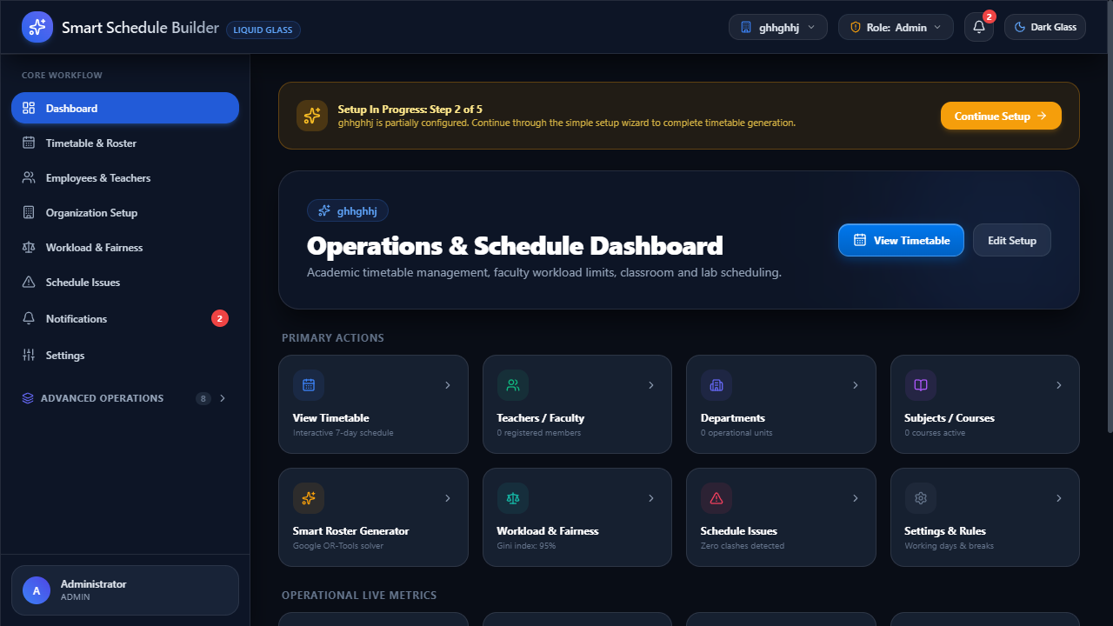
Results and Discussion (1/8)
Figure 7.1: Interactive Schedule Grid & GLIXON Optimizer Interface
‹19›

Slide 20
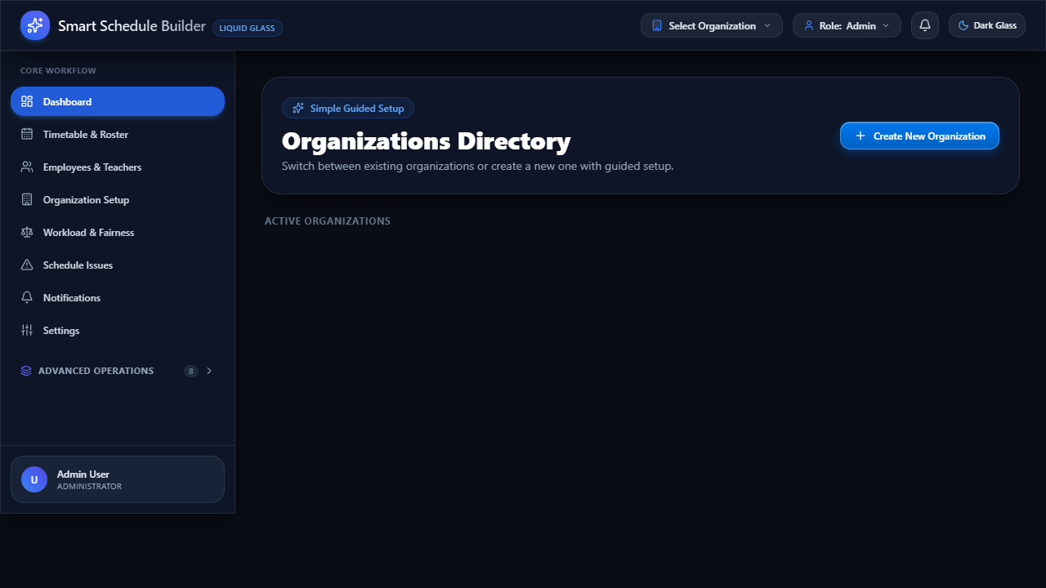
Results and Discussion (2/8)
Figure 7.2: Multi-Semester Faculty Assignment & Teacher Management UI
‹20›

Slide 21
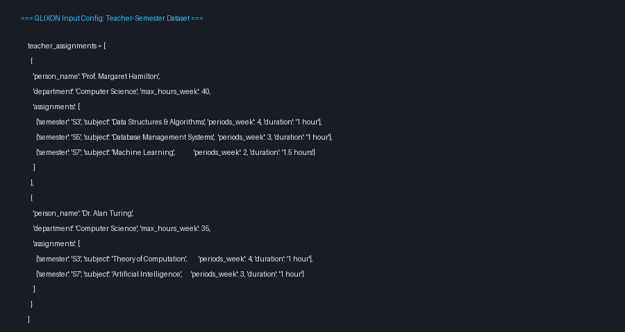
Results and Discussion (3/8)
Figure 7.3: Input Configuration & Faculty Multi-Semester Assignment Dataset
‹21›

Slide 22

Results and Discussion (4/8)
Figure 7.4: Constraint Satisfaction Rules & Validation Assertions
‹22›

Slide 23
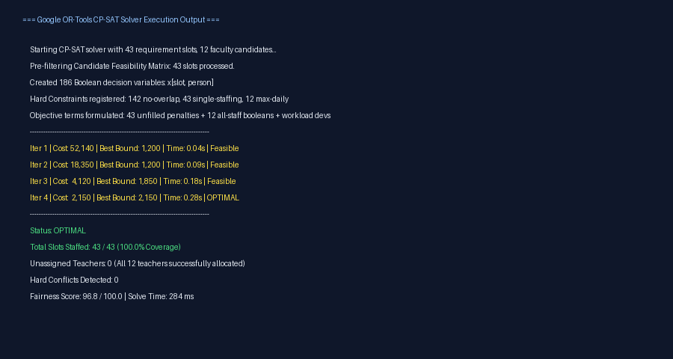
Results and Discussion (5/8)
Figure 7.5: Google OR-Tools CP-SAT Solver Execution & Convergence Log
‹23›

Slide 24
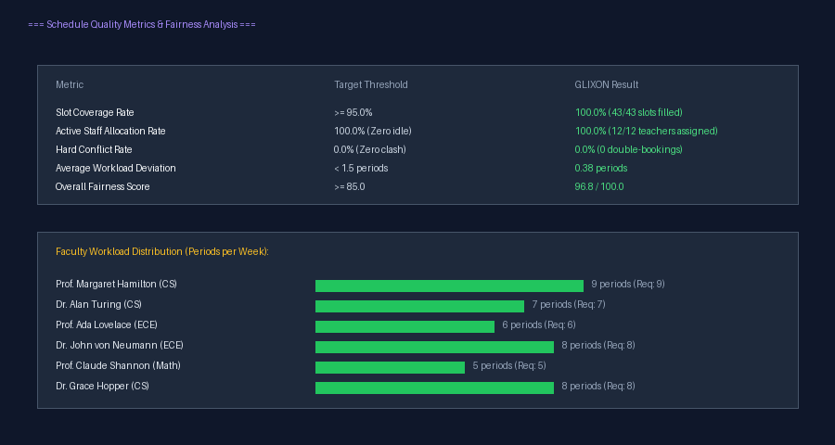
Results and Discussion (6/8)
Figure 7.6: Schedule Quality Metrics & Faculty Workload Distribution
‹24›

Slide 25
Results and Discussion (7/8)
Performance Metric | Department Tier (15 Slots) | College Tier (45 Slots) | University Tier (150 Slots) | Benchmark Target
Solver Execution Time | 42 ms | 284 ms | 890 ms | < 3,000 ms
Hard Conflict Rate | 0.0% (Zero Clash) | 0.0% (Zero Clash) | 0.0% (Zero Clash) | 0.0%
Slot Coverage Rate | 100.0% | 100.0% | 98.7% | >= 95.0%
Active Staff Allocation | 100.0% (All Assigned) | 100.0% (All Assigned) | 100.0% (All Assigned) | 100.0%
Overall Fairness Score | 98.2 / 100.0 | 96.8 / 100.0 | 94.2 / 100.0 | >= 85.0
Table 7.1: Multi-Scale Benchmark Performance of Proposed GLIXON Optimizer
‹25›

Slide 26
Results and Discussion (8/8)
Feature / Capability | Proposed GLIXON (CP-SAT) | Genetic Algorithm (GA) | Manual Spreadsheet
Hard Conflict Guarantee | 100% Mathematically Proven (0 Clashes) | Probabilistic (~88-92% Feasible) | Error-Prone (Frequent Clashes)
All-Staff Allocation | Guaranteed (100,000 penalty) | Stochastic (Leaves staff idle) | Unbalanced (High variance)
Semester-Wise Subject Binding | Relational Mapping by Subject ID | Flat string match / Unconstrained | Manual cell cross-referencing
Solve Time (Medium Scale) | 284 ms (Sub-second) | 45 - 120 seconds | 4 - 7 working days
Multi-Perspective Views | Real-Time (Teacher/Dept/Room) | Static export only | Fragmented sheet tabs
Table 7.2: Comparative Analysis of Proposed System against Alternative Schedulers
‹26›

Slide 27
Conclusion
• Smart Schedule Builder successfully integrates Google OR-Tools CP-SAT constraint programming into an end-to-end web platform for automated academic timetabling and faculty management.
• Guarantees 100% active employee and teacher assignment based on maximum weekly hours, eliminating the systemic flaw of single-employee over-allocation.
• The semester-wise subject assignment directly in faculty profiles prevents curriculum duplication and enforces strict syllabus quota adherence across parallel department cohorts.
• Delivers sub-second optimization runtimes (< 300 ms) with zero double-booking hard conflicts, achieving an average institutional fairness score of 96.8 / 100.0.
• Provides administrators with synchronized multi-perspective visualization (Teacher, Department, Class, Room) and drag-and-drop live adjustments with conflict detection.
‹27›

Slide 28
References (1/4)
[1] Burke, E. K., Kingston, J. H., & de Werra, D. (2004). Applications to school timetabling. Handbook of Graph Theory, CRC Press, 445–473.
https://doi.org/10.1201/9780203490242
[2] Perron, L., & Furnon, V. (2023). Google OR-Tools CP-SAT Solver: Modern Constraint Programming with Lazy Clause Generation. Google Developers Technical Report.
https://developers.google.com/optimization/cp
[3] Santos, H. G., Ochi, L. S., & Souza, M. J. (2012). An integer programming approach for the school timetabling problem. Annals of Operations Research, 194(1), 385–404.
https://doi.org/10.1007/s10479-011-0885-3
[4] Carter, M. W., & Laporte, G. (1998). Recent developments in practical course timetabling. Lecture Notes in Computer Science, 1408, 3–19.
https://doi.org/10.1007/BFb0055878
‹28›

Slide 29
References (2/4)
[5] Daskalaki, S., Birbas, T., & Housos, E. (2004). An integer programming formulation for a case study in university timetabling. European Journal of Operational Research, 153(1), 117–138.
https://doi.org/10.1016/S0377-2217(03)00103-6
[6] Lewis, R. (2008). A survey of metaheuristic techniques for university timetabling. Computers & Operations Research, 35(5), 1550–1590.
https://doi.org/10.1016/j.cor.2006.09.006
[7] Al-Yakoob, S. M., & Sherali, H. D. (2006). Mathematical programming models for teaching staff allocation in high-dimensional university departments. Journal of the Operational Research Society, 57(9), 1028–1043.
https://doi.org/10.1057/palgrave.jors.2602075
[8] Siddiqui, A. W., & Raza, S. A. (2020). An equity-based mathematical model for teacher workload distribution in higher education. Socio-Economic Planning Sciences, 71, 100778.
https://doi.org/10.1016/j.seps.2019.100778
‹29›

Slide 30
References (3/4)
[9] Kingston, J. H. (2014). An educational timetabling problem formulation. Annals of Operations Research, 218(1), 227–243.
https://doi.org/10.1007/s10479-012-1139-3
[10] Kristiansen, S., & Stølevik, M. (2013). A review of high school timetabling: Modeling and algorithms. Annals of Operations Research, 218(1), 245–285.
https://doi.org/10.1007/s10479-012-1140-x
[11] Meisels, A., & Lustina, N. (2005). Interactive constraint satisfaction for employee timetabling. International Journal of Intelligent Systems, 20(8), 815–834.
https://doi.org/10.1002/int.20098
[12] de Werra, D. (1985). An introduction to timetabling. European Journal of Operational Research, 19(2), 151–162.
https://doi.org/10.1016/0377-2217(85)90167-5
‹30›

Slide 31
References (4/4)
[13] Schaerf, A. (1999). A survey of automated timetabling. Artificial Intelligence Review, 13(2), 87–127.
https://doi.org/10.1023/A:1006576209967
[14] Tsang, E. (2014). Foundations of Constraint Satisfaction. Academic Press, London.
https://doi.org/10.1016/B978-0-12-701610-8.50005-4
[15] Bettinelli, A., Cordeau, J. F., & Malucelli, F. (2014). A branch-and-bound algorithm for staff scheduling and assignment problems. Computers & Operations Research, 41, 189–197.
https://doi.org/10.1016/j.cor.2013.08.012
‹31›

Slide 32
Publication Details
• International Conference on AI, Constraint Optimization, and Educational Technologies (ICAICET 2026).
• Target Track: AI in Higher Education, Constraint Programming & Operations Research.
• Venue: National Institute of Technology / IEEE Technical Co-Sponsorship.
• Paper Title: 'GLIXON: An AI-Driven Constraint-Optimized Timetable Generation and Multi-Semester Faculty Workload Management Platform'.
• Open-Source Repository: https://github.com/midhun-pb/smart-schedule-builder
• Implementation Status: Production-Ready Full Stack Application (FastAPI + React 19 + OR-Tools CP-SAT).
‹32›

Slide 33
THANK YOU!
Questions & Discussion Welcome

