Slide 1
OPERATING SYSTEMS · BCSE303L · PROJECT REVIEW
T1
Predictive Deadlock Prevention Using Contention Analysis and Score Forecasting
T6
T2
circular wait
T5
T3
Real operating-system threads · Wait-For Graph detection · early-warning score · lock ordering · victim recovery
T4
Midhun Gereketi · P. Satya Mani Shraavanth · M. Lakshman Sai
Live: predictive-deadlock-lab.vercel.app
Predictive Deadlock Prevention · Operating Systems (BCSE303L)
1
Notes:
Introduce the project and the team.

Slide 2
01 · ABSTRACT
Abstract
Deadlocks freeze concurrent programs when threads wait for each other in a circle. This project builds controlled deadlocks with real operating-system threads and studies how to detect, warn about, prevent and recover from them.
A two-thread experiment (T1: A→B, T2: B→A) forms a cycle that a Wait-For Graph confirms, while a transparent 0–100 risk score raises an early warning before the cycle closes. Protected mode learns one global lock order and always completes. A configurable ring of 2–32 threads forms a cycle through every thread; a supervisor detects it and recovers by aborting one victim thread.
A web dashboard replays every run and explains, compares and exports the results. The warning is a documented heuristic evaluated in a controlled experiment, not a predictor for arbitrary programs.
20/20
two-thread vulnerable runs deadlocked (saved + new sets)
121.6 ms
mean warning before the deadlock (new set)
50/50
protected ring runs (2–32 threads) completed
Predictive Deadlock Prevention · Operating Systems (BCSE303L)
2
Notes:
Summarise the whole project in one minute.

Slide 3
02 · INTRODUCTION
Introduction: why deadlocks still matter
Multithreading is everywhere: OS kernels, databases, servers and mobile apps.
Studies of real systems keep finding deadlocks: Linux kernel (54 found by DLOS), Go and Rust projects, distributed databases.
Detection after the fact freezes the program; prevention by lock ordering needs discipline; prediction in general is intractable (Tunç et al., 2023).
This project makes the whole lifecycle visible and measurable: form, warn, detect, prevent, recover.
1
Mutual exclusion
2
Hold and wait
A lock has one owner at a time
Threads keep locks while waiting
3
No preemption
4
Circular wait
Held locks cannot be taken away
Each thread waits for the next
All four Coffman conditions must hold at once for a deadlock.
Predictive Deadlock Prevention · Operating Systems (BCSE303L)
3
Notes:
Explain deadlock and the four Coffman conditions; motivate with real-world studies.

Slide 4
03 · LITERATURE REVIEW
Literature review (1/6) · 2020
# | Authors (year) | Title · venue | Method / contribution | Drawback (our assessment)
1 | Qin et al. (2020) | Understanding memory and thread safety practices and issues in real-world Rust programs · PLDI 2020 | Studied 850 unsafe usages and 170 bugs (incl. blocking bugs) in Rust projects; built two static bug detectors. | Empirical study of a fixed set of projects; detectors cover only specific bug patterns.
2 | Cai, Meng & Palsberg (2020) | Low-overhead deadlock prediction · ICSE 2020 | AirLock keeps a small lock reachability graph, searches it for cycles; ~3.5% average overhead. | Predicts only from observed execution traces; deadlocks on unexecuted paths are missed.
3 | Mukherjee et al. (2020) | Learning-based controlled concurrency testing · OOPSLA 2020 | QL uses Q-learning to steer a controlled scheduler through thread interleavings. | Needs a controlled-testing harness; testing can find bugs but cannot prove their absence.
4 | Yuan & Yang (2020) | Effective concurrency testing for distributed systems · ASPLOS 2020 | Morpheus: partial-order sampling plus conflict analysis; found 11 new errors (incl. deadlocks) in Erlang systems. | Targets Erlang only; guarantees are probabilistic.
5 | Wei et al. (2020) | MPI-RCDD: A framework for MPI runtime communication deadlock detection · JCST 35(2) | Message logging and distributed dependency tracking; AND⊕OR-model algorithm (AODA) avoids false positives. | Specific to MPI programs; logging and dependency messages add runtime overhead.
Predictive Deadlock Prevention · Operating Systems (BCSE303L)
4
Notes:
Papers are verified against publisher, conference, arXiv or DBLP records. The drawback column is our assessment of each paper's scope and limits.

Slide 5
03 · LITERATURE REVIEW
Literature review (2/6) · 2021–2022
# | Authors (year) | Title · venue | Method / contribution | Drawback (our assessment)
6 | Liu et al. (2021) | Automatically detecting and fixing concurrency bugs in Go software systems · ASPLOS 2021 | GCatch finds channel blocking bugs with a constraint solver; GFix patches them (124 of 149 fixed). | Go channels only; automatic fixes cover limited bug patterns.
7 | Yuan et al. (2021) | GoBench: A benchmark suite of real-world Go concurrency bugs · CGO 2021 | Benchmark of 82 real bugs from 9 applications plus 103 bug kernels for evaluating detectors. | A benchmark, not a detector; limited to Go.
8 | Gong et al. (2021) | Snowboard: Finding kernel concurrency bugs through systematic inter-thread communication analysis · SOSP 2021 | Identifies likely inter-thread communications in the kernel and tests interleavings around them. | Testing in a virtualised kernel is costly and cannot prove a kernel deadlock-free.
9 | Dilley & Lange (2021) | Automated verification of Go programs via bounded model checking · ASE 2021 | Gomela: bounded model checking of Go concurrency, incl. statically unknown thread counts. | Bounded: bugs beyond the bounds are missed; Go only.
10 | Liu et al. (2022) | Who goes first? Detecting Go concurrency bugs via message reordering · ASPLOS 2022 | GFuzz reorders concurrent message processing; found 184 new bugs in 7 Go systems. | Dynamic fuzzing depends on available tests; channel-related bugs only.
Predictive Deadlock Prevention · Operating Systems (BCSE303L)
5
Notes:
Papers are verified against publisher, conference, arXiv or DBLP records. The drawback column is our assessment of each paper's scope and limits.

Slide 6
03 · LITERATURE REVIEW
Literature review (3/6) · 2022
# | Authors (year) | Title · venue | Method / contribution | Drawback (our assessment)
11 | Cutner, Yoshida & Vassor (2022) | Deadlock-free asynchronous message reordering in Rust with multiparty session types · PPoPP 2022 | Rumpsteak guarantees deadlock freedom by construction for async Rust using session types. | Programs must be written against session-type protocols; covers message passing, not locks.
12 | Jiang et al. (2022) | Context-sensitive and directional concurrency fuzzing for data-race detection · NDSS 2022 | Conzzer guides fuzzing with concurrent call pairs; found 95 data races in apps and kernel filesystems. | Targets data races rather than deadlocks; fuzzing coverage is never complete.
13 | Bai, Li & Hu (2022) | DLOS: Effective static detection of deadlocks in OS kernels · USENIX ATC 2022 | Summary-based lock analysis finds locking cycles in Linux; 54 real deadlocks, 31 confirmed. | Static analysis with a 17% false-positive rate; kernel-specific.
14 | Veileborg, Saioc & Møller (2022) | Detecting blocking errors in Go programs using localized abstract interpretation · ASE 2022 | Goat splits programs into fragments for abstract interpretation; 104 errors missed by GCatch. | Go only; static approximation can still report false alarms.
15 | Cai et al. (2022) | Peahen: Fast and precise static deadlock detection via context reduction · ESEC/FSE 2022 | Reduces calling contexts to make static lock-cycle detection fast and precise. | Static only: no runtime warning, prevention or recovery.
Predictive Deadlock Prevention · Operating Systems (BCSE303L)
6
Notes:
Papers are verified against publisher, conference, arXiv or DBLP records. The drawback column is our assessment of each paper's scope and limits.

Slide 7
03 · LITERATURE REVIEW
Literature review (4/6) · 2023–2024
# | Authors (year) | Title · venue | Method / contribution | Drawback (our assessment)
16 | Tunç et al. (2023) | Sound dynamic deadlock prediction in linear time · PLDI 2023 | Defines sync-preserving deadlocks; SPDOffline/SPDOnline predict them in linear time. | Covers only sync-preserving deadlocks; the online algorithm handles two-thread deadlocks.
17 | Yang et al. (2023) | LCL: A lock chain length-based distributed algorithm for deadlock detection and resolution · ICDE 2023 | Distributed deadlock detection for database transactions, extending Mitchell–Merritt. | Database transactions only; slower on mixed local/distributed deadlocks (addressed by LCL+).
18 | Saioc, Shirchenko & Chabbi (2024) | Unveiling and vanquishing goroutine leaks in enterprise microservices · CGO 2024 | GOLEAK and LEAKPROF find blocked (leaked) goroutines in Uber's monorepo; 857 leaks in a year. | Dynamic: only exercised paths; Go-specific.
19 | Qin et al. (2024) | Understanding and detecting real-world safety issues in Rust · IEEE TSE 2024 | Studied 100 concurrency bugs among others; five static detectors (lockbud). | Pattern-based static detectors; Rust only.
20 | Ye, Cai & Zhang (2024) | When threads meet interrupts: Effective static detection of interrupt-based deadlocks in Linux · USENIX Security 2024 | Archerfish builds an interrupt-aware lock graph and refines its cycles. | Limited to interrupt-based deadlocks in the Linux kernel.
Predictive Deadlock Prevention · Operating Systems (BCSE303L)
7
Notes:
Papers are verified against publisher, conference, arXiv or DBLP records. The drawback column is our assessment of each paper's scope and limits.

Slide 8
03 · LITERATURE REVIEW
Literature review (5/6) · 2024–2025
# | Authors (year) | Title · venue | Method / contribution | Drawback (our assessment)
21 | Pratissoli et al. (2024) | Hierarchical traffic management of multi-AGV systems with deadlock prevention · IEEE T-ASE 21(3) | Time-expanded-graph coordination prevents deadlocks among automated guided vehicles. | Robot-traffic domain with known roadmaps; not OS threads or locks.
22 | Zhang, Zhang & Liu (2024) | Static deadlock detection for Rust programs · arXiv preprint | Static detection of resource deadlocks in Rust (extended in 2026 to communication deadlocks). | Preprint, not peer-reviewed; static and Rust only.
23 | Lu et al. (2024) | Deadlock detection: Background, techniques, and future improvements · ZTE Communications 22(2) | Survey comparing static and dynamic detection on accuracy, complexity and scalability. | Survey only: no new technique or experiments.
24 | Jain & Purandare (2025) | Assessing large language models in comprehending and verifying concurrent programs across memory models · arXiv preprint | Tests GPT-4-class models on pthread programs: they spot races and deadlocks under sequential consistency. | Models struggle under relaxed memory models; small benchmark set.
25 | van den Heuvel, Sulzmann & Thiemann (2025) | Partial orders for precise and efficient dynamic deadlock prediction · arXiv preprint | Partial orders over a trace filter false-positive deadlock patterns. | A 2026 corrigendum states the prediction is unsound; trace-based.
Predictive Deadlock Prevention · Operating Systems (BCSE303L)
8
Notes:
Papers are verified against publisher, conference, arXiv or DBLP records. The drawback column is our assessment of each paper's scope and limits.

Slide 9
03 · LITERATURE REVIEW
Literature review (6/6) · 2025–2026
# | Authors (year) | Title · venue | Method / contribution | Drawback (our assessment)
26 | Song, Xu & Huang (2025) | GoPV: Detecting blocking concurrency bugs related to shared-memory synchronization in Go · ISSTA 2025 | Concurrency and (post-)dominator analysis; 17 bugs in 21 large Go applications. | Go shared-memory primitives only; static.
27 | Yang et al. (2025) | LCL+: A lock chain length-based distributed deadlock detection and resolution service built for OceanBase · ACM TOCS 43(4) | Faster detection of hybrid local/distributed deadlocks; deployed in OceanBase. | Designed for one distributed database's transaction model.
28 | Feng et al. (2025) | Concurrency bug detection via static analysis and large language models · Future Internet 17(12) | ConSynergy: four-stage pipeline combining static analysis with LLM reasoning. | Relies on LLM reasoning, which can hallucinate; cost of model queries.
29 | Sulzmann (2025) | Beyond per-thread lock sets: Multi-thread critical sections and dynamic deadlock prediction · arXiv preprint | Lets critical sections span threads; extends SPDOffline to find more deadlocks soundly. | Preprint; trace-based, so only observed executions are analysed.
30 | Sulzmann (2026) | Critical sections are not per-thread: A trace semantics for lock-based concurrency · arXiv preprint | Trace-based definition of critical sections that may span threads (C/Pthreads). | Preprint focused on formal semantics rather than a detection tool.
Predictive Deadlock Prevention · Operating Systems (BCSE303L)
9
Notes:
Papers are verified against publisher, conference, arXiv or DBLP records. The drawback column is our assessment of each paper's scope and limits.

Slide 10
04 · PROBLEM STATEMENT
Problem statement
How can we reproduce deadlocks with real OS threads, confirm them reliably, warn before they form, prevent them, and recover when they happen, while measuring every step honestly?
1
2
3
4
Invisible until too late
Detection ≠ warning
Fixes have trade-offs
Claims need evidence
A deadlocked program simply stops; the cycle is hidden inside lock state.
A Wait-For Graph cycle proves deadlock only after it forms; earlier signals are heuristics.
Ordering needs global discipline; recovery must pick a victim and release its locks.
Results must come from repeated, bounded runs, not one demonstration.
Predictive Deadlock Prevention · Operating Systems (BCSE303L)
10
Notes:
State the problem precisely and what is in scope.

Slide 11
05 · RESEARCH GAPS
Research gaps identified from the literature
G1
Language- or domain-specific tools
Most detectors target one language or system (Go: GCatch, GFuzz, Goat, GoPV; Rust: Qin et al.; kernels: DLOS, Archerfish; databases: LCL).
[1, 6, 10, 13, 14, 17, 20, 26]
G2
Static vs. dynamic trade-off
Static tools report false positives (DLOS 17%); dynamic and trace-based tools see only executed paths (AirLock, GOLEAK, SPD).
[13, 2, 18, 16]
G3
Detection without prevention or recovery
Most work stops at reporting a bug; few combine warning, prevention and runtime recovery in one system.
[2, 15, 16, 20]
G4
Prediction is hard in general
Sound and complete prediction is intractable; heuristic warnings are rarely transparent or measured.
[16, 25, 29]
G5
Little support for understanding
Tools output reports, not an explanation of how a deadlock forms, which matters for teaching and debugging.
[23, 24, 28]
Numbers refer to the literature table (slides 4–9).
Predictive Deadlock Prevention · Operating Systems (BCSE303L)
11
Notes:
Each gap is tied to the reviewed papers.

Slide 12
06 · EXISTING SYSTEM
Existing system
Approach | How it works | Limitation
Ignore (ostrich) | Most general-purpose OSs assume deadlocks are rare | System hangs; manual restart needed
Periodic detection | Build a Wait-For Graph and look for cycles | Acts only after the deadlock has happened
Avoidance (Banker's) | Grant a request only if the state stays safe | Needs maximum demands in advance; costly
Prevention by ordering | All threads take locks in one global order | Relies on programmer discipline
Static / dynamic tools | GCatch, DLOS, AirLock, SPD and others report likely deadlocks | Language-specific; false positives or missed paths; no live recovery
No single existing setup lets students reproduce, warn about, prevent and recover from deadlocks on real threads while measuring each step.
Predictive Deadlock Prevention · Operating Systems (BCSE303L)
12
Notes:
Classical OS approaches and current tools, and their limits.

Slide 13
07 · OBJECTIVES
Objectives
Reproduce
Detect
1
2
Create deadlocks on demand with real OS threads, from 2 to 32 threads.
Confirm deadlock exactly from a Wait-For Graph cycle.
Warn
Prevent
3
4
Raise a transparent, tunable early-warning score before the cycle forms, and measure the lead time.
Remove circular wait with a learned or global lock order.
Recover
Explain and evaluate
5
6
Break a detected cycle by aborting one victim thread so the rest finish.
Replay, analyse and compare runs; repeated, bounded trials with saved results.
Predictive Deadlock Prevention · Operating Systems (BCSE303L)
13
Notes:
Each objective maps to a module and a measurement.

Slide 14
08 · PROPOSED SYSTEM
Proposed system
1
Two-thread experiment
2
N-thread ring (2–32)
3
Dashboard
T1: A→B, T2: B→A on real threads
Wait-For Graph confirms the cycle
Risk score warns before it
Protected: probe learns A→B order
Thread Ti needs locks Ri and Ri+1
Vulnerable: one cycle through all N
Supervisor detects it in ms and aborts a victim
Protected: lower-numbered lock first
Replay of every real run
Analysis: why and when it warned
Compare: both modes, repeated trials, 2–32 scaling
Per-visitor weights; CSV export
Key rule: only a Wait-For Graph cycle confirms a deadlock. The risk score is an early-warning heuristic for this controlled experiment, not a general predictor.
Predictive Deadlock Prevention · Operating Systems (BCSE303L)
14
Notes:
Two experiments, one scoring engine, prevention and recovery, one dashboard.

Slide 15
09 · SYSTEM ARCHITECTURE
System architecture
Dashboard
FastAPI
Experiments
Event log
Analysis
Lab · Analysis · Compare
Stateless, per-request scoring
Two-thread · N-thread ring
High-resolution timestamps
Wait-For Graph · score · heatmap
trial JSON, results and replay data back to the browser
Supervisor
Bounded runs
Deployment
Polls a consistent lock snapshot every 1 ms and cancels a victim's wait.
Every lock wait and request has a timeout; nothing can hang.
Same code locally (uvicorn) and on Vercel; no server-side state.
Predictive Deadlock Prevention · Operating Systems (BCSE303L)
15
Notes:
Stateless FastAPI backend; each request runs its own bounded experiment and builds its own scorer.

Slide 16
10 · MODULES
Modules
1
Experiment engine
2
Lock manager
3
N-thread ring & recovery
Vulnerable/protected two-thread trials; adaptive lock-order policy
Ownership, bounded and cancellable waits, consistent snapshots, cycle check
2–32 threads on N locks; supervisor detection and victim abort
member2_backend · Shraavanth
member2_backend · Shraavanth
member2_backend · Shraavanth
4
Analysis & scoring
5
API
6
Dashboard
Wait-For Graph, risk score, trend, heatmap, repeated-trial comparison
FastAPI endpoints with per-request scoring weights
Replay, Analysis and Compare views, scaling test, CSV export
member3_analysis · Lakshman
member2/member3 · Shraavanth, Lakshman
frontend · Midhun
Predictive Deadlock Prevention · Operating Systems (BCSE303L)
16
Notes:
Six modules and who built them.

Slide 17
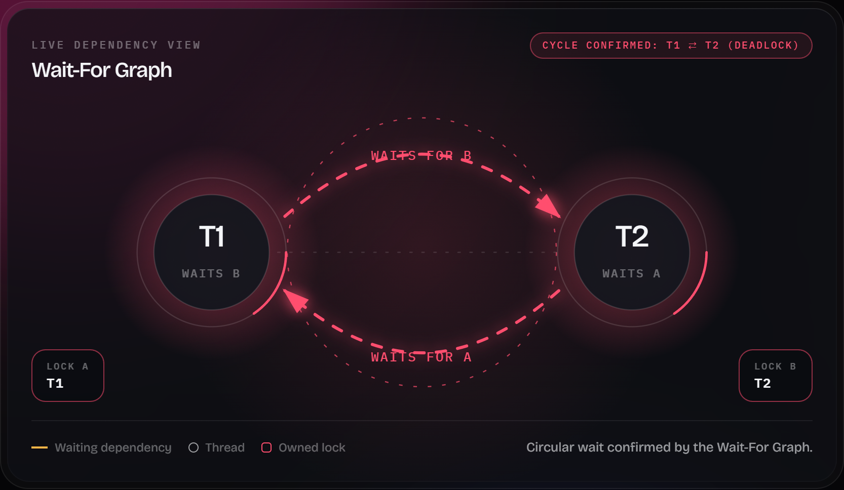
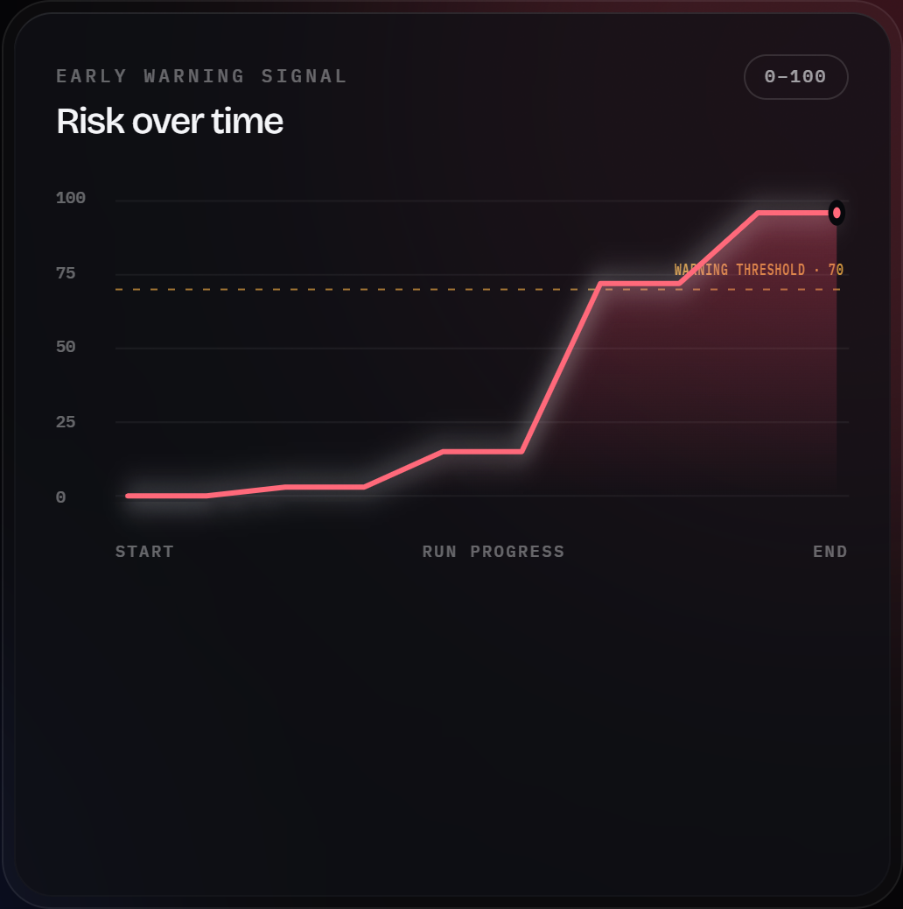
11 · RESULTS
Results · two-thread deadlock and early warning
Wait-For Graph of a live vulnerable trial: T1 waits for B (held by T2), T2 waits for A (held by T1): the cycle confirms deadlock.
Risk score of the same run crosses the warning threshold (70) before the deadlock.
Predictive Deadlock Prevention · Operating Systems (BCSE303L)
17
Notes:
Real backend trial: the score crossed 70 before the cycle formed.

Slide 18
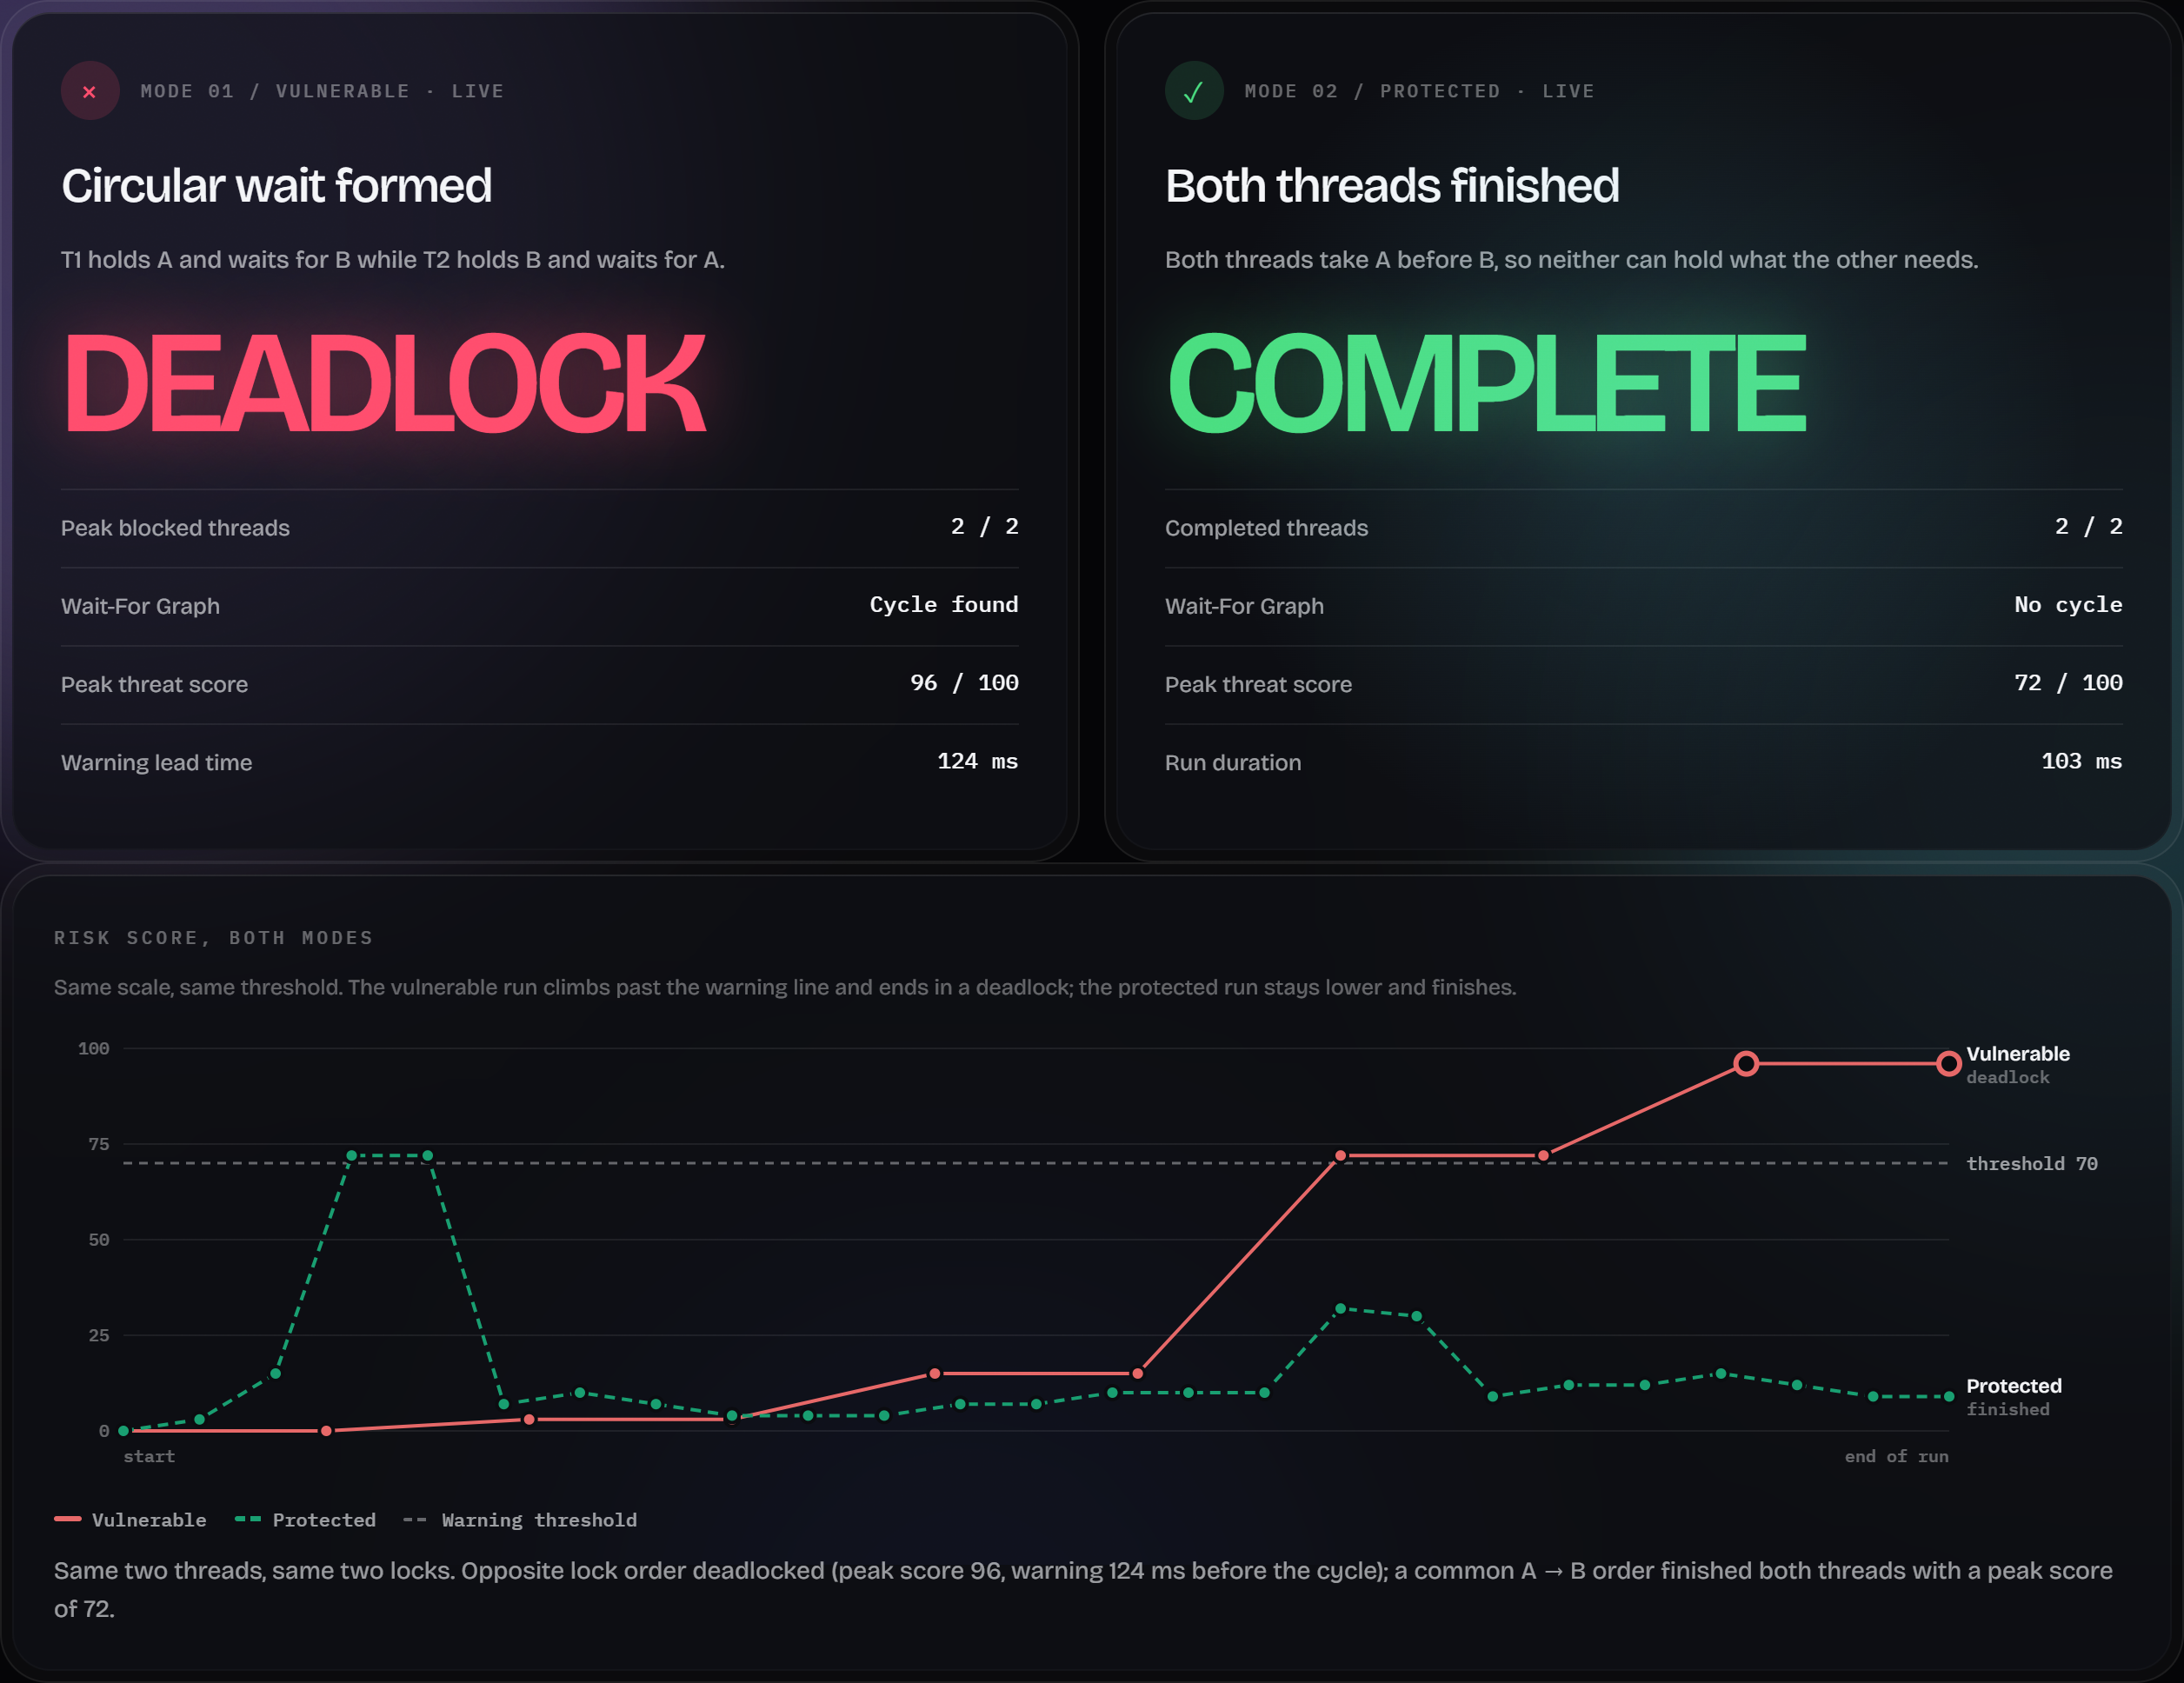
11 · RESULTS
Results · vulnerable vs. protected
Metric | Saved V | Saved P | New V | New P
Trials | 10 | 10 | 10 | 10
Deadlocked | 10 | 0 | 10 | 0
Completed | 0 | 10 | 0 | 10
Warning lead | 120.4 ms | n/a | 121.6 ms | n/a
Mean runtime | 813.6 ms | 104.6 ms | 813.4 ms | 103.9 ms
Saved set: 15 Oct 2026 · new set: 26 Oct 2026 (10 trials per mode each). V = vulnerable, P = protected.
Left: live dashboard comparison of one run per mode.
Predictive Deadlock Prevention · Operating Systems (BCSE303L)
18
Notes:
One live run of each mode, then repeated trials.

Slide 19
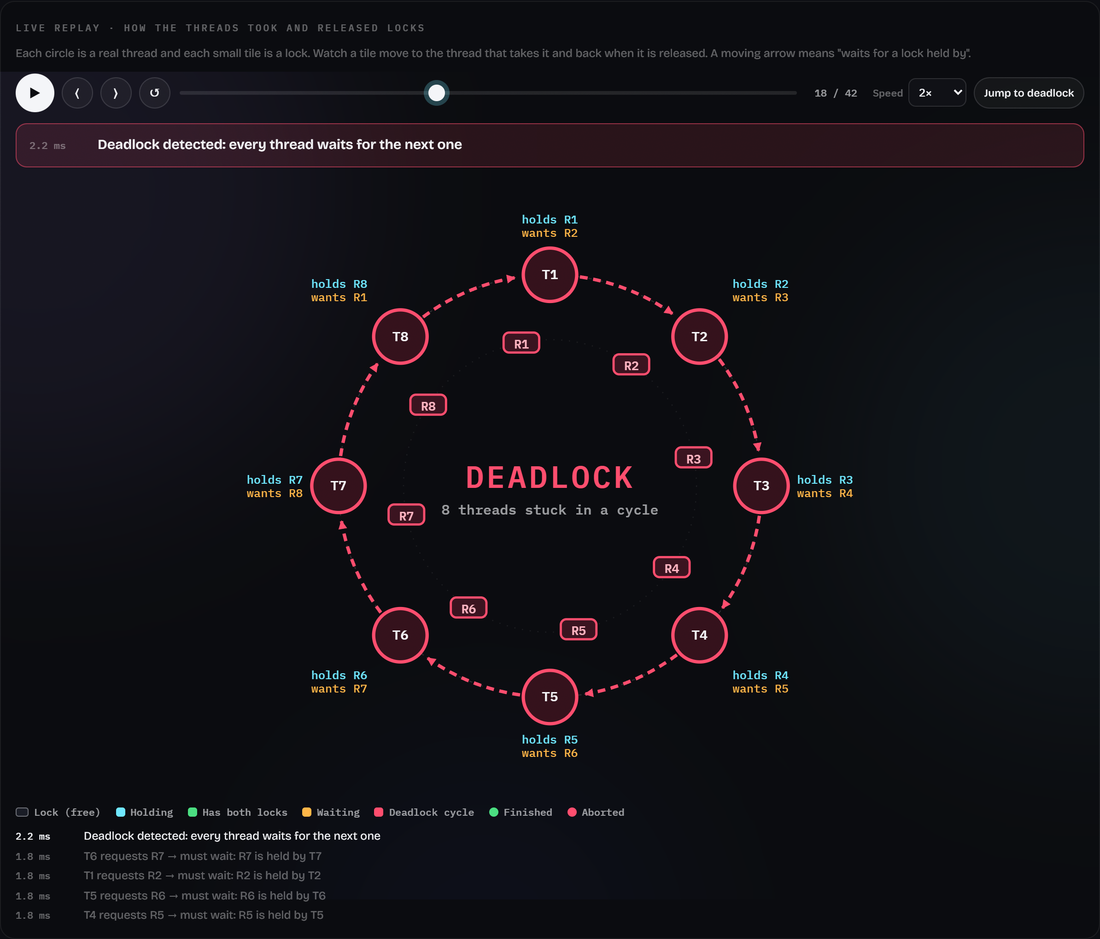
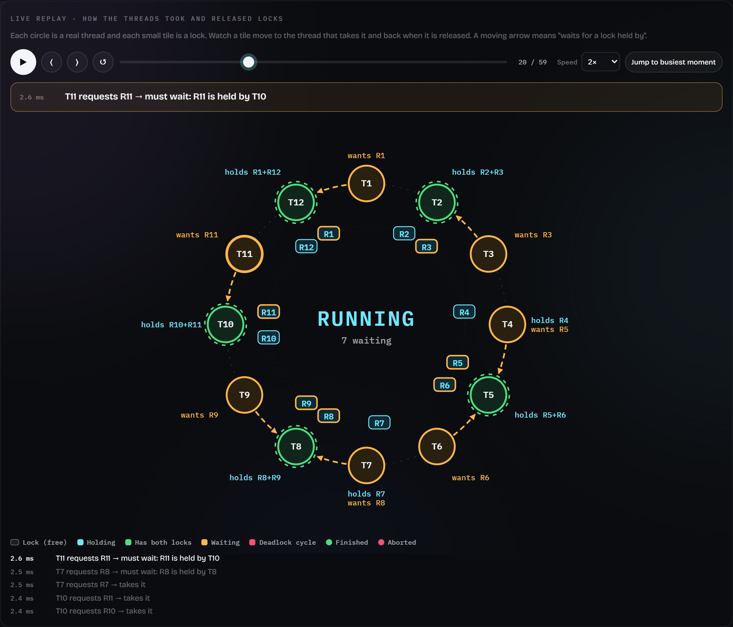
11 · RESULTS
Results · N-thread ring: deadlock and recovery vs. ordering
Vulnerable, 8 threads: one cycle through all 8, detected within milliseconds; T8 is aborted. Across the scaling set: 50/50 full cycles, 50/50 recoveries.
Protected, 12 threads: threads queue behind neighbours, no cycle; 50/50 protected runs completed.
Predictive Deadlock Prevention · Operating Systems (BCSE303L)
19
Notes:
Left: 8 threads in one cycle at detection. Right: 12 protected threads queue but never form a cycle.

Slide 20
11 · RESULTS
Results · scaling from 2 to 32 threads (new set)
Threads | Deadlocked | Detect (mean) | Vuln. time | Protected done | Prot. time
2 | 10/10 | 1.8 ms | 45 ± 3 ms | 10/10 | 62 ± 1 ms
4 | 10/10 | 2.0 ms | 107 ± 2 ms | 10/10 | 69 ± 19 ms
8 | 10/10 | 2.5 ms | 229 ± 3 ms | 10/10 | 94 ± 25 ms
16 | 10/10 | 4.2 ms | 473 ± 4 ms | 10/10 | 92 ± 17 ms
32 | 10/10 | 6.7 ms | 968 ± 4 ms | 10/10 | 96 ± 9 ms
Every vulnerable run formed a cycle through all N threads; detection ≤ 8.0 ms. Vulnerable time grows ~30 ms per thread (threads finish one by one after recovery). Mean ± SD of 10 trials per size and mode. Controlled runs, not a benchmark.
Predictive Deadlock Prevention · Operating Systems (BCSE303L)
20
Notes:
10 trials per size and mode. Vulnerable time includes detection and recovery; protected time is completion.

Slide 21
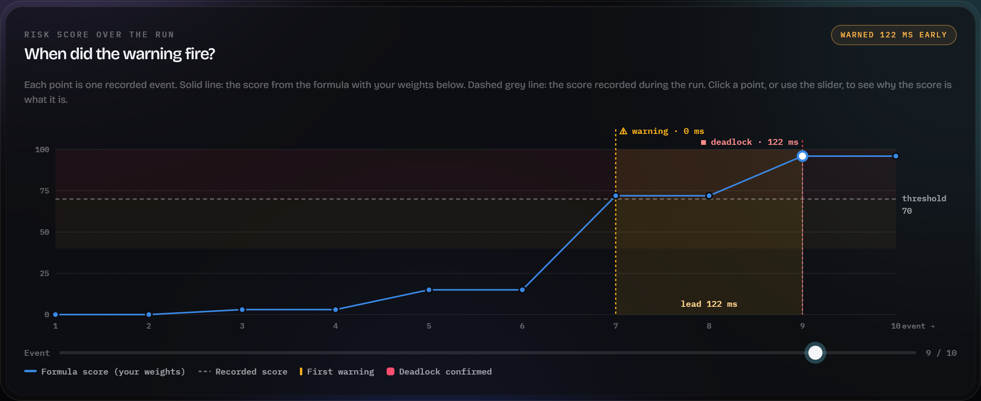
11 · RESULTS
Results · when did the warning fire?
Live vulnerable trial in the Analysis view: the score crosses the threshold (70) at event 7 and the cycle is confirmed at event 9; the shaded band is the warning lead time.
Predictive Deadlock Prevention · Operating Systems (BCSE303L)
21
Notes:
The Analysis view of a live vulnerable trial: score per event, first warning, deadlock and lead time.

Slide 22
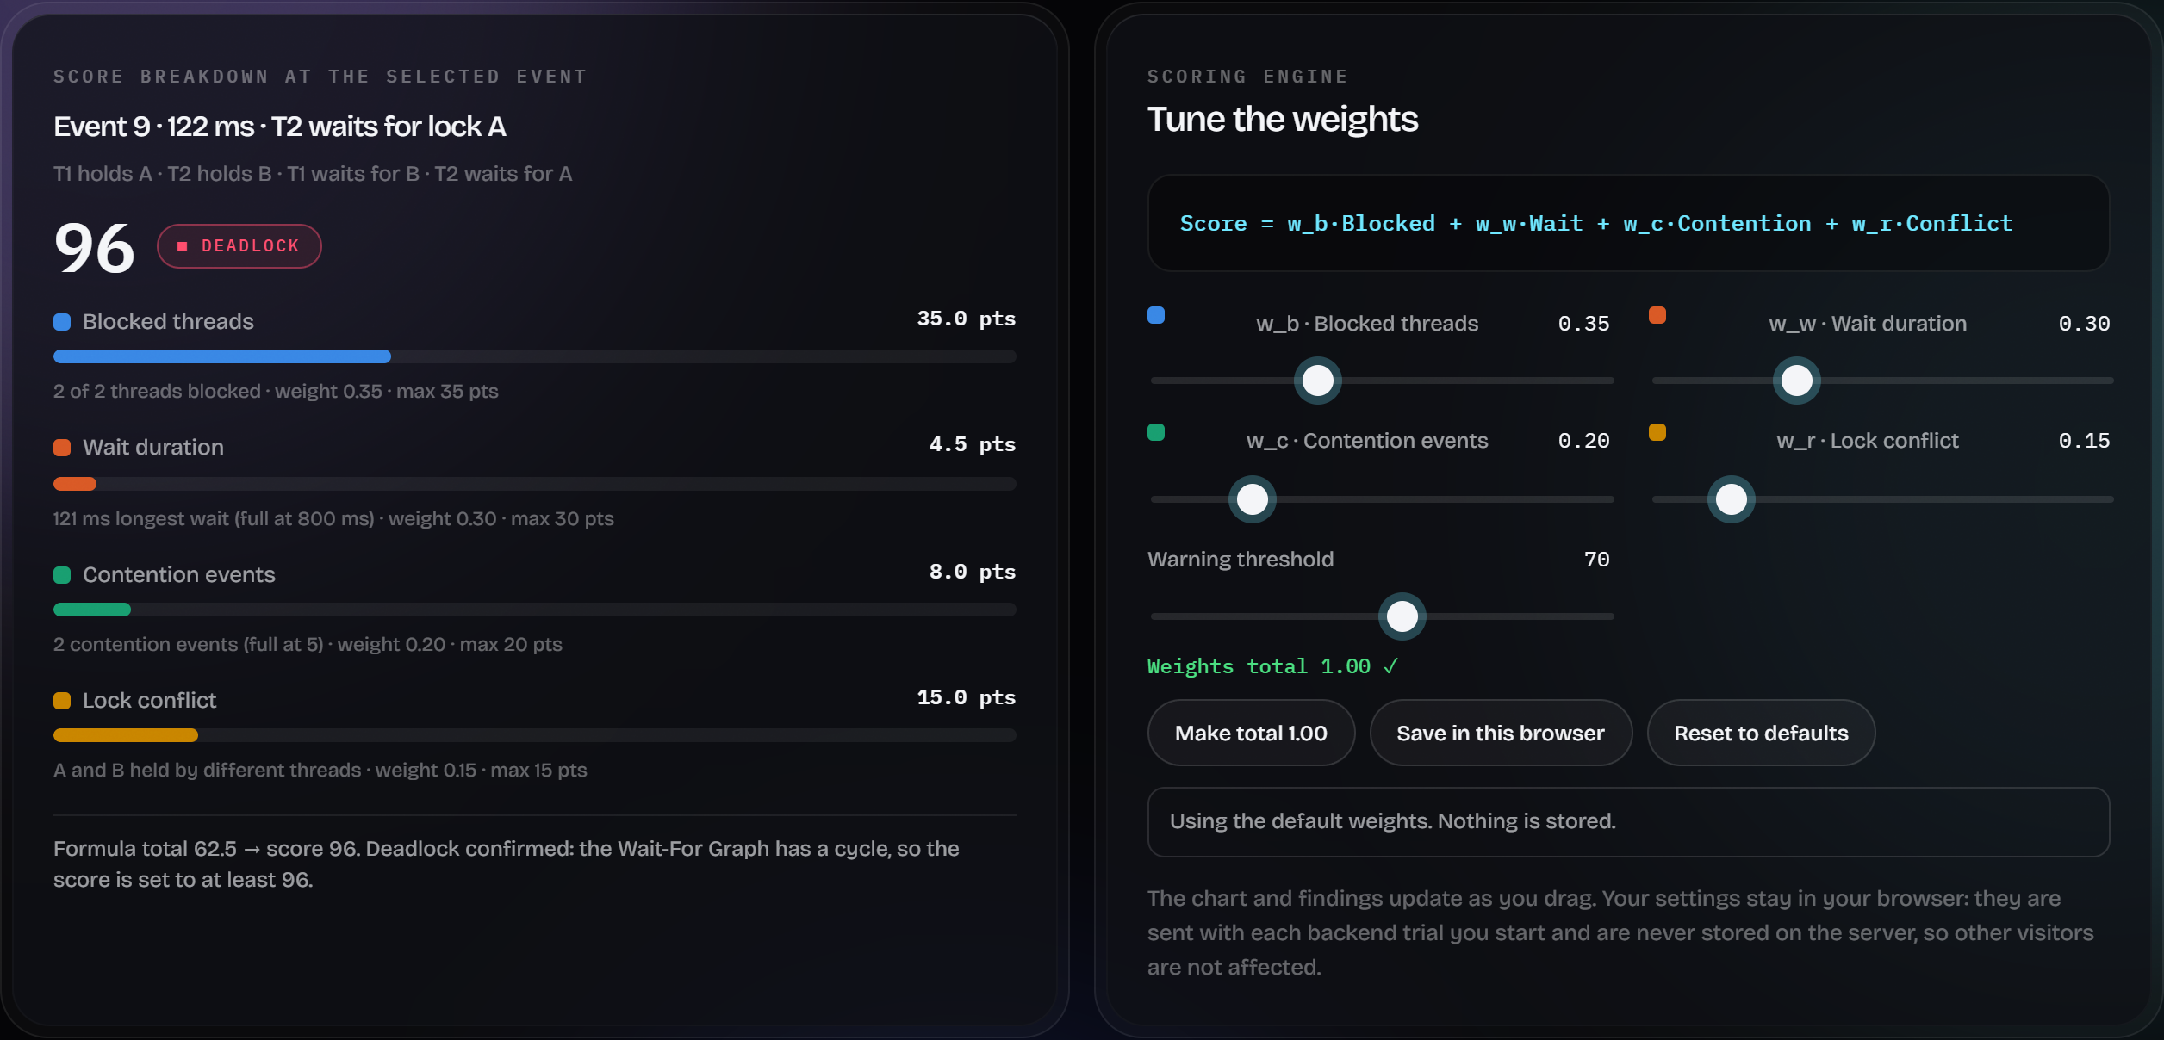
11 · RESULTS
Results · why the score is what it is
Per-factor contribution to the selected event's score (left) and the weight tuner (right). Weights are kept per browser and sent with each request; nothing is stored on the server.
Predictive Deadlock Prevention · Operating Systems (BCSE303L)
22
Notes:
Per-factor breakdown of the selected event, and the weight tuner, whose values stay in that visitor's browser.

Slide 23
CONCLUSION
Conclusion and future work
Conclusion
Future work
Real threads reproduce circular wait on demand, from 2 to 32 threads
A Wait-For Graph confirms it; the score warns before it in the staged case
A global lock order prevents it; aborting one victim recovers from it
Every result comes from repeated, saved measurements
Calibrate the score for N-thread workloads and real programs
Smarter victim choice (cost, priority, fairness)
Process-level isolation and other languages
Evaluate warnings on public bug benchmarks (e.g., GoBench)
Predictive Deadlock Prevention · Operating Systems (BCSE303L)
23
Notes:
Close with the main results and honest limits.

Slide 24
12 · REFERENCES · APA 7TH EDITION
References (1/4)
Bai, J.-J., Li, T., & Hu, S.-M. (2022). DLOS: Effective static detection of deadlocks in OS kernels. In 2022 USENIX Annual Technical Conference (USENIX ATC 22) (pp. 367–382). USENIX Association.
Cai, Y., Meng, R., & Palsberg, J. (2020). Low-overhead deadlock prediction. In Proceedings of the ACM/IEEE 42nd International Conference on Software Engineering (pp. 1298–1309). ACM. https://doi.org/10.1145/3377811.3380367
Cai, Y., Ye, C., Shi, Q., & Zhang, C. (2022). Peahen: Fast and precise static deadlock detection via context reduction. In Proceedings of the 30th ACM Joint European Software Engineering Conference and Symposium on the Foundations of Software Engineering (pp. 784–796). ACM.
Cutner, Z., Yoshida, N., & Vassor, M. (2022). Deadlock-free asynchronous message reordering in Rust with multiparty session types. In Proceedings of the 27th ACM SIGPLAN Symposium on Principles and Practice of Parallel Programming. ACM. https://arxiv.org/abs/2112.12693
Dilley, N., & Lange, J. (2021). Automated verification of Go programs via bounded model checking. In 2021 36th IEEE/ACM International Conference on Automated Software Engineering (ASE). IEEE.
Feng, Z., Chen, Y., Zhang, K., Li, X., & Liu, G. (2025). Concurrency bug detection via static analysis and large language models. Future Internet, 17(12), 578.
Gong, S., Altınbüken, D., Fonseca, P., & Maniatis, P. (2021). Snowboard: Finding kernel concurrency bugs through systematic inter-thread communication analysis. In Proceedings of the ACM SIGOPS 28th Symposium on Operating Systems Principles. ACM. https://doi.org/10.1145/3477132.3483549
Jain, R., & Purandare, R. (2025). Assessing large language models in comprehending and verifying concurrent programs across memory models (arXiv:2501.14326). arXiv. https://arxiv.org/abs/2501.14326
Predictive Deadlock Prevention · Operating Systems (BCSE303L)
24
Notes:
APA 7th edition, alphabetical by first author.

Slide 25
12 · REFERENCES · APA 7TH EDITION
References (2/4)
Jiang, Z.-M., Bai, J.-J., Lu, K., & Hu, S.-M. (2022). Context-sensitive and directional concurrency fuzzing for data-race detection. In Network and Distributed System Security Symposium (NDSS 2022). Internet Society.
Liu, Z., Xia, S., Liang, Y., Song, L., & Hu, H. (2022). Who goes first? Detecting Go concurrency bugs via message reordering. In Proceedings of the 27th ACM International Conference on Architectural Support for Programming Languages and Operating Systems. ACM.
Liu, Z., Zhu, S., Qin, B., Chen, H., & Song, L. (2021). Automatically detecting and fixing concurrency bugs in Go software systems. In Proceedings of the 26th ACM International Conference on Architectural Support for Programming Languages and Operating Systems. ACM. https://github.com/system-pclub/GCatch
Lu, J., Niu, Z., Chen, L., Dong, L., & Shen, T. (2024). Deadlock detection: Background, techniques, and future improvements. ZTE Communications, 22(2). https://zte.magtechjournal.com/EN/Y2024/V22/I2/71
Mukherjee, S., Deligiannis, P., Biswas, A., & Lal, A. (2020). Learning-based controlled concurrency testing. Proceedings of the ACM on Programming Languages, 4(OOPSLA). https://www.microsoft.com/en-us/research/publication/learning-based-controlled-concurrency-testing/
Pratissoli, F., Brugioni, R., Battilani, N., & Sabattini, L. (2024). Hierarchical traffic management of multi-AGV systems with deadlock prevention applied to industrial environments. IEEE Transactions on Automation Science and Engineering, 21(3), 3155–3169. https://doi.org/10.1109/TASE.2023.3276233
Qin, B., Chen, Y., Liu, H., Zhang, H., Wen, Q., Song, L., & Zhang, Y. (2024). Understanding and detecting real-world safety issues in Rust. IEEE Transactions on Software Engineering. https://doi.org/10.1109/TSE.2024.3380393
Qin, B., Chen, Y., Yu, Z., Song, L., & Zhang, Y. (2020). Understanding memory and thread safety practices and issues in real-world Rust programs. In Proceedings of the 41st ACM SIGPLAN Conference on Programming Language Design and Implementation. ACM. https://pldi20.sigplan.org/details/pldi-2020-papers/76
Predictive Deadlock Prevention · Operating Systems (BCSE303L)
25
Notes:
APA 7th edition, alphabetical by first author.

Slide 26
12 · REFERENCES · APA 7TH EDITION
References (3/4)
Saioc, G.-V., Shirchenko, D., & Chabbi, M. (2024). Unveiling and vanquishing goroutine leaks in enterprise microservices: A dynamic analysis approach. In Proceedings of the 2024 IEEE/ACM International Symposium on Code Generation and Optimization. https://arxiv.org/abs/2312.12002
Song, W., Xu, X., & Huang, J. (2025). GoPV: Detecting blocking concurrency bugs related to shared-memory synchronization in Go. Proceedings of the ACM on Software Engineering, 2(ISSTA). https://doi.org/10.1145/3728979
Sulzmann, M. (2025). Beyond per-thread lock sets: Multi-thread critical sections and dynamic deadlock prediction (arXiv:2512.23552). arXiv. https://arxiv.org/abs/2512.23552
Sulzmann, M. (2026). Critical sections are not per-thread: A trace semantics for lock-based concurrency (arXiv:2603.13142). arXiv. https://arxiv.org/abs/2603.13142
Tunç, H. C., Mathur, U., Pavlogiannis, A., & Viswanathan, M. (2023). Sound dynamic deadlock prediction in linear time. Proceedings of the ACM on Programming Languages, 7(PLDI), Article 177. https://doi.org/10.1145/3591291
van den Heuvel, B., Sulzmann, M., & Thiemann, P. (2025). Partial orders for precise and efficient dynamic deadlock prediction (arXiv:2502.20070). arXiv. https://arxiv.org/abs/2502.20070
Veileborg, O. H., Saioc, G.-V., & Møller, A. (2022). Detecting blocking errors in Go programs using localized abstract interpretation. In Proceedings of the 37th IEEE/ACM International Conference on Automated Software Engineering. ACM.
Wei, H.-M., Gao, J., Qing, P., Yu, K., Fang, Y.-F., & Li, M.-L. (2020). MPI-RCDD: A framework for MPI runtime communication deadlock detection. Journal of Computer Science and Technology, 35(2), 395–411. https://doi.org/10.1007/s11390-020-9701-4
Predictive Deadlock Prevention · Operating Systems (BCSE303L)
26
Notes:
APA 7th edition, alphabetical by first author.

Slide 27
12 · REFERENCES · APA 7TH EDITION
References (4/4)
Yang, Z., Qian, C., Teng, X., Kong, F., Han, F., & Xu, Q. (2023). LCL: A lock chain length-based distributed algorithm for deadlock detection and resolution. In 2023 IEEE 39th International Conference on Data Engineering (ICDE) (pp. 151–163). IEEE. https://doi.org/10.1109/ICDE55515.2023.00019
Yang, Z., Qian, C., Teng, X., Kong, F., Han, F., Xu, Q., & Hu, D. (2025). LCL+: A lock chain length-based distributed deadlock detection and resolution service built for OceanBase. ACM Transactions on Computer Systems, 43(4), Article 15. https://doi.org/10.1145/3768621
Ye, C., Cai, Y., & Zhang, C. (2024). When threads meet interrupts: Effective static detection of interrupt-based deadlocks in Linux. In 33rd USENIX Security Symposium (USENIX Security 24). USENIX Association.
Yuan, T., Li, G., Lu, J., & Liu, C. (2021). GoBench: A benchmark suite of real-world Go concurrency bugs. In 2021 IEEE/ACM International Symposium on Code Generation and Optimization (CGO). IEEE. https://doi.org/10.1109/CGO51591.2021.9370317
Yuan, X., & Yang, J. (2020). Effective concurrency testing for distributed systems. In Proceedings of the 25th International Conference on Architectural Support for Programming Languages and Operating Systems. ACM.
Zhang, Y., Zhang, K., & Liu, G. (2024). Static deadlock detection for Rust programs (arXiv:2401.01114). arXiv. https://arxiv.org/abs/2401.01114
Predictive Deadlock Prevention · Operating Systems (BCSE303L)
27
Notes:
APA 7th edition, alphabetical by first author.

Slide 28
Thank you
Questions and live demo: predictive-deadlock-lab.vercel.app
Midhun Gereketi · P. Satya Mani Shraavanth · M. Lakshman Sai
Predictive Deadlock Prevention · Operating Systems (BCSE303L)
28
Notes:
Invite questions; offer a live demo.

