Slide 1
OPERATING SYSTEMS · BCSE303L · CASE STUDY
T1
Predictive Deadlock Prevention
T6
T2
Contention analysis, score forecasting, lock ordering and victim recovery with real operating-system threads
circular wait
T5
T3
Midhun Gereketi · P. Satya Mani Shraavanth · M. Lakshman Sai
T4
Live: predictive-deadlock-lab.vercel.app
Predictive Deadlock Lab · Operating Systems case study
1
Notes:
Introduce the team and the question: can we observe, warn about, prevent and recover from deadlocks with real threads? Stress that every result is measured, and the warning is a heuristic in a controlled experiment.

Slide 2
THE PROBLEM
Deadlock needs four conditions at the same time
1
Mutual exclusion
2
Hold and wait
Opposite lock order
T1: A → B
T2: B → A
A lock has one owner at a time
A thread keeps its lock while waiting for another
T1
waits for B
T2
3
No preemption
4
Circular wait
waits for A
A held lock cannot be taken away
Each thread waits for the next one in a cycle
Each holds the lock the other needs.
We break circular wait with one global lock order, or no preemption by aborting a victim thread.
Predictive Deadlock Lab · Operating Systems case study
2
Notes:
All four Coffman conditions must hold. We make circular wait happen on purpose, then remove it with a global lock order, or break it at runtime by preempting one thread.

Slide 3
ARCHITECTURE
One stateless backend, real threads, one dashboard
Dashboard
FastAPI
Experiments
Event log
Analysis
Lab · Analysis · Compare
Stateless, per-request scoring
Two-thread · N-thread ring
perf_counter timestamps
Wait-For Graph · score · heatmap
trial JSON, results and replay data back to the browser
Real OS threads
Bounded, cancellable waits
Same code everywhere
Python threads and mutexes; every run reports distinct OS thread ids.
Every lock wait has a timeout; the supervisor can cancel a victim's wait.
uvicorn locally, app.py on Vercel; no server-side state between requests.
Predictive Deadlock Lab · Operating Systems case study
3
Notes:
The FastAPI app runs the experiments and serves the dashboard, so the same code runs locally and on Vercel. Nothing is stored between requests: each request runs its own bounded experiment and builds its own scorer.

Slide 4
ORIGINAL TWO-THREAD EXPERIMENT
Two threads, two locks: the cycle forms on cue
1
T1 takes A
Wait-For Graph at step 4
score low
2
T2 takes B
waits for B (held by T2)
both locks held
T1
T2
3
T1 requests B and must wait
waits for A (held by T1)
warning: score 72 (lock-order rule)
A cycle with single-instance locks is a confirmed deadlock.
4
T2 requests A: cycle T1 → T2 → T1
deadlock confirmed: score 96
Saved set: 10/10 vulnerable runs deadlocked; the warning came 120.4 ms before the cycle on average.
Predictive Deadlock Lab · Operating Systems case study
4
Notes:
Walk through the staged schedule. The warning fires at step 3, before the cycle exists. Saved set: 10/10 deadlocked, mean warning lead 120.4 ms.

Slide 5
SCORE FORECASTING
The risk score is an early warning, not a proof
Score = w_b·Blocked + w_w·Wait + w_c·Contention + w_r·Conflict
≥ 72
Different threads hold A and B and one waits (lock-order rule)
Blocked threads
0.35
≥ 96
A cycle is confirmed in the Wait-For Graph
Longest wait (full at 800 ms)
0.30
70
Default warning threshold; tunable
Contention events (full at 5)
0.20
Lock conflict (A and B held apart)
0.15
Per visitor: weights live in your browser and travel with your own requests; the server stores nothing.
Predictive Deadlock Lab · Operating Systems case study
5
Notes:
Explain the four normalised factors and the two rules. The score only uses the current snapshot. Weights are tunable per visitor in the Analysis view and are never stored on the server.

Slide 6
PREVENTION
One global lock order removes circular wait
✓
Two threads: learned order
✓
N-thread ring: ordered acquisition
A short probe lets T1 hold A while it waits for B, then stops before a cycle can form.
The policy derives the order A → B from that observation.
Both workers request A, then B, before taking any lock.
Thread Ti needs locks Ri and Ri+1 (last thread wraps to R1).
Every thread takes its lower-numbered lock first.
The last thread asks for R1 before RN, so the circle cannot close.
10/10 saved · 10/10 new runs completed
50/50 runs completed every thread
If every thread acquires locks in the same order, no thread can hold a later lock while waiting for an earlier one.
Predictive Deadlock Lab · Operating Systems case study
6
Notes:
Two-thread: the probe observes A before B and both workers adopt that order. Ring: lower-numbered lock first, so the last thread asks for R1 before RN. Results: two-thread protected 10/10 saved and 10/10 new; ring 50/50.

Slide 7
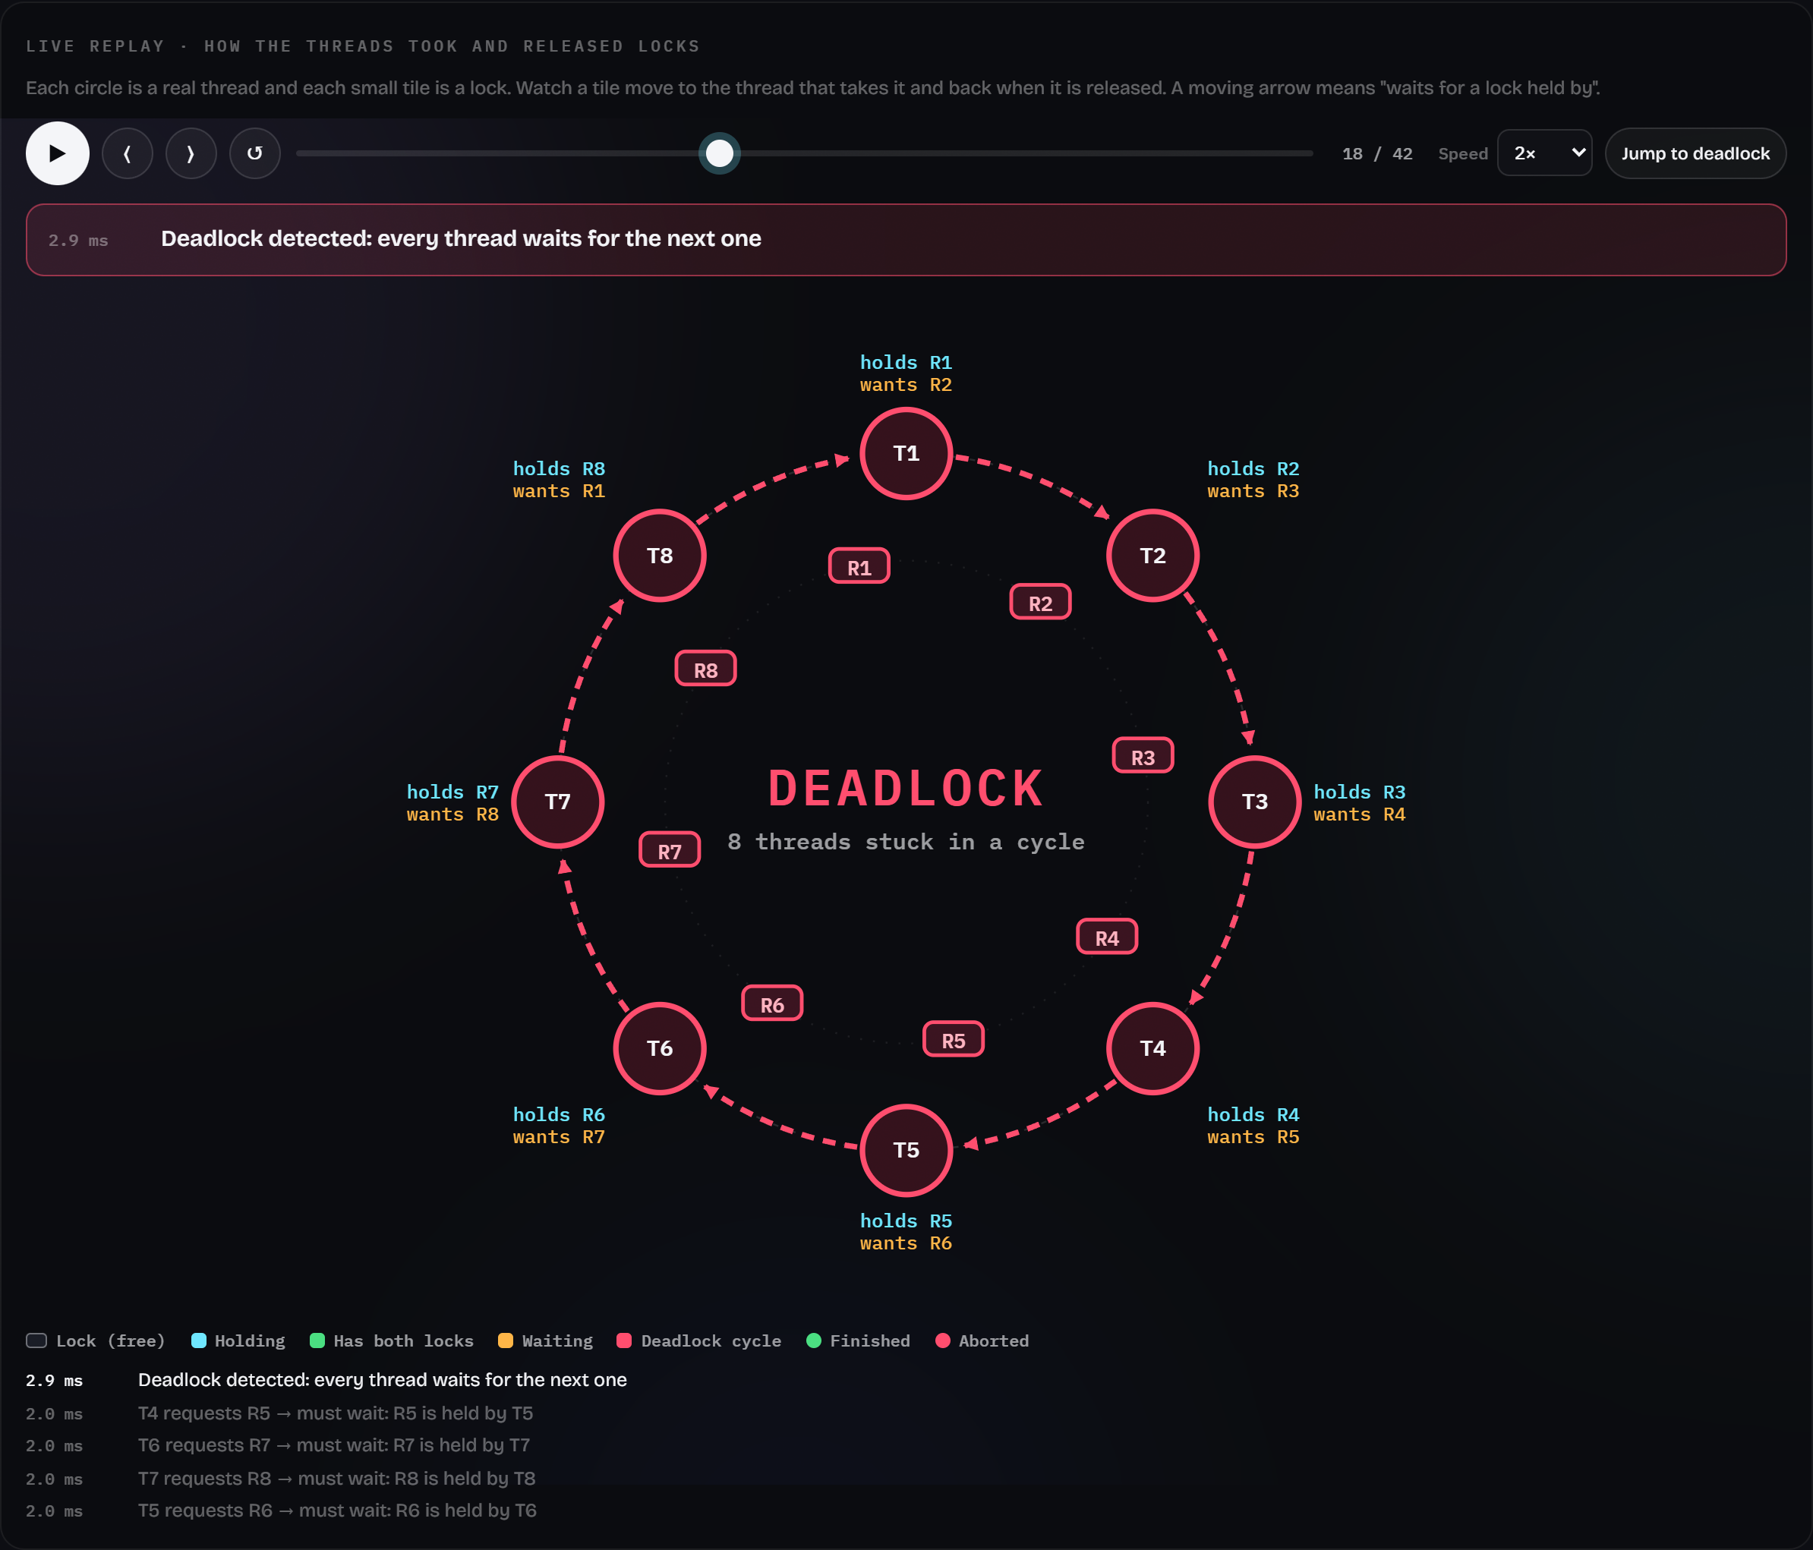
CONFIGURABLE 2–32 THREADS
N-thread ring: detect the cycle, abort a victim, unwind
1
Every thread holds its lock and waits for the next
Cycle through all N threads in 50/50 runs
2
Supervisor scans a consistent snapshot every 1 ms
Detected within 8.0 ms (2–32 threads)
3
Abort the highest-numbered thread; others finish in turn
50/50 runs: N−1 finished, 1 aborted
Predictive Deadlock Lab · Operating Systems case study
7
Notes:
The screenshot is a real 8-thread run paused at detection. Across the scaling set, 50/50 vulnerable runs formed a cycle through all N threads, detection took at most 8.0 ms, and 50/50 recovered with exactly one aborted thread.

Slide 8
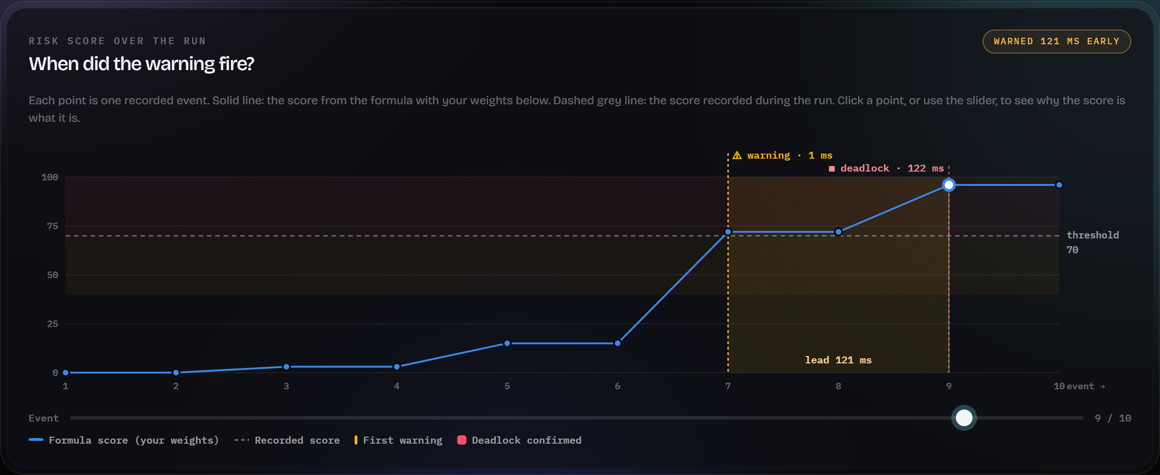
THE DASHBOARD
Replay, Analysis and Compare make every run inspectable
R
Replay
Lock tiles move between threads; the deadlock flashes; recovery unwinds step by step.
A
Analysis
Peak score, first warning, lead time, per-event factor breakdown, live weight tuning.
C
Compare
Both modes side by side, repeated trials, 2–32 thread scaling, CSV export.
Live two-thread trial in the Analysis view: key findings and the risk chart (warning 121 ms before the deadlock).
Predictive Deadlock Lab · Operating Systems case study
8
Notes:
Replay animates the real event log. Analysis shows when the warning fired and why, and re-scores live as weights change. Compare runs both modes, repeated trials and the scaling test, with CSV export.

Slide 9
METHOD
Evaluation protocol: repeated, bounded, fully recorded
Two-thread experiment
N-thread scaling
10 trials per mode, 3 s cap per trial
120 ms observation window before the conflicting request
Deadlock rate, completion rate, warning lead, detection latency
Failed runs counted as inconclusive
Sizes 2, 4, 8, 16, 32; 10 trials per size and mode
Modes alternate so drift affects both equally
Vulnerable time = detection + victim abort + others finishing
Protected time = every thread completed
Saved set collected 15 Oct 2026 (docs/results.json) · New sets collected 26 Oct 2026 (two-thread re-run and scaling) in separate files
Predictive Deadlock Lab · Operating Systems case study
9
Notes:
Every trial is a real run with a timeout. Failed runs are counted as inconclusive, never as successes. The saved and new sets are kept in separate, dated files with every raw run.

Slide 10
RESULTS
Two-thread results: saved and new sets agree
Metric | Saved · vulnerable | Saved · protected | New · vulnerable | New · protected
Trials | 10 | 10 | 10 | 10
Deadlocked / completed | 10 / 0 | 0 / 10 | 10 / 0 | 0 / 10
Inconclusive | 0 | 0 | 0 | 0
Mean runtime | 813.6 ms | 104.6 ms | 813.4 ms | 103.9 ms
Mean peak wait | 809.0 ms | 28.9 ms | 808.4 ms | 29.4 ms
Mean peak score | 96 | 72 | 96 | 72
Warning lead before cycle | 120.4 ms | n/a | 121.6 ms | n/a
Detection latency | 4.6 ms | n/a | 3.1 ms | n/a
Saved set used time.monotonic (≈15.6 ms ticks on Windows); the new set uses time.perf_counter. Protected runs reach 72 during the safe probe, before the policy applies.
Predictive Deadlock Lab · Operating Systems case study
10
Notes:
Read the outcome rows first: every vulnerable run deadlocked and every protected run completed in both sets. Small times differ partly because the saved set used a coarser clock.

Slide 11
RESULTS · NEW SET
Scaling: every cycle spans all N threads
50/50
vulnerable runs deadlocked; all with a cycle through every thread
50/50
recovered with exactly one aborted thread
50/50
protected runs completed every thread
≈31 ms
extra vulnerable time per added thread (sequential unwinding)
Run-to-run spread is small (vulnerable sd ≤ 4.5 ms). Controlled ring workload on one machine; not a performance benchmark.
Predictive Deadlock Lab · Operating Systems case study
11
Notes:
Line chart of mean times from the 26 Oct scaling set. Vulnerable time grows by about 31 ms per extra thread because threads finish one after another after recovery; protected time stays near 100 ms. These are controlled runs, not a benchmark.

Slide 12
LITERATURE REVIEW
Related work, 2020–2025
Work | Idea | Relevance here
Qin et al., PLDI 2020 | Study of real Rust bugs, incl. blocking bugs; static detectors | Lock-order deadlocks persist in safe languages
Cai, Meng & Palsberg, ICSE 2020 | AirLock: cycle search in a small lock graph, ~3.5 % overhead | Cheap cycle search, like our supervisor
Liu et al., ASPLOS 2021 | GCatch detects, GFix repairs Go blocking bugs | Detect then repair vs. our detect then recover
Tunç et al., PLDI 2023 | Sound linear-time prediction of sync-preserving deadlocks | General prediction is intractable: our score is a heuristic
Qin et al., IEEE TSE 2024 | 100 Rust concurrency bugs; five static detectors (lockbud) | Supports lock ordering as prevention
van den Heuvel et al., arXiv 2025 | Partial orders filter false deadlock warnings | Why we report false alarms honestly
Full references with DOIs or official links are in docs/FINAL_REPORT.md and the PDF report.
Predictive Deadlock Lab · Operating Systems case study
12
Notes:
All six works are verifiable; DOIs or official pages are in the report. The key point from Tunç et al.: sound and complete deadlock prediction is intractable in general, which is why our score is presented as a heuristic.

Slide 13
WRAP-UP
Limitations and conclusion
Limitations
Conclusion
Controlled schedules (barriers, 120 ms window): lead time is not general prediction accuracy
Score ceilings are tuned for two threads
Simple victim choice: highest-numbered thread
Python threads under the GIL on one machine; timings vary
Teaching prototype, not a process-isolated service
Real threads reproduce circular wait on demand, from 2 to 32 threads
A Wait-For Graph confirms it; the score warns before it in the staged case
A global lock order prevents it; aborting one victim recovers from it
Every claim is backed by saved, repeatable measurements
Predictive Deadlock Lab · Operating Systems case study
13
Notes:
Be explicit about what the results do not show. Close with the three demonstrated results.

Slide 14
PROJECT
Team roles and testing
M
S
M
Midhun Gereketi
P. Satya Mani Shraavanth
M. Lakshman Sai
Dashboard, replay, Analysis and Compare views, integration, deployment, documentation
Threaded experiments, lock manager, protected policy, N-thread ring and recovery, REST API
Wait-For Graph, risk score, trend and heatmap analysis, repeated-trial evaluation
59
Python tests: experiments, API, ring, scoring consistency and isolation
6
Node tests: trial contract and browser scoring
8
Browser tests with a real server: tabs, tuning, privacy, both modes, scaling, errors, CSV
github.com/midhungereketi/predictive-deadlock-lab
Predictive Deadlock Lab · Operating Systems case study
14
Notes:
Each member presents their part in the demo. All automated tests pass; numbers are from the final run before submission.

