Slide 1
Coursera : Capstone Project IBM Data Science Title: Hotel Apartment Business in Kochi, Kerala
Midhun Madhavan
May 2020

Slide 2
Business Problem
client wants to utilize the hospitality business potential of Kochi
Location is the most important factor for success
Where to open the hotel?
What are the factors to consider?

Slide 3
Data
Suburbs of Kochi - https://en.wikipedia.org/wiki/Category:Suburbs_of_Kochi
Location data for each neighborhood
Venue data

Slide 4
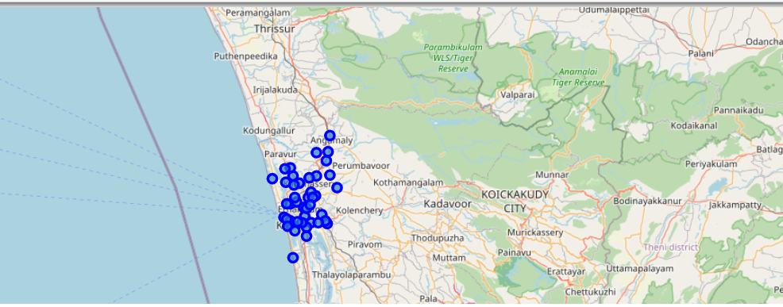
Data Acquisition & Cleaning
Python packages to extract and clean the data.
Location data is added
Map is created

Slide 5
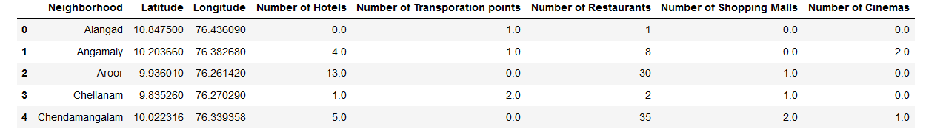
Exploratory Analysis
Foursquare API is used to get the venue details
Identified the depending venue category for hotel business

Slide 6
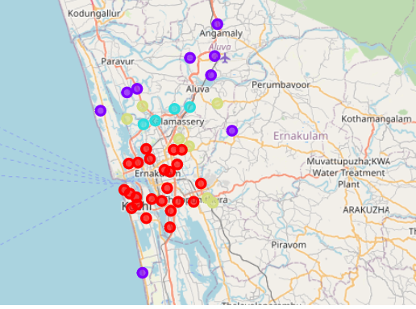
Cluster Analysis
Cluster Analysis is perfumed
Clustered the data into 4 clusters
Analyzed each cluster and a map is created

Slide 7
Result
Cluster 0: Neighborhoods has the high number of hotels.
Cluster 1: Neighborhoods with very a smaller number of hotels,
Cluster 2 and 3: Neighborhoods with smaller number of hotels but higher than Cluster 1

Slide 8
Observations
Cluster 0 has the greatest number of hotels.
cluster 0 is closer to the city center
Cluster 0 also has the highest number of shopping malls, cinema and Restaurants
Less completion in Cluster 1,2 and 3
Very less restaurants, malls in cluster 1 and 2
Cluster 3 has good number of restaurants and malls

Slide 9
Conclusion
Based on the analysis below mentioned clusters and neighborhoods are selected,
Cluster 3 is looking promising with not much competition and other customer attracting facilities like restaurant, malls and cinema. Consider locations like Kadamakkudy and Thiruvankulam.
If client is ready to accept the competition and provide a good quality service, then we can even consider the center of the city which is Cluster 0 where most of the hotels are located. Consider locations like Irumpanam and vaduthala.

Slide 10


Thank You

