Slide 1
E-Commerce
Customer Analytics
Stop spraying. Start aiming.
Some customers are worth 23x others and shop entirely different aisles, so no single campaign, however big, wins them both. This analysis segments the customer base, forecasts each customer's value, and aims every dollar at acquisition and retention where they actually pay off.
Midhun Shyam Lead Data Scientist
MARKET RESEARCH CASE STUDY
Synthetic e-commerce data
1,000 customers and 10,503 transactions, Jan 2025 to Jun 2026
Methods
k-Means, k-NN, gradient boosting, integer programming, SQL

Slide 2
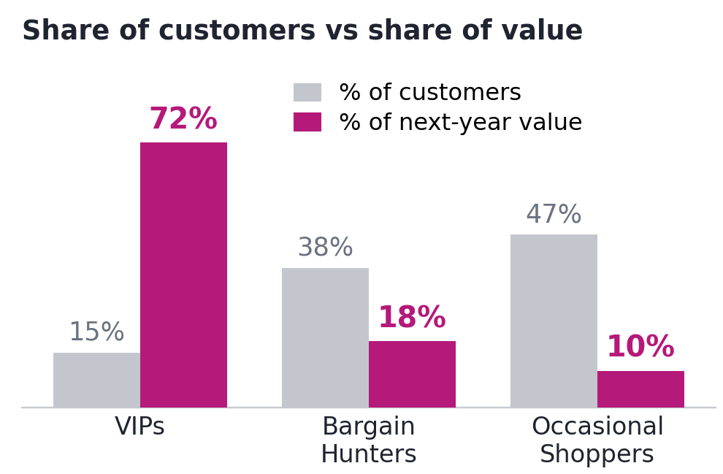
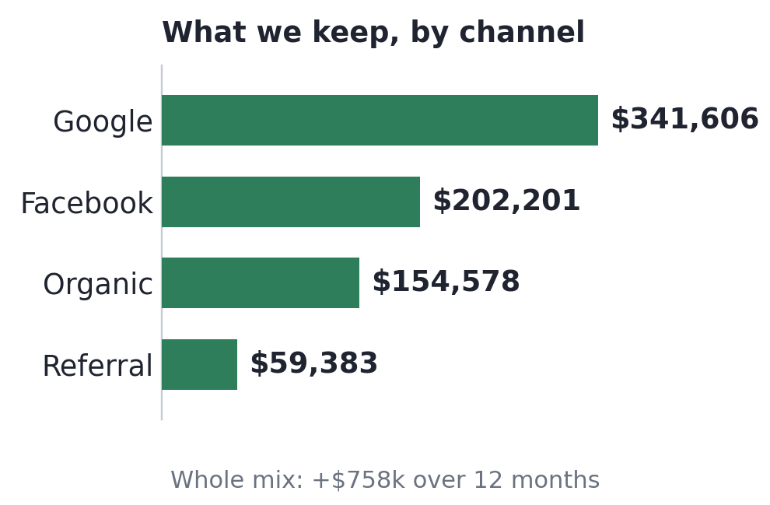
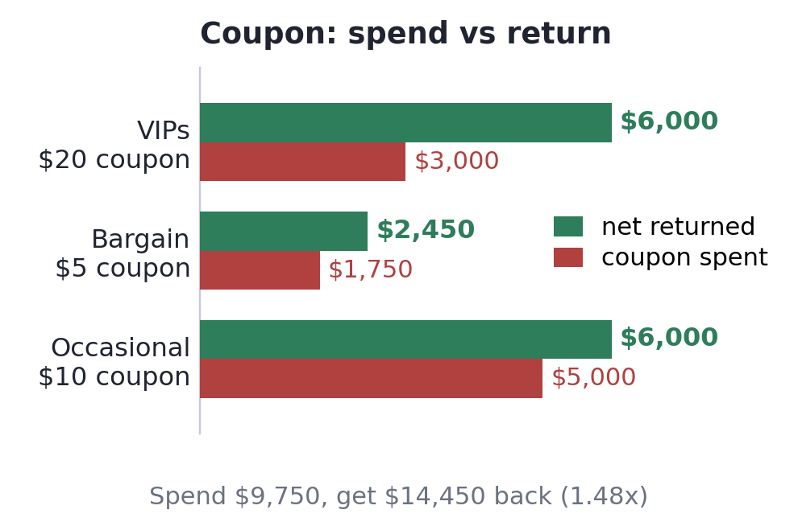
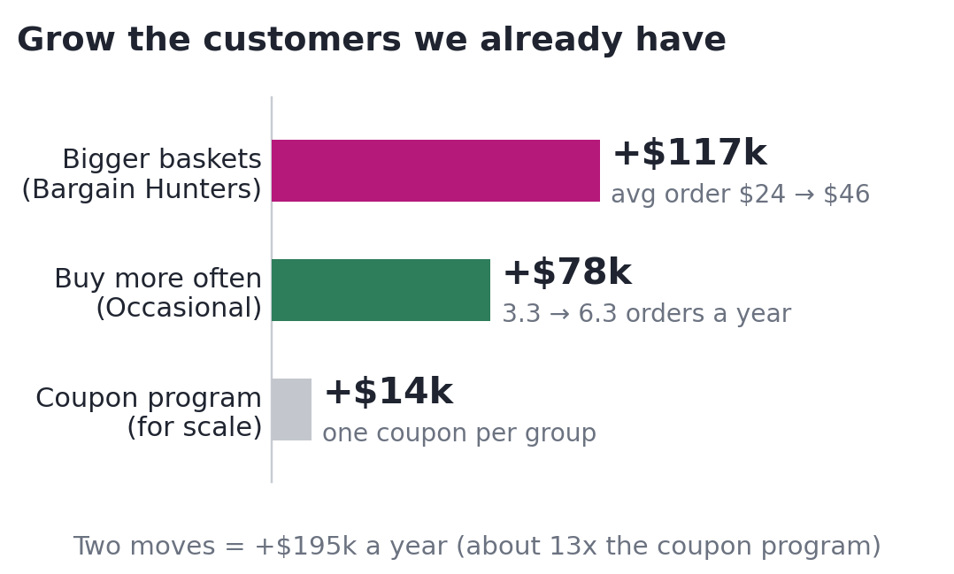
EXECUTIVE SUMMARY
15% of Customers, 72% of the Money
Four findings and their dollar impact. A few customers hold most of the value, and the coupon budget is a rounding error next to the real prize: keeping them and winning more like them.
A few customers are worth almost everything.
Just 15% of customers (148 VIPs) will bring in about 72% of next year's spending. One VIP is worth about 23x an Occasional Shopper: $3,826 versus $165 over 12 months.
We win far more than we pay to get customers.
Every channel is profitable. Together, the customers we bring in are worth +$758k more than they cost, over 12 months. Google returns about $26 for every $1 spent.
A ready quick win from the coupon budget.
One tailored coupon per group. Spending $9,750 should return +$14,450 in extra sales, about $1.48 back for every $1. Confirm with a live test first.
The bigger prize: grow customers we already have.
This is the biggest one here. Two moves: loyal small-spenders roughly double their basket (+$117k), and occasional buyers visit about twice as often (+$78k). Together +$195k a year, about 13x the coupon program.
The bottom line: the coupon is a quick win, but small change next to the real opportunity. Revenue has been flat for 18 months because we stopped bringing in new customers back in 2024, not because our marketing is wasteful: every channel we run makes money. So the answer is growth, not cost-cutting. Bring in more customers who behave like our VIPs (through Google and Facebook), sell more to the ones we already have, and prove each move with a small test before scaling.

Slide 3
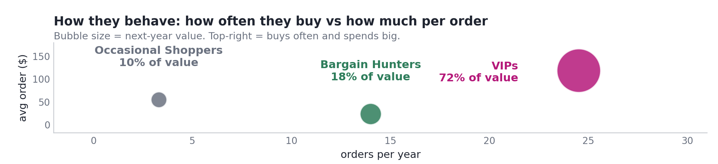
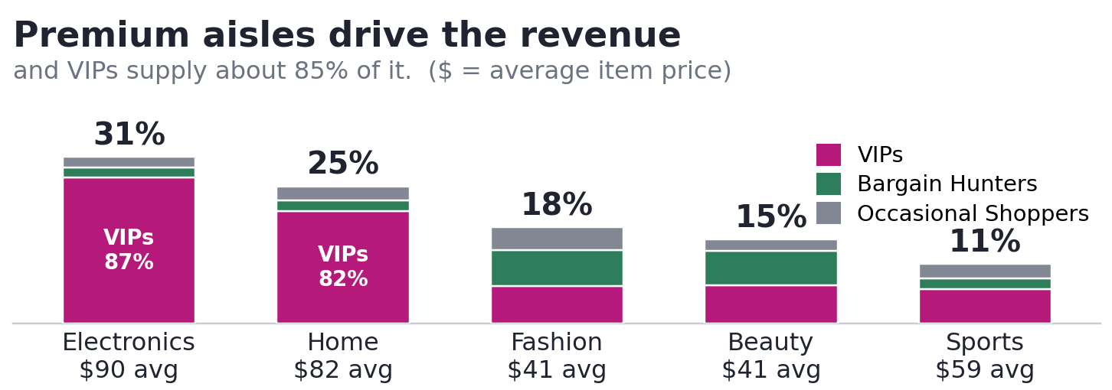
CUSTOMER SEGMENTATION
Three Segments, Three Plays: Reward, Grow, Re-engage
That value lives in three behaviour groups. Same age, channel and signup year: only how they shop tells them apart, and each needs its own play.
REWARD
GROW THE BASKET
RE-ENGAGE
VIPs
Loyal big spenders
148 customers, 15% of base. Worth $566,228 next year (72% of value).
Orders per year: 24.5
Avg order (per purchase): $119
Last purchase: 22 days ago
Top aisles: Electronics, Home
Reward: loyalty perks and early access to premium lines.
Bargain Hunters
Loyal, but tiny baskets
380 customers, 38% of base. Worth $138,690 next year (18% of value).
Orders per year: 14.0
Avg order (per purchase): $24
Last purchase: 35 days ago
Top aisles: Fashion, Beauty
Grow baskets: bundles and free-shipping offers, not discounts.
Occasional Shoppers
Drifting away
472 customers, 47% of base. Worth $77,677 next year (10% of value).
Orders per year: 3.3
Avg order (per purchase): $55
Last purchase: 153 days ago
Top aisles: Fashion, Sports
Re-engage: win-back reminders before they lapse (stop for good).
The bottom line: the three groups look identical on age, gender and where they came from; what sets them apart is how they shop. So target by how they shop, not who they are: reward the VIPs, grow the Bargain Hunters' small baskets, and win back the Occasional Shoppers before they drift away.

Slide 4
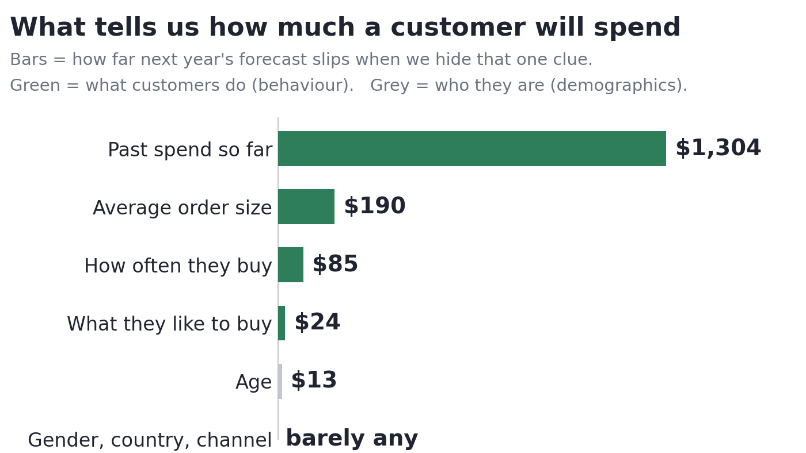
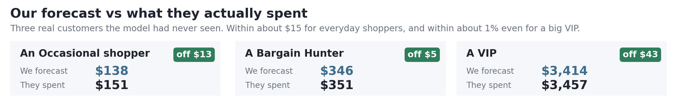
CLV INSIGHTS
Behaviour Predicts Spend, Almost to the Dollar
Behaviour does not just group customers, it predicts them: a customer's own history forecasts next year's spend to within about $15, so we can aim budget with confidence.
What predicts value
A forecast you can trust
Behaviour, not demographics. What a customer has spent, their order size, and how often they buy tell us almost everything; who they are barely moves the needle.
Off by only about $15.
For a typical customer, the forecast of next year's spend misses by only about $15. Predict $200 and they usually spend about $185 to $215.
Proven on customers we had never seen.
We held 250 customers out of the build and tested on them, so the accuracy holds for new people too, not just today's shoppers.
A complex engine, made simple.
The forecaster (Gradient Boosting) learns hundreds of small patterns from past purchases, each fixing the last, into one reliable number per customer.
The bottom line: judge a customer by what they do, not who they are. Because their own buying history predicts next year's spend to within about $15, we can rank every customer today and put budget behind the ones worth the most, instead of guessing.

Slide 5
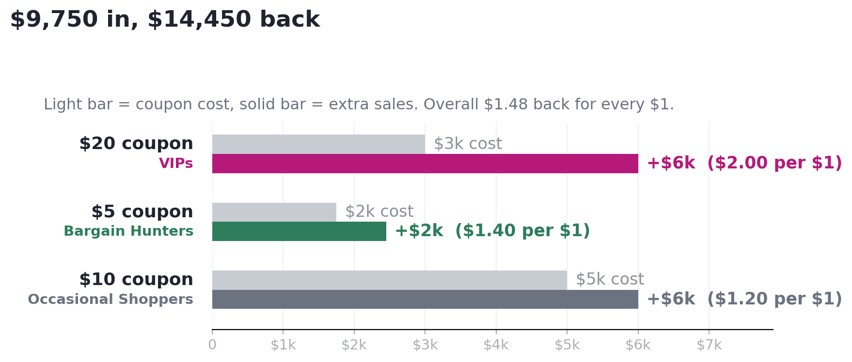
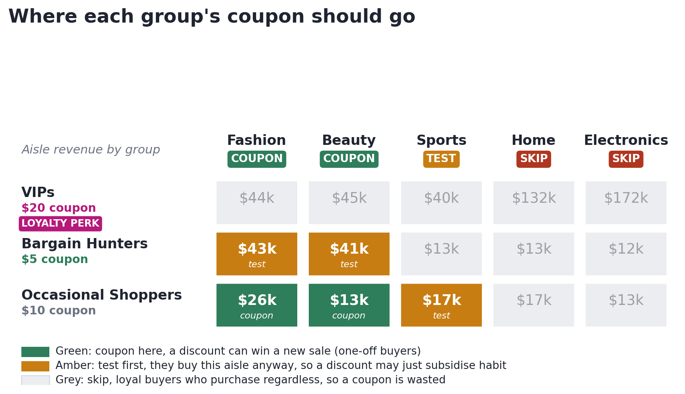
OPTIMIZED MARKETING STRATEGY
The Coupon Strategy: Set the Budget, Then Aim It
The assigned $10,000 coupon budget, aimed by two decisions: the size of each group's coupon, and the one aisle where a discount can move a sale. The fast win before the bigger prizes.
1. What each coupon returns
2. Where each coupon should go
We tested every possible coupon combination and kept the best plan within the $10,000 budget.
Spend $9,750, get +$14,450 back, about $1.48 for every $1.
$250 stays unspent: giving every group its favourite coupon would cost $11,500 for just $350 more, so we stop.
Coupon only where a discount changes a sale, not where people buy anyway.
Occasional Shoppers are the clean coupon: one-off buyers of Fashion and Beauty a discount can win. Bargain Hunters buy those aisles habitually (5x a year, 96% repeat), so use bundles or test first, not a flat discount. VIPs get a loyalty perk.
The bottom line: aim every coupon dollar at a sale a discount can actually win, and stay out of Electronics and Home, where 82 to 87% of buyers are VIPs who buy regardless. The VIP coupon is the weak link: reward VIPs with perks, not a discount they do not need. And test each coupon against a hold-back group (customers who get nothing) before spending the full budget.

Slide 6
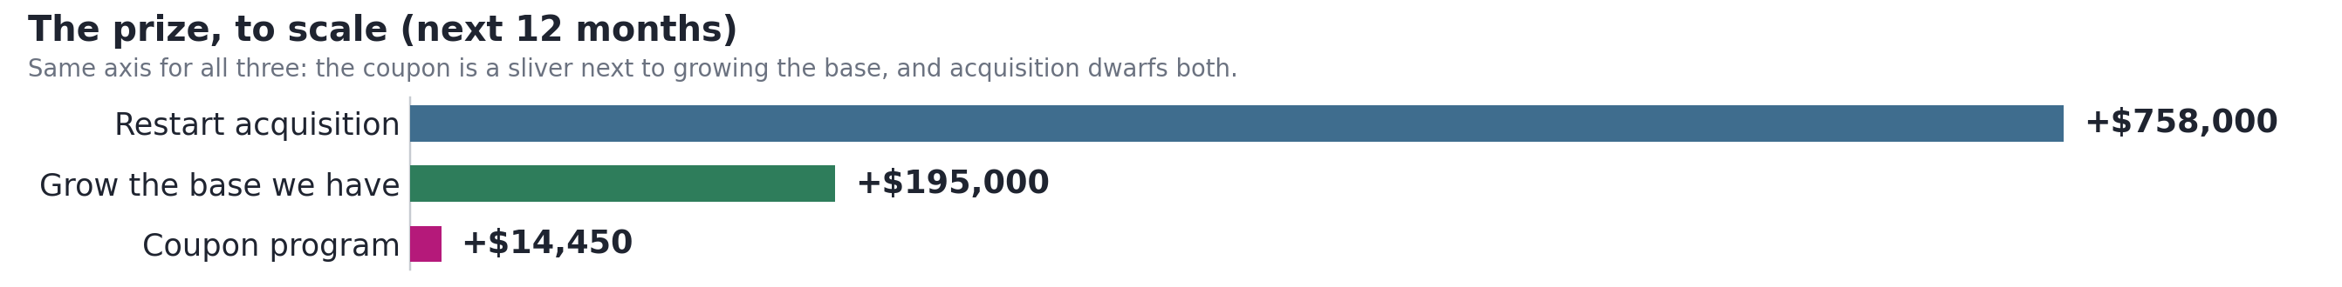
DATA-DRIVEN ROADMAP
Prove the Small Bet, Then Scale the Biggest Prize
Six moves, smallest first, each proven by an A/B test: give the change to some customers, hold a comparison group back, and keep only what beats that group.
NOW
validate the coupon
NEXT
grow the base we have
BIGGEST PRIZE
restart acquisition
1 A/B test the coupon plan first: VIPs $20, Bargain $5, Occasional $10.
Give it to some shoppers, hold a comparison group back, then compare. The modelled +$14,450 is a best case: it is extra sales, not profit. Keep only the coupons that beat the no-coupon group by enough to cover the goods.
2 Test higher VIP coupons, $30 to $50.
A VIP is worth about $3,826 (23x an Occasional) and did not level off at $20, so test $20 vs $30 vs $50.
1 Grow Bargain baskets with bundles and free shipping, not discounts.
Lifts their small (about $24) basket without cutting price, so we keep the profit. Worth about +$117k/yr.
2 Re-engage Occasional Shoppers on their own cadence (buying rhythm).
Nudge each one once it goes quiet for about twice its usual gap (about 96 days). Worth about +$78k/yr.
3 Win back about 100 lapsed shoppers with Home and Sports offers.
They over-index there (buy far more than average). About 1.6% of value and no VIPs, so keep it cheap.
1 Restart acquisition into Google and Facebook, targeting VIP-shaped behaviour.
No one has signed up since 2024 and revenue has been flat about 18 months. Chase look-alikes of our VIPs (people who buy often and spend big). Today's mix already nets +$758k over 12 months (Google returns 26x), so this dwarfs the coupon, about 50x its size. Start with a small, capped budget on each channel, aimed at look-alike audiences, then scale as long as the return beats our target.
The bottom line: run every step as a live A/B test with a hold-back group (a comparison group that gets nothing), and target customers by how they shop, not who they are. Even the coupon's +$14,450 is sales, not profit, and roughly breaks even once you subtract what the goods cost, so the real prize is growing the customers we already have (about +$195k a year) and, above all, restarting acquisition (+$758k, about 50x the coupon).

Slide 7
Thank you

