Slide 1
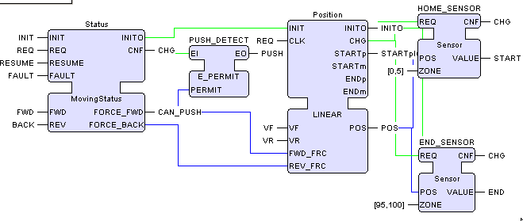
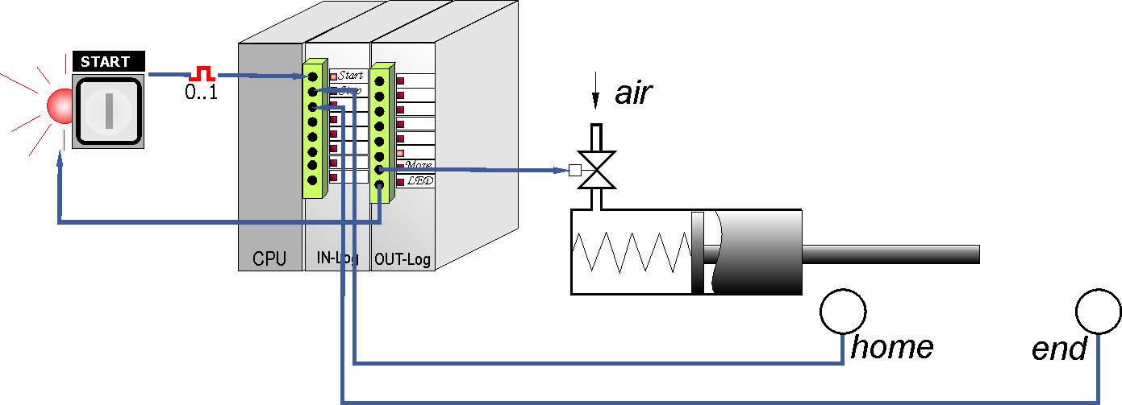

Function Blocks ↔ NCES Modules
IEC 61499
NCES

