Slide 1
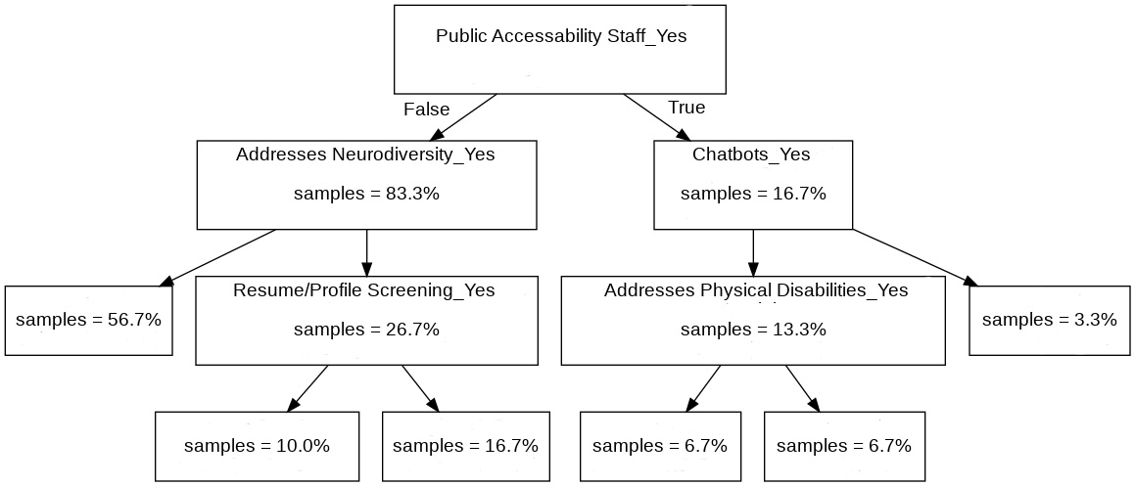
100% of Vendors
83.3% of Vendors
16.7% of Vendors
True
False
True
False
56.7% of Vendors.
0% of these vendors offer accommodation.
3.3% of Organizations
26.7% of Vendors
13.3% of Vendors
3.3% of Vendors.
100% of these vendors offer accommodation.
False
True
False
True
10.0% of Vendors.
66.7% of these vendors
offer accommodations.
16.7% of Vendors.
0% of these vendors offer accommodations.
6.7% of Vendors.
50% of these vendors offer accommodations.
6.7% of Vendors.
50% of these vendors offer accommodations.

