Slide 1

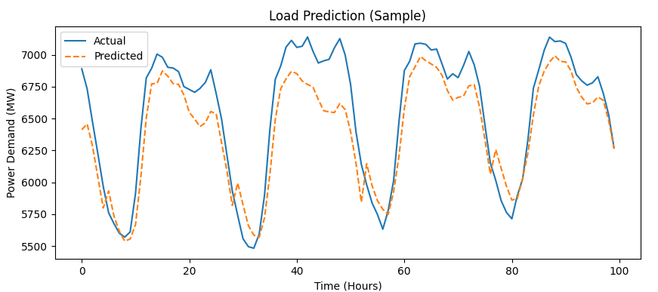
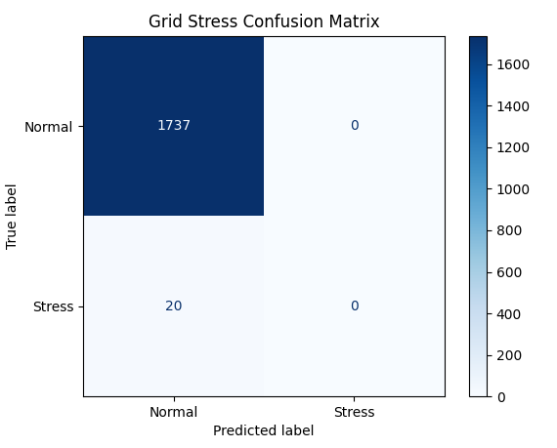
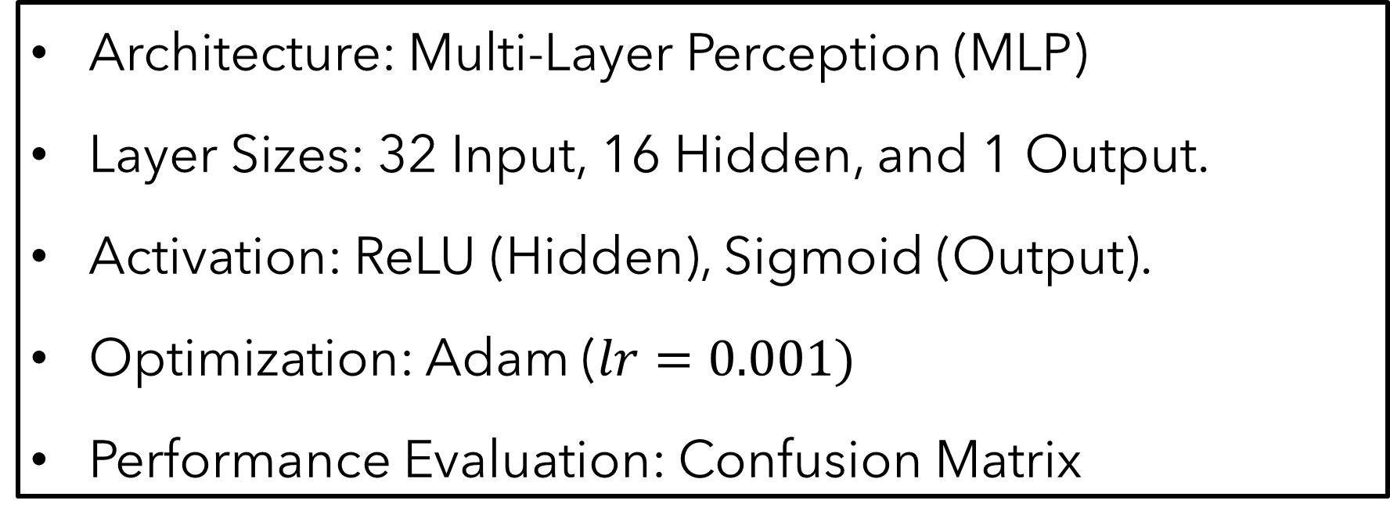
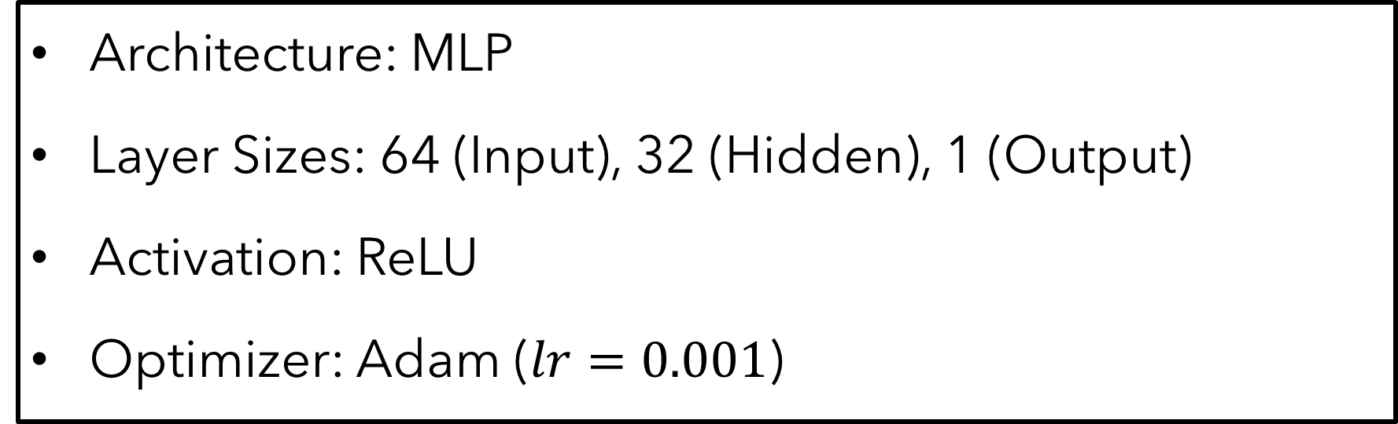
Deep Learning & Regional Grid Stability
David Vuksanovich
CSCI 4852
Spring 2026
Background
Classification Method
Regression Method
Infrastructure Sensitivity: Regional electrical grids are highly sensitive to fluctuating meteorological conditions and industrial demand cycles.
Grid Stability: Precise forecasting is a prerequisite for maintaining grid stability and preventing localized blackouts or equipment strain.
Architecture: Multi-Layer Perception (MLP)
Layer Sizes: 32 Input, 16 Hidden, and 1 Output.
Activation: ReLU (Hidden), Sigmoid (Output).
Optimization: Adam ($lr=0.001)$
Performance Evaluation: Confusion Matrix
Architecture: MLP
Layer Sizes: 64 (Input), 32 (Hidden), 1 (Output)
Activation: ReLU
Optimizer: Adam ($lr=0.001$)
Regression Results
Research Questions
Classification Results
Analysis: The 64-32-1 MLP architecture demonstrated superior convergence, tracking diurnal load cycles with high fidelity as shown in the time-series residuals.
Conclusion: The inclusion of 24-hour lags and temperature rolling averages allows the model to forecast demand within a highly acceptable error margin of ~265 MW.
Classification: Can a binary neural network effectively serve as an ‘Early Warning System’ to classify high-risk ‘Grid Stress’ events?
Regression: To what extent can environmental indicators and historical lags accurately forecast quantitative regional power demand in Megawatts?
Analysis: The MLP Classifier outperformed the majority-class baseline by successfully filtering all 1,737 normal operating hours with no false alarms.
Conclusion: The model effectively identifies standard states but exhibits conservative bias during stress events.
Dataset
Metric | Baseline | MLP Classifier
Accuracy | 90.00% | 98.86%
True Negatives | 1,737 | 1,737
False Positives | 0 | 0
Overview: A multi-source hourly time-series dataset (8,783 observations) merging meteorological and grid-load data.
Sources: Historical load data via PJM Interconnection API; climate data via NOAA GHCN API.
Data Preparation
Metric | Baseline | MLP Regressor
MSE | 0.1400 | 0.0023
MAE | ~500+ MW | 265.19 MW
Feature Engineering: Generated cyclic time freatures and 3-hour rolling weather averages to capture thermal inertia.
Scaling: Applied Min-Max Normalizaiton to all inputs to ensur gradient stability.
Future Work
Imbalance Resolution: Implementing Focal Loss to increase the classifier’s sensitivity to rare events.
Transitioning from static MLPs to Gated Recurrent Units to better capture long-range dependencies.

