Slide 1
Performance and Scalability Testing with Python and Multi-Mechanize
multimechanize.com

Slide 2
Multi-Mechanize
Multi-Mechanize is an open source framework for performance and load testing. It runs concurrent Python scripts to generate load (synthetic transactions) against a remote site or service.
Multi-Mechanize is most commonly used for web performance and scalability testing, but can be used to generate workload against any remote API accessible from Python.
Test output reports are saved as HTML or JMeter-compatible XML.
  Open Source (LGPLv3)
  Started Development in 2010
  Python 2 (2.6+)
  Project Hosted on Google Code (SVN)
  Website: multimechanize.com
    Download
    Code Samples / Script Dev Guide
    Wiki
    Discussion Group

Slide 3
Uses
Which API's Can You Test?
You have a remote API or website and need to:
  stress test server and network infrastructure
  find application bottlenecks
  expose errors under load
  performance benchmarks
  capacity planning
You write the virtual user (client) scripts in Python, so any remote protocol/lib you want:
  Web/HTTP
    Raw HTTP (urllib2, httplib)
    Web Forms (mechanize)
    REST/SOAP/XMLRPC
  Sockets
  Database, NoSQL, Cache
  Any Python API

Slide 4
Things I Like
  Free
  Runs on multiple platforms (nix, win)
  Python code base
  Scripts are in Python (batteries included, python libraries)
  Scalable load generator
  Automatic report generation
  Aggregate stats (response times, throughput, percentiles)
  Graphs (scatter, time-series)

Slide 5
Inside Multi-Mechanize
  Multi-process/Multi-threaded Test Harness
  Virtual User Scripting in Python
  Configurable Test Runner
  Report Generator
  Input: Virtual User Test Scripts, Config File
  Output: HTML Report with PNG images (graphs)

Slide 6
Mechanize Installation
Installation Requirements:
Linux Debian Distribution:
Ubuntu 12.04
Run as root : sudo su
Perform updates and upgrades :
sudo apt-get update
sudo apt-get upgrade
The Installation instructions have been tested and serves as a platform during the load testing.

Slide 7
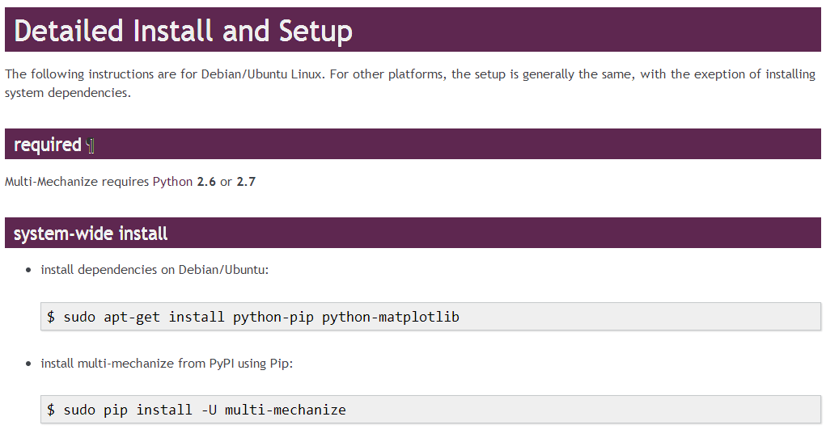
Installing Mechanize

Slide 8
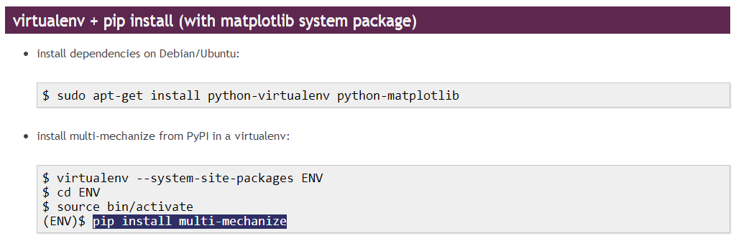
Installing Mechanize

Slide 9
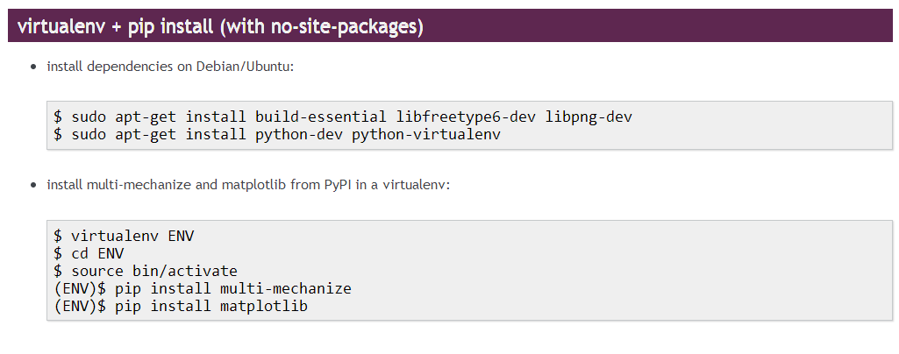
Installing Mechanize

Slide 10
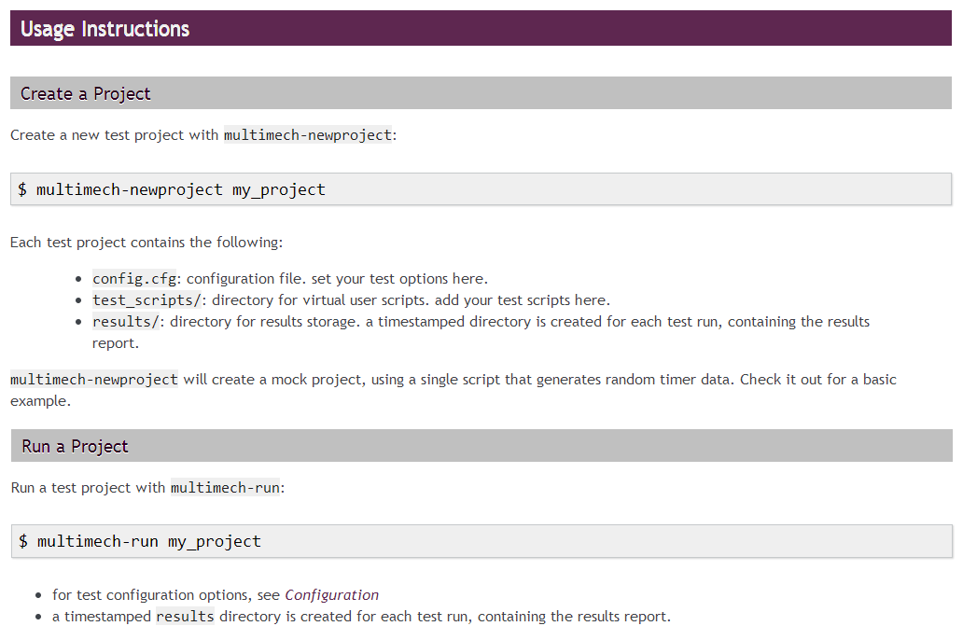
My First Project

Slide 11
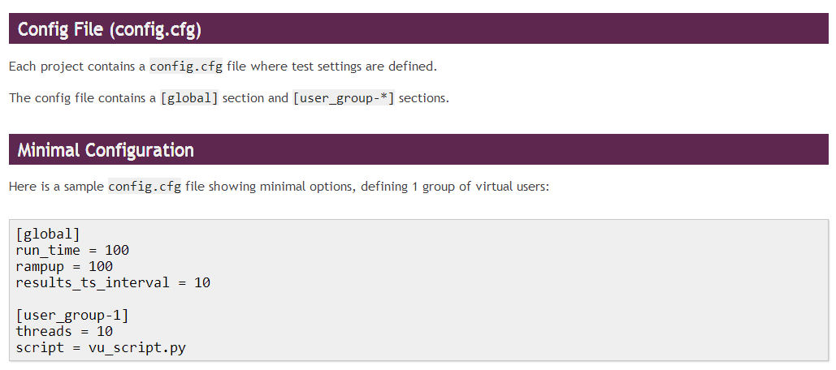
Configuring Mechanize

Slide 12
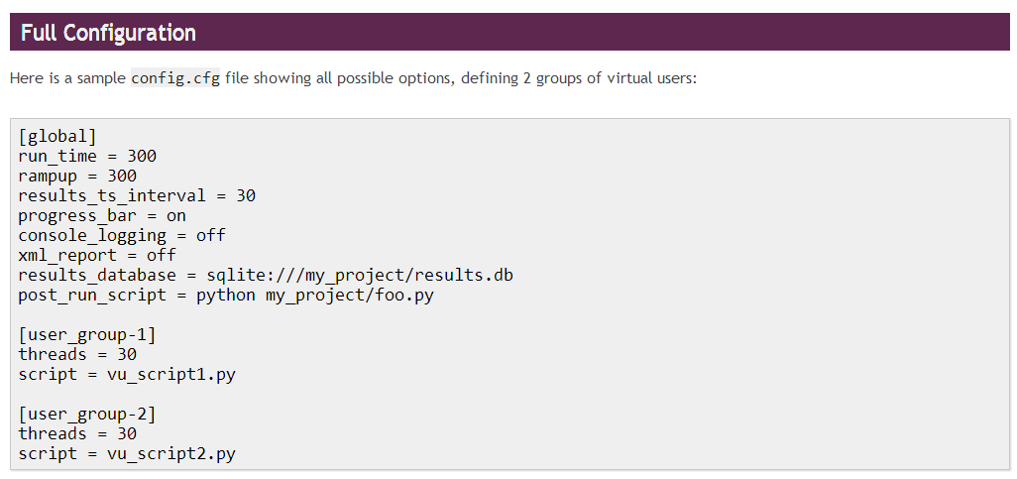
Configuring Mechanize

Slide 13
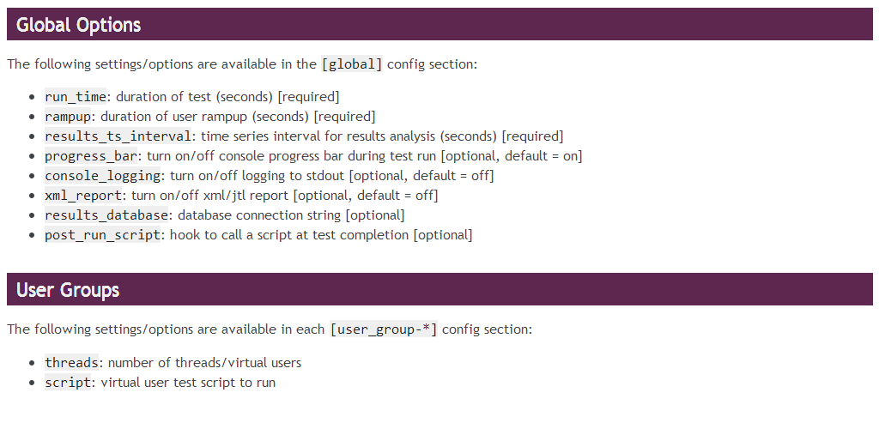
Configuring Mechanize

Slide 14
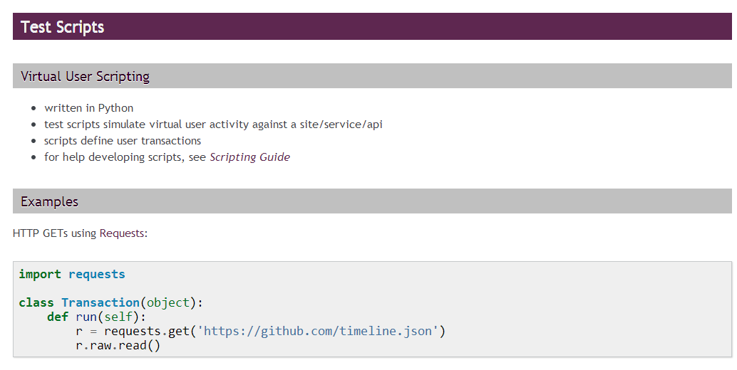
First Run

Slide 15
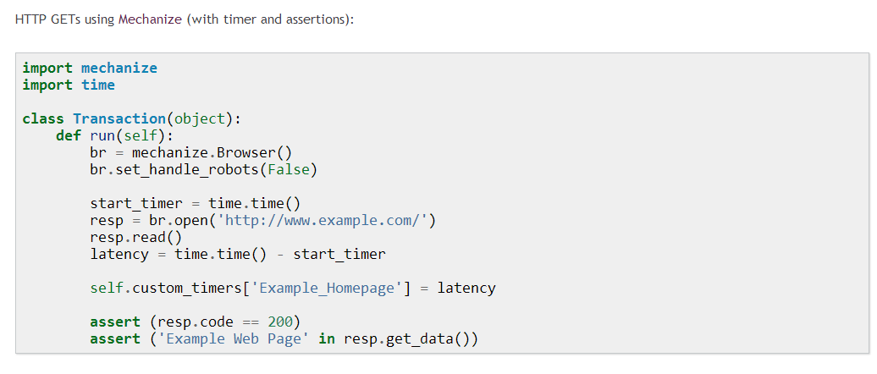
First Run

Slide 16
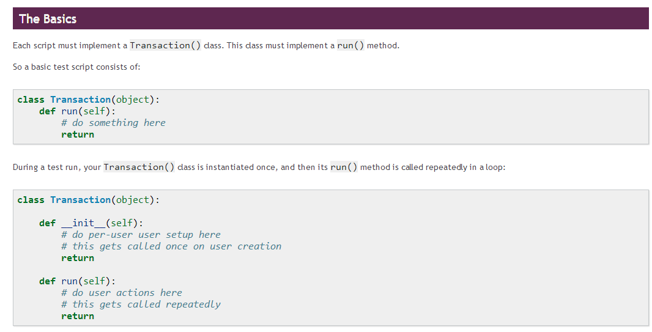
Virtual User Scripting
Scripts are written in Python. You have full access to the Python standard library and any additional modules you have installed.

Slide 17
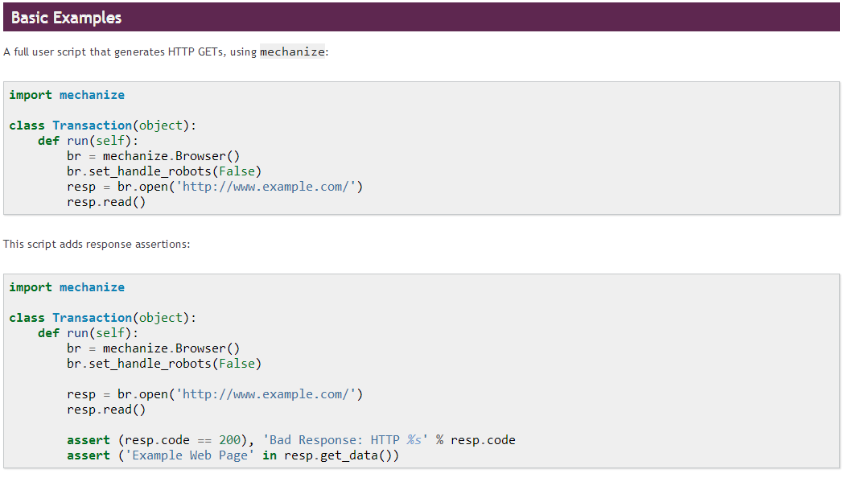
Virtual User Scripting

Slide 18
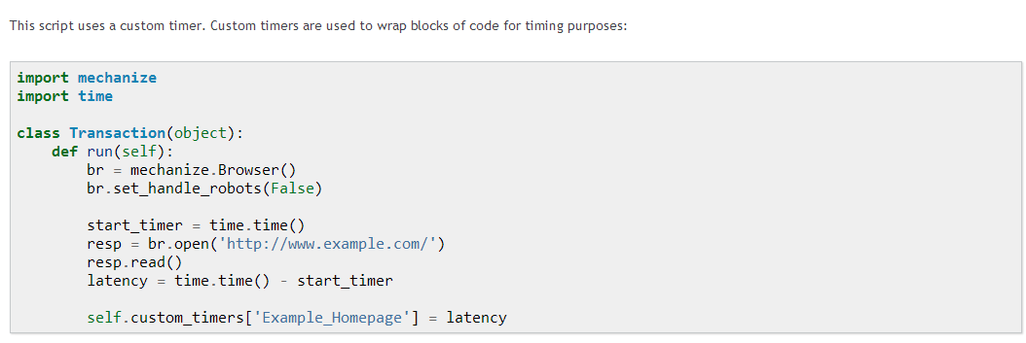
Virtual User Scripting
For More Examples

Slide 19
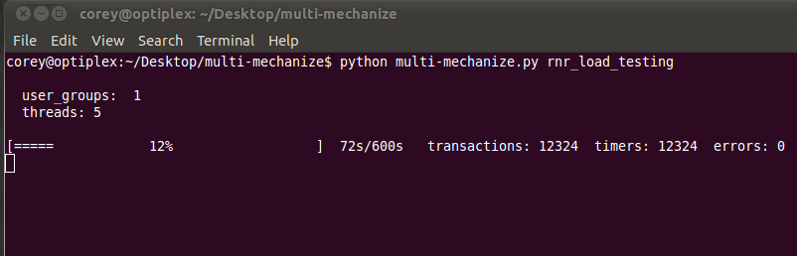
Running a Test

Slide 20
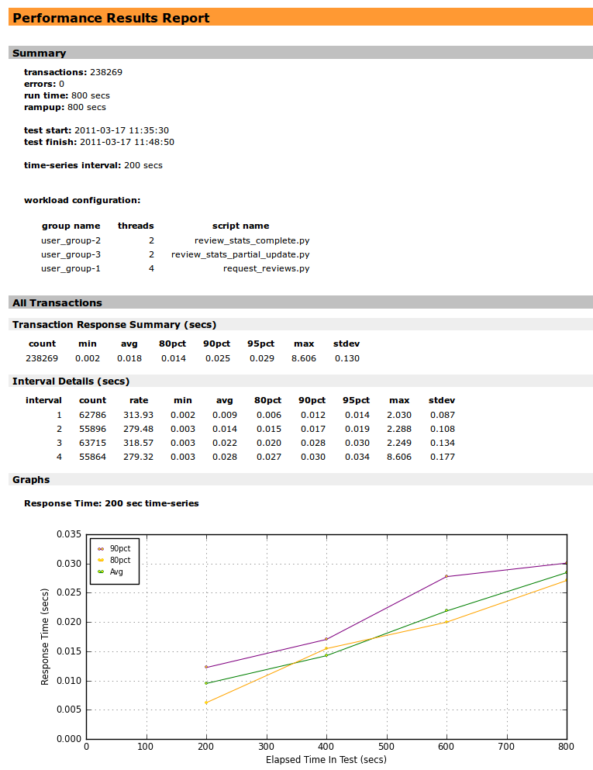
Reports

Slide 21
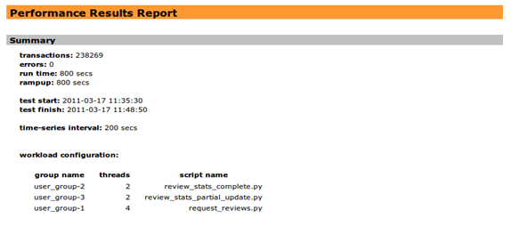
test start: | 2011-03-17 11:35:30
test finish: | 2011-03-17 11:48:50
Time interval series | 200 secs
Workload configuration
Group name | threads | Script name
User_group-1 | 4 | request_review.py
User_group-2 | 2 | Review_stats_complete.py
User_group-3 | 2 | review_stats_partial_update.py
transactions: | 238269
errors: | 0
runtime: | 800 secs (13.3 minutes)
rampup: | 800 secs (13.3 minutes)

Slide 22

Transaction Response Summary: (secs)
count: | count of transactions during runtime period
min: | fastest response time
avg: | average response time during runtime period
80pct: | 80th percentile sample computed from data set (Response time)
90pct: | 90th percentile sample computed from data set (Response time)
95pct: | 95th percentile sample computed from data set (Response time)

Slide 23

Interval Details (secs)
Interval: | Based on time series interval of 200 sec per sampling leading to 4 sample test points
count: | transaction count at which sampling has occurred
rate: | number of transactions during sampling interval
min: | minimum response time during interval
avg: | average response time during sampling
80pct: | 80th percentile sample during interval
90pct: | 90th percentile sample during interval
95pct: | 95th percentile sample during interval
max: | maximum response time during interval
stdev: | standard deviation value during interval

Slide 24
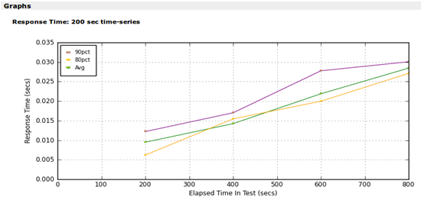
Time series graph
Graph extrapolated from data sets of the load testing.

Slide 25
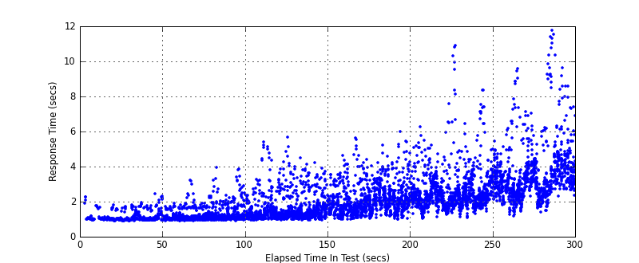
Results Reports (Graphs)
response time scatter plot:
Scatter plot represent all server response time vs elapsed time .

Slide 26
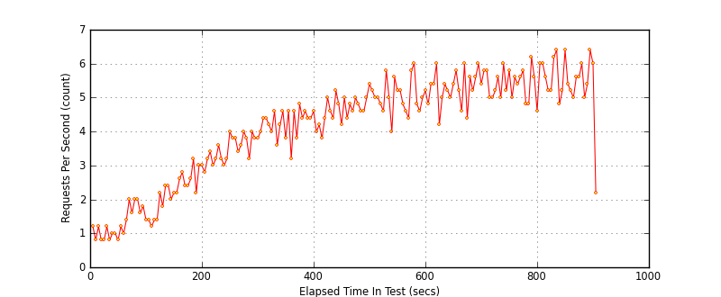
Results Reports (Graphs)
throughput time-series plot:
Request per second vs Elapsed time

Slide 27
Conclusion
The two graphs are related
and highly proportional.
In the increase of request per
sec; there is an increase of
response time. The more
scattered the scatter plot
Represents a more variance
In response time.

Slide 28
The End
visit: http://multimechanize.com

