Slide 1


Jerry’s Bootcamp
The Basics

Slide 2
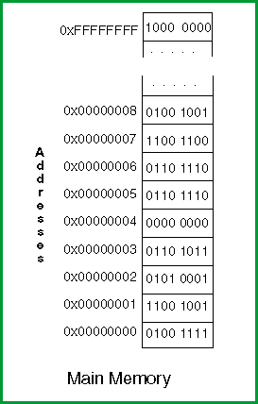
What’s a computer program?
It’s simply a list of instructions inside the computer’s RAM.
The CPU (Central PROCESSING Unit) reads each instruction one by one and executes it.
The instructions are encoded as binary numbers and have to be decoded by the CPU at runtime.

Slide 3
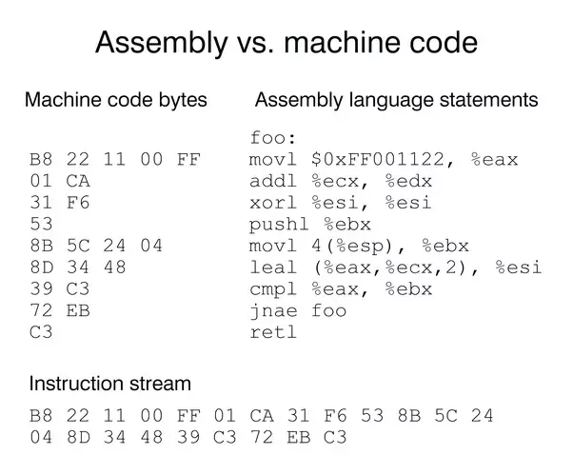
Machine Code
The entire program is a stream of binary numbers!
Each command or MNEMONIC along with its parameters get converted to an OpCode and Operand
Notice how the Instruction Stream is a concatenation of all of the machine code bytes

Slide 4
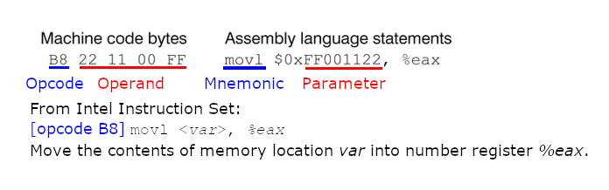
Machine Code – Closer Look
Each instruction can be made up of two components: Opcode and Operand
There are at least 150 opcodes for Intel x86 processer – all painstakingly assigned to do a single focused task.
A mnemonic might translate to a different opcode based on its parameter type.
Side Note: movl is a mnemonic for “MOVE LONG”. That means 4 bytes of data are moved.

Slide 5
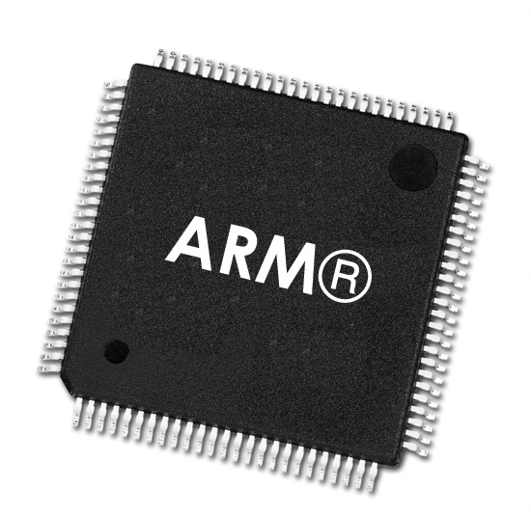
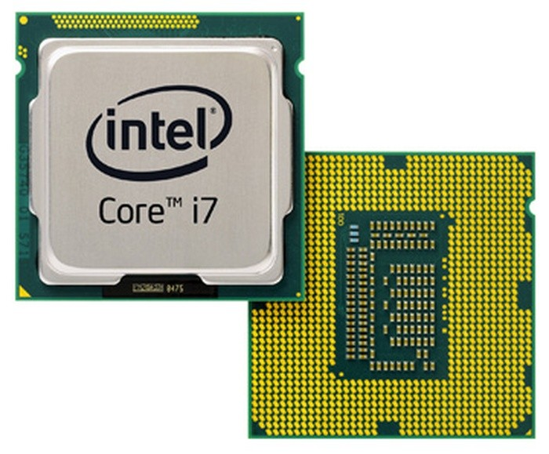


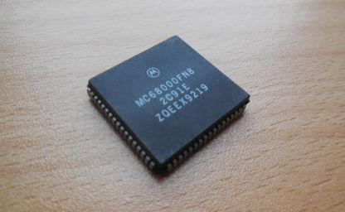
Why does this matter?
Each CPU has its own instruction set.
Writing a program requires an ASSEMBLER to convert the source code into machine byte code, or object code.
ARM Processor
Intel Processor
Assembly Code
Object Code
Motorola Processor

Slide 6


But it gets more complicated…
Each computer runs on an operating system.
A LINKER is then used to take all of the object files and package them as an executable for a given OS.

Slide 7
Cross Platform Headaches
Each OS requires a LINKER
Each CPU requires its own ASSEMBLER
Compilers for High Level languages such as C and C++ packaged the LINKER and ASSEMBLER together, but it still required different compilers for each OS.
Imagine if you had to make your code compatible with every OS compiler so you could be cross-platform compatible. People didn’t bother!
This is where Java comes in.

Slide 8

“Write Once, Run Anywhere”
Java was invented in 1995 by Sun Microsystems for use on the Web.
It took over the responsibility of linking and assembling for all Operating Systems and CPUs.
Sun did this by creating the Java Virtual Machine (JVM)
The developer writes the application in Java which then gets compiled into Java bytecode.
The JVM reads Java bytecode and then transcodes that into the appropriate machine code for the platform.
When you “download Java”, you’re installing the JVM to execute Java applications.
The developers at Sun (now Oracle) ensure there is full compatibility between Java bytecode and the platforms underneath!
Java Virtual Machine

Slide 9
Let’s get started!
Download Java 11 JDK
https://www.oracle.com/java/technologies/javase-jdk11-downloads.html
Install IntelliJ Community edition
https://www.jetbrains.com/idea/
Install Git Bash
https://gitforwindows.org/
Create a folder for all of your projects
Now go to https://github.com/midnjerry/bootcamp for further instructions.

Slide 10
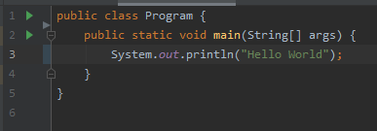
Hello World
Hello World for Java can be a little confusing!
Notice the class Program. It has a left brace at line:1 and a closing brace on line:5.
If an ‘application’ is a ‘book’ then a ‘class’ is a ‘chapter’. Every book has at least one chapter.
Also notice public static void main.
This is a method. It’s basically the first paragraph of the book. Every application requires a main method defined like this. This is where program execution begins.
Notice System.out.println(“Hello World”);
This is the line that displays Hello World.

Slide 11
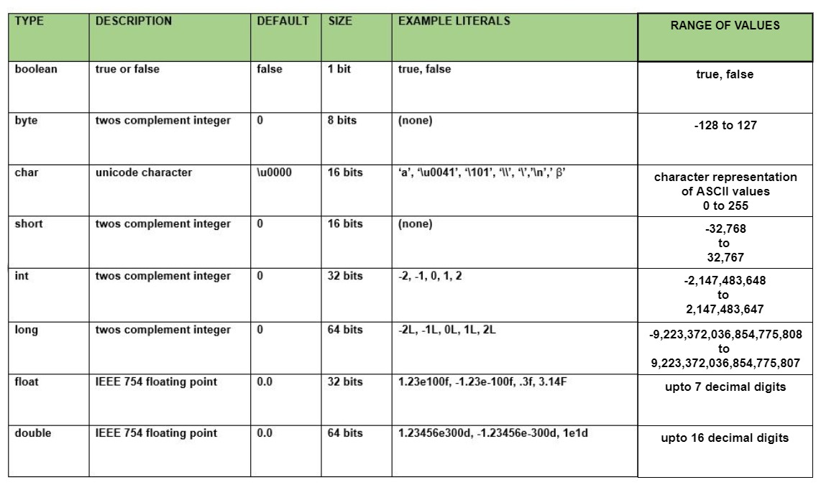
Primitive Data Types

Slide 12
Hexadecimal Format
People operate on a base-10 scale. Our number system has 10 digits. [0-9]
Computers, however, are designed to operate on a base-2 scale. Each digit can be [0-1]
Hexadecimal is a base-16 scale. [0-F]
We use letters to represent numbers when we get to 10-15.
A = 10
B = 11
C = 12
D = 13
E = 14
F = 15

Slide 13
Why Hexadecimal?
It allows us compress byte data very conveniently until two digits.
Example: 203

Slide 14
What’s a computer program?
It’s a list of instructions inside the computer’s RAM.
The CPU (Central PROCESSING Unit) reads each instruction one by one and executes it.
The instructions are encoded as binary numbers and have to be decoded by the CPU at runtime.

Slide 15
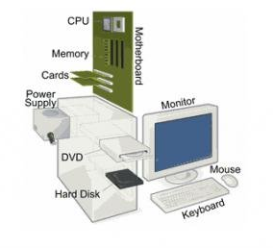
What is a computer?
At a very basic level a computer is made up of the following:
CPU (Central Processing Unit)
RAM (Random Access Memory, i.e. memory sticks)
Long Term Memory (Hard Drive/ Hard Disk)
Input Devices
Display Device
Power Supply
Peripheral Cards (to enhance use – like WiFi Adapter, Video Card, etc.)

Slide 16
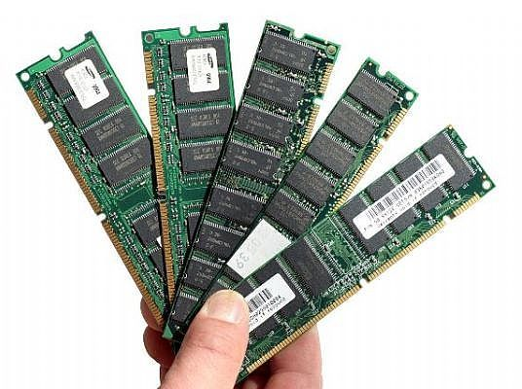
What is a RAM?
Random Access Memory can be considered temporary storage space.
It is EXTREMELY FAST and is used to remember the state of user sessions.
Even the pixels displayed by this presentation need to be stored somewhere – it’s in the RAM.
All data in RAM is lost when the computer is turned off.
Memory can be considered as a long string of bytes, with each byte referenced by a memory address.
Adding another stick of RAM increases the number of bytes (and memory addresses) available for running programs to use.

Slide 17
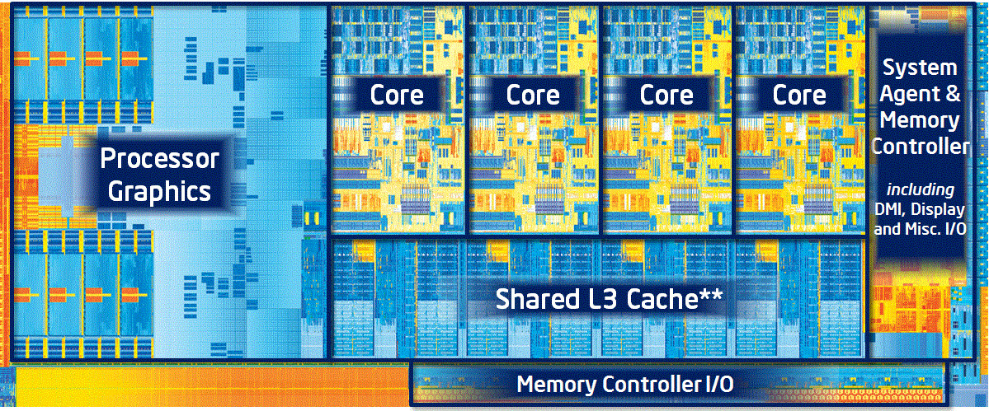
What is a CPU?
A CPU stands for Central Processing Unit and is usually known as a “CORE”.
It is responsible for running instructions one at a time loaded from RAM.
Since a CPU is quick, it seems like it processes many things at the same time, but it’s not. It only processes one instruction at a time.
When a processor has more than one CPU, algorithms can be executed that can utilize all CPUs processing at the same time. This is called parallel processing.
Inside an Intel “Ivybridge” Core I7 3770K
Boasting 1.4 BILLION transistors
Four Core CPUs
Each CPU operates at 3.5 GHz
(3.5 BILLION cycles per second)

Slide 18
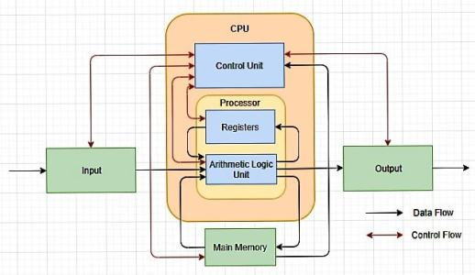
What is a CPU? A Deeper Look
A CPU has the following components:
Control Unit
Controls timing by acting as cadence for CPU
Takes instructions in numerical format, decodes it, and determines how to execute it.
Like an Air Traffic Controller, it routes data to appropriate components for the given instruction its executing
Registers (Imagine them as Variables)
Used to store numerical data (binary)
Arithmetic Logic Unit (A Fancy Calculator)
Takes inputs from specific registers and completes arithmetic
Result is stored in a special Accumulator register.

Slide 19

What is a CPU? A Deeper Look
https://www.youtube.com/watch?v=Z5JC9Ve1sfI

Slide 20
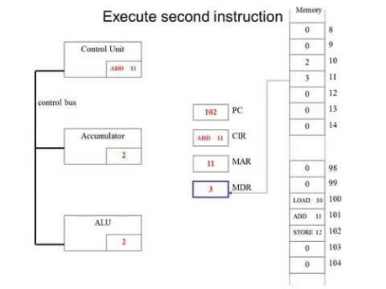
What is a CPU? A Deeper Look
https://www.youtube.com/watch?v=jFDMZpkUWCw

Slide 21
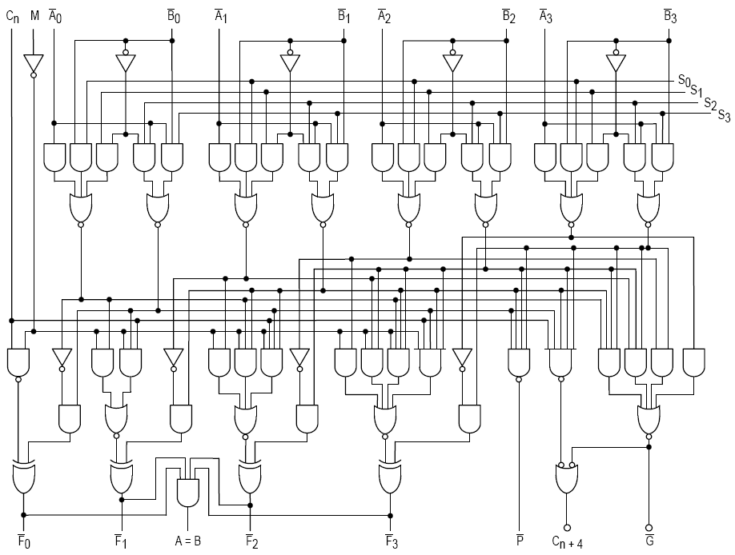
How an ALU adds numbers
Working Example: https://www.youtube.com/watch?v=omTVn77Qxbw
ALU stands for Arithmetic Logic Unit
Part of ALU has an ADDER. It’s an electronic component designed to take values from 2 registers and then finds sum.
Logic Gate Diagram for a 4-bit adder

Slide 22
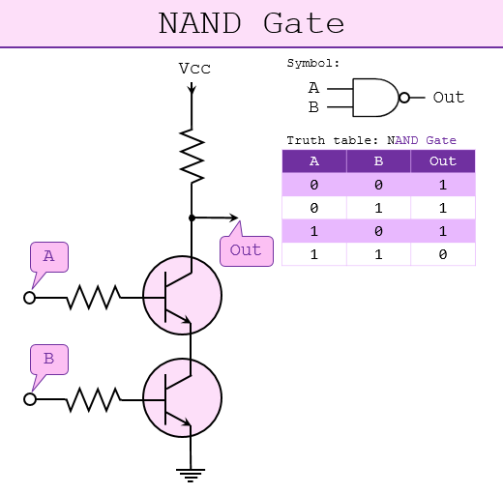
Logic Gates
Logic gates are physical circuits that simulate logic operations.
Current CPUs have BILLIONS of these gates, all made up of transistors.
Gates are made to output either 0V (LOW) or some predetermined voltage Vcc (HIGH).
LOW voltage can also be represented by 0.
HIGH voltage can also be represented by 1.
Circuit Diagram of a NAND Gate

Slide 23
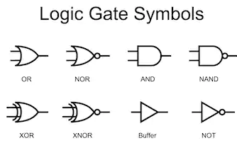
Logic Gates
Logic Gates basically come in 4 flavors:
AND
XOR
OR
NOT
Each gate mentioned above has a counterpart.

Slide 24
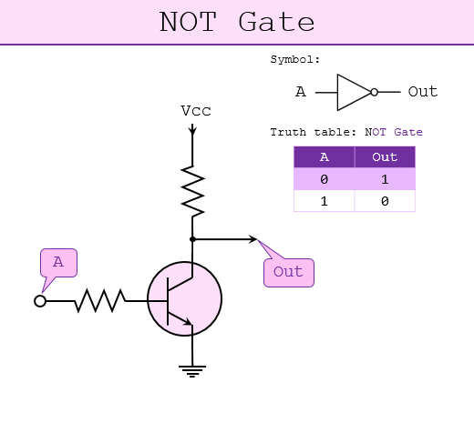
NOT / BUFFER Gate
A NOT gate outputs HIGH if input is LOW, and outputs LOW in input is HIGH.
A NOT gate is useful because it can be used to invert the output of other logic gates.
The counterpart of a NOT gate is a BUFFER.
A BUFFER outputs HIGH if input is HIGH, and LOW if input is LOW.
A BUFFER is useful because it can amplify a weak voltage. (Think Minecraft Repeater)
Circuit Diagram of a NOT Gate

Slide 25
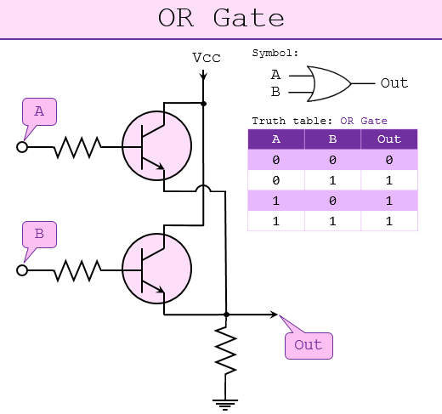
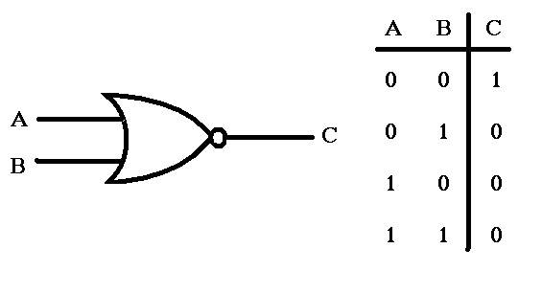
OR / NOR Logic Gates
An OR Gate outputs HIGH if either input is HIGH.
A NOR Gate is the opposite. It outputs HIGH only if both inputs are LOW.
The equivalent output of an OR Gate can be generated by a NOR Gate in series with a NOT Gate
The equivalent output of a NOR Gate can be generated by an OR Gate in series with a NOT Gate
Circuit Diagram of a OR Gate
Truth Table: NOR Gate

Slide 26
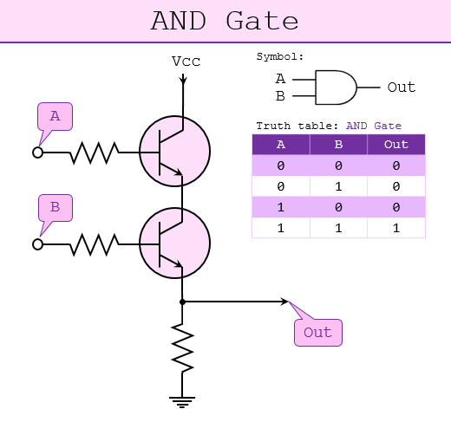
AND / NAND Gates
An AND Gate outputs HIGH if both inputs are HIGH.
A NAND Gate is the opposite. It outputs LOW if both inputs are HIGH, and HIGH for rest of scenarios.
The equivalent output of an AND Gate can be generated by a NAND Gate in series with a NOT Gate
The equivalent output of a NAND Gate can be generated by an AND Gate in series with a NOT Gate
Typically NAND gates are cheaper to purchase than AND gates, so you will see many circuits diagrams using NAND.
Circuit Diagram of a AND Gate

Slide 27
XOR / XNOR Gates
XOR stands for “Exclusive OR”

