Slide 1

C Programming Basic – week 8
Gdb – Make
Tree
Lecturers :
Cao Tuan Dung
Le Duc Trung
Dept of Software Engineering
Hanoi University of Technology

Slide 2
Topics of this week
How to use debugger tool(gdb)
Tree data structure
  Binary Tree
  Binary Search Tree
Recursive processing on Tree

Slide 3
gdb for debugging (1)
gdb: the Gnu DeBugger
http://www.cs.caltech.edu/courses/cs11/material/c/mike/misc/gdb.html
Use when program core dumps
or when want to walk through execution of program line-by-line

Slide 4
gdb for debugging (2)
Before using gdb:
  Must compile C code with additional flag: -g
  This puts all the source code into the binary executable
Then can execute as: gdb myprogram
Brings up an interpreted environment

Slide 5
gdb for debugging (3)
gdb> run
Program runs...
If all is well, program exits successfully, returning you to prompt
If there is (e.g.) a core dump, gdb will tell you and abort the program

Slide 6
gdb – basic commands (1)
Stack backtrace ("where")
  Your program core dumps
  Where was the last line in the program that was executed before the core dump?
  That's what the where command tells you

Slide 7
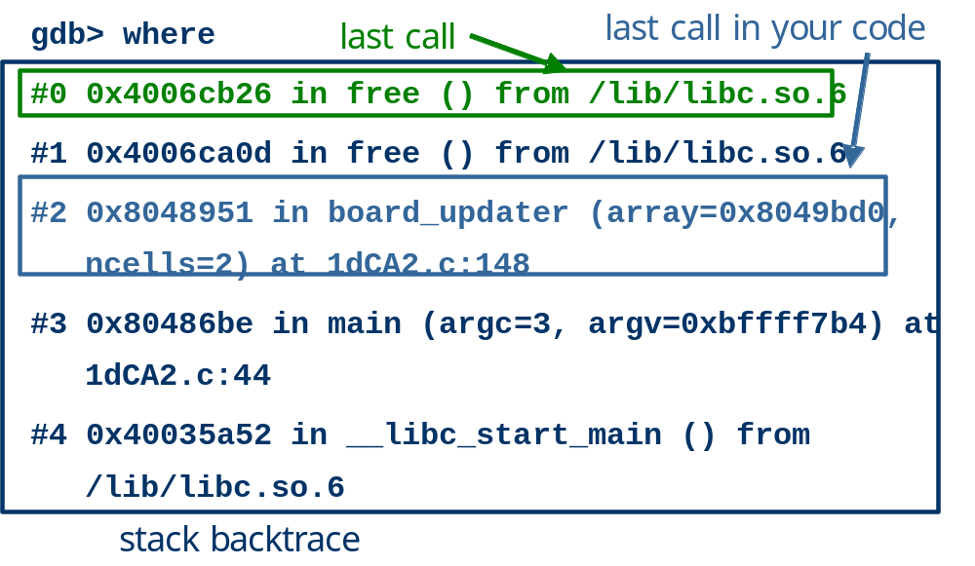
gdb – basic commands (2)

Slide 8
gdb – basic commands (3)
Look for topmost location in stack backtrace that corresponds to your code
Watch out for
  freeing memory you didn't allocate
  accessing arrays beyond their maximum elements
  dereferencing pointers that don't point to part of a malloc()ed block

Slide 9
gdb – basic commands (4)
break, continue, next, step commands
break causes execution to stop on a given line
  gdb> break foo.c: 100 (setting a breakpoint)
continue resumes execution from that point
next executes the next line, then stops
step executes the next statement
  goes into functions if necessary (next doesn't)

Slide 10
gdb – basic commands (5)
print and display commands
print prints the value of any program expression
  gdb> print i
  $1 = 100
display prints a particular value every time execution stops
  gdb> display i

Slide 11
gdb – printing arrays (1)
print will print arrays as well
int arr[] = { 1, 2, 3 };
gdb> print arr
$1 = {1, 2, 3}
N.B. the $1 is just a name for the result
print $1
$2 = {1, 2, 3}

Slide 12
gdb – printing arrays (2)
print has problems with dynamically-allocated arrays
int *arr;
arr = (int *)malloc(3 * sizeof(int));
arr[0] = 1; arr[1] = 2; arr[2] = 3;
gdb> print arr
$1 = (int *) 0x8094610
Not very useful...

Slide 13
gdb – printing arrays (3)
Can print this array by using @ (gdb special syntax)
int *arr;
arr = (int *)malloc(3 * sizeof(int));
arr[0] = 1; arr[1] = 2; arr[2] = 3;
gdb> print *arr@3
$2 = {1, 2, 3}

Slide 14
gdb – abbreviations
Common gdb commands have abbreviations
p (same as print)
c (same as continue)
n (same as next)
s (same as step)
More convenient to use when interactively debugging

Slide 15



Tree

Slide 16
Trees, Binary Trees, and Binary Search Trees
Linked lists are linear structures and it is difficult to use them to organize a hierarchical representation of objects.
Although stacks and queues reflect some hierarchy, they are limited to only one dimension.
To overcome this limitation, we create a new data type called a tree that consists of nodes and arcs. Unlike natural trees, these trees are depicted upside down with the root at the top and the leaves at the bottom.

Slide 17
Family Tree
Root
Dusty
Honey Bear
Brandy
Brunhilde
Terry
Coyote
Nugget
Gill
Tansey
Tweed
Zoe
Crocus
Primrose
Nous
Belle
leaf

Slide 18
Definition of tree
A tree is a finite set of one or more nodes
such that:
There is a specially designated node called
the root.
The remaining nodes are partitioned into n>=0 disjoint sets T1, ..., Tn, where each of these sets is a tree.
We call T1, ..., Tn the subtrees of the root.

Slide 19
Recursive definition
Root of Tree T
T1
T2
T3
T4
T5
SubTree

Slide 20
Binary Tree
A binary tree is a tree in which no node can have more than two children.
Each node has 0, 1, or 2 children

Slide 21
Linked Representation
Each tree node is represented as an object whose data type is
The space required by an n node binary tree is n * (space required by one node)
  typedef ... elmType;
  //whatever type of element
  typedef struct nodeType {
    elmType element;
    struct nodeType *left, *right;
  };
  typedef struct nodeType *treetype;
element (data)
left child right child

Slide 22
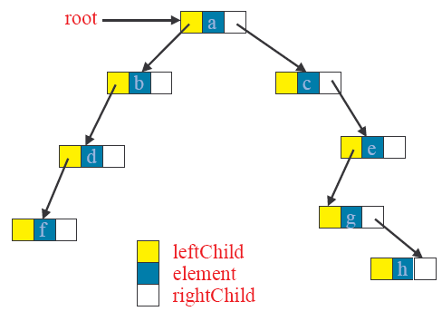
A linked binary tree

Slide 23
Binary Tree ADT
makenullTree(treetype *t)
creatnewNode()
isEmpty()

Slide 24
Tree initialization and verification
  typedef … elmType;
  typedef struct nodeType {
    elmType element;
    struct nodeType *left, *right;
  } node_Type;
  typedef struct nodeType *treetype;
  void MakeNullTree(treetype *T){
  (*T)=NULL;
  }
  int EmptyTree(treetype T){
  return T==NULL;
  }

Slide 25
Access left and right child
treetype LeftChild(treetype n)
{
if (n!=NULL) return n->left;
else return NULL;
}
treetype RightChild(treetype n)
{
if (n!=NULL) return n->right;
else return NULL;
}

Slide 26
create a new node
node_type *create_node(elmtype NewData)
{
N=(node_type*)malloc(sizeof(node_type));
if (N != NULL)
{
N->left = NULL;
N->right = NULL;
N->element = NewData;
}
return N;
}

Slide 27
check if a node is a leaf
int IsLeaf(treetype n){
if(n!=NULL)
  return(LeftChild(n)==NULL)&&(RightChild(n)==NULL);
  else return -1;
}

Slide 28
Recursive processing:
Number of nodes
As tree is a recursive data structure, recursive algorithms are usefuls when they are applied on tree.
int nb_nodes(treetype T){
if(EmptyTree(T)) return 0;
  else return 1+nb_nodes(LeftChild(T))+
    nb_nodes(RightChild(T));
}

Slide 29
Creat a tree from two sub-trees
treetype createfrom2(elmtype v, treetype l, treetype r){
treetype N; N=(node_type*)malloc(sizeof(node_type));
N->element=v;
N->left=l;
N->right=r;
return N;
}

Slide 30
Adding a new node to the left most position
treetype Add_Left(treetype *Tree, elmtype NewData){ node_type *NewNode = Create_Node(NewData);
if (NewNode == NULL) return (NewNode);
if (*Tree == NULL)
*Tree = NewNode;
else{
node_type *Lnode = *Tree;
while (Lnode->left != NULL)
Lnode = Lnode->left;
Lnode->left = NewNode;
}
return (NewNode);
}

Slide 31
Adding a new node to the right most position
treetype Add_Left(treetype *Tree, elmtype NewData){ node_type *NewNode = Create_Node(NewData);
if (NewNode == NULL) return (NewNode);
if (*Tree == NULL)
*Tree = NewNode;
else{
node_type *Rnode = *Tree;
while (Rnode->right != NULL)
Rnode = Lnode->right;
Rnode->right = NewNode;
}
return (NewNode);
}

Slide 32
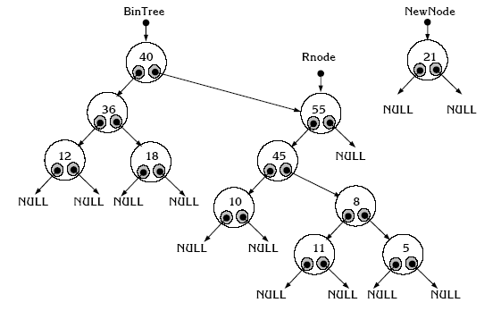
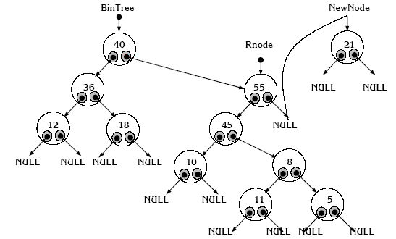
Illustration

Slide 33
Exercise
Develop the following helper functions for a tree:
  return the height of a binary tree.
  return the number of leafs
  return the number of internal nodes
  count the number of right children.

Slide 34
Exercise
A binary can represent an arithmetic expression: The leaves are operands and the other nodes are operators.
The left and right subtrees of an operator node represent subexpressions that must be evaluated before applying the operator at the root of the subtree.
For example
  !a + (b – c)/d
Write a program create a tree
representing this expression
+
!
/
-
d
a
b
c

Slide 35
Binary Search Tree
v
  Every element has a unique key.
  The keys in a nonempty left subtree (right subtree) are smaller (larger) than the key in the root of subtree.
  The left and right subtrees are also binary search trees.
≤ v
≥ v
BST
BST
7
7
3
9
3
9
2
5
2
5
8

Slide 36
Binary Search Tree Implementation
#include <stdio.h>
#include <stdlib.h>
typedef . . . KeyType; // specify a type for the data
typedef struct Node{
KeyType key;
  struct Node* left,right;
  } NodeType;
typedef Node* TreeType;

Slide 37
Search on BST
TreeType Search(KeyType x,TreeType Root){
if (Root == NULL) return NULL; // not found
else if (Root->key == x) /* found x */
return Root;
else if (Root->key < x)
//continue searching in the right sub tree
return Search(x,Root->right);
else {
// continue searching in the left sub tree
return Search(x,Root->left);
}
}

Slide 38
Insert a node from a BST
In a binary, there are not two nodes with the same key.
void InsertNode(KeyType x,TreeType *Root ){
if (*Root == NULL){
/* Create a new node for key x */
  *Root=(NodeType*)malloc(sizeof(NodeType));
  (*Root)->key = x;
  (*Root)->left = NULL;
  (*Root)->right = NULL;
}
else if (x < (*Root)->key) InsertNode(x, &(*Root)->left);
else if (x> Root->key) InsertNode(x, &(*Root)->right);
}

Slide 39
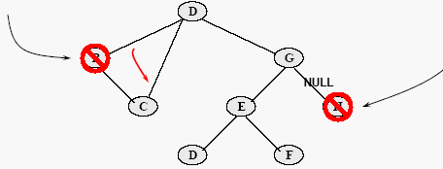
Delete a node from a BST
Removing a leaf node is trivial, just set the relevant child pointer in the parent node to NULL.
Removing an internal node which has only one subtree is also trivial, just set the relevant child pointer in the parent node to target the root of the subtree.

Slide 40
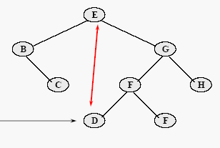
Delete a node from a BST
Removing an internal node which has two subtrees is more complex
  Find the left-most node of the right subtree, and then swap data values between it and the targeted node.
  Delete the swapped value from the right subtree.

Slide 41
Find the left-most node of right sub tree
This function find the leftmost node then delete it.
KeyType DeleteMin (TreeType *Root ){
KeyType k;
if ((*Root)->left == NULL){
  k=(*Root)->key;
  (*Root) = (*Root)->right;
  return k;
}
else return DeleteMin(&(*Root)->left);
}

Slide 42
Delete a node from a BST
void DeleteNode(key X,TreeType *Root){
if (*Root!=NULL)
if (x < (*Root)->Key) DeleteNode(x, &(*Root)->left)
else if (x > (*Root)->Key)
DeleteNode(x, &(*Root)->right)
else if
((*Root)->left==NULL)&&((*Root)->right==NULL)
  *Root=NULL;
else if ((*Root)->left == NULL)
*Root = (*Root)->right
  else if ((*Root)->right==NULL)
  *Root = (*Root)->left
    else (*Root)->Key = DeleteMin(&(*Root)->right);
}

Slide 43
Pretty print a BST
void prettyprint(TreeType tree,char *prefix){
char *prefixend=prefix+strlen(prefix);
if (tree!=NULL){
printf("%04d",tree->key);
if (tree->left!=NULL) if (tree->right==NULL){
printf("\304");strcat(prefix," ");
}
else {
printf("\302");strcat(prefix,"\263 ");
}
prettyprint(tree->left,prefix);
*prefixend='\0';
if (tree->right!=NULL) if (tree->left!=NULL){
printf("\n%s",prefix);printf("\300");
} else printf("\304");
strcat(prefix," ");
prettyprint(tree->right,prefix);
}
}

Slide 44
Exercise
Write a function to delete all node of a tree. This function must be called before terminating program.

Slide 45
Solution
void freetree(TreeType tree)
{
if (tree!=NULL)
{
freetree(tree->left);
freetree(tree->right);
free((void *) tree);
}
}

Slide 46
Exercise
Create an binary search tree with 10 nodes. Each node contains an random integer.
Ask user to input an number and search for it.
Print the content of the trees.

Slide 47
Solution
#include <stdio.h>
#include <stdlib.h>
#include <bsttree.h> // create by your self
#include <time.h>
int main(){
TreeType p, tree = NULL;
int i, n = 0;
srand(time(NULL));
for ( i = 0; i < 10; i++ )
insert (rand() % 100, tree );
printf("pretty print:\n");
strcpy(prefix," ");
prettyprint(tree,prefix);
printf("\n");
do {
printf("Enter key to search (-1 to quit):");
scanf("%d", &n);
p= Search(n, tree);
if (p!=NULL) printf("Key %d found on the tree",n);
else insert(n, tree);
while (n!=-1);
return 0;
}

Slide 48
Exercise
We assume that you make a mobile phone’s address book.
Declare a structure which can store at least "name", "telephone number", "e-mail address.”.
Declare a structure for a binary tree which can stores the structure of an address book inside. Read data of about 10 from an input file to this binary tree as the following rules.
  An address data which is smaller in the dictionary order for the e-mail address is stored to the left side of a node.
  An address data which is larger in the dictionary order for the e-mail address is stored to the right side of a node.
(1) Confirm the address data is organized in the binary tree structure with some methods (printing, debugger, etc).
(2) Find a specified e-mail address in the binary tree and output it to a file if found.
(3) Output all the data stored in the binary tree in ascending order for the e-mail address. (Reserve it for the next week)

Slide 49
Solution
#include <stdio.h>
#define MAX 20
typedef struct phoneaddress_t {
char name[20];
char tel[11];
char email[25];
}phoneaddress;
typedef struct Node{
phoneaddress key;
struct Node* Left,Right;
} NodeType;
typedef Node* TreeType;

Slide 50
Search function
TreeType Search(char* email,TreeType Root){
if (Root == NULL) return NULL; // not found
else if (strcmp((Root->Key).email, email) == 0) return Root;
else if (strcmp((Root->Key).email, email) < 0)
//continue searching in the right sub tree
return Search(email,Root->right);
else {
// continue searching in the left sub tree
return Search(email,Root->left);
}
}

Slide 51
Insert a node
void InsertNode(phoneaddress x,TreeType *Root ){
if (*Root == NULL){
*Root=(NodeType*)malloc(sizeof(NodeType));
(*Root)->Key = x;
(*Root)->left = NULL;
(*Root)->right = NULL;
}
else if (strcmp(((*Root)->Key).email, x.email) > 0)
InsertNode(x, (*Root)->left);
else if (strcmp(((*Root)->Key).email, x.email) > 0) InsertNode(x,(*Root)->right);
}

Slide 52
Solution
int main(void)
{
FILE *fp;
phoneaddress phonearr[MAX];
treetype root;
int i,n, irc; // return code
int reval = SUCCESS;
int n=10;
//read from this file to array again
if ((fp = fopen("phonebook.dat","rb")) == NULL){
printf("Can not open %s.\n", "phonebook.dat");
reval = FAIL;
}
irc = fread(phonearr, sizeof(phoneaddress), n, fp);
fclose(fp);

Slide 53
Solution
. . .;
for (i=0; i<n; i++)
root = InsertNode(phonearr[i],root);
pretty_print(root,0);
// Search for an email
// Do it by your self
. . .
}

