Slide 1

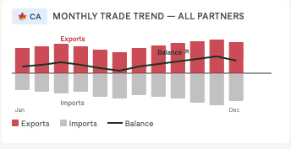
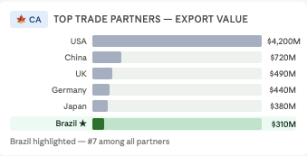
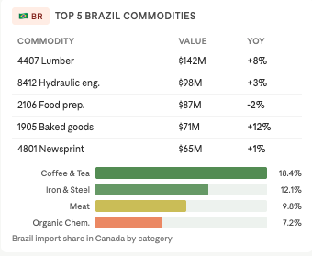
Canada Trade
Total trade flow, balance, and year-over-year trend · 2024–2025
Country
Commodity
Province
Trade Type
Mar 2024 – Apr 2025
Overview
Total trade flow, balance, and year-over-year trend
Canada – Overall Trade
TRADE BALANCE
CANADA EXPORTS
CANADA IMPORTS
$8.4B
$8.4B
$8.4B
Total Canada Export Value – All countries
Total Import Value – All countries
Exports minus imports
6.2% vs 2024
6.2% vs 2024
6.2% vs 2024
MONTHLY TRADE TREND — ALL PARTNERS
TOP TRADE PARTNERS – EXPORT VALUES
TOP TRADE TREND VS PEERS
Product Performance
TOP H2S CHAPTER - export
FASTEST GROWING - Exports
TOP H2S CHAPTER - Import
FASTEST GROWING - Imports
84
+12%
84
+12%
Machinery – highest volum
Baked goods
Machinery – highest volum
Baked goods
YOY growth by commodity TOTAL VALUE (CAD)
Which products drive the most trade value · grouped by HS chapter
TOP 10 HS2 CHAPTERS BY TOTAL VALUE (CAD)
Geographic Insights
TOP Province
TOP Province
ON
ON
Ontario Leads CA exports
38% of total volume
Ontario Leads CA Imports
38% of total volume
EXPORT VALUE BY PROVINCE
YOY growth by province
TOTAL VALUE (CAD)
PROVINCE (ORIGIN OF CA EXPORTS)

Slide 2

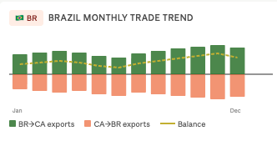
Canada × Brazil Trade
Total trade flow, balance, and year-over-year trend · 2024–2025
Country
Commodity
Province
Trade Type
Mar 2024 – Apr 2025
Overview
Total trade flow, balance, and year-over-year trend
Canada – Overall Trade
TRADE BALANCE
CANADA EXPORTS
CANADA IMPORTS
$8.4B
$8.4B
$8.4B
Total Canada Export Value – All countries
Total Import Value – All countries
Exports minus imports
6.2% vs 2024
6.2% vs 2024
6.2% vs 2024
MONTHLY TRADE TREND — ALL PARTNERS
TOP TRADE PARTNERS – EXPORT VALUES
Brazil – Bilateral Trade
BRAZIL EXPORTS
BRAZIL IMPORTS
# 7 PARTNER RANK
$8.4B
$8.4B
# 7
Brazil among Canada’s partners
Canada → Brazil
Brazil among Canada’s partners
Was #8 in 2024
6.2% vs 2024
6. Was #8 in 2024
BRAZIL TRADE TREND VS PEERS
🇧🇷 BR
BRAZIL TRADE TREND VS PEERS
Product Performance
TOP H2S CHAPTER
FASTEST GROWING
CANADA EXPORTS
84
+12%
115
Machinery – highest volum
Baked goods
Unique commodities
Brazil-Canada only
Which products drive the most trade value · grouped by HS chapter
TOP 10 HS2 CHAPTERS BY TOTAL VALUE (CAD)
Geographic Insights
TOP Province
TOP BR origin
ON
ON
Ontario Leads CA exports
38% of total volume
Province most active with Brazil
34% of CA -. BR exports
EXPORT VALUE BY PROVINCE
PROVINCE → BRAZIL (ORIGIN OF CA EXPORTS)

Slide 3
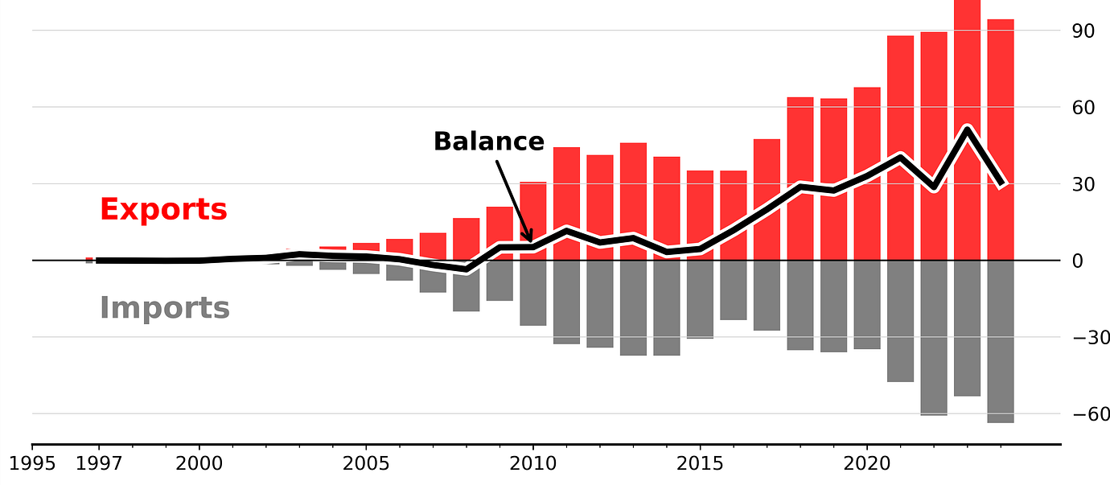
Canada × Brazil Trade
Total trade flow, balance, and year-over-year trend · 2024–2025
Country
Commodity
Province
Trade Type
Mar 2024 – Apr 2025
Overview
Total trade flow, balance, and year-over-year trend
$8.4B
$12.1B
-$3.7B
$1.2B
$1.2B
Total Canada Export Value
Total Canada Import Value
Trade Balance
Brazil Export Volume
Brazil Import Volume
6.2% vs 2024
all countries → Canada
Exports minus imports
Brazil → Canada
Canada → Brazil
CANADA MONTHLY TRADE VALUE TREND — CANADA EXPORTS VS IMPORTS
CANADA MONTHLY TRADE VALUE TREND — CANADA EXPORTS VS IMPORTS
Product Performance
115 Products
IMPORTS
Which products drive the most trade value · grouped by HS chapter
Total Number of imported products from Brazil
TOP 10 HS2 CHAPTERS BY TOTAL VALUE (CAD)
TOP 5 COMMODITIES — Brazil → Canada
Commodity | Value | YoY
4407 Lumber | $142M | +8%
8412 Hydraulic eng. | $98M | +3%
2106 Food prep. | $87M | -2%
1905 Baked goods | $71M | +12%
4801 Newsprint | $65M | +1%
Competitive Positioning – Brazil’s Market Share by Product
Where Brazil is gaining, holding, or losing ground relative to other countries
BRAZIL SHARE CHANGE YOY (PERCENTAGE POINTS)
BRAZIL'S IMPORT SHARE IN CANADA — TOP COMMODITY CATEGORIES (%)
Geographic Insights
+12% YoY
# 7 Partner
Brazil Export Volume
Brazil Export Volume
Where trade originates in Canada and how Brazil compares to other partners
Brazil trade volume grew in 2025
Brazil ranks 7th among Canada’s export destinations
TOP 10 TRADE PARTNERS — VALUE RANK
EXPORT VALUE BY PROVINCE

