Slide 1
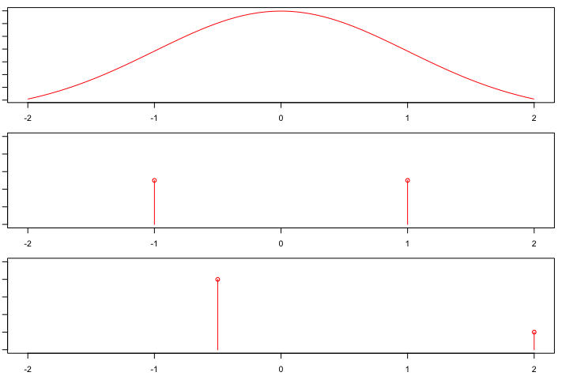
Normal
Mean=0, S.D.=1
Error Rate = .02
Symmetric Binary
Mean=0, S.D.=1
Error Rate = .00
Skewed Binary
Mean=0, S.D.=1
Error Rate = .20

