Slide 1
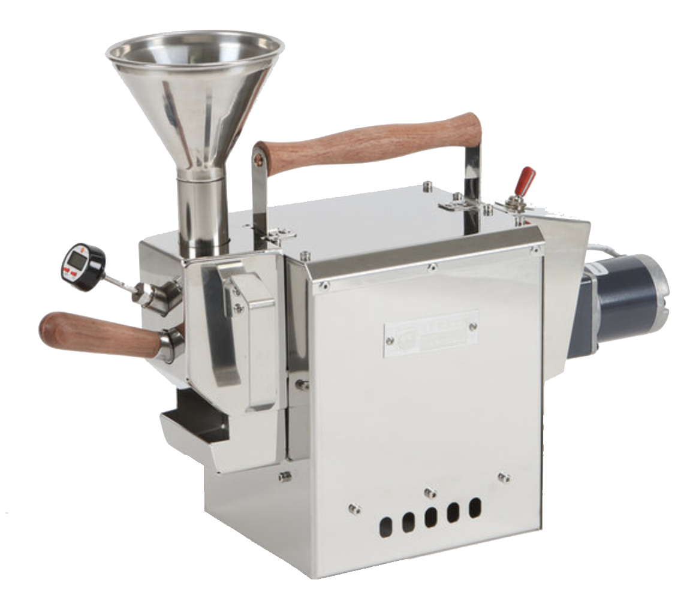
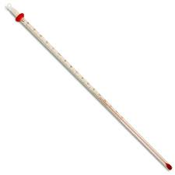
Functions of a Random Variable
160
RV T is temperature in Fahrenheit. Need Celsius.
T: Ω->R. f: R -> R. f(t) = 5/9 (f-32)
f(T) is a RV. f◦T(w)
Ω
T
f
R
R

Slide 2
Creating Events from a Random Variable
160
You want to know if the temperature is under 150
T < 150
P(T<150) = P( )
P(T > 100) or P(100 < T < 120)
T
160
Ω
130
120

Slide 3
Operators of a Random Variable
160
You want to know the minimum possible temperature of the roaster.
(if it exists!)
Ω
T
–459.67°F.

