Slide 1
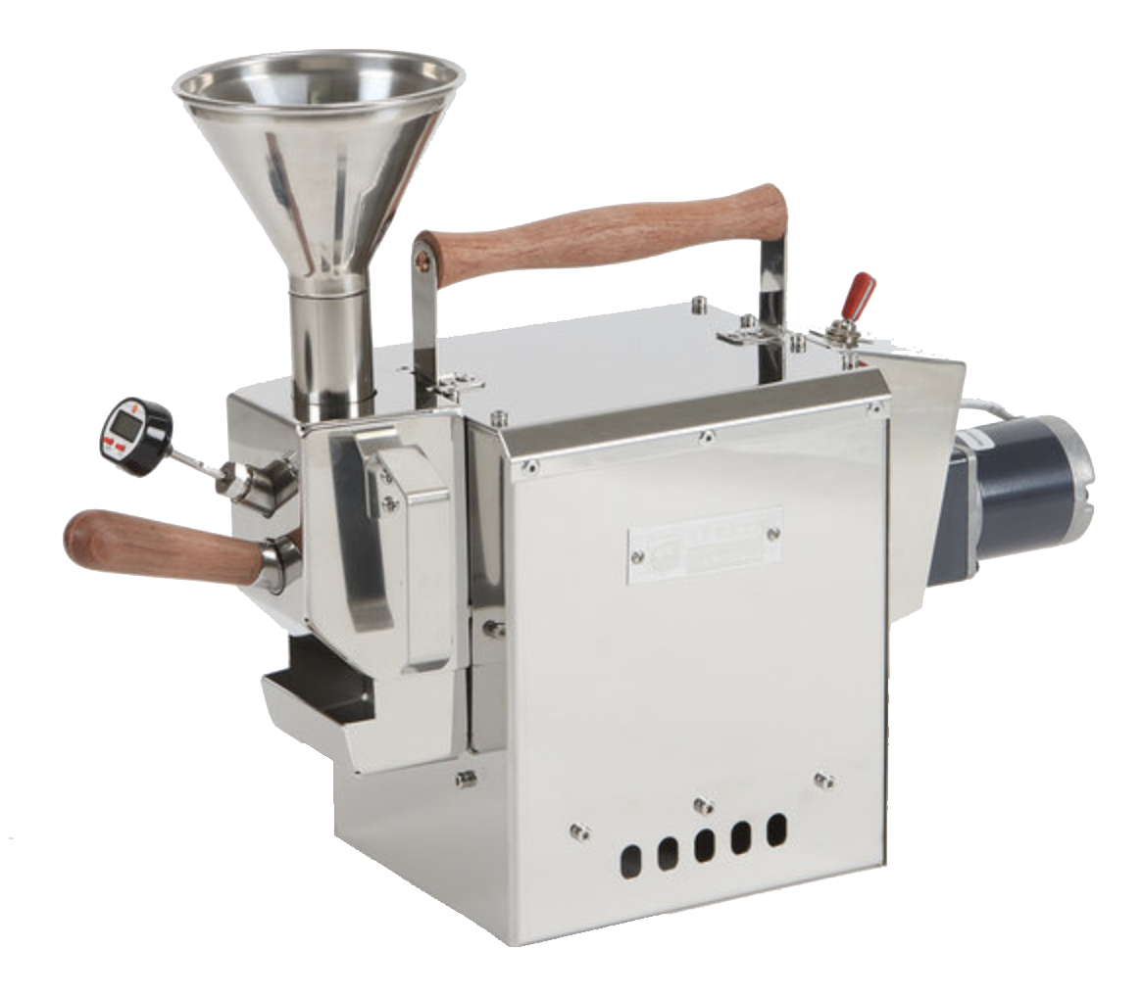
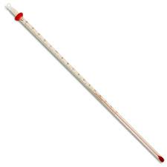
160
Sample Space
Ω
👉🏽
T
Nature
Events S
Probability P

Slide 2
Sample Space
Ω
T

