Slide 1
CPSC 375 Introduction to Data Science and Big Data Analytics
Dr. Anand Panangadan
apanangadan@fullerton.edu

Slide 2
Clustering
K-means clustering

Slide 3
Supervised Learning
Features
Labels
Petal Length | Petal Width | Sepal Length | Sepal Width | Species
5.1 | 3.5 | 1.4 | 0.2 | Setosa
4.9 | 3.0 | 1.4 | 0.2 | Setosa
6.2 | 2.9 | 4.3 | 1.3 | Versicolor
6.3 | 3.3 | 6.0 | 2.5 | Virginica
5.1 | 2.5 | 3.0 | 1.1 | Versicolor
7.1 | 3.0 | 5.9 | 2.1 | Virginica
Training data
5.1 | 3.5 | 1.4 | 0.2 | ?
7.1 | 3.0 | 5.9 | 2.1 | ?
Predictions

Slide 4
Supervised Learning
Features
Labels
Petal Length | Petal Width | Sepal Length | Sepal Width | Species
5.1 | 3.5 | 1.4 | 0.2 | Setosa
4.9 | 3.0 | 1.4 | 0.2 | Setosa
6.2 | 2.9 | 4.3 | 1.3 | Versicolor
6.3 | 3.3 | 6.0 | 2.5 | Virginica
5.1 | 2.5 | 3.0 | 1.1 | Versicolor
7.1 | 3.0 | 5.9 | 2.1 | Virginica
Training data
Split for evaluation
Test data

Slide 5
Unsupervised Learning
Features
Labels
Petal Length | Petal Width | Sepal Length | Sepal Width | Species
5.1 | 3.5 | 1.4 | 0.2 | Setosa
4.9 | 3.0 | 1.4 | 0.2 | Setosa
6.2 | 2.9 | 4.3 | 1.3 | Versicolor
6.3 | 3.3 | 6.0 | 2.5 | Virginica
5.1 | 2.5 | 3.0 | 1.1 | Versicolor
7.1 | 3.0 | 5.9 | 2.1 | Virginica
Also called “Clustering”

Slide 6
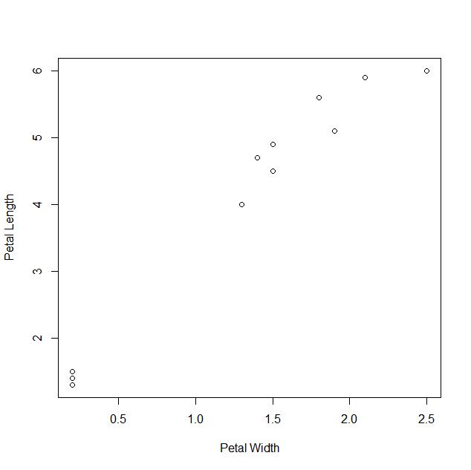
Clustering

Slide 7
Clustering
Partitioning of a data set into subsets (the clusters), so that the data in each subset
are similar to others in that subset
and different from data in other subsets
Similarity defined by some distance measure
Data within a subset are near each other
The challenge:
How do we draw the cluster boundaries?
Clustering algorithms

Slide 8
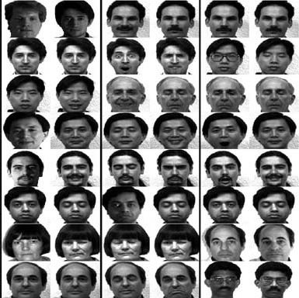
Clustering example
Clustering/Unsupervised learning

Slide 9
K-means clustering algorithm
Most popular clustering algorithm
Start with k initial cluster centers
Iterate:
Assign/cluster each example to closest center
Recalculate centers as the mean of the points in a cluster

Slide 10
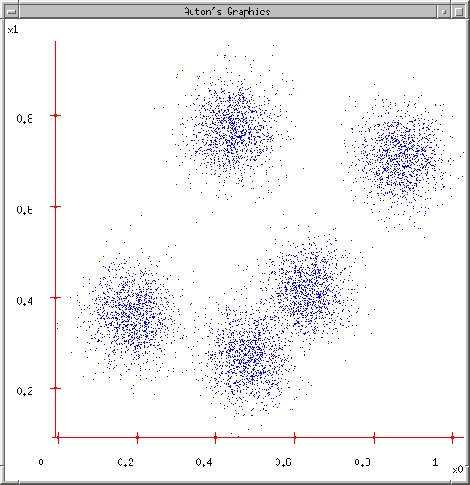
K-means
Ask user how many clusters they’d like. (e.g. k=5)

Slide 11
K-means
Ask user how many clusters they’d like. (e.g. k=5)
Randomly guess k cluster Center locations

Slide 12
K-means
Ask user how many clusters they’d like. (e.g. k=5)
Randomly guess k cluster Center locations
Each datapoint finds out which Center it’s closest to. (Thus each Center “owns” a set of datapoints)

Slide 13
K-means
Ask user how many clusters they’d like. (e.g. k=5)
Randomly guess k cluster Center locations
Each datapoint finds out which Center it’s closest to.
Each Center finds the centroid of the points it owns

Slide 14
K-means
Ask user how many clusters they’d like. (e.g. k=5)
Randomly guess k cluster Center locations
Each datapoint finds out which Center it’s closest to.
Each Center finds the centroid of the points it owns…
…and jumps there
…Repeat until terminated!

Slide 15
K-means: an example

Slide 16
K-means: Initialize centers randomly

Slide 17
K-means: assign points to nearest center

Slide 18
K-means: readjust centers

Slide 19
K-means: assign points to nearest center

Slide 20
K-means: readjust centers

Slide 21
K-means: assign points to nearest center

Slide 22
K-means: readjust centers

Slide 23
K-means: assign points to nearest center
No changes: Done

Slide 24
K-means
Iterate:
Assign each data point to closest center
Recalculate centers as the mean of the points in a cluster

Slide 25
K-means
Iterate:
Assign each data point to closest center
Recalculate centers as the mean of the points in a cluster
iterate over each point:
- get distance to each cluster center
- assign to closest center
Which distance measure?

Slide 26
Distance measures
Euclidean:

Slide 27
K-means
Iterate:
Assign/cluster each example to closest center
Recalculate centers as the mean of the points in a cluster
Where are the cluster centers?

Slide 28
K-means
Iterate:
Assign/cluster each example to closest center
Recalculate centers as the mean of the points in a cluster
Mean of the points in the cluster:

Slide 29
K-means convergence
When do we stop the algorithm?
A fixed number of iterations
partitions unchanged
Cluster centers don’t change

Slide 30
K-means loss function
K-means tries to minimize what is called the k-means loss function:
that is, the sum of the squared distances from each point to the associated cluster center

Slide 31
Minimizing k-means loss
Iterate:
1. Assign/cluster each example to closest center
2. Recalculate centers as the mean of the points in a cluster
Each step of k-means moves towards reducing this loss function
Basis of proof that k-means converges to a solution in a finite number of steps

Slide 32
It converges – but will we find the optimal configuration?
Not always
Example: a configuration that has converged, but does not have the minimum loss

Slide 33
Will we find the optimal configuration?
A configuration that has converged, but does not have the minimum loss

Slide 34
Minimizing k-means loss
Iterate:
1. Assign/cluster each example to closest center
2. Recalculate centers as the mean of the points in a cluster
NO! It will find a minimum.
Unfortunately, the k-means loss function is generally not convex and for most problems has many, many minima
We’re only guaranteed to find one of them

Slide 35
K-means in R
kmeans(x, centers=k)
x: data in matrix form
centers: the number of clusters, k
Outputs an object with the centers after convergence and which point belongs to which center
irismeans <- kmeans(iris[,3:4], centers=3)
> irismeans$centers
Sepal.Length Sepal.Width Petal.Length Petal.Width
1 6.850000 3.073684 5.742105 2.071053
2 5.901613 2.748387 4.393548 1.433871
3 5.006000 3.428000 1.462000 0.246000

Slide 36
Classwork
Cluster the iris dataset into 3 clusters using all four Petal/Sepal columns
Compare the clusters with the true labels (Species)
Check if increasing random restarts increases clustering accuracy

Slide 37
Seed choice
Results can vary drastically based on seed selection
Some seeds can result in poor convergence rate, or convergence to sub-optimal clusterings
Common heuristics
Random centers in the space
Randomly pick data points
Points least similar to any existing center
Furthest centers heuristic
Do many runs of k-means, each from a different random start configuration

Slide 38
K-means: Initialize centers randomly
What would happen here?

Slide 39
K-means: Initialize centers randomly
What would happen here?

Slide 40
Furthest centers heuristic
μ₁ = pick random point
for i = 2 to K:
μ_{i} = point that is furthest from any previous centers
point with the largest distance to any previous center
smallest distance from x to any previous center

Slide 41
K-means: Initialize furthest from centers
Pick a random point for the first center

Slide 42
K-means: Initialize furthest from centers
What point will be chosen next?

Slide 43
K-means: Initialize furthest from centers
Furthest point from center
What point will be chosen next?

Slide 44
K-means: Initialize furthest from centers
Furthest point from center
What point will be chosen next?

Slide 45
K-means: Initialize furthest from centers
Furthest point from center

Slide 46
Furthest points concerns
If k = 4, which points will get chosen?

Slide 47
Furthest points concerns
If we do a number of trials, will we get different centers?
Notes:
yes and no
we will get different centers, but the three outliers will always get chosen!

Slide 48
Furthest points concerns
Doesn’t deal well with outliers

Slide 49
Weaknesses of K-Mean Clustering
Sensitive to initial conditions: Initial centers affect the final clusters
The number of clusters, K, must be determined before hand.
The order of the data points in the data set matters
Algorithm converges but not necessarily to the global optimum

Slide 50
Strengths of K-Means Clustering
Computationally efficient
Linear in the number of data points
Improvements to seed selection continue to be made
K-means++

Slide 51
K-means++
μ₁ = pick random point
for k = 2 to K:
for i = 1 to N:
s_{i} = min d(x_{i}, μ_{1…k-1}) // smallest distance to any center
μ_{k} = randomly pick point proportional to s
How does this help?

Slide 52
K-means++
μ₁ = pick random point
for k = 2 to K:
for i = 1 to N:
s_{i} = min d(x_{i}, μ_{1…k-1}) // smallest distance to any center
μ_{k} = randomly pick point proportional to s
Makes it possible to select other points
if #points >> #outliers, we will pick good points
Makes it non-deterministic, which will help with random runs
Nice theoretical guarantees!

Slide 53
Hard vs. soft clustering
Hard clustering: Each example belongs to exactly one cluster
Soft clustering: An example can belong to more than one cluster (probabilistic)
Makes more sense for applications like creating hierarchies
You may want to put a pair of sneakers in two clusters:
(i) sports apparel
(ii) shoes

Slide 54
Type of Clustering Algorithms
Flat algorithms
Start with a random (partial) partitioning
Refine it iteratively
K means clustering
Hierarchical algorithms
Bottom-up, agglomerative
Top-down, divisive

Slide 55
Single Linkage Hierarchical Clustering
Say “Every point is its own cluster”

Slide 56
Single Linkage Hierarchical Clustering
Say “Every point is its own cluster”
Find “most similar” pair of clusters

Slide 57
Single Linkage Hierarchical Clustering
Say “Every point is its own cluster”
Find “most similar” pair of clusters
Merge it into a parent cluster

Slide 58
Single Linkage Hierarchical Clustering
Say “Every point is its own cluster”
Find “most similar” pair of clusters
Merge it into a parent cluster
Repeat

Slide 59
Single Linkage Hierarchical Clustering
Say “Every point is its own cluster”
Find “most similar” pair of clusters
Merge it into a parent cluster
Repeat

Slide 60
Single Linkage Hierarchical Clustering
How do we define similarity between clusters?
Minimum distance between points in clusters (in which case we’re simply doing Euclidian Minimum Spanning Trees)
Maximum distance between points in clusters
Average distance between points in clusters
Say “Every point is its own cluster”
Find “most similar” pair of clusters
Merge it into a parent cluster
Repeat…until you’ve merged the whole dataset into one cluster
Dendrogram: a hierarchy of datapoints

Slide 61
Acknowledgment
Andrew Moore, CMU
Link to the source repository of tutorials: http://www.cs.cmu.edu/~awm/tutorials
David Kauchak, Pomona College
http://www.cs.pomona.edu/~dkauchak/classes/f13/cs451-f13/

