Slide 1
CPSC 375 Introduction to Data Science and Big Data Analytics
Dr. Anand Panangadan
apanangadan@fullerton.edu

Slide 2
What we will cover
Time series data type in R
Decomposing time series

Slide 3
Time-Series Data
Numerical data obtained at regular time intervals
The time intervals can be annually, quarterly, monthly, weekly, daily, hourly, etc.
Example:
Year: 2005 2006 2007 2008 2009
Sales: 75.3 74.2 78.5 79.7 80.2

Slide 4
Time Plot
A time-series plot (time plot) is a two-dimensional plot of time series data
the vertical axis measures the variable of interest
the horizontal axis corresponds to the time periods

Slide 5
Question
You are the manager of a clothing store and the sales have gone up this month.
Is this reason to give yourself a salary raise?!

Slide 6
Question
Atmospheric CO2 levels have been increasing at a high rate for the last 6 months.
Are we doomed?!
https://keelingcurve.ucsd.edu/
Look at 6 months plot

Slide 7
Time-Series Components
Time-Series
Trend Component
Seasonal Component
Irregular /Random Component
Overall, persistent, long-term change
Regular periodic fluctuations
Erratic or residual fluctuations

Slide 8
Trend Component
Long-term increase or decrease over time
Sales
Upward trend
Time

Slide 9
Trend Component
Trend can be upward or downward
Trend can be linear or non-linear
Sales
Sales
Time
Time
Downward linear trend
Upward non-linear trend

Slide 10
Seasonal Component
Regular wave-like patterns
Business applications: Often monthly or quarterly
IoT sensor applications: daily
Sales
Summer
Winter
Summer
Winter
Spring
Fall
Spring
Fall
Time (Quarterly)

Slide 11
Irregular/Random Component
Unpredictable, random, “residual” fluctuations
“Noise” in the time series

Slide 12
Two simplified time series models
Non-seasonal Model
Only Trend (+ random)
Classical Decomposition Model
Trend and Seasonal Components (+ random)

Slide 13

Non-seasonal Model
Only trend (+ random)
$$Y_{t}=m_{t}+ε_{t}$$
Observed
Trend
Random noise
$$Y_{t}=m_{t}+ε_{t}=\left(β_{0}+β_{1}t\right)+ε_{t}$$

Slide 14
Non-seasonal Models with Trend
Method: Trend estimation
Estimate the trend by regression analysis
Then remove it

Slide 15

Trend Estimation by Regression Analysis
Estimate a trend line using regression analysis
Use time (t) as the independent variable:
Year | Time Period (t) | Sales (Y)
2004 2005 2006 2007 2008 2009 | 0 1 2 3 4 5 | 20 40 30 50 70 65
$$\hat{Y_{t}}=β_{0}+β_{1}t$$
In least squares linear, non-linear, and
exponential modeling, time periods are
numbered starting with 0 and increasing
by 1 for each time period.

Slide 16

Least Squares Regression
The estimated linear trend equation is:
Year | Time Period (t) | Sales (Y)
2004 2005 2006 2007 2008 2009 | 0 1 2 3 4 5 | 20 40 30 50 70 65
$$\hat{Y_{t}}=21.905+9.571t$$

Slide 17

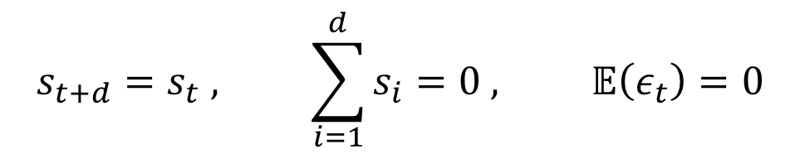
Classical Decomposition Model
Trend + Seasonal (+ random)
$$Y_{t}=m_{t}+s_{t}+ε_{t}$$
Observed
Trend
Seasonal
Random noise
$$s_{t+d}=s_{t} , \sum_{i=1}^{d}{s_{i}}=0 , 𝔼\left(ε_{t}\right)=0$$

Slide 18
Classical Decomposition Model
Method: Filtering
First, estimate and remove the trend component by using moving average method
Then, estimate and remove the seasonal component by using suitable periodic averages

Slide 19
Time series analysis in R
ts object
class with attributes to represent data which has been sampled at equally-spaced points in time
To convert vector x to timeseries object xts:
xts <- ts(x, frequency=7)
Frequency
Difference between a vector and a time-series
Assume equally spaced samples
frequency is used when the series is sampled an integral number of times in each unit time interval.
Examples:
freq=7 when the data are sampled daily and the natural time period is a week
freq=12 when the data are sampled monthly and the natural time period is a year
Notes:
print(nottem)

Slide 20
Time period and Frequency
CO2 levels measured monthly
Natural time period: 12 months (year)
Frequency: 12
Freeway traffic measured hourly
Natural time period:1 day (morning rush hour …)
Frequency: 24
Freeway traffic measured daily
Natural time period: 1 week
Frequency: 7

Slide 21
Time series analysis in R
Autocorrelation
Correlation of the time series with shifted versions of itself
X-axis: amount of shift
Y-axis: correlation
To identify frequency if we don’t know this from domain knowledge
A peak is seen when the shift matches the natural time-period of the data
Highest peak is always at x=0 which is not interesting
Pick second highest peak

Slide 22
Autocorrelation
Shift | Correlation
None | 1 (Very high)
A little | A little lower
More | Significantly lower
shift=full cycle: frequency | High again (<1)

Slide 23
Autocorrelation
Shift | Correlation
No shift | High
Small shift | High, but less than previous
Shift more | High, lesser than before
 | Low correlation (negative)
shift=frequency | Goes up again

Slide 24
Time series analysis in R
Autocorrelation in R
acf(myvector)
Plots autocorrelation
Identify 2nd peak and use corresponding lag value (x-axis) for frequency

Slide 25
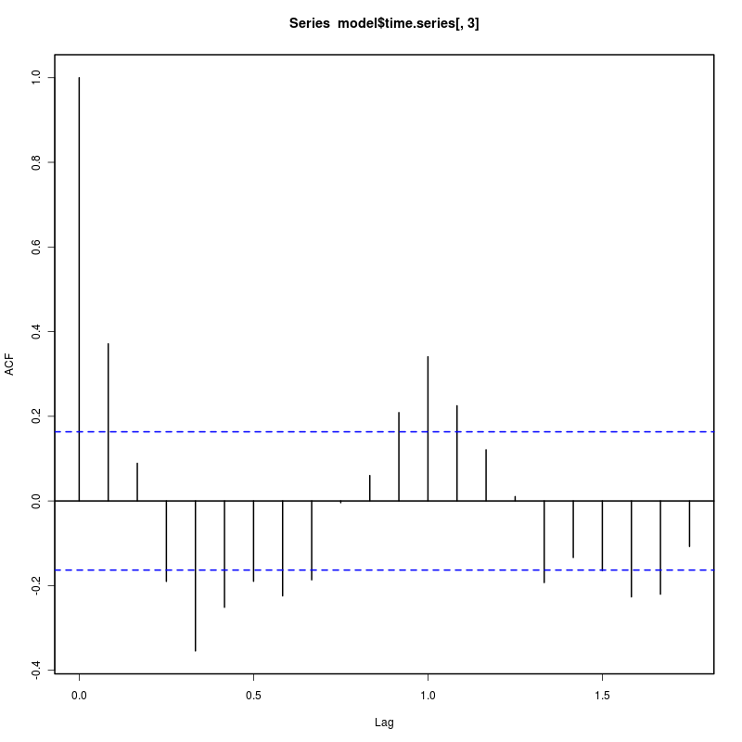
Time series analysis in R
Autocorrelation
1st peak at lag=0 is always highest
2nd peak indicating natural time period
Lag value is the natural time period

Slide 26
Time series analysis in R
decompose(myts)
Assumes frequency is set correctly
Separates myts into trend, seasonal, and random components

Slide 27
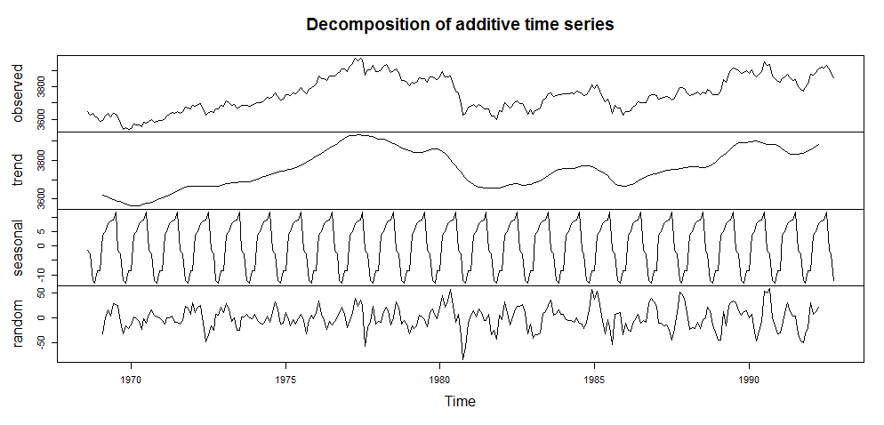
Time series analysis in R
plot(decompose(myts))

Slide 28
Classwork
Read the text CSV file at https://raw.githubusercontent.com/jbrownlee/Datasets/master/daily-min-temperatures.csv which describes the minimum daily temperatures over 10 years (1981-1990) in Melbourne, Australia. The goal is to convert this to a R ts object with the appropriate frequency and then decompose it into trend, seasonal, and random components. Write R code to do the following:
Read the file into a R object
Find the frequency of the seasonal component (Hint: use acf() with a large lag.max parameter value)
Convert to a ts object
Decompose the ts object

