Slide 1
CPSC 375 Introduction to Data Science and Big Data Analytics
Dr. Anand Panangadan
apanangadan@fullerton.edu

Slide 2
What we will cover today
Introductions
What is Data Science?
What is the relationship between Data Science and Big Data?
Where does this course fit in CSUF?
Course Outline

Slide 3

A bit about myself
Associate Professor
Computer Science Department

Slide 4
Research interests
Applications of machine learning
Transportation
Social network analysis
Text mining
Sensor networks
Classification of time-series

Slide 5
A bit about yourself?
In next 5 minutes:
Move to breakout rooms of 3 students
Introduce yourselves to each other
Learn your partner’s name
Why they chose CPSC 375
Anything else they would like to share
When you come back to the main room
Introduce your new friend to the class

Slide 6
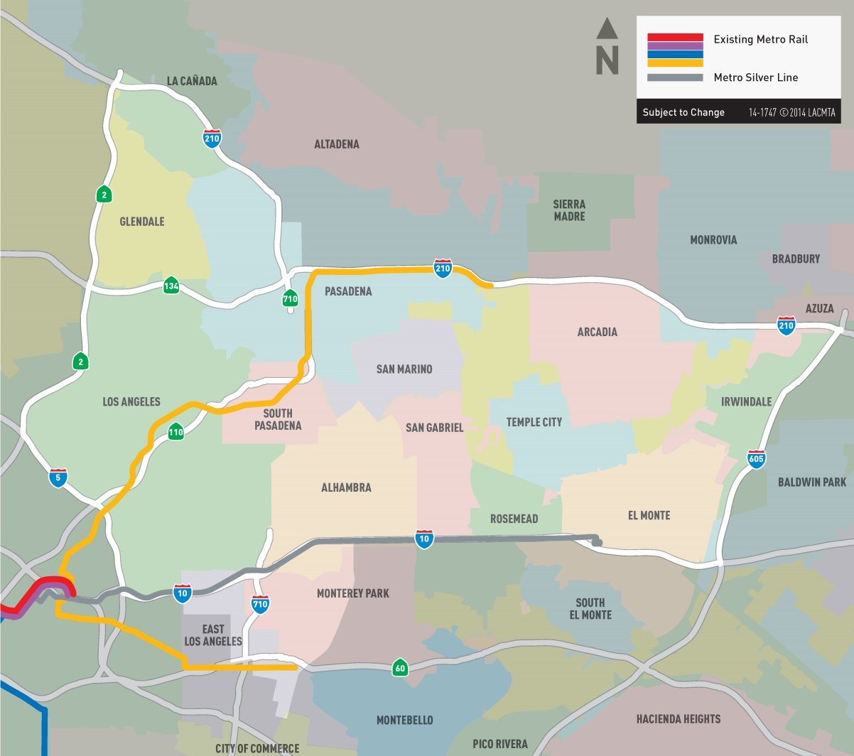
Example application
I-710 Freeway in Los Angeles

Slide 7
Which of these are favored by the public?
Some people do not want a freeway to go through their city
Some people want a freeway to reduce traffic congestion in their city

Slide 8
5 options before the public
Formally developed by Caltrans
1
2
3
4
5
Bus Rapid Transit
Freeway Tunnel
Light Rail Transit
No Build
Transportation System Management/Transportation Demand Management(TSM/TDM)

Slide 9
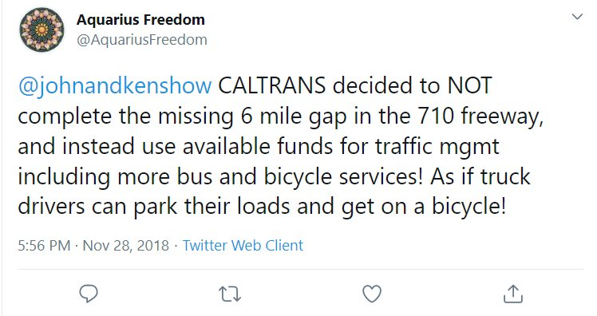
Use social media
Analyze “sentiment” in Twitter tweets
Sentiment: degree of subjective positivity/negative in a message

Slide 10
Challenges
Need to write programs to
Identify tweets that are about the 710 freeway project
Classify tweets into one of the 5 choices
Compute average sentiment for each topic/choice

Slide 11
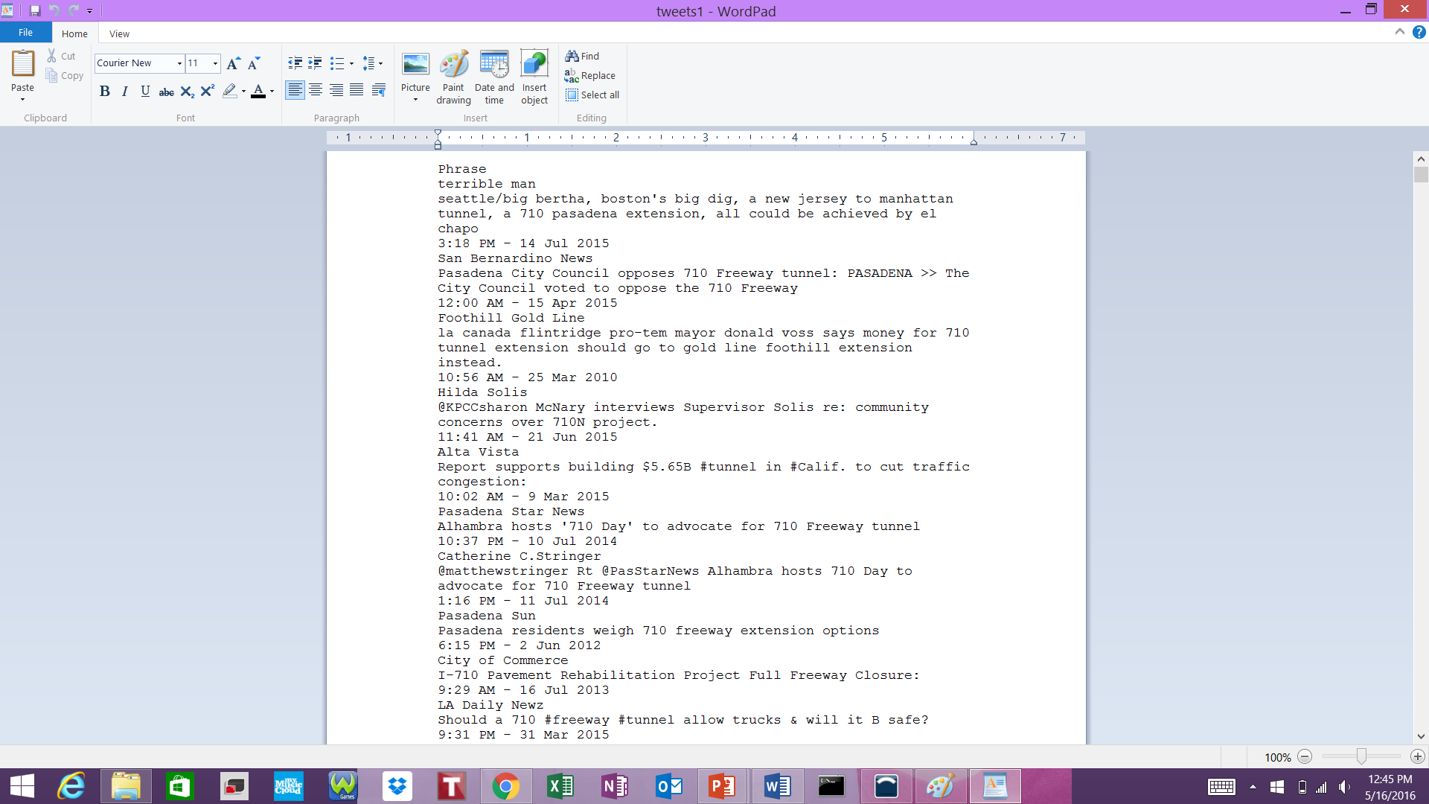
Download data

Slide 12
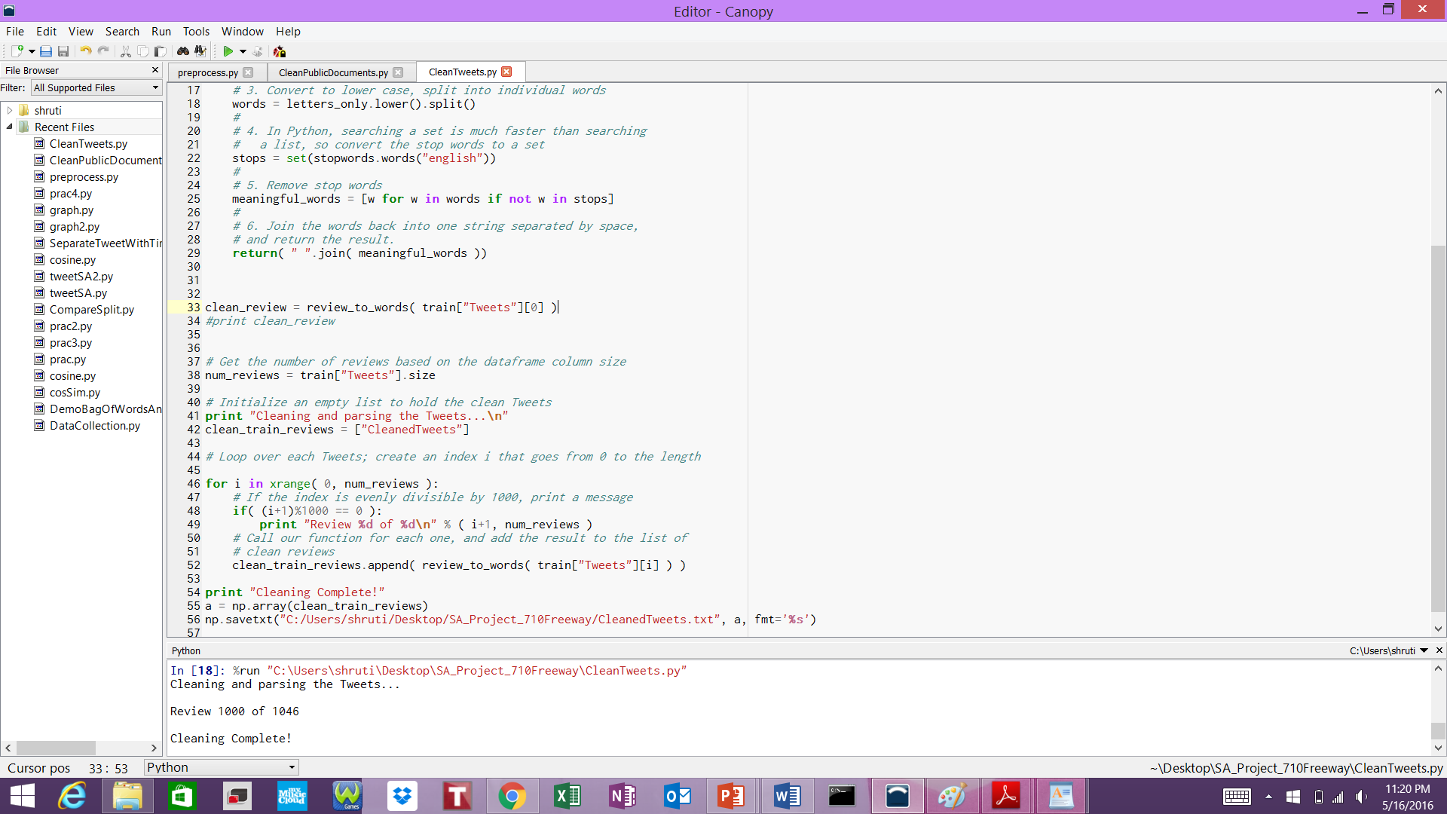
Write (lots of) code!
Pre-process the tweets

Slide 13
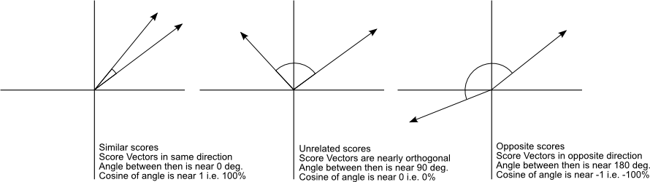
Compute similarity to topics
Cosine similarity
Write code for this

Slide 14
Present results
Quantitative results
Options | Positive Tweets | Negative Tweets | Neutral Tweets | Total Tweets (1046) | % Positives/ Total tweets
BRT | 43 | 40 | 134 | 217 | 4.11
LRT | 14 | 7 | 64 | 85 | 1.33
Tunnel | 254 | 136 | 303 | 693 | 24.28
TSM | 5 | 3 | 4 | 15 | 0.47
No Build | 6 | 6 | 24 | 36 | 0.57

Slide 15
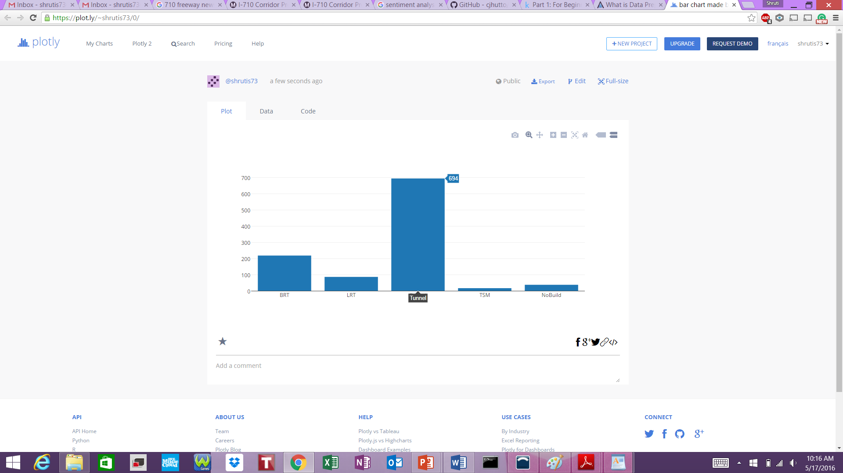
Present results
Quantitative results

Slide 16
Some questions
What does “data science” mean?
Is data science only the stuff going on in companies like Google and Facebook and tech companies?
What is “Big Data”?
Just how big is big? Or is it just a relative term?
What is the relationship between Big Data and data science?
Is data science the science of Big Data?
Why do many people refer to Big Data as crossing disciplines (astronomy, finance, tech, etc.)

Slide 17
Data Science – A Definition
Data Science is the science which uses computer science, statistics and machine learning, visualization and human-computer interactions to collect, clean, integrate, analyze, visualize, interact with data to create data products.
data product: an insight or tool created out of raw data that can be used to improve decision making⁺
⁺https://www.quora.com/What-are-data-products/answer/MoData

Slide 18
Examples of data →data products
Movie reviews →movie recommendation (Netflix)
Medical data →diagnosis
Smartwatch sensor data →activity level (Fitbit)
Tweets on Twitter →identify revolutions
Google search data →flu activity [Google Flu Trends]
Home sales data → home selling strategy

Slide 19
Goal of Data Science
Turn data into data products
It is a process
Not a science?!

Slide 20
The Data Science Process
Data Visualization
Data analysis
Exploratory Data Analysis
Other data
Formatting, Cleaning
Data integration
Storage
Data

Slide 21
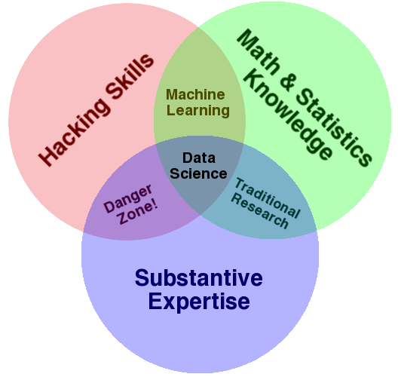
Data Science – A Visual Definition
Notes:
Drew Conway’s definition

Slide 22

Activity
Please fill out the survey at:
https://goo.gl/forms/XLLy01jDVCug1EIi1

Slide 23
Data science and Big Data
How are they related?

Slide 24

Big Data Everywhere!
Lots of data is being collected and warehoused
Web data, e-commerce
purchases at stores
Bank/Credit Card transactions
Social Network

Slide 25
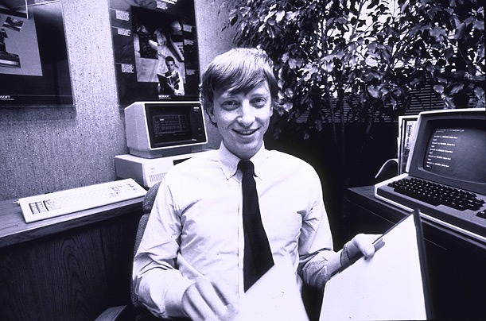
How much data?
CERN’s Large Hydron Collider (LHC) generates 15 PB a year
Oil and gas
“… a single well can produce terabytes of data in a couple of hours …”
640K ought to be enough for anybody.

Slide 26
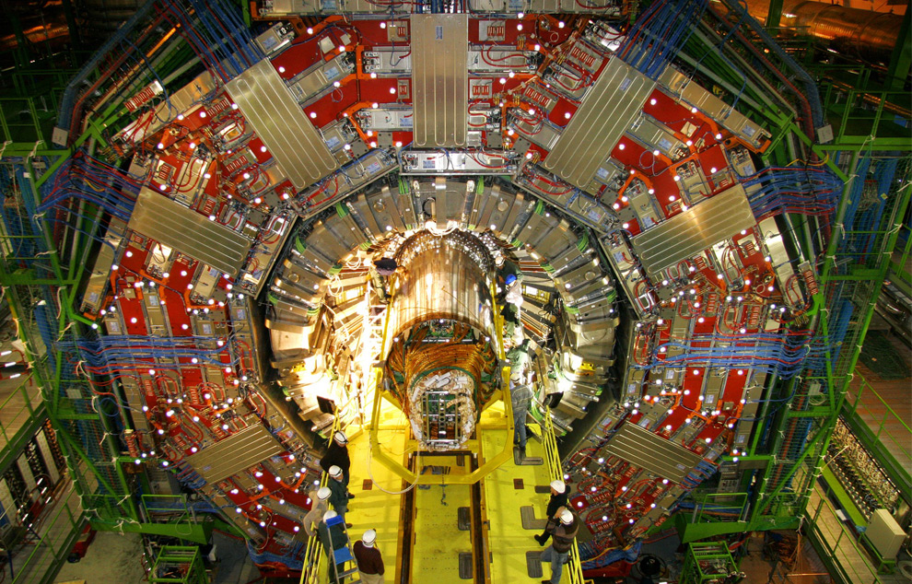
Maximilien Brice, © CERN

Slide 27
3 Vs of Big Data
Raw Data: Volume
Rate at which data comes in: Velocity
http://www.internetlivestats.com/twitter-statistics/
Data types: Variety
Web clicks
Sensor data
Text: articles, tweets
Multimedia: Instagram, …
Notes:
Unstructured data
* (Possibly??) Add a slide on railroads as connection to what I do now. Compare railroad network with internet operation => analytics to understand, improve utilization and plan for growth.

Slide 28
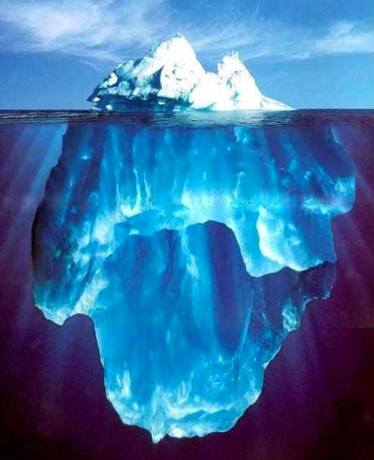






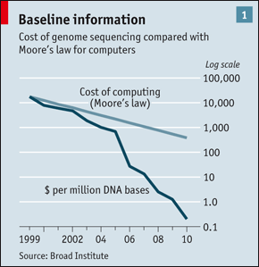
Data Sources
It’s All Happening On-line
User Generated (Web & Mobile)
Every:
Click
Ad impression
Billing event
Fast Forward, pause,…
Server request
Transaction
Network message
Fault
…
…..
Internet of Things / M2M
Health/Scientific Computing

Slide 29
Class exercise
In next 5 minutes:
Move to breakout rooms
Identify one data science application that you know
What is its “data”?
What is its “data product”?
When you come back to the main room
Present your application

Slide 30
Context of the course at CSUF
Counts as an upper division elective for CS majors
Synergistic developments
Big Data Discovery & Diversity
Courses on IoT in CS and Computer Engineering

Slide 31
Contents of the course
Approximately 70% Data Science
Fundamental statistical analysis
R programming language
Other 30% Big Data
Focus on fundamentals
Most popular platforms
Syllabus

