Slide 1


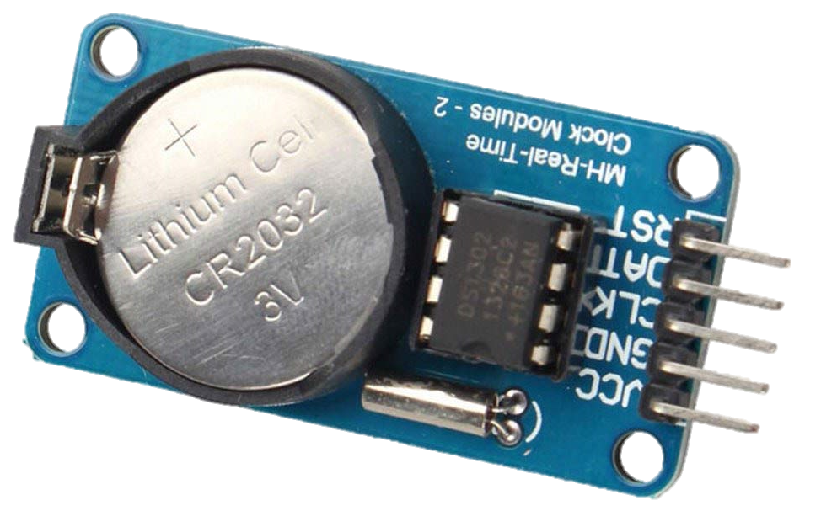
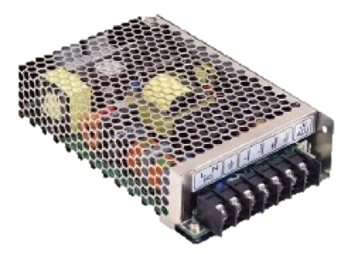



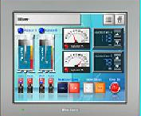
Work Hard，Eat Healthy
Give signal
output
In This Moment…
output
During this time…
Give Power
Or This Moment…
Give Power
input

