Slide 1

Group, Solve, Merge!
A decomposition heuristic for makespan-minimising multi-trip vehicle routing
Polikarpus Arya Pradhanika
Ehime University
Notes:
Group, Solve, Merge: a fast decomposition heuristic for multi-trip vehicle routing where the goal is the makespan.

Slide 2
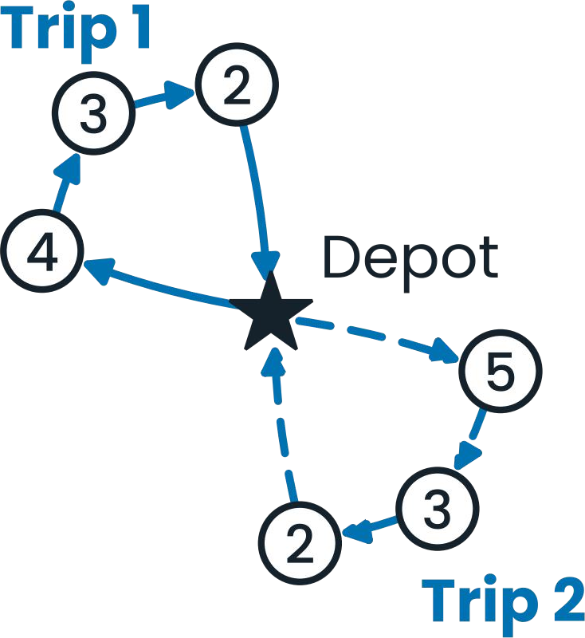
Motivation
1
Given a depot, customers who need goods, and a limited fleet of vehicles, we plan how to deliver.
With a limited fleet, one vehicle often makes several trips, and the day ends when the last vehicle is back.
Exact solvers are slow, so we need fast, quasi-optimal solutions.
One vehicle serves some customers, returns to the depot, then goes out again. Numbers are demands.

Slide 3
Problem
2
A depot and N customers, each at a known location with a known demand.
K vehicles, each carrying at most Q units, may run several trips from the depot.
Travel distance is the straight-line (Euclidean) distance between two points.
Goal: minimise the makespan, the time the last vehicle returns.
Notation
N
number of customers
i, j
customer indices
(x_{i}, y_{i})
location of customer i
q_{i}
demand of customer i
d_{i,j}
√( (x_{i} − x_{j})² + (y_{i} − y_{j})² )
K
number of vehicles
Q
vehicle's capacity
T(r)
duration of trip r

Slide 4
Method
3
PRUNE
GROUP
SOLVE
MERGE
Line sweep keeps only short candidate edges
Kruskal merges customers while demand ≤ Q and size ≤ X
Held-Karp or Lin-Kernighan (LK) gives one tour per group
Binary search on the makespan, pack trips onto vehicles
Notation
E
number of edges
LB
lower bound
X
maximum group size
E ≤ N(N − 1) / 2
G
number of groups after merging (one trip each)
UB
upper bound
T*
makespan of final solution
UB = Σ_{r∈R} T(r)
R
set of trips, |R| = G
LB = max{ T(r) | r ∈ R }

Slide 5
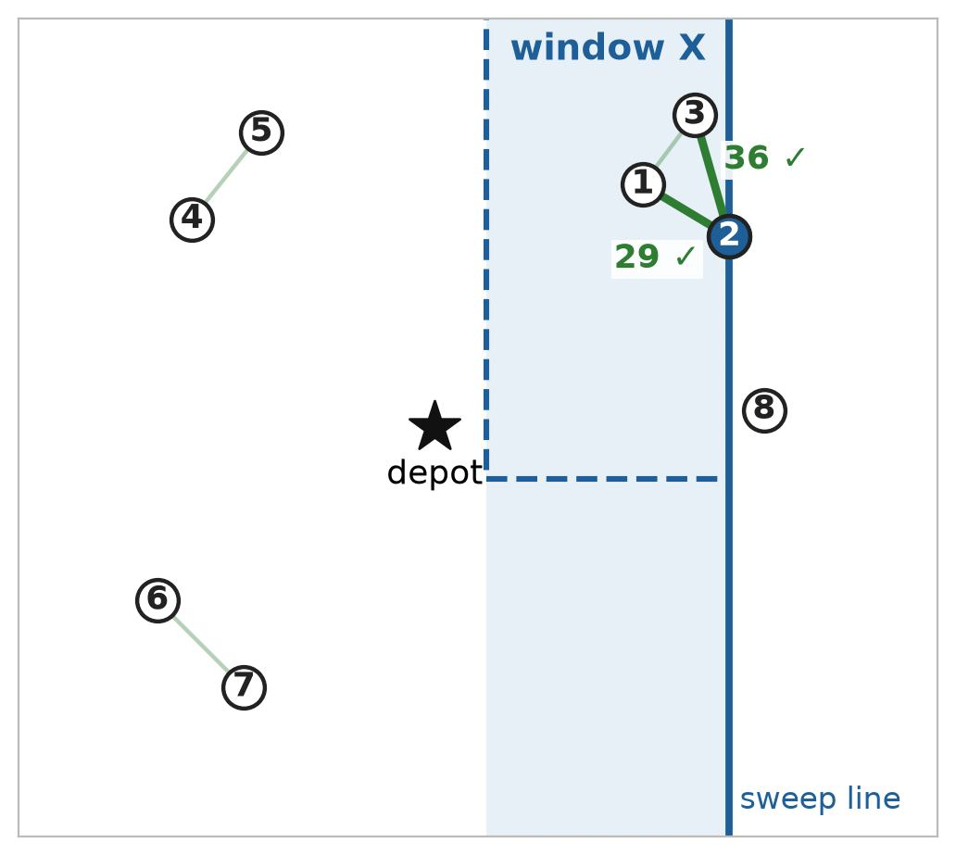
PRUNE
Line sweep keeps only short candidate edges
Sweep customers left to right. Only pairs inside the window X are checked, so we never store all N² edges.
Time complexity
O(N log N + E)

Slide 6
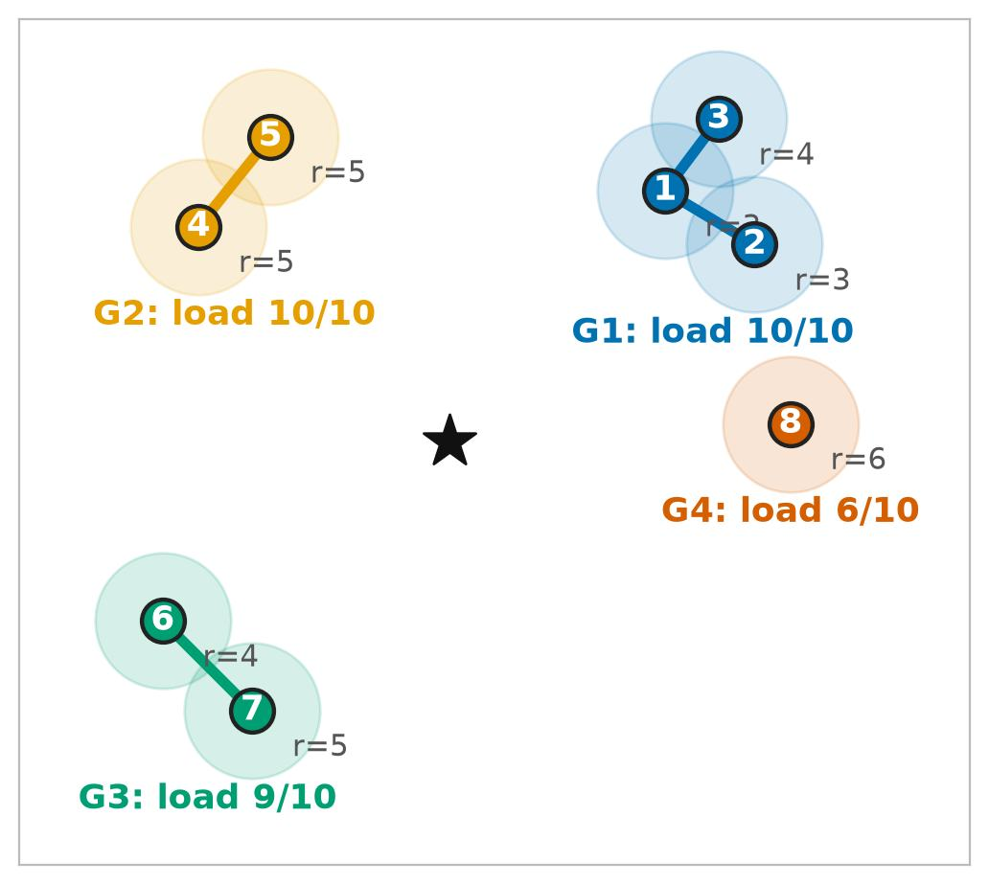
GROUP
Kruskal merges customers while demand ≤ Q and size ≤ X
Edges are taken shortest first. Two groups join only if the result still fits in one trip.
Time complexity
O(E log E)

Slide 7
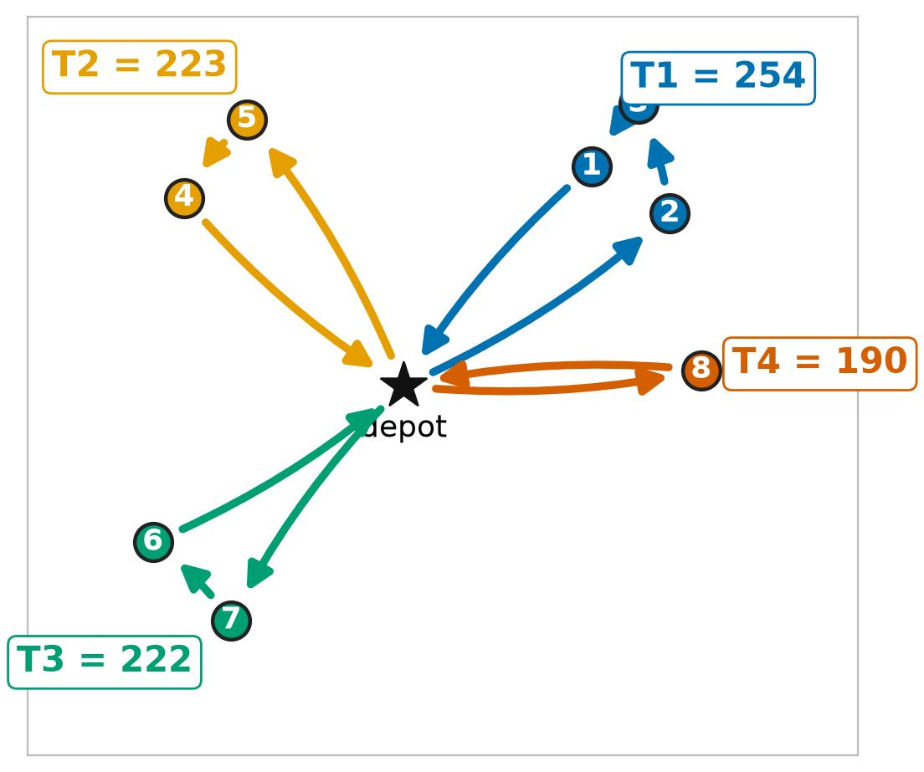
SOLVE
Held-Karp or Lin-Kernighan gives one tour per group
Held-Karp is exact on small groups (X = 10). LK scales to larger groups (X = 40).
Time complexity
O(G X² 2^{X}) Held-Karp
O(G X^{2.2}) Lin-Kernighan

Slide 8
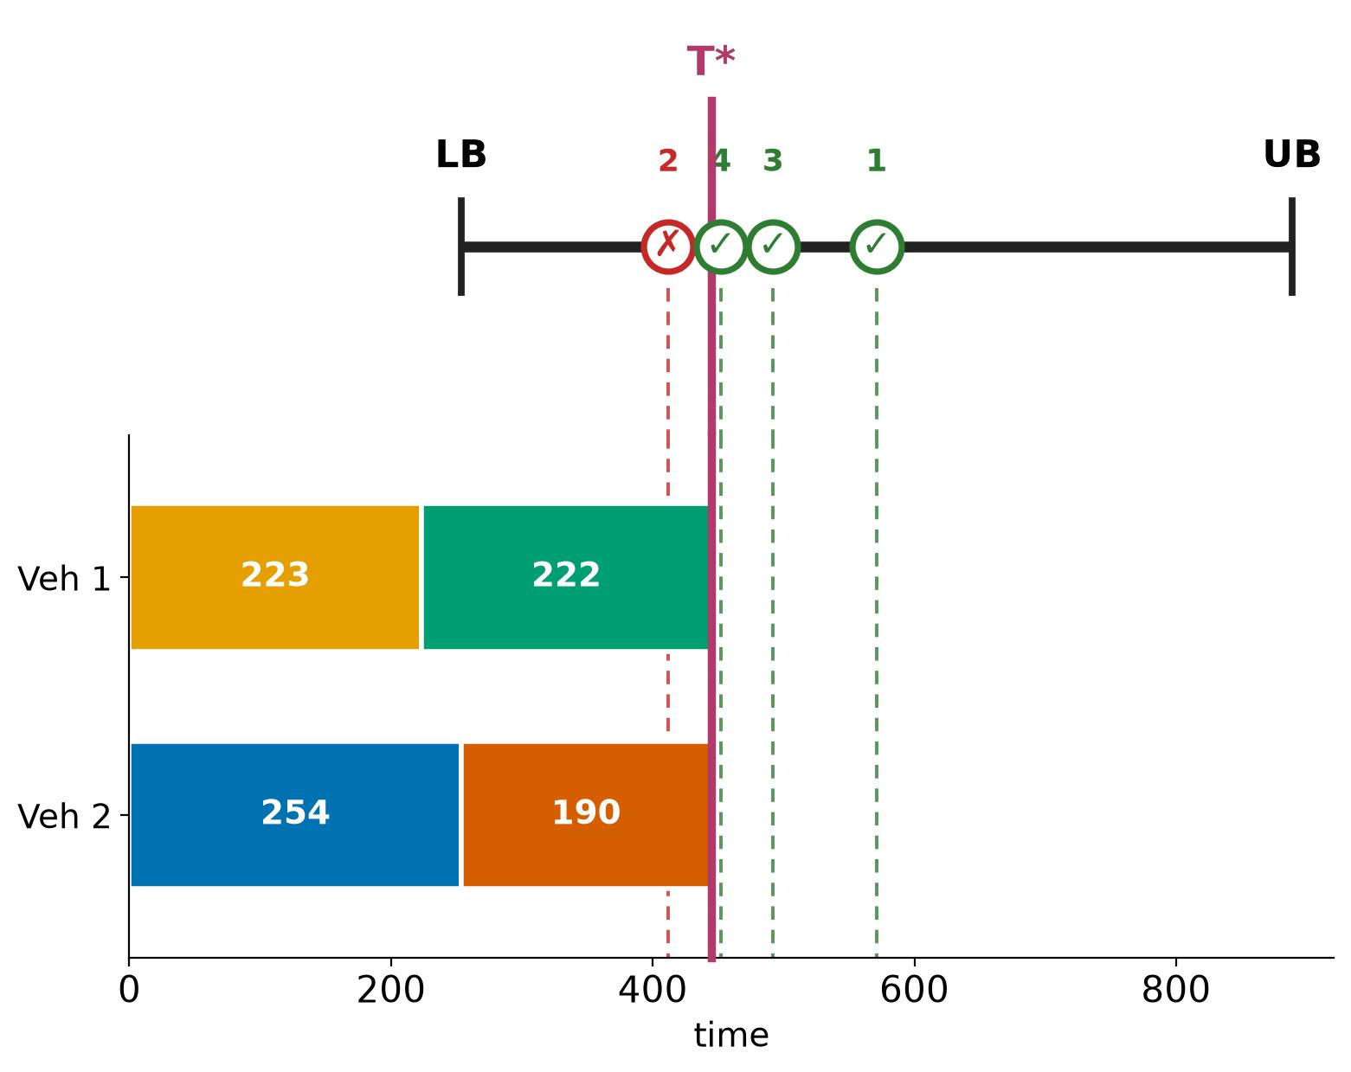
MERGE
Binary search on the makespan, pack trips onto vehicles
For each candidate M between LB and UB, check whether all trips fit on K vehicles. Keep the smallest that fits.
Time complexity
O(G log G + G log(UB − LB))

Slide 9
MERGE
Why binary search works
Makespan at most M: the trips in R can be split among K vehicles, each back by time M.
Σ_{r ∈ Rk} T(r) ≤ M for every vehicle k, where R_{k} ⊆ R are the trips of vehicle k
If the trips fit in M, they also fit in M + 1: the same split still works.
Makespan
LB
…
M* − 1
M*
M* + 1
…
UB
Possible?
no
no
no
yes
yes
yes
yes
Binary search on [LB, UB] finds M*, the first “yes”, where LB = max T(r) and UB = Σ T(r).
Notes:
Feasibility is monotone in M: a split that works for M also works for any larger M. So the yes/no answers are sorted, and binary search finds the smallest feasible M between LB and UB.

Slide 10
MERGE
Checking one M with two pointers
Sort the trip durations D ascending (n trips). ll starts at the shortest trip, rr at the longest.
Example: D = [1, 2, 4, 5, 6, 6, 7], K = 3
Start
ll rr
index
1
2
3
4
5
6
7
D[ll] + D[rr] ≤ M
merge: D[rr] += D[ll], ll++
value
1
2
4
5
6
6
7
D[ll] + D[rr] > M
vehicle rr is full: rr−−
ll
rr
stop when ll = rr
vehicles used = n − rr + 1
End, M = 10
index
1
2
3
4
5
6
7
value
1
2
4
5
6
10
10
Possible ⇔ n − rr + 1 ≤ K ⇔ rr > n − K
ll = rr
Each index from rr to n is one vehicle R_{k}, and D[rr] is its total duration.
rr = 4: 7 − 4 + 1 = 4 > K, so M = 10 is not possible.
Notes:
ll walks over the shortest trips not yet merged; rr is the vehicle collecting them. If the shortest trip still fits under M, merge it into rr. If not, rr is full and the next longest trip starts a new vehicle. Count the vehicles at the end.

Slide 11
MERGE
Example: M = 10 vs M = 11
D = [1, 2, 4, 5, 6, 6, 7], K = 3. The two runs are identical until step 6.
Step
ll
rr
D[ll] + D[rr]
M = 10
M = 11
Step 6
1
1
7
1 + 7 = 8
merge
merge
5 + 6 = 11
2
2
7
2 + 8 = 10
merge
merge
3
3
7
4 + 10 = 14
rr−−
rr−−
Too big for M = 10: a 4th vehicle is needed.
Fits in M = 11: 3 vehicles are enough.
4
3
6
4 + 6 = 10
merge
merge
5
4
6
5 + 10 = 15
rr−−
rr−−
6
4
5
5 + 6 = 11
rr−−
merge
End
4 vehicles: no
3 vehicles: yes
Binary search tries M = 19 yes, 12 yes, 9 no, 10 no, 11 yes, so M* = 11.
Lower bound ⌈31 / 3⌉ = 11, so M* = 11 is optimal for this example.
Notes:
Only step 6 differs: 5 + 6 = 11 does not fit under M = 10, so a fourth vehicle opens; under M = 11 it fits and three vehicles suffice. If asked whether BSTA is always optimal: the binary search is exact, but the two-pointer check is greedy, so a better split can exist in some cases, e.g. D = [3, 3, 4, 5, 5], K = 2.

Slide 12
Setup
4
Instances (random)
Two grids, 8 × 8 cells
Methods and metrics
Depot at (0, 0)
x_{i}, y_{i} are integers in [−100, 100]
q_{i} is an integer in [1, 10]
One instance per cell, one run per method, sequentially
N–K with Q = 320
N–Q with K = 20
Each grid varies two parameters over 8 values; a cell is one pair of values, i.e. one random instance.
Held-Karp (X_{max} = 10)
LK (X_{max} = 40)
PyVRP (ILS), stops after 20,000 iterations without improvement
Makespan T* (lower is better)
Wall-clock time (s)
Hardware and Libraries
Intel Core Ultra 7 155H (22 logical CPUs), 15 GiB RAM, Ubuntu 24.04 (WSL2). Python 3.13.13, NumPy 2.5.4, PyVRP 0.14.1, lk-heuristic 0.0.4.

Slide 13
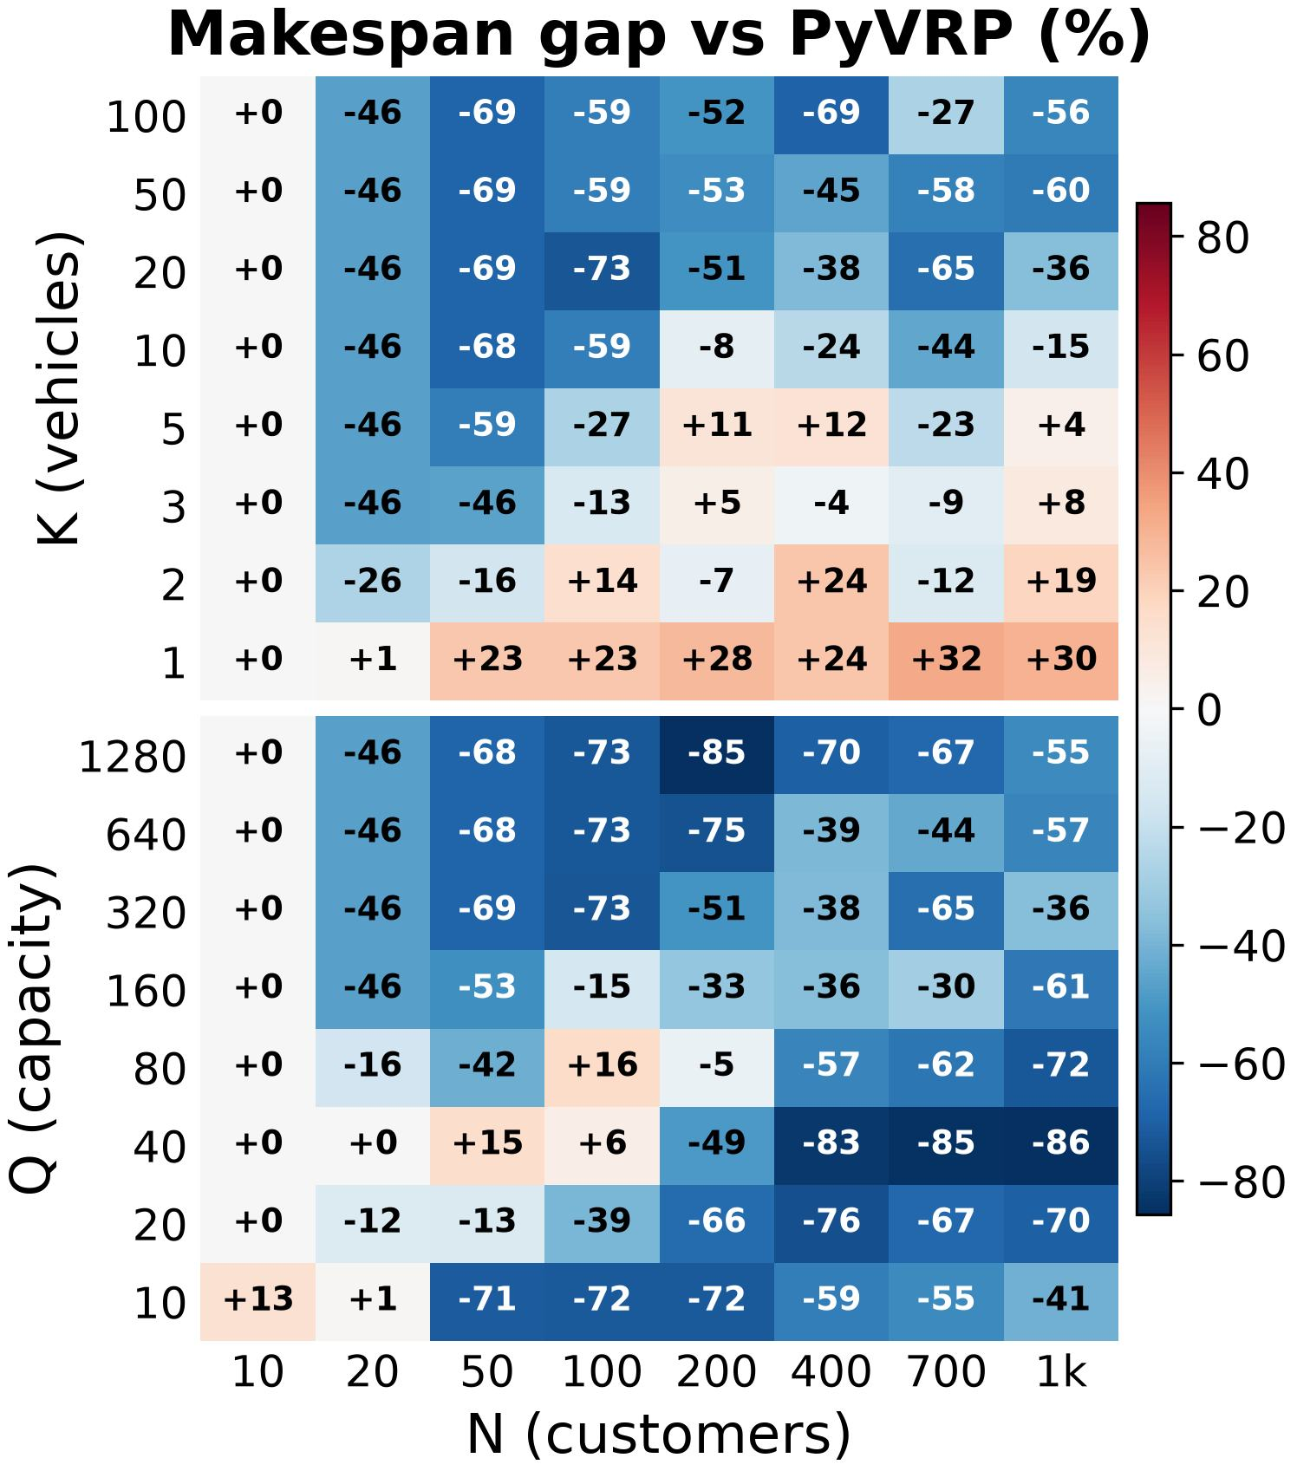
Makespan vs PyVRP
5
85 / 128
cells where our makespan is lower than PyVRP
Gap = (ours − PyVRP) / PyVRP, using the better of Held-Karp and LK.
Blue means we win, red means PyVRP wins.
Each cell is one instance (no averaging).

Slide 14
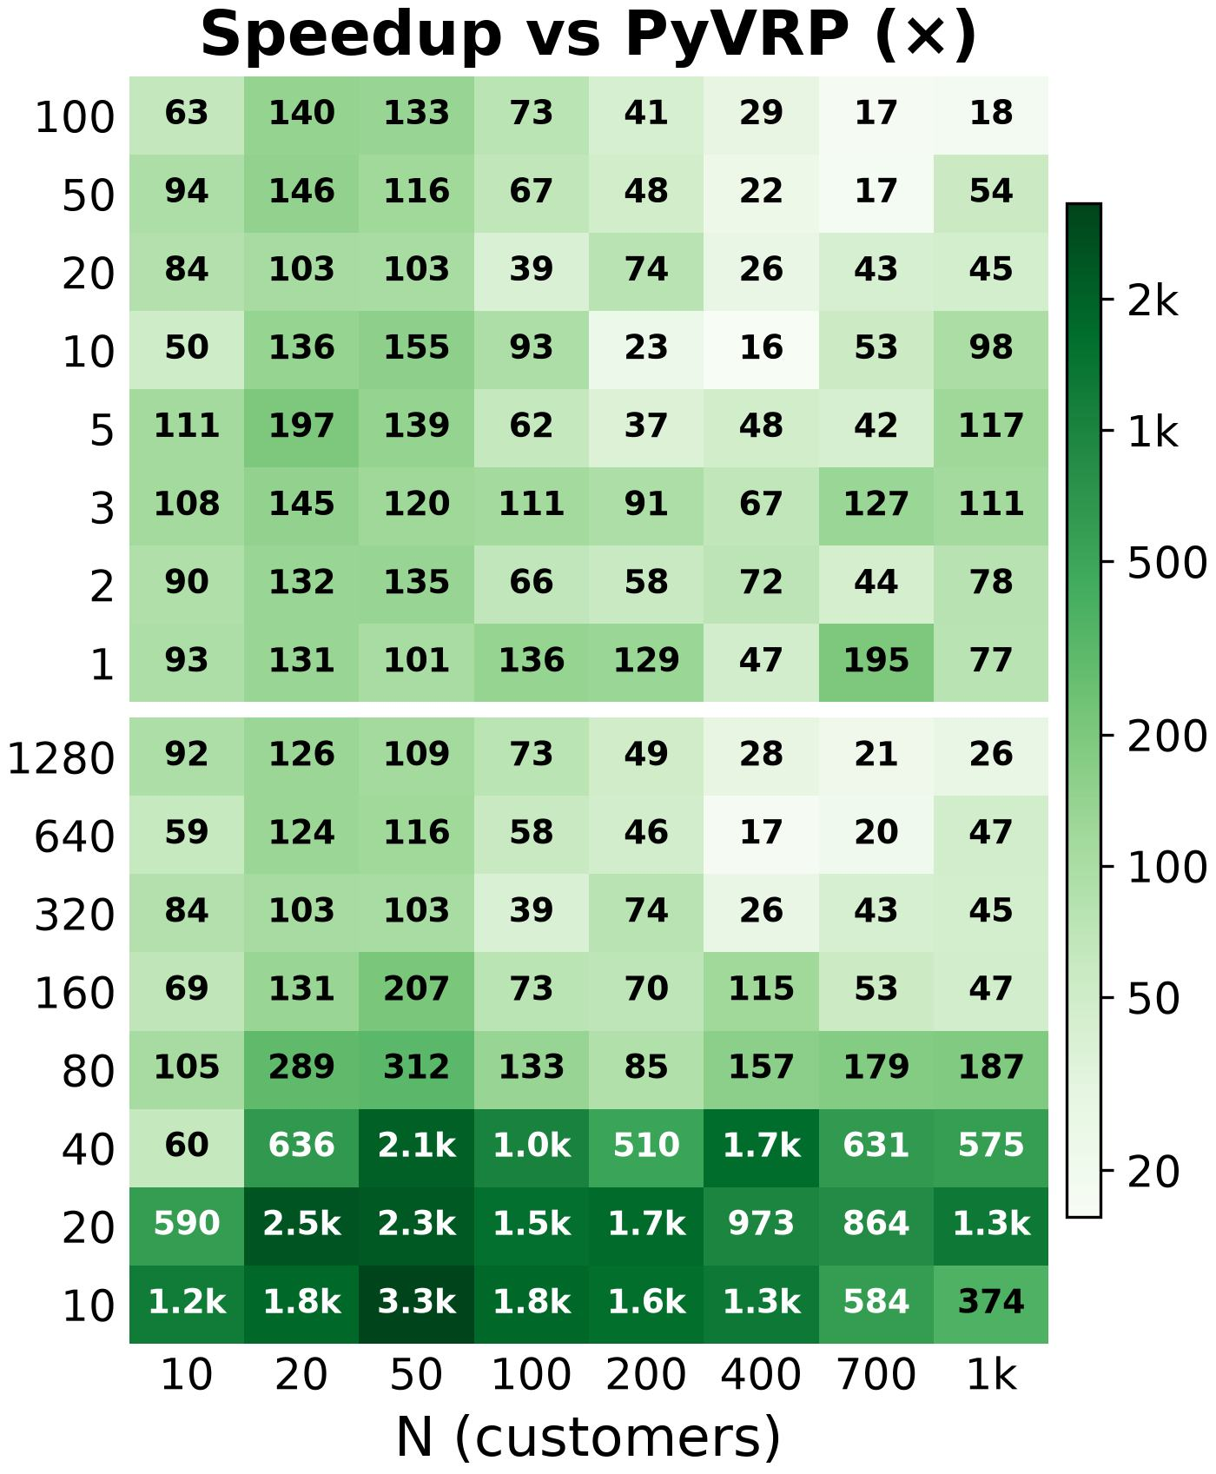
Speedup vs PyVRP
5
≥ 15×
faster in every cell where we win
103×
median speedup in those cells
Speedup = PyVRP time / our time. Darker is faster.

Slide 15
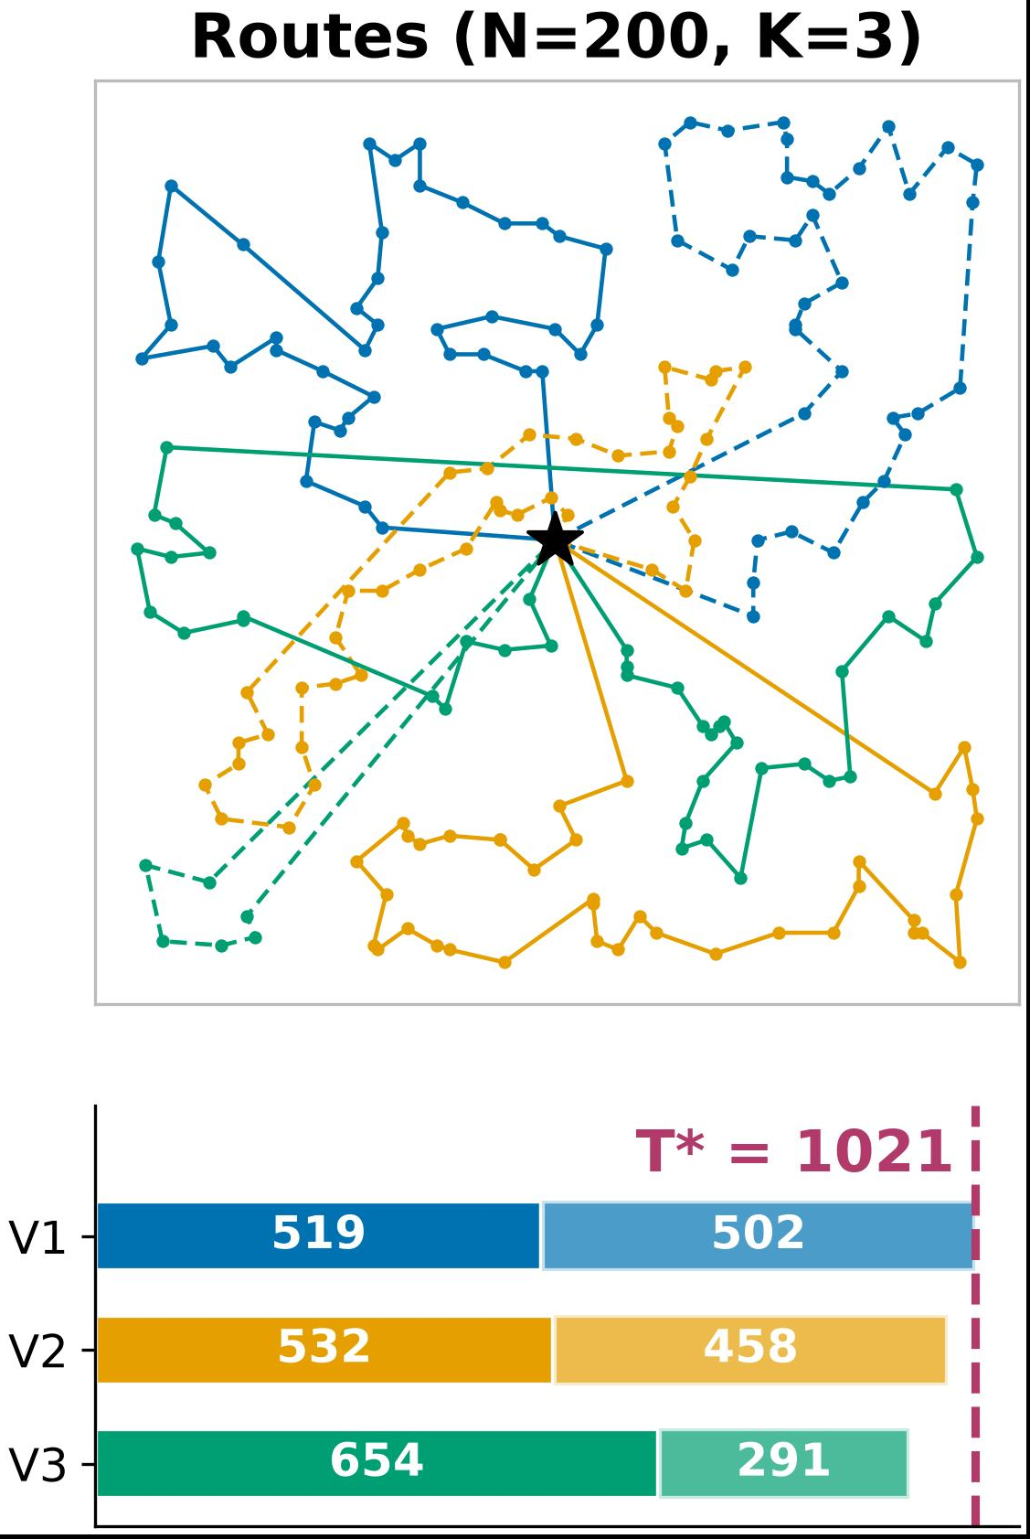
Routes for N = 200, K = 3
5
T* = 1021
makespan of the final solution
Each color is one vehicle, and each vehicle runs two trips.
The bars show each vehicle's two trip durations back to back. The last one returns at T* = 1021.

Slide 16
Key Findings
!
85 of 128
≥ 15×
103×
cells where the better of Held-Karp and LK beats PyVRP (ILS) on makespan
faster than PyVRP in all of those cells
median speedup
PyVRP is better mainly with 1–5 vehicles, where its objective (total distance) is closest to the makespan.
Each cell is one random instance (no averaging).

Slide 17
Limitation
6
Two groups may fit in one trip (Σ q_{i} ≤ Q) and finish sooner than two separate trips. Our method cannot merge trips this way.
Exact methods (e.g. dynamic programming over subsets) only scale for small N (≤ 20), so for larger N the gap to the optimum is unknown.

Slide 18
Future Works
7
Merge trips into one when the capacity allows and the makespan improves.
Compare with a baseline that minimises makespan, since PyVRP minimises total distance.

Slide 19
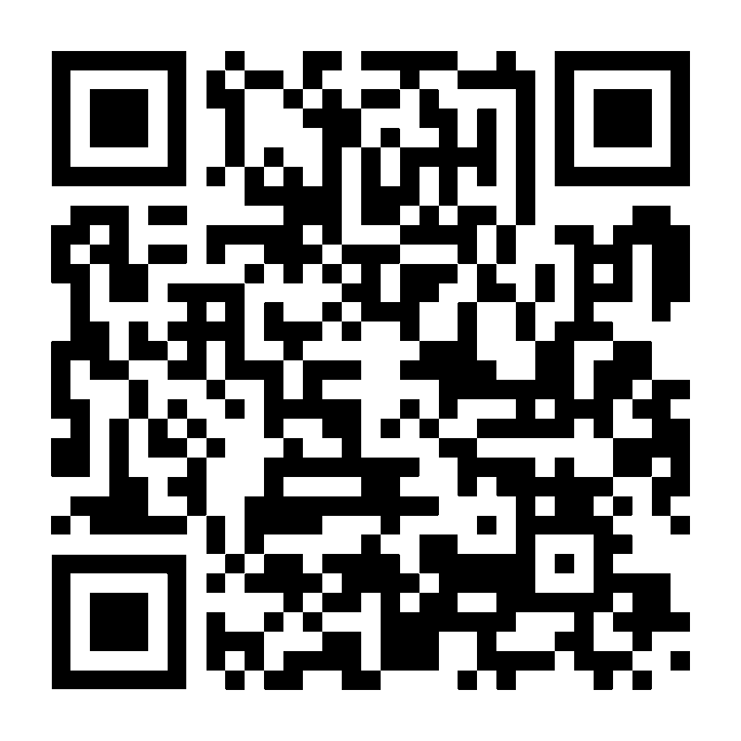
References
8
Code and Data
[1] A. Laaksonen, Competitive Programmer's Handbook, 2018. [Online]. Available: https://cses.fi/book/book.pdf
github.com/mie-intel/ehime-works

Slide 20
Thank you
Questions and feedback are welcome.

