Slide 1
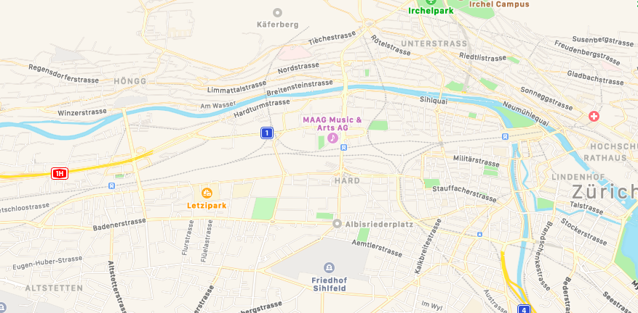
Activity
e.g.
Work
Home
Tour
Trip
Tripleg
Tram
Transport Mode Identification
Train
Bus
Staypoint
Positionfix
Road Network and Context

Slide 2
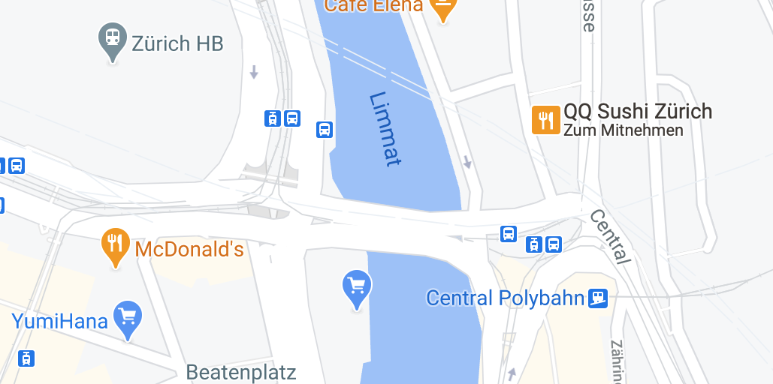
Staypoint
Positionfix
Users
Location
Tripleg

Slide 3
Staypoint
Tripleg
Users
Location

Slide 4
(A)
(B)
Activity
e.g.
Work
Home
Tour
Trip
Tripleg
Tram
Transport Mode Identification
Train
Bus
Staypoint
Positionfix
Road Network and Context
Staypoint
Positionfix
Users
Location
Tripleg

