Slide 1
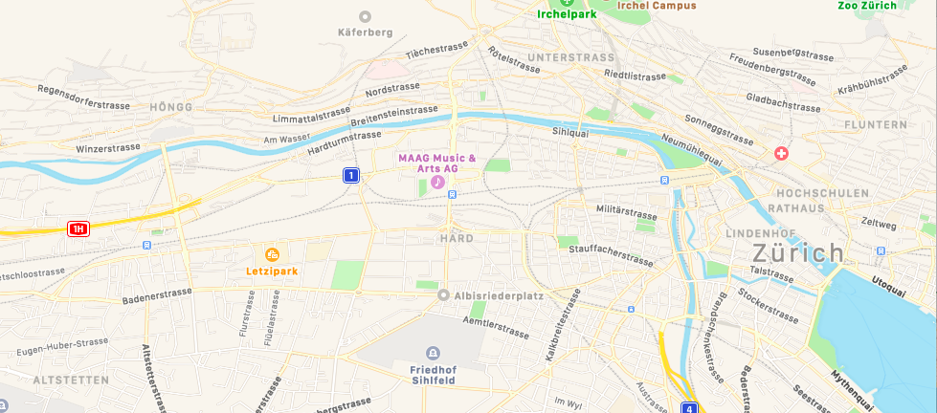
Activities
e.g.
Work
Home
Tours
Trips
Triplegs
Tram
Transport Mode Identification
Train
Bus
Staypoints
Positionfixes
Road Network and Context

Slide 2
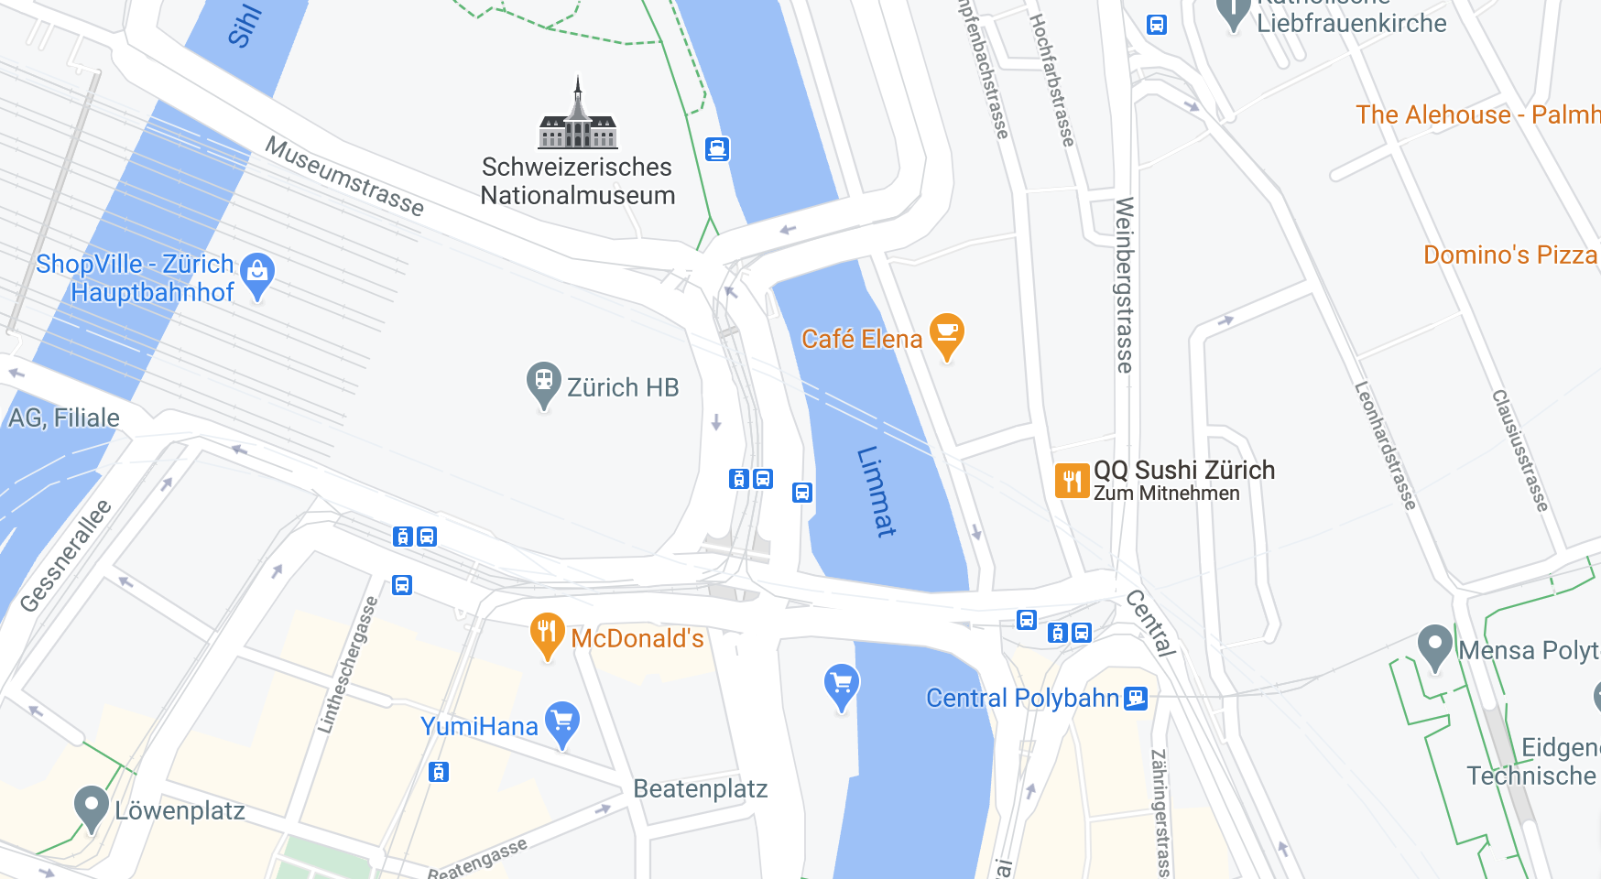
Staypoint
Positionfixes
Tripleg
Users
Location

Slide 3
Staypoint
Tripleg
Users
Location

