Slide 1
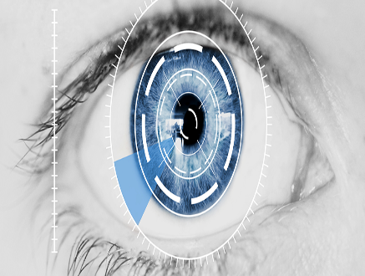
NHẬP MÔN BẢO MẬT THÔNG TIN
BIOMETRIC
RECOGNITION SYSTEMS IRIS
------ Group 14 ------

Slide 2
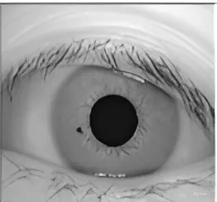
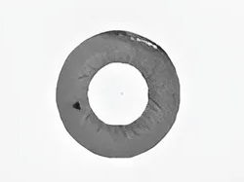
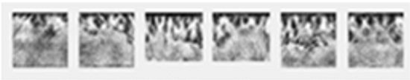
Image Acquisition
Iris Localization
Iris Normalozation
Closest Image or Unrecognized
Matching
(Euclidean Distance)
Feature Extraction
Database

