Slide 1



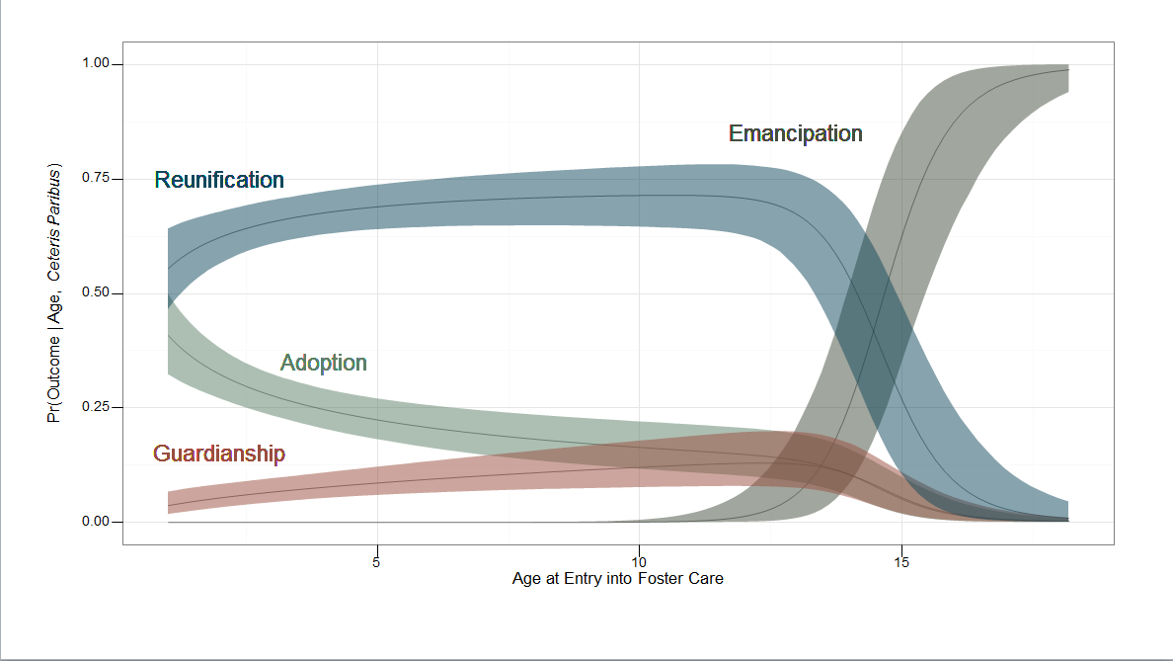
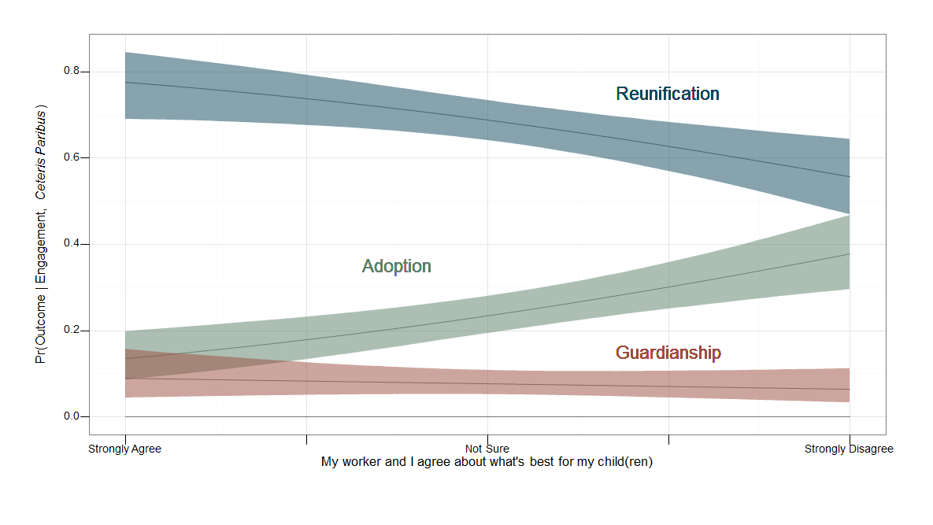
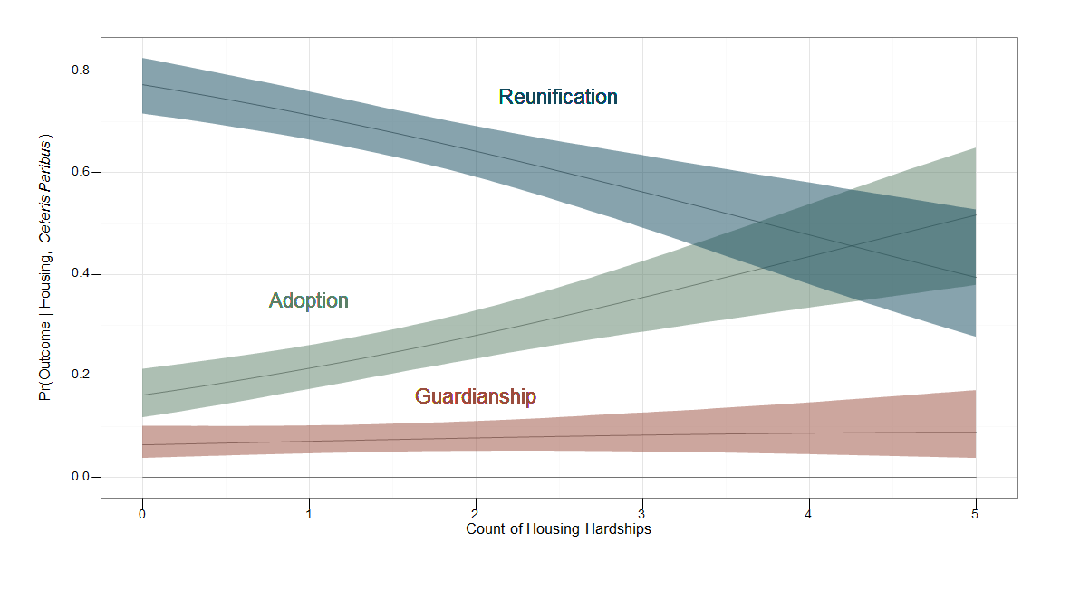
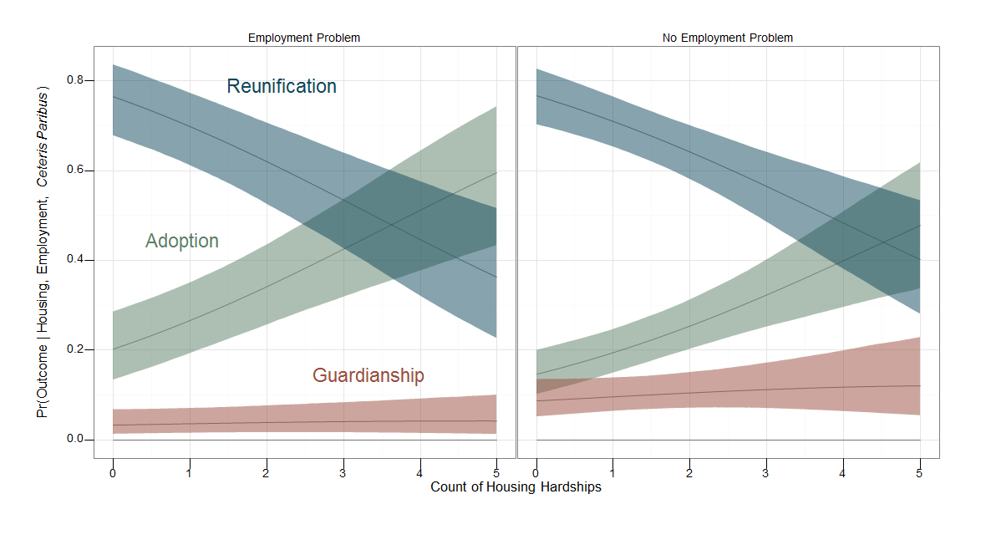
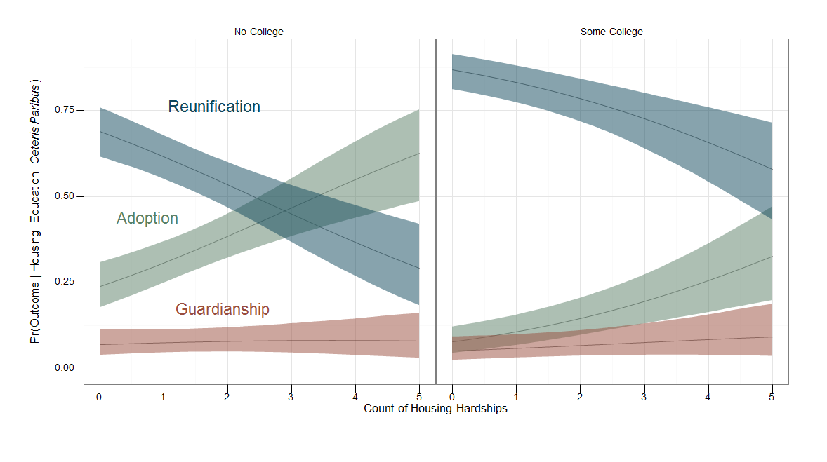
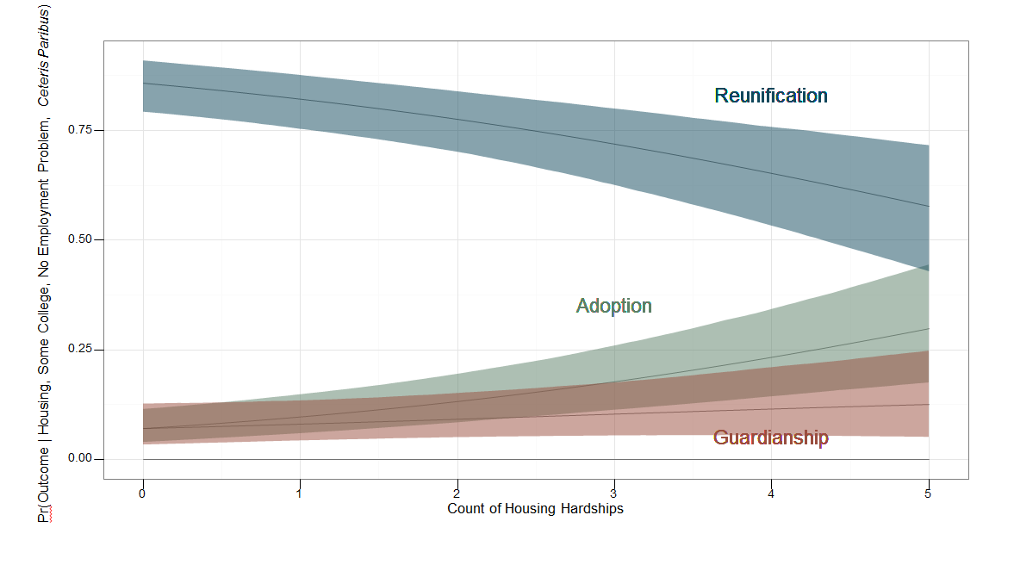
Factors Predicting Permanency Outcomes for Children in Out-of-Home Care:
A Comprehensive Examination of Originally Collected Data Linked to Administrative Records
Joseph A. Mienko¹, Mark E. Courtney², & Maureen O. Marcenko¹
¹University of Washington, ²University of Chicago
Background
Analytic Methods
Graphical Results
The timing of permanency outcomes for children placed in out-of-home care is a substantive concern to child welfare scholars and policy makers alike.
Extended out-of-home care stays also create a significant cost burden for states – even when compared to the long-term costs of adoption subsidies.
While previous attempts have sought to examine the timing of the competing permanency options, the covariates examined in these studies have been limited to those available in administrative data.
The current paper makes use of a unique set of originally collected survey data linked to longitudinal court and child welfare administrative data in order to provide deeper insight into child and family-level factors associated with competing permanency options.
Relevant potential predictor variables were identified based on a review of the literature.
A variation of Yatchmenoff’s engagement measure was operationalized on the basis of Monte Carlo cross validation.
The process above yielded a candidate list of predictor variables which was subjected to Bayesian model averaging across binomial generalized linear models (i.e. logistic regressions) for each permanency outcome to yield a final list of covariates.
The final list of covariates was then applied to a multinomial logistic regression model (results below).
Simulations were conducted for significant covariates as shown in the graphical results section to examine various counterfactual values.
Effects of Age
Effects of Engagement
Effects of Housing
Numeric Results
Objectives
Variable | Reunification | Adoption | Guardianship
Child Age (ln ) | -25.38(0.85)*** | -24.45(0.86)*** | -24.87(0.85)***
Parent Age | 0.11(0.06)* | 0.11(0.06)ns | 0.1(0.05)ms
Married Parents | -0.19(0.81)ns | -1.13(0.84)ns | -0.12(0.78)ns
Household Size | 0.01(0.20)ns | 0.23(0.20)ns | 0(0.19)ns
Relative Placements | 0.84(0.82)ns | 2.83(0.85)*** | 1.37(0.81)ns
Housing Hardships | -0.83(0.30)** | -1.01(0.31)** | -1.2(0.30)***
High Income | -0.01(0.85)ns | -0.27(0.87)ns | -0.04(0.83)ns
Some College | 0.55(0.92)ns | 1.36(0.93)ns | 1.91(0.90)*
Employment Prob. | -0.78(1.04)ns | -2.12(1.09)ms | -1.11(1.02)ns
Mistrust | -0.16(0.21)ns | -0.24(0.21)ns | -0.04(0.20)ns
Working Relation | -0.24(0.20)ns | -0.41(0.21)* | -0.41(0.20)*
Identify those demographic factors which predict a child’s likelihood of exiting the foster care system through reunification, adoption, guardianship, or emancipation.
Assess the predictive validity of such demographic factors relative to survey-based factors related to household economics and parent engagement with their social workers.
Protective Effects:
Employment
Protective Effects:
Education
Protective Effects:
Employment and Education
Conclusions
In this analysis, variables related to parental perception of engagement and economic status tend to explain more variation in permanency outcome than many demographic factors typically available in administrative data (e.g. race).
Age has a strong effect on a child’s probability of experiencing permanency – but much more so in older children than in younger children.
Housing hardships have a strong effect on permanency outcomes but the effect can be mitigated by other economic factors such as education and employment status.
Data Collection Methods
In-person interviews were conducted with a statewide, representative sample of parents.
Survey data were linked to child welfare and court administrative data to look at the children’s permanency outcomes from September 24, 2007 to December 31, 2013. The final sample included 619 children nested in 373 households.
P<.001 = ‘***’; p<.01 = ‘**’; p<.05 = ‘*’; p<.1 = ‘ms’; p>=.01 = ‘ns’

Slide 2
1.00
Emancipation
)
Reunification
0.75
Ceteris Paribus
0.50
Pr(Outcome | Age,
Adoption
0.25
Guardianship
0.00
5
10
15
Age at Entry into Foster Care

Slide 3
0.8
Reunification
)
Ceteris Paribus
0.6
0.4
Pr(Outcome | Engagement,
Adoption
0.2
Guardianship
0.0
Strongly Agree
Not Sure
Strongly Disagree
My worker and I agree about what's best for my child(ren)

Slide 4
0.8
Reunification
)
0.6
Ceteris Paribus
0.4
Adoption
Pr(Outcome | Housing,
0.2
Guardianship
0.0
0
1
2
3
4
5
Count of Housing Hardships

Slide 5
Employment Problem
No Employment Problem
)
0.8
Reunification
Ceteris Paribus
0.6
Adoption
0.4
Pr(Outcome | Housing, Employment,
0.2
Guardianship
0.0
0
1
2
3
4
5
0
1
2
3
4
5
Count of Housing Hardships

Slide 6
No College
Some College
)
0.75
Ceteris Paribus
Reunification
0.50
Adoption
Pr(Outcome | Housing, Education,
0.25
Guardianship
0.00
0
1
2
3
4
5
0
1
2
3
4
5
Count of Housing Hardships

Slide 7
Ceteris Paribus
Reunification
0.75
0.50
Pr(Outcome | Housing, Some College, No Employment Problem,
Adoption
0.25
Guardianship
0.00
0
1
2
3
4
5
Count of Housing Hardships

