Slide 1
MNIST Digit Recognizer - Exploration
April 09, 2020
Mien Nguyen
CSCI 5952 – Big Data Science
Department of Computer Science & Engineering

Slide 2

Agenda
Problem Statement
MNIST Dataset
Algorithms and Tools (4 methods below)
Linear Regression
Multinomial Logistic Regression
SSL Graph-based Method
Convolutional Neural Network
Result
Apply CNN in Android
Future Work & Questions

Slide 3
Problem Statement
Is there a problem?
from Kaggle: MNIST ("Modified National Institute of Standards and Technology") is the de facto “hello world” dataset of computer vision. In this competition, your goal is to correctly identify digits from a dataset of tens of thousands of handwritten images.
Solution…?
CNN Keras - 0.997 (top 6%) accuracy
What do we do in this slide show?
Explore MNIST through different algorithms
Apply the high accuracy algorithm to a software application

Slide 4
MNIST dataset
Release in 1999
Serve as a basic benchmarking for classification algorithms
Training set
42000 samples, each sample is one (black and white) digit image with label
One “label” – Y (label)
784 “pixels” – X (pixel0, pixel1,…, pixel783)
784 pixels = 28 x 28 matrix of pixels
label | pixel0 | pixel1 | pixel2 | … | pixel783
3 | 0 | 137 | 71 |  | 0
6 | 0 | 0 | 0 | … | 55
Test set
28000 rows, each row is one (black and white) digit image withOUT label
pixel0 | pixel1 | pixel2 | … | pixel783
0 | 137 | 71 |  | 0
0 | 0 | 0 | … | 55
Overall mission:
Obtain the model from training set
Apply the model on the test set to yield the label for each test row

Slide 5
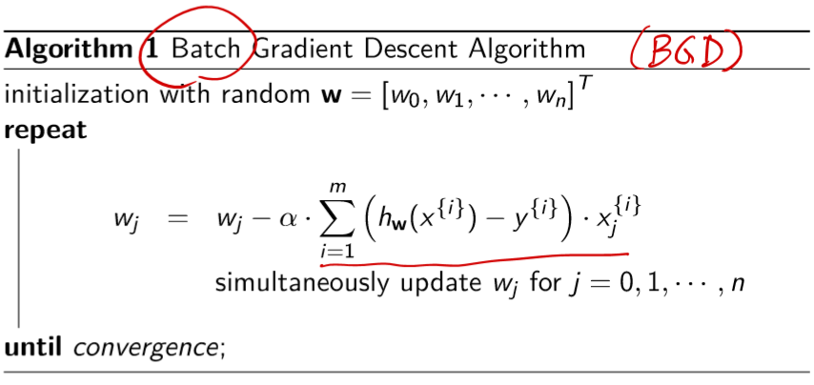
Method 1 – Linear Regression
Linear Regression is a supervised learning
Apply Batch Gradient Descent to obtain the weight vector
TOOL: Closed Form Batch Gradient Descent is coded using Python 3.0, no API is used

Slide 6
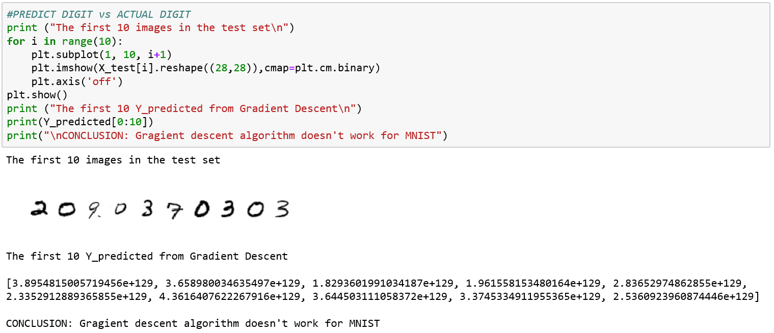
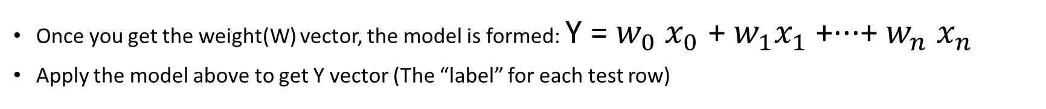
Method 1 – Linear Regression
Once you get the weight(W) vector, the model is formed: Y = $w_{0}$ $x_{0}$ + $w_{1}x_{1}$ +···+ $w_{n}$ $x_{n}$
Apply the model above to get Y vector (The “label” for each test row)

Slide 7
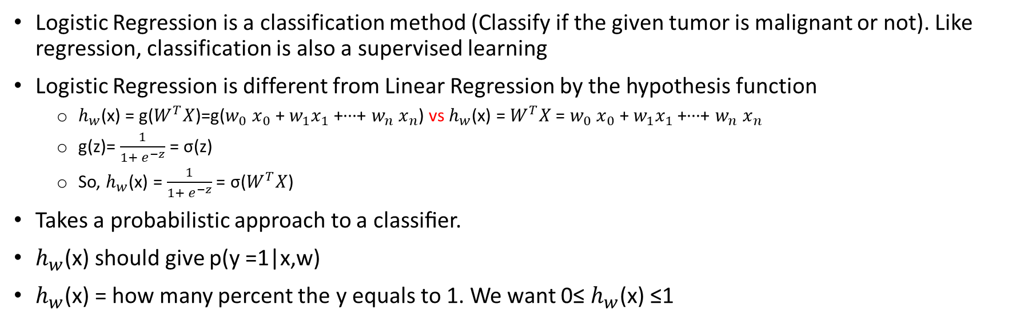
Method 2 – Logistic Regression
Logistic Regression is a classification method (Classify if the given tumor is malignant or not). Like regression, classification is also a supervised learning
Logistic Regression is different from Linear Regression by the hypothesis function
$h_{w}$(x) = g($W^{T}X$)=g($w_{0}$ $x_{0}$ + $w_{1}x_{1}$ +···+ $w_{n}$ $x_{n}$) vs $h_{w}$(x) = $W^{T}X$ = $w_{0}$ $x_{0}$ + $w_{1}x_{1}$ +···+ $w_{n}$ $x_{n}$
g(z)= $\frac{1}{1+ e^{−z}}$ = σ(z)
So, $h_{w}$(x) = $\frac{1}{1+ e^{−z}}$ = σ($W^{T}X$)
Takes a probabilistic approach to a classiﬁer.
$h_{w}$(x) should give p(y =1|x,w)
$h_{w}$(x) = how many percent the y equals to 1. We want 0≤ $h_{w}$(x) ≤1
In this dataset, we expect many Y - “label”, it is the multi-class classification, different from “binary” classification (Ex: The tumor is malignant: 1 or not - 0). We need to classify 10 classes:
Class 0: The image is for digit “0”
Class 1: // “1”
…
Class 9: The image is for digit “9”

Slide 8
Method 2 – Logistic Regression
How do we do multi-class classification? → We can utilize the binary classification to classify multi-class, it calls “one-vs-rest”, here goes:
Turn the “multi-class” classification problem into 10 separate “binary” classification problems
Learn the classifier for class 0: Learn the boundary to separate “class 0” from “not class 0”
Create a “fake” dataset, if the Y = 0 (digit “0”) then the sample is assigned to “class 0” - positive, otherwise, the sample is assigned to “not class 0” – negative
Use Logistic Regression method, run through the new training set, we will have a hypothesis function $h_{w}^{\left[0\right]}\left(x\right), which tells us how many percentage the x is labled \text{"}\text{class}\text{ 0}“$ (P(Y=0|(X,W))
Learn the classifier for class 1: Learn the boundary to separate “class 1” from “not class 1”
…
Learn the classifier for class 9: Learn the boundary to separate “class 9” from “not class 9”
Eventually we will have 10 classifiers
When the new sample X come in, we just need to run the X though 10 classifiers. The classifier gives the maximum probability will be the decision classifier.
TOOL: Use Scikit-learn Multinomial Logistic Regression (MLR) model

Slide 9
Method 3 – SSL – Graph based method
Focus on Semi-Supervised Classification (not much for Semi-supervised classiﬁcation’s cousins, semi-supervised clustering and regression)
Transductive (or Semi-Supervised) SVM → (Q: Already using SVM? Transductive SVM is a natural extension. A: NO)
Cotraining (or Multi-Viewed Learning) → (Q: Do the features naturally split into two sets? A: NO)
Graph-based Methods → (Q: Is it true that two points with similar features tend to be in the same class? A: YES)

Slide 10
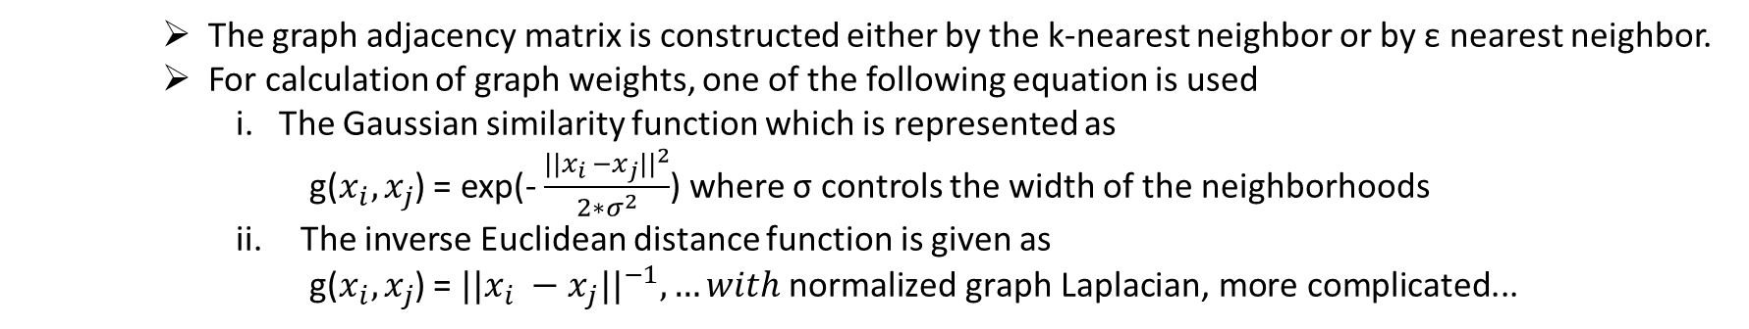
Method 3 – SSL – Graph based method
Graph-based Methods – Main Idea
← kNN graph
Construct graph G with edges between very similar samples (both Labeled and Unlabeled)
The similarity between samples is represented by the thickness of the edges. The process of construction of the graph involves two stages (Cheng et al., 2010). The initial phase involves graph adjacency matrix construction and second phase deals with graph weight calculation.
The graph adjacency matrix is constructed either by the k-nearest neighbor or by ε nearest neighbor.
For calculation of graph weights, one of the following equation is used
i. The Gaussian similarity function which is represented as
g($x_{i}, x_{j}$) = exp(- $\frac{{||x_{i} −x_{j}||}^{2}}{2∗σ^{2}}$) where σ controls the width of the neighborhoods
The inverse Euclidean distance function is given as
g($x_{i}, x_{j}$) = ${||x_{i} −x_{j}||}^{−1}, …with \text{normalized} \text{graph} \text{Laplacian}\text{, }\text{more} \text{complicated}\text{...}$
← Gaussian similarity function
2. Unlabeled data can help to glue the objects of the same class together
3. Run a graph partitioning algorithm to separate graph into pieces

Slide 11
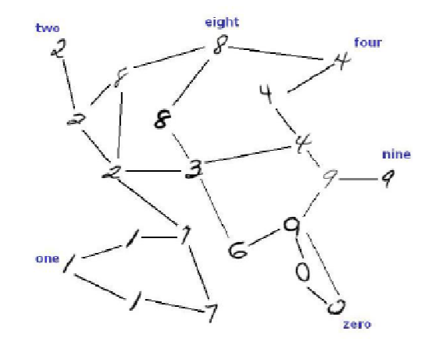





Method 3 – SSL – Graph based method
STEP 1, 2: Construct a kNN graph with weights
STEP 3: Run a graph partitioning algorithm to separate graph into pieces, each piece is one class as desire
The labeled vertices specify classes
The unlabeled vertices help “glue” the objects of the same class
Then, weight the graph

Slide 12
Method 3 – SSL – Graph based method
BAM! FAILS for MNIST
STEP 1, 2: Construct a kNN graph with weights
It’s a graph of labeled and unlabeled samples, = (42000 + 28000) = 70,000 samples
The adjacent matrix of 70,000 X 70,000 = 4,900,000,000 elements exceed the capability of a python list on a 32 bits system, which only can handle 536,870,912 elements
Therefore, constructing a kNN graph with weights fails on a regular computer
To determine the nearest neighbor of a new data point x, we must compute the distance to all m training examples
Expensive and slow, running time is O(mn) = (4,900,000,000 samples x 784 dimensions), where m is the number of samples, and n is the dimension of each sample.
FROM SSL_ALL SURVEY, the current semi-supervised learning methods have not yet handled large amount of data. The complexity of many elegant graph-based methods is close to O(n3). Speed-up improvements have been proposed (Mahdaviani et al. 2005; Delalleau et al. 2005; Zhu and Lafferty 2005; Yu et al. 2005; Garcke and Griebel 2005; and more), their effectiveness has yet to be proven on real large problems.

Slide 13
Method 4 – Active Learning
Not applicable for MNIST

Slide 14
Method 5 – Online Learning
Not applicable for MNIST

Slide 15
Method 6 – Deep Learning – Convolutional Neural Network
TOOL: The model was designed using Keras, as below
Conv2D -> relu
Conv2D -> relu
MaxPool2D
Dropout
Conv2D -> relu
Conv2D -> relu
MaxPool2D
Dropout
Flatten
Dense
Dropout
Out

Slide 16
Result
Linear Regression is not applicable for MNIST dataset classification
Multinomial Logistic Regression shows results less accurate than CNN
Graph-based SSL is not coded due to lacking of GPU resource
CNN shows the highest accuracy that is up to 0.997. CNN is elected to apply to an Android app, next slide.

Slide 17
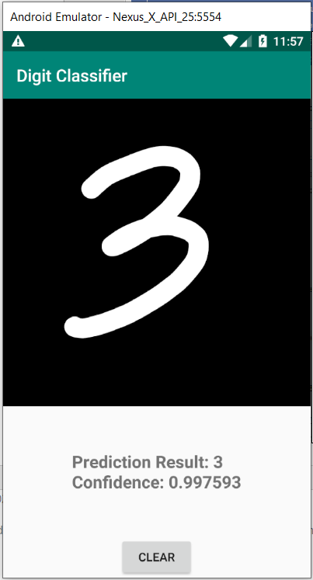
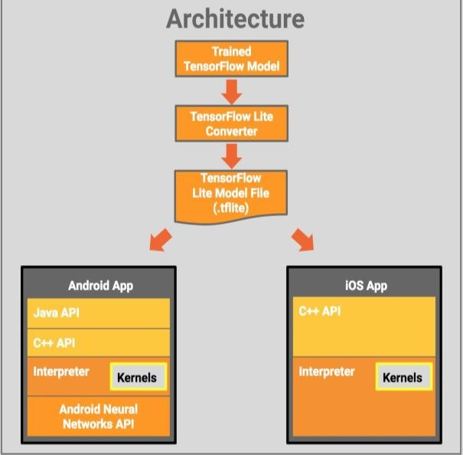
Apply CNN to Android
Tensorflow Lite is a mechanism allows you to integrate a tensorflow model to Android

Slide 18
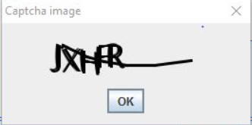
Captcha
CAPTCHA as an acronym for "Completely Automated Public Turing test to tell Computers and Humans Apart". Many registration forms use Captcha to prevent a robot to massively register to their application/website, subsequently break the application/website.
A human can easily recognize the number or letter in a giggling image, but a computer barely can do so (well, back then). If a "machine" can solve Captcha, Captcha does not really do its job.
Well, Captcha is death. People use services to break Captcha (Ex: “Best CAPTCHA Solver Bypass Service” (https://www.deathbycaptcha.com/user/login), $0.99 for 1000 solved CAPTCHAs). These services are in fact human, there are many captcha solving humans sitting all day long, receiving Captcha from requestor, and giving the answer within 10-15 seconds.
It’s the millennium of Data Science, Machine Learning, isn’t it? Can we use ML to break Captcha?

Slide 19
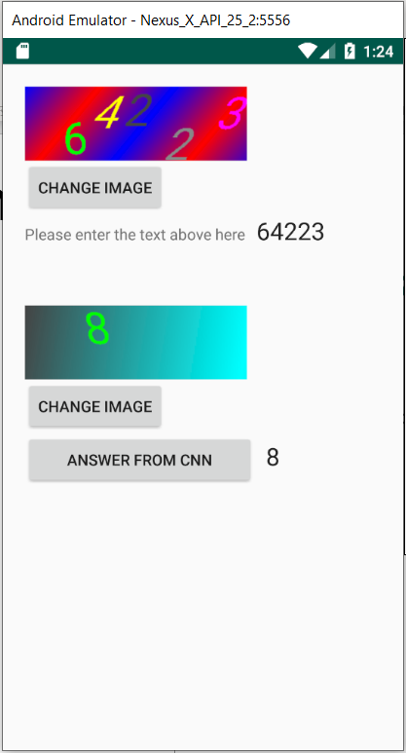
Method 6 – How CNN breaks Captcha
Human/Robot detection process:
User enters the digit in the image to the textbox and submit.
System will validate the answer from the textbox against the answers for the image which was stored in the database
CNN can recognize the digit in the image, CNN can pretend to be a human ☺

Slide 20
Future Work
Develop an Image Recognizer to break other types of Captcha such as Cars, Human, Traffic Signs

Slide 21
Thank you!
Questions?

