Slide 1
Backend Testing & Logging
Session 2 after second freeze

Slide 2
Table of contents
01
02
03
04
What is Backend Testing & Why ?
Types of Backend Testing
Automated VS Manual testing
The Testing Pyramid

Slide 3
Table of contents
05
06
07
08
09
Example of Testing Tools
What is Logging & Why ?
What Every Program Should Log ?
Core Components of a Log Message
Log Levels & Logging Ideals

Slide 4
01
What is Backend Testing

Slide 5
Backend Testing
Backend testing is the process of verifying the server-side components of an application
including the application logic, APIs, server operations, and database
to ensure they function correctly, process data accurately, maintain data integrity, and handle requests reliably without errors.
Its primary goal is to identify defects in the backend before they affect the application's functionality, performance, or users.

Slide 6
02
Types of Backend Testing

Slide 7
Types of Backend Testing
1. Manual Testing:
Manual testing is the process of verifying a software application by executing test cases manually, without using automation tools or scripts. A tester interacts with the application as a real user would, checking whether it behaves according to the requirements and reporting any defects found.

Slide 8
Types of Backend Testing
2. Automation Testing:
is a software testing approach in which test cases are executed using tools and scripts instead of being performed manually.
It helps teams test applications faster, improve accuracy, reduce repetitive effort, and support frequent releases in modern development environments.
types:
Executes test cases automatically using tools and scripts
Used for repetitive, stable, and high-value test scenarios
Commonly applied in regression, smoke, API, and CI/CD-based testing

Slide 9
Types of Backend Testing
3. Functional Testing
Functional Testing is a type of testing that verifies what the software does. It checks whether each feature behaves according to the specified functional requirements, regardless of how the code is implemented.
In functional testing, the tester provides inputs, performs actions, and verifies that the outputs match the expected results. The internal code, algorithms, and implementation details are not the focus.

Slide 10
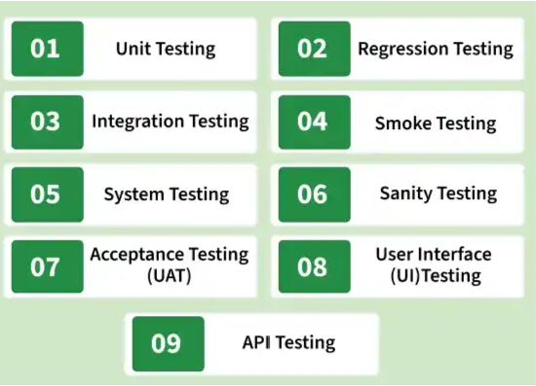
Types of Backend Testing

Slide 11
Types of Backend Testing
White Box Testing:
is a software testing technique where the tester has knowledge of the internal code and structure of the application. It focuses on verifying the flow of logic, conditions, and code paths to ensure the program works correctly.
test cases are derived from the source code, control flow, branches, and implementation details.
Examples:
A developer tests a login function by checking all code paths such as valid login, invalid password, and empty fields to ensure every condition works correctly.

Slide 12
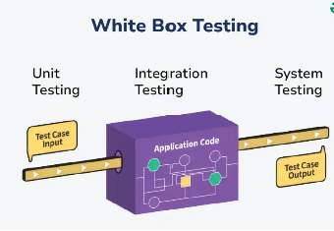
Types of Backend Testing

Slide 13
Types of Backend Testing
Black Box Testing:
is a software testing technique where the internal code or structure of the application is not known to the tester. It focuses only on verifying the functionality of the software based on input and expected output. It ensures the system behaves as per user requirements.
Test cases are derived from requirements, specifications, and expected behavior.
Examples:
A tester verifies a login page by entering username and password and checks whether the user is able to log in successfully. The internal code or logic is not considered while testing.

Slide 14
Types of Backend Testing
4. Non-Functional Testing
is the process of performing load testing, stress testing, and checking minimum system requirements are required to meet the requirements.
It will also detect risks, and errors and optimize the performance of the database.
Common types:
Load Testing: Measures performance under expected user load.
Stress Testing: Determines system behavior beyond normal capacity.

Slide 15
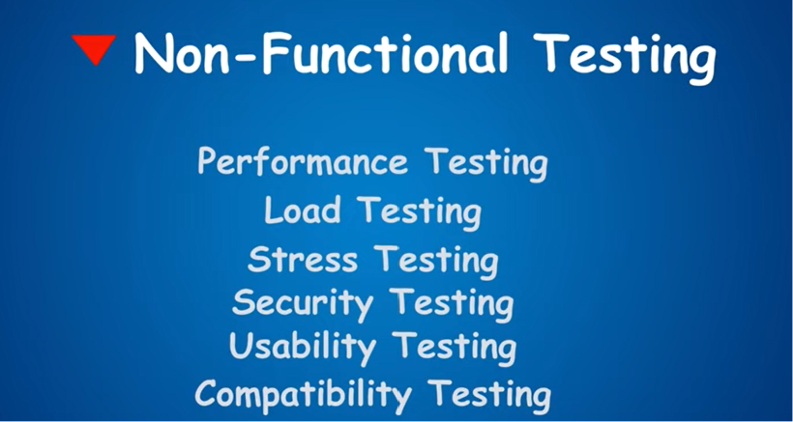
Types of Backend Testing

Slide 16
Automated VS Manual testing
03

Slide 17
Automated VS Manual testing
Manual
Automated
Needs a human Automated
Takes time Less time
Repeat for each new feature Refactor with Confidence
Doesn't help with code Write a better code

Slide 18
When to use both Automated & Manual testing
Automated
Manual
Exploratory Testing
Usability Testing
Visual Validation
Ad-hoc Testing
Regression Testing
Smoke Testing
Data-Driven Testing
Business-Critical Testing
Deterministic Testing

Slide 19
TDD & BDD
Test Driven Development (TDD):
Test Driven Development (TDD) is a software development approach where automated tests are created first to define expected functionality before implementation begins.
It ensures that every feature is developed only after defining its expected behavior through tests, which helps improve code quality and reduce bugs.

Slide 20
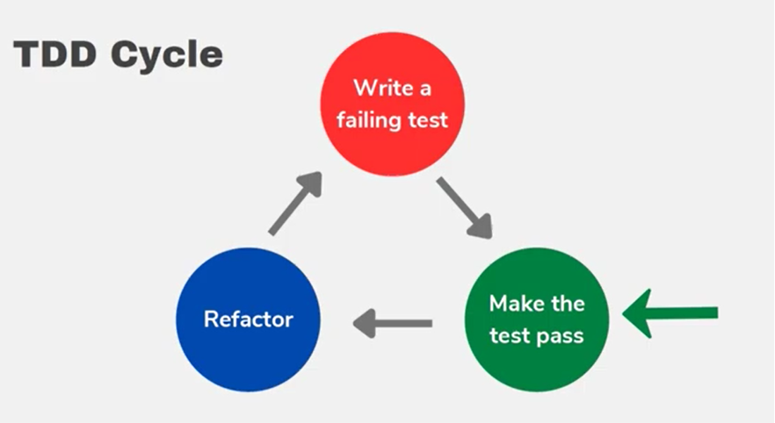
TDD & BDD
Test Driven Development (TDD):

Slide 21
TDD & BDD
Behavior Driven Development (BDD)
BDD is a software development approach that focuses on defining the behavior of an application from the user’s perspective. It promotes collaboration between developers, testers, and business stakeholders to ensure that the final product meets expected requirements.

Slide 22
04
The Testing Pyramid

Slide 23
The Testing Pyramid–Key Layers of Testing
The Testing Pyramid is a software testing strategy that recommends how to distribute automated tests across different levels to achieve fast feedback, high confidence, and lower maintenance cost.
The idea is simple:
Write many fast, low-cost tests at the bottom.
Write fewer complex, expensive tests at the top.

Slide 24
The Testing Pyramid–Key Layers of Testing
1. Unit Testing:
test a single functionality and small units of code.
For unit testing, isolation is the key. Individual function is tested separately without its external dependencies .
Examples:
User authentication methods: How does the login system respond to incorrect passwords or usernames? Does the system require the correct credentials?
Notification system: Does the system provide accurate alerts when errors occur?

Slide 25
The Testing Pyramid–Key Layers of Testing
2. Integration Testing/Service testing:
Now that you’ve laid a strong foundation with unit testing, continue with the next phase of integration (or service or component ) testing , which checks the combination of the components. They ensure that the modules, services, and systems will all work together seamlessly , with systems external dependencies.
Examples:
User Permissions: Verify that when one user updates data, other authorized users see the updated information.
E-commerce Checkout: Verify that login, cart, and payment services work together successfully.
Microservices Communication: Verify that one service correctly communicates with other services (e.g., transaction → email).

Slide 26
The Testing Pyramid–Key Layers of Testing
3. End-to-End (E2E) Testing User experience (UI) tests :
End-to-End (E2E) Testing validate the application from the user’s perspective. These tests interact with the fully deployed application through its user interface to ensure that all integrated components (UI, backend, APIs, and database) work together correctly to deliver the expected user experience.
Examples:
Collaboration features: Can team members work together on a project without running into bugs? Simulate different working situations.
Buying a product: Simulate someone logging in, browsing, and purchasing a product.

Slide 27
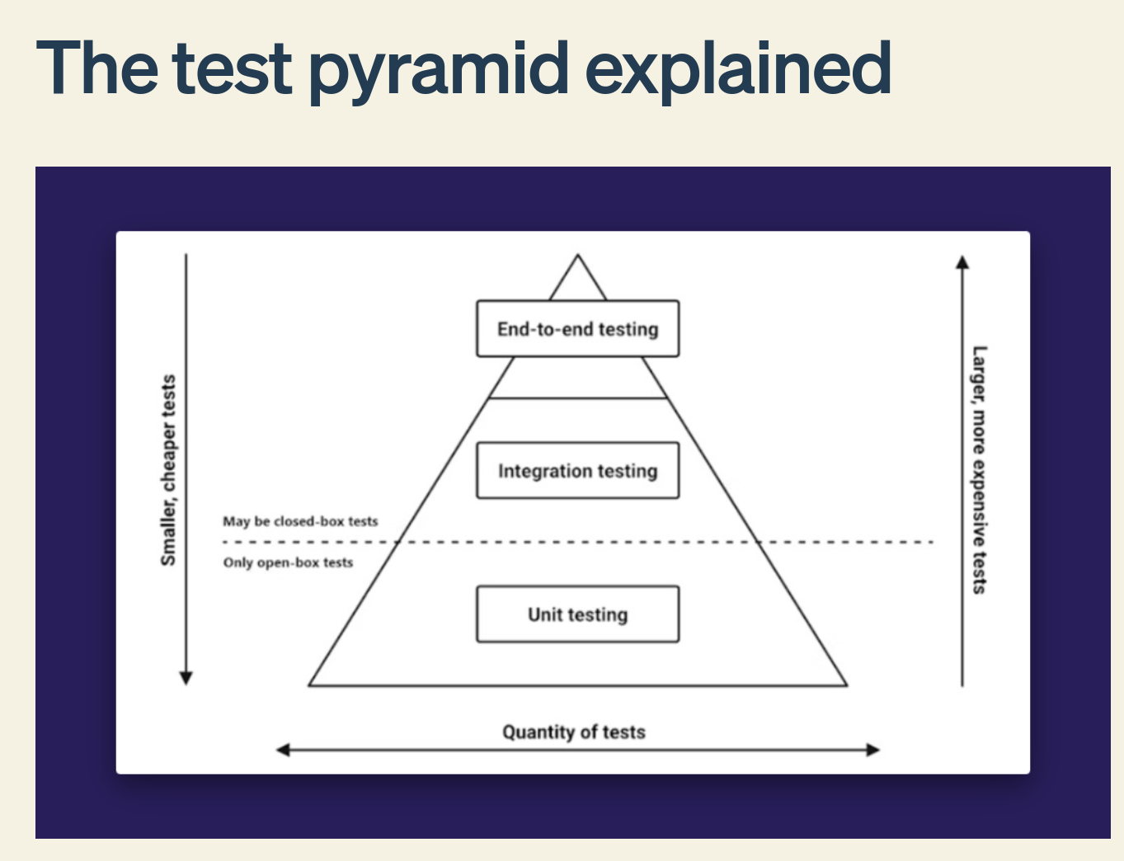
The Testing Pyramid–Key Layers of Testing

Slide 28
05
Example of Testing Tools

Slide 29
Tools of testing :
Testing Frameworks
Jest – Unit, integration, and API testing (most popular for Node.js).
Mocha – Flexible JavaScript testing framework.
TestNG – Java testing framework for unit and integration tests.
API Testing
Supertest – Test Express/NestJS APIs.
Postman – Test APIs manually or automate API collections.
CI/CD Automation
GitHub Actions – Automatically runs your tests on every push or pull request.
Jenkins – Automates building, testing, and deployment.

Slide 30
Tech Time !

Slide 31
06
What is Logging & Why?

Slide 32
What is Logging?
Logging :
Logging is the process of automatically recording events that happen while your program is running.
Think of it as the application writing down everything important it does.
Why is it called "Logging"?
The word comes from the English word log.
Originally, a logbook was literally a notebook used to record important events in chronological order.
So logging literally means:
"Keeping a log (a diary/journal) of everything important that happens."

Slide 33
What is Logging?
Imagine you're playing a game. Suddenly the game crashes.
Without logs:
"It crashed."
That's all you know.
With logs:
Player joined
Loaded map
Connected to database
Spawned enemies
Saving progress...
ERROR: Database timeout
Game closed
Now you know exactly where things went wrong.

Slide 34
What is Logging?
Logging is the process of recording important events that happen inside a running application so developers can monitor, debug, and understand what the system did.

Slide 35
What is Application Log?
An application log is simply the collection of log messages generated by an application while it is running.
Logging → the action of writing records.
Log message → one individual record.
Application log → the complete file (or stream) containing all those records.

Slide 36
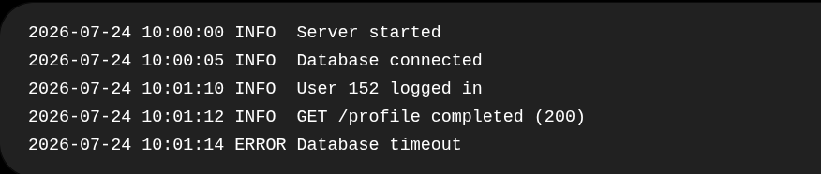
What is Application Log?
Each line is a log message (log entry).
All of these lines together form the application log.

Slide 37
What is Application Log?
Why do we say application log?
Because many things generate logs:
Operating System logs
Database logs (PostgreSQL, MongoDB)
Docker logs
Kubernetes logs
Application logs ← the logs generated by your code

Slide 38
Why is Logging important?
Imagine it's 3:00 AM, Your backend serves 100,000 users.
Suddenly someone calls you:
"The website isn't working."
You weren't watching the server.
The request happened hours ago.
The user already closed the browser.
You can't attach a debugger.
You can't ask the server to replay the request.
The only evidence left is the logs.
That's why every production application logs events.

Slide 39
Why is Logging important?
Diagnostics / troubleshooting — pinpoint exactly when and why something failed, especially in production where a debugger can't be attached.
Tracking & correlation — follow a single request or user's journey across multiple services/components, and feed that trail into analytics or monitoring.
Security / Auditing — a durable record of significant, security-relevant events; answers "who did what, and when?" — needed for compliance and for investigating incidents after the fact.
Performance monitoring — logs of resource usage and response times help confirm a system is healthy, not just that it isn't crashing.

Slide 40
Why is Logging important?
Think about CCTV cameras.
They don't stop crimes.
They record what happened so later you can investigate.
Logs are the CCTV cameras of your backend.

Slide 41
07
What Every Program Should Log ?

Slide 42
What Every Program Should Log ?
Authentication & authorization — logins, logouts, failed login attempts, permission checks.
Changes — creation, updates, deletion of important data (who changed what).
Availability — application start-up, shutdown, restarts, health-check failures.
Resources — database connections opened/closed, connection pool exhaustion, external API call failures.
Threats / security — suspicious activity: repeated failed logins, malformed requests, rate-limit violations.

Slide 43
08
The Core Components of a Log Message

Slide 44
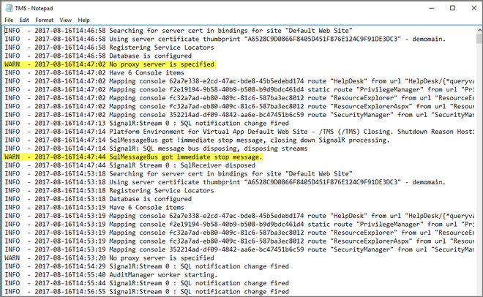

Slide 45
The Core Components of a Log Message
Context information — background detail that gives insight into the state of the app at the time of the message (e.g., request ID, user ID, module name) — an informative message that actually expresses what happened, not vague noise.
Timestamps — a specific piece of contextual information needed for tracking and correlating issues over time.
Log levels — labels that convey how important/severe an entry is, so entries can be filtered by seriousness.

Slide 46
09
Log Levels & Logging Ideals

Slide 47
Log Levels
A log level or log severity is a piece of information telling how important a given log message is.
It is a simple, yet very powerful way of distinguishing log events from each other.
You can think of the log levels as a way to filter the critical information about your system state and the one that is purely informative.
The log levels can help to reduce the information noise and alert fatigue.

Slide 48
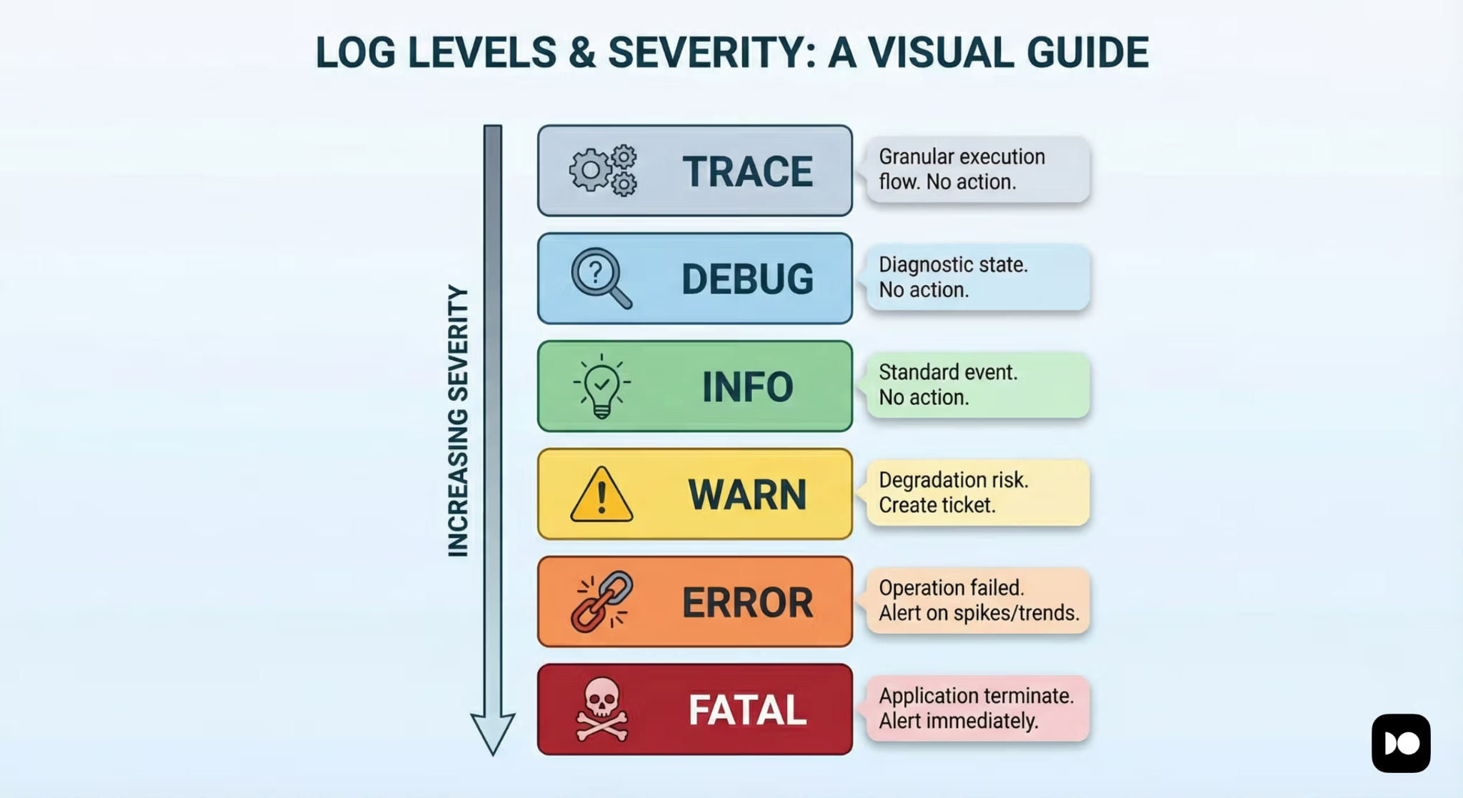
Log Levels in Wiston

Slide 49
Log Levels in Wiston
Level | Meaning | When to Use | Example
TRACE | Extremely detailed execution flow. | Deep troubleshooting and tracing every step of execution. Rarely enabled in production. | Entering a function, every loop iteration, method calls.
DEBUG | Detailed information for developers. | Debugging issues during development. Usually disabled in production. | Database query executed, cache miss, variable values.
INFO | Normal application events. | Record expected application behavior. | Server started, user logged in, request completed.
WARN | Something unexpected happened, but the application can continue. | Situations that may require attention later. | Invalid input, failed login attempt, deprecated API used.
ERROR | An operation failed, but the application is still running. | Recoverable failures affecting a request or operation. | Database connection failed, payment API failed, file upload failed.
FATAL / CRITICAL | A severe error that prevents the application from continuing. | Unrecoverable failures that terminate the application. | Application crash, startup failure, out-of-memory error.

Slide 50
Backend Logging Ideals (Checklist)
1. Assign a Unique Request ID
or other non-sensitive identifiers, and redact sensitive data whenever possible.
2. Use Structured Logs
Store logs in a structured format (e.g., JSON) instead of plain text.
Structured logs are easier to search, filter, and analyze using logging tools.
3. Use Consistent Log Levels
Every log entry should include a severity level (e.g., DEBUG, INFO, WARN, ERROR).
Consistent levels allow developers to quickly filter logs and focus on the most important issues.

Slide 51
Backend Logging Ideals (Checklist)
4. Never Log Sensitive Information (PII)
Avoid logging personally identifiable information such as passwords, emails, phone numbers, or credit card details. Prefer logging user IDs or other non-sensitive identifiers, and redact sensitive data whenever possible.
5. Log with Context
Include useful context with every log, such as Request ID, User ID, Route, IP Address, or Service Name. Context makes logs much easier to understand and greatly simplifies debugging.

Slide 52
I already have console.log().
Why do I need logging?

Slide 53
Why Not Just use console.log?
console.log doesn't scale for a real backend:
No levels — everything prints the same way; there's no way to filter "just show me errors" in production.
No structure — output is plain text, hard to search, filter, or feed into a monitoring tool.
No destinations — can't easily also write to a file, a database, or a remote log-collection service at the same time.
Performance under volume — logging heavy traffic (1,000+ records) directly and synchronously can slow the whole application down. A proper logging library batches, buffers, and streams log writes in smaller, manageable chunks instead of blocking the main thread on every single write.
No safety net for errors — logging a raw Error object with console.log often loses the stack trace and structured detail needed to actually debug it.

Slide 54
Tech Time !

Slide 55
Lets Kahoot !

Slide 56
Thank You !

