Slide 1
Introduction to NoSQL databases and CS554 projects based on ZHT
Overview on ZHT

Slide 2
Outlines
General terms
Overview to NoSQL dabases and key-value stores
Introduction to ZHT
CS554 projects

Slide 3
Databases/datastores
Relational databases
Query with SQL
DB2, MySQL, Oracle, SQL Server
CS 425, 525
NoSQL databses
Loose consistency model
Simpler design
High performance
Distributed design

Slide 4
Categories in NoSQL
Key-Value store
ZHT, Dynamo, Memcached, Cassandra, Chord
Document Oriented Databases
MongoDB, Couchbase
Graph databases
Neo4J, Allegro, Virtuoso

Slide 5
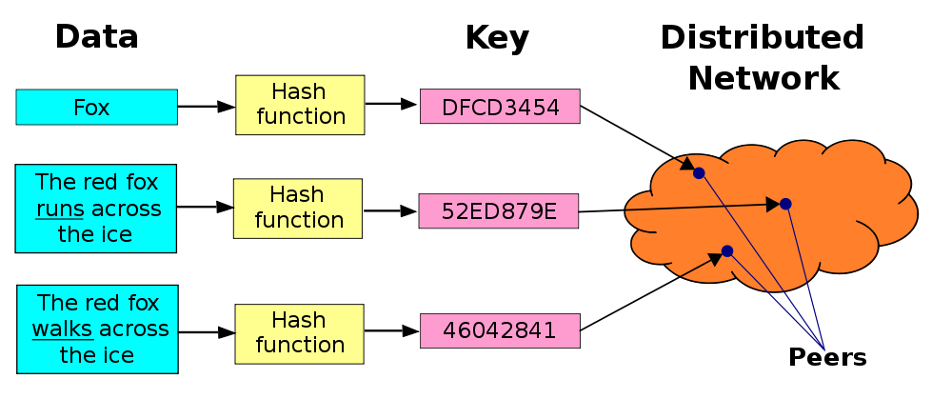
Key-value Stores
Another name for Distributed Hash Table

Slide 6
Zero-hop hash mapping

Slide 7
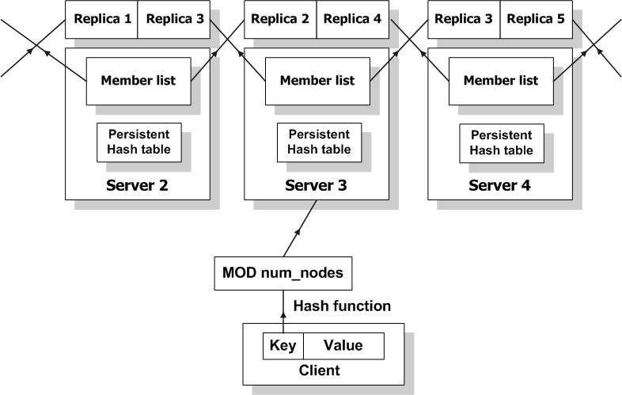
2-layer hashing

Slide 8
Consistency
Updating membership tables
Planed nodes join and leave: strong consistency
Nodes fail: eventual consistency
Updating replicas
Configurable
Strong consistency: consistent, reliable
Eventual consistency: fast, availability

Slide 9
Related work: Distributed Hash Tables
Many DHTs: Chord, Kademlia, Pastry, Cassandra, C-MPI, Memcached, Dynamo ...
Why another?
Name | Impl. | Routing Time | Persistence | Dynamic membership | Append Operation
Cassandra | Java | Log(N) | Yes | Yes | No
C-MPI | C | Log(N) | No | No | No
Dynamo | Java | 0 to Log(N) | Yes | Yes | No
Memcached | C | 0 | No | No | No
ZHT | C++ | 0 to 2 | Yes | Yes | Yes

Slide 10
Related projects
ZHT Bench: Benchmarking mainstream NoSQL databases
ZHT Cons: Eventual consistency support for ZHT
ZHT DMHDFS: Distributed Metadata Management for the Hadoop File System
ZHT Graph: Design and implement a graph database on ZHT
ZHT OHT: Hierarchical Distributed Hash Tables
ZHT ZST: Enhance ZHT through Range Queries and Iterators

Slide 11
Evaluation: test beds
IBM Blue Gene/P supercomputer
Up to 8192 nodes
32768 instance deployed
Commodity Cluster
Up to 64 node
Amazon EC2
M1.medium and Cc2.8xlarge
96 VMs, 768 ZHT instances deployed

Slide 12
Genera requirements
Familiar with Linux and it’s command line
Shell scripting language (eg. Bash, zsh…)
Programming skills in C++/C (except benchmark)
GCC compiler
No object oriented skill needed

Slide 13
ZHT Bench: Benchmarking mainstream NoSQL databases
Goal: Extensively benchmarking NoSQL databases and analysis performance data.
ZHT, MongoDB, Cassandra
Neo4J (experiment for Graph)
And others…
Metrics
Latency and its distribution , throughput
Parameters
Message size
Scales
Key Distributions

Slide 14
ZHT Cons: Eventual consistency support for ZHT
Goal 1: allow replicas serve read operation
Goal 2: maintain eventual consistency between replicas
Goal 3: make it scale (pretty hard!)
Optional goal: allow replicas serve write requests and maintain consistency (applying Paxos protocol, even harder)

Slide 15
ZHT DMHDFS: Distributed Metadata Management for the Hadoop File System
What is metadata?
Goal: improve HDFS performance by adding distributed metadata service
Requirement: experience with Hadoop and HDFS; strong programming skill in both Java and C++

Slide 16
ZHT Graph: Design and implement a graph database on ZHT
Goal: build a graph databases on top of ZHT
How: construct a mapping from key-value store interface to graph interface

Slide 17
ZHT OHT: Hierarchical Distributed Hash Tables
Goal: adding a proxy level to ZHT architecture so to reduce concurrency stress to each server
Easy: make it work and scale
Hard: handle failures

Slide 18
ZHT ZST: Enhance ZHT through Range Queries and Iterators
Goal: design and implement new interface methods to ZHT
Iterator: next/previous operation
Range get/put: given a range of key, return a series of results in one request loop
How?
Sorted map
B+ tree (bold!)

Slide 19
What do I expect?
Communication: come and talk to me (by appointment)
Make good use of Google
Fail quick, fail early, fail cheap.
Fast iteration: very small but frequent progress
Why bother? 80% points from projects!

Slide 20
Welcome abroad and enjoy!
Tonglin Li
tli13@hawk.iit.edu
http://datasys.cs.iit.edu/projects/ZHT/

