Slide 1
A Zero-hop distributed Hash Table for high-end computing systems
ZHT
Tonglin Li

Slide 2
Acknowledgements
I’d like to thank Dr. Ioan Raicu for his support and advising, and the help from Raman Verma, Xi Duan, and Hui Jin.
This work is published in HPDC/SigMetrics 2011 poster session.

Slide 3
Background
Data: files
Metadata: data about files
Distributed Storage System

Slide 4
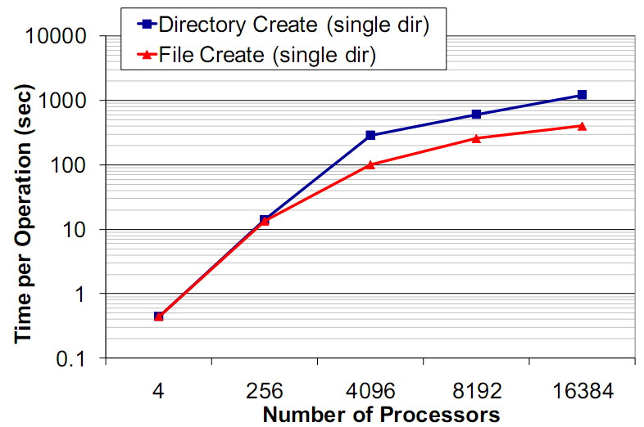
State-of-art metadata management
Relational DB based metadata
Heavy
Centralized metadata management
Communication jam
Fragile
Not scalable
Typical parallel file
System: GPFS by IBM
Notes:
Def: metadata, hash table, explain many basic things here, spend more time.

Slide 5
Proposed work: a new DHT for metadata management
What is a DHT?
Why DHT?
Fully distributed: no centralized bottleneck
High performance: high aggregated I/O
Fault tolerance
But existing DHTs are not fast enough.
Slow and heavy
High latency

Slide 6
Related work: DHT
 | Architecture Topology | Routing Time(hops)
Chord | Ring | Log(N)
CAN | Virtual multidimensional Cartesian coordinate space on a multi-torus | O(dn^{l/d})
Pastry | Hypercube | O(logN)
Tapestry | Hypercube | O(log_{B}N)
Cycloid | Cube-connected-cycle graph | O(d)
Kademlia | Ring | Log(N)
Memcached | Ring | 2
C-MPI | Ring | Log(N)
Dynamo | Ring | 0
Notes:
Compare with ZHT: 0-hop

Slide 7
Practical assumptions of HEC
Reliable hardware
Fast network interconnects
Non-existent node “churn”
Batch oriented: steady amount of resource

Slide 8
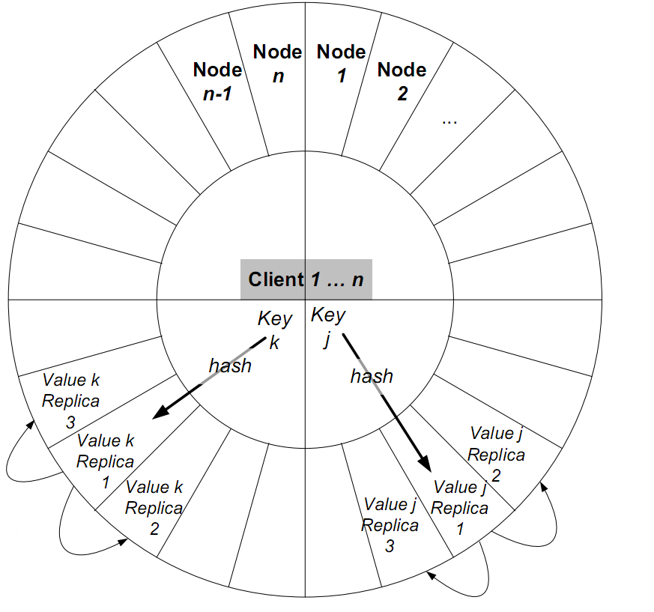
Overview of Design
Zero-hop

Slide 9
Implementation: Persistency
Database or key-value store
Relational database: transaction, complex query
BerkeleyDB, MySQL
Key-value store: small, simple, fast, flexible
Kyotocabinet, CouchDB, HBase
Log recording and playback
Bootstrap system requires to playback all log records for loading metadata

Slide 10
Implementation: Failure handling
Insert
If one try failed: send it to closest replica
Mark this record as primary copy
Recover to original node when reboot system
Lookup
If one try fail: try next one, until go through all replicas
Remove
Mark record removed(but not really remove)
Recover to original node when reboot system

Slide 11
Membership management
Static member list
reliable hardware
non-existent node “churn”
If a node quit, it never come back
Consistent hashing
Remove a node doesn't impact the hash map much

Slide 12
Replication update
Server-side replication
Asynchronized update
Sequential update among replicas
P->R1; R1->R2; R2->R3

Slide 13
Performance evaluation
Hardware: SiCortex SC5832
970 nodes
4GB RAM/node
5,832 cores
OS: Cento OS 5.0 (Linux)
Batch execution system: SLURM

Slide 14
Throughput
Ideal throughput:
T_{i} = tested single node throughput * node number
Measured throughput :
T _{a}= Sum of all single node tested throughputs

Slide 15
Ideal vs. measured throughput
Notes:
Use linear chart, explain the result: we are faster thousand time than anyone else

Slide 16
TCP v.s. UDP
Notes:
Put shapes on line make them distinct

Slide 17
ZHT v.s. C-MPI
Notes:
Why c-mpi slow: mpi nature and multi-hop

Slide 18
Replication overhead

Slide 19
Replication overhead

Slide 20
Future work
Comprehensive fault tolerance
Dynamic membership management
More protocol support (MBI…)
Merge with FusionFS
Data aware job scheduling
Many optimizations
Larger scale evaluation (BlueGene/P, etc)
Notes:
Dynamic membership: gossip based membership, failure detection ----------too much time on this

Slide 21
Conclusion
ZHT offer a good solution of distributed key-value store, they are
Light-weighted: cost less than 10MB memory/node
Scalable: near-linearly scales up to 5000 cores
Very fast: 100,000 operations/ sec
Low latency: about 10ms
Wide range of use: open source
Notes:
Contribution

Slide 22
Questions?

