Slide 1
HDB Price Prediction
Michelle Ng

Slide 2
Problem Statement
Singaporeans often take up their first loan when they buy their first HDB flat.
Often we spend use up the most of our savings to pay for a HDB flat.
How can we better prepare ourselves to buy a resale HDB flat?
How do we know if we are paying too high for a flat?

Slide 3
Workflow
Extract data
Scrape additional data from databases (eg. routing data)
Data Cleaning and Reconciliation
EDA
Model data
Choose the best data

Slide 4
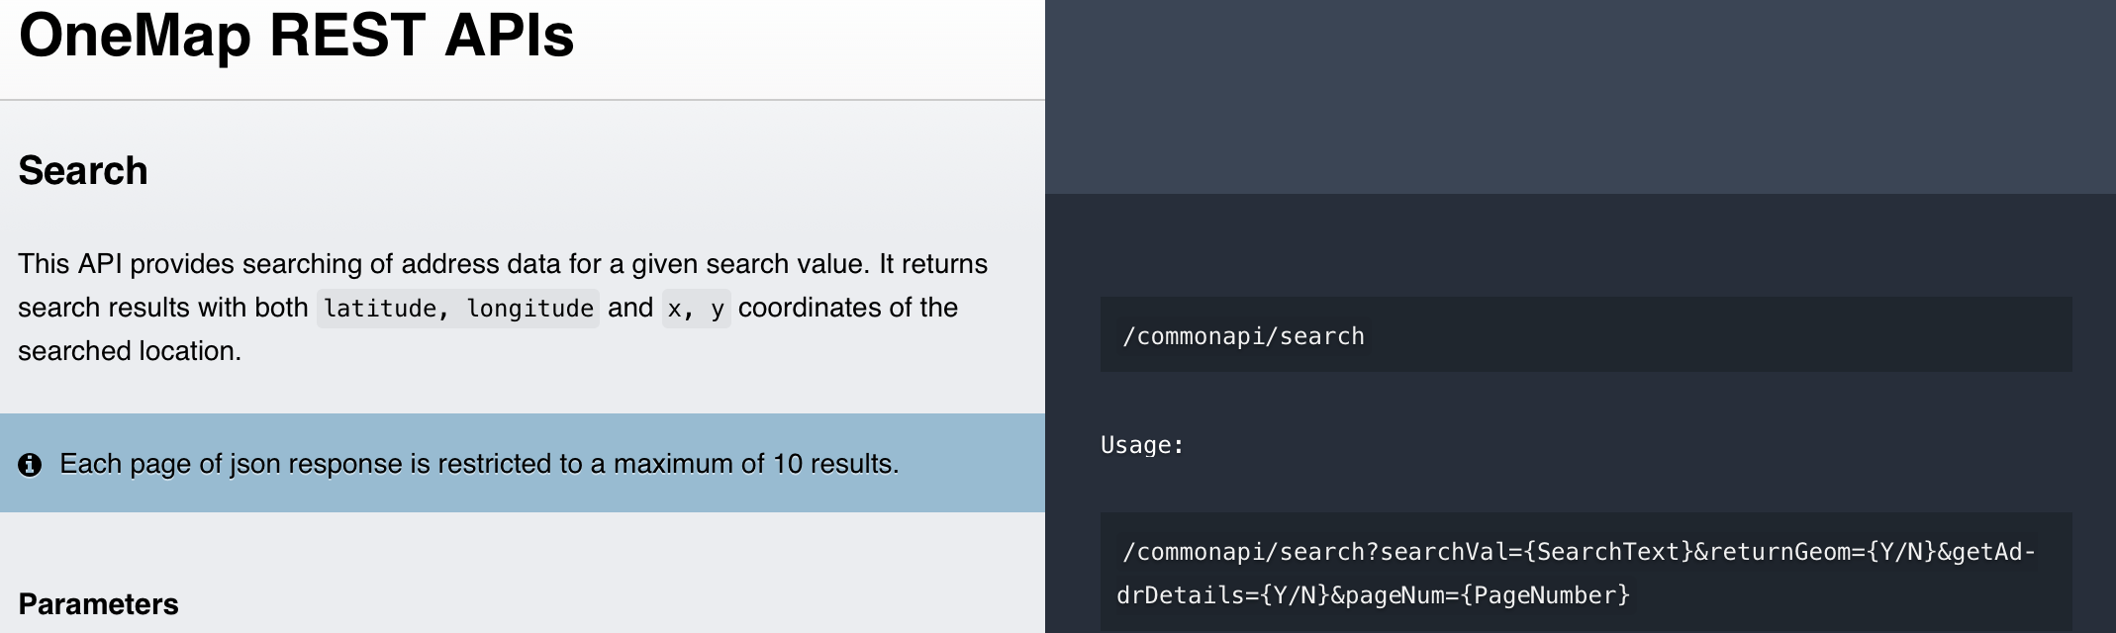
Extraction of data
Used standalone python files for scraping of data from:
LTA
SLA
Used publicly available data on data.gov.sg

Slide 5
Data Cleaning and Reconciliation
Data on data.gov.sg is quite clean fortunately… … but historical data keeping is not.
Problems encountered with data cleaning and reconciliation:
Historical bookkeeping have variables that align … but do not line categorically
Had to drop storey column because they were categorised in 2012 - 2014 by every 5 floors, but by every 3 floors in 2015-2019
API queries do not give a legitimate result.
Altogether there is 129997 at the end.

Slide 6
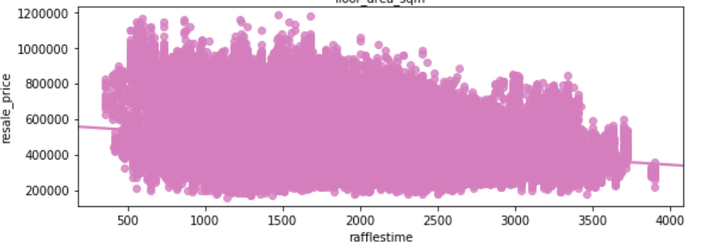
EDA

Slide 7
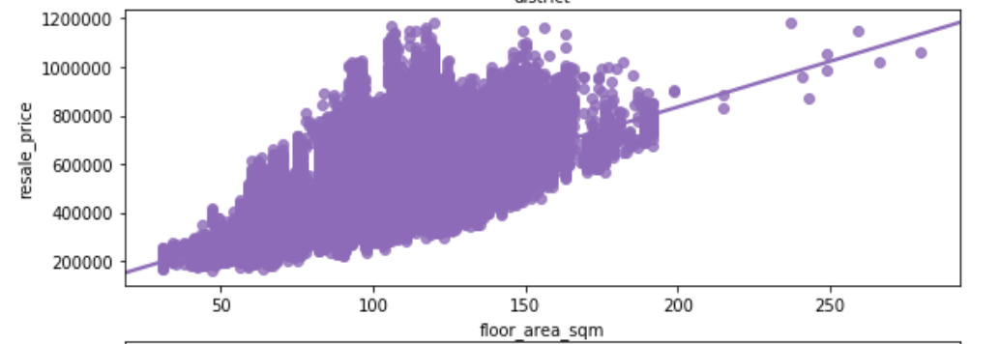
More EDA

Slide 8
Tests(ANOVA)
ANOVA on Room vs Price
Category | Mean Price
1 Room | 216513.89
2 Room | 253412.88
3 Room | 332546.37
4 Room | 444371.43
5 Room | 534751.64
Executive | 632612.22
Multi-Gen | 781350.58
P Value | 0.0

Slide 9
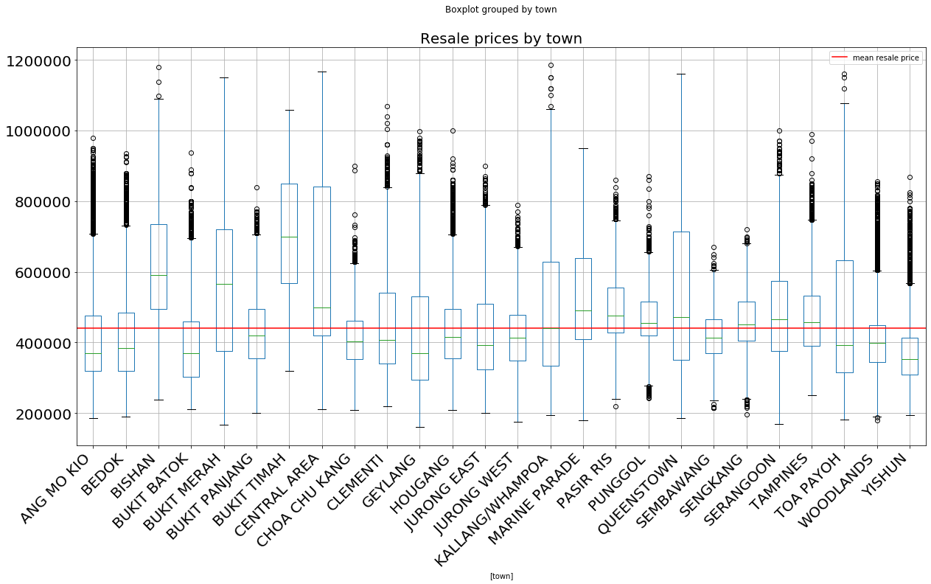
ANOVA - P value = 0.0

Slide 10
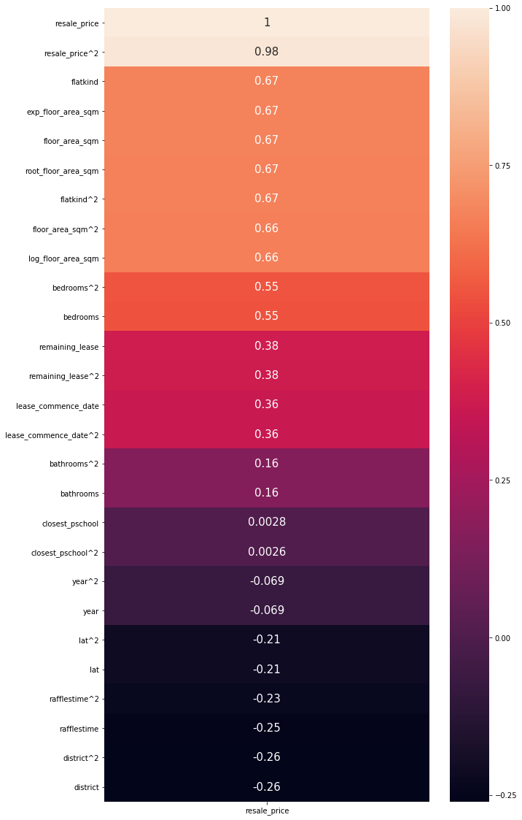
Correlation Heatmap

Slide 11
Modelling Results
Features | Model | Val Score | Val RMSE | Test Score | Test RMSE | Chosen
Normal | Linear Regression | 0.832 | 56299 | 0.823 | 65402 | N
 | Lasso | 0.832 | 56324 | 0.822 | 65464 | N
 | Ridge | 0.832 | 56299 | 0.823 | 65403 | N
 | ElasticNet | 0.806 | 60532 | 0.779 | 73023 | N
 | Random Forest | 0.948 | 31425 | 0.927 | 42048 | Y
 | Gradient Boosting | 0.891 | 45355 | 0.861 | 57990 | N
 | AdaBoost | 0.629 | 83590 | 0.518 | 107826 | N
Polynomial | Linear Regression | 0.826 | 57224 | 0.812 | 67403 | N

Slide 12
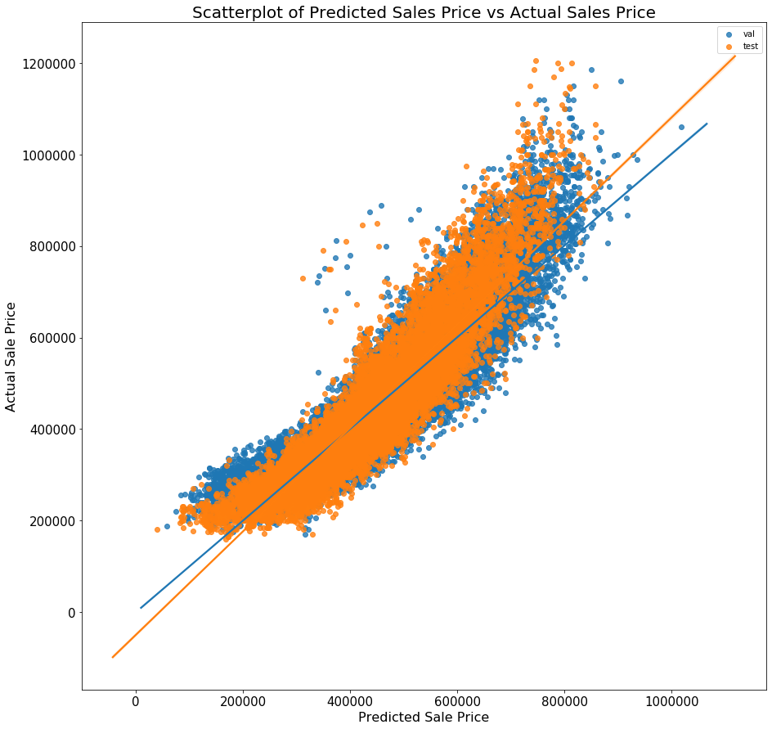
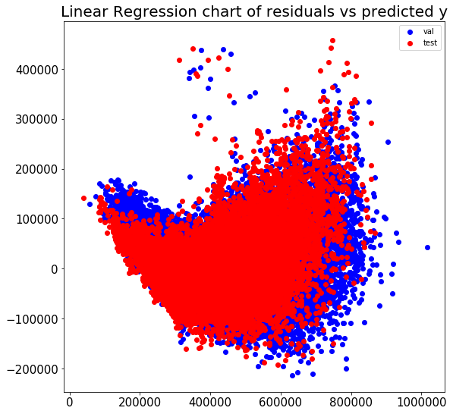
Common Trend (Linear, Lasso, Ridge, ElasticNet)

Slide 13
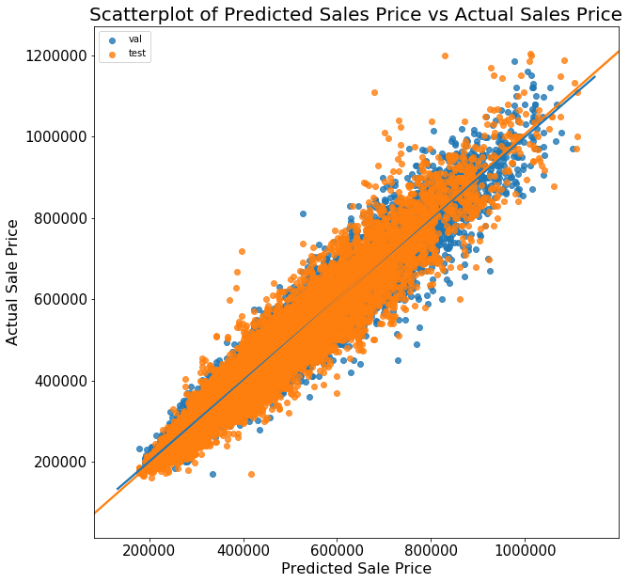
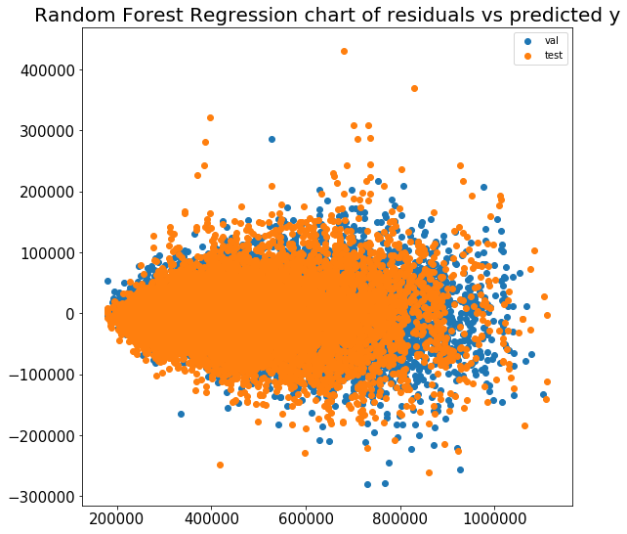
Common Trend (RandomForest, GBoost, AdaBoost)

Slide 14
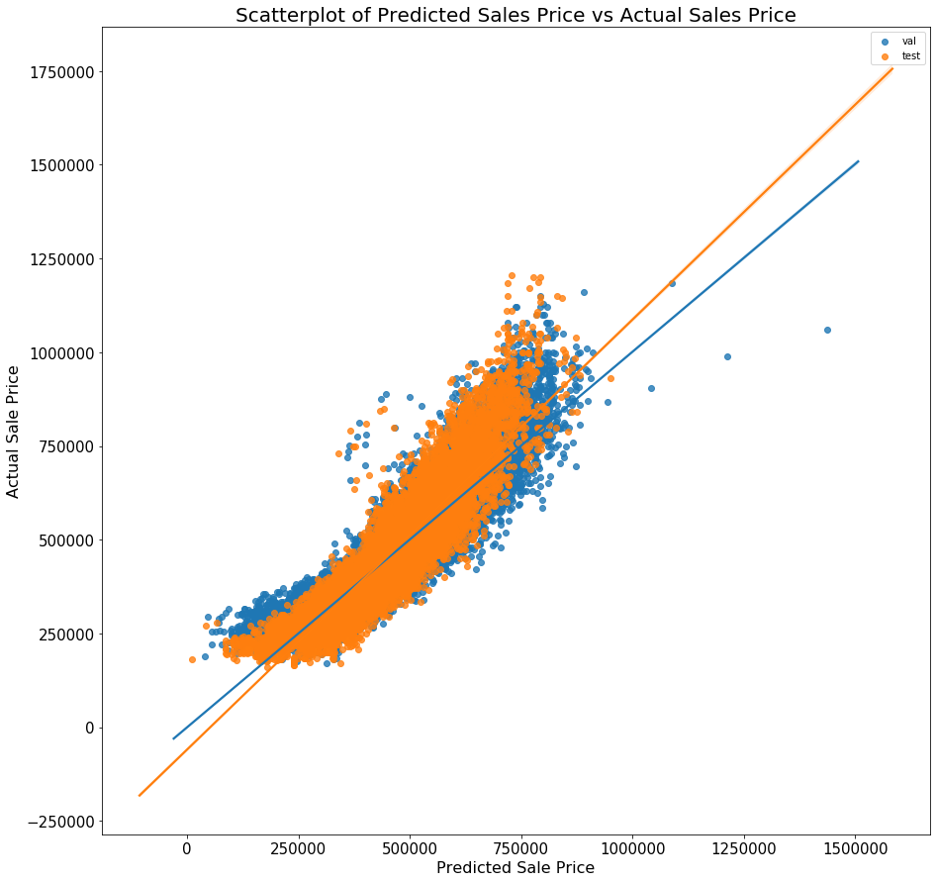
...after using floor_area_sqm^2

Slide 15
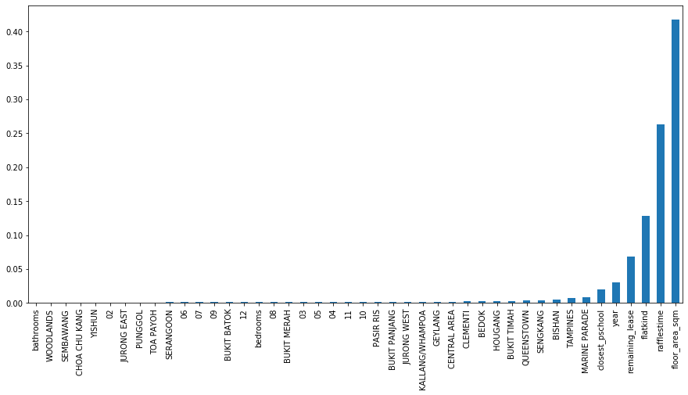
Coefficients in Random Forest Regressor

Slide 16
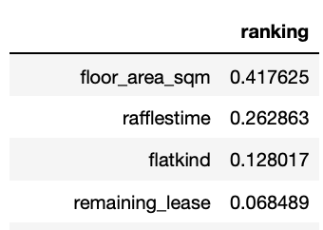
Conclusions
Random Forest Regressor fitted the best
It was able to produce a model that was
Homoscedastic
Linear
Best Predictors

Slide 17
Limitations
Unavailability of information on the storey of unit transacted
Probably has a considerable effect as there is considerable property classifieds that specify the floor
Lack of other forms of data
Inability to explain the curve in the extreme ends of the data
Only usable till HDB implements the next cooling down policy
Need future data

Slide 18
Further Deliberations
Time Series
Seasonality might be a factor - month is correlated
Town might be a factor - towns have different mean resale price
Need further data as
90 time points recorded
Stratifying by town - only 100 data for some flats

