Slide 1
RECOMMENDATIONS FOR THE SAT
Group Presentation:
Michelle Ng Elaine Zhao Amir Yunus
General Assembly DSI 10 - Project 1

Slide 2
PROBLEM STATEMENT
How can we use historical data to increase SAT participation rate across the nation?

Slide 3
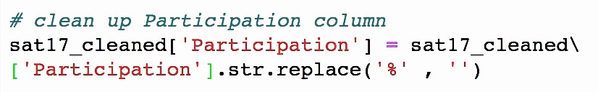
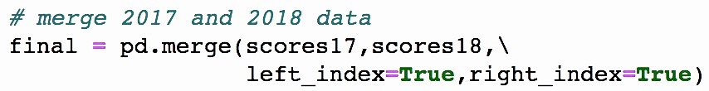
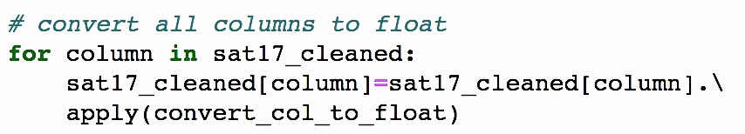
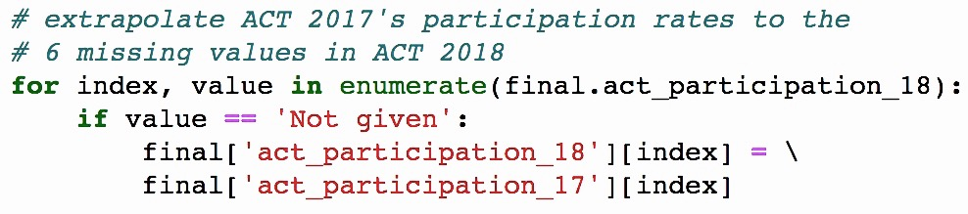
Challenges with raw participation rate data Sources: SAT & ACT participation rates in 2017 and 2018
1 | Extra characters | 3 | Merged both tests’ and both years’ dataframes
2 | Incorrect data types | 4 | Missing values in certain rows
Notes:
The data I looked at for this project are the SAT and ACT participation rates for 2017 and 2018
There were some challenges
The % sign in participation rate columns were causing the to be read as strings instead of integers, so had to be removed.
And then I standardised all columns to float and merged both years’ dataframes
For ACT 2018, there were some missing participation rates that I was not able to find online. For these I extrapolated 2017’s participation rates.’
So with the cleaned data

Slide 4
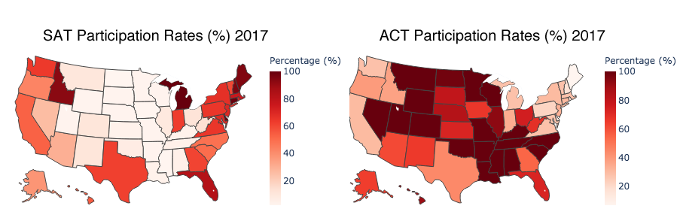

Notes:
These maps show the SAT and ACT participation rates in 2017 and 2018. The darker colours represent higher participation rates and the lighter ones mean lower participation rates.
From here you can see that SAT participation rates are lower (in the middle) where ACT participation rates are high.

Slide 5
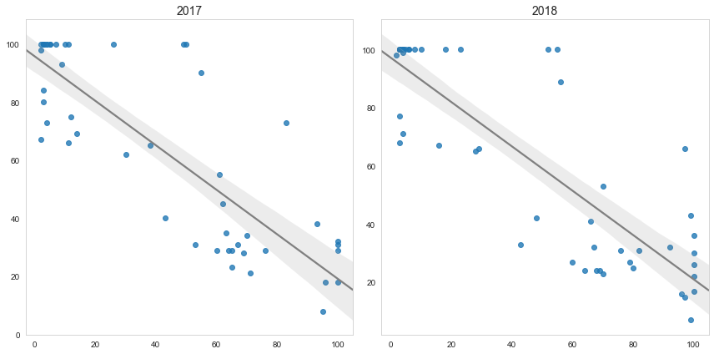
Inverse relationship between SAT and ACT participation rates.
ACT participation rates (%)
r = -0.74
r = -0.85
SAT participation rates (%)
Notes:
So there is an inverse relationship between SAT and ACT participation rates.
These are the ACT participation rates plotted against SAT participation rates. The inverse relationship means that the higher the SAT participation rates are, the lower the ACT participation rates (bottom right of graph), and vice versa for ACT (top left of graph).

Slide 6
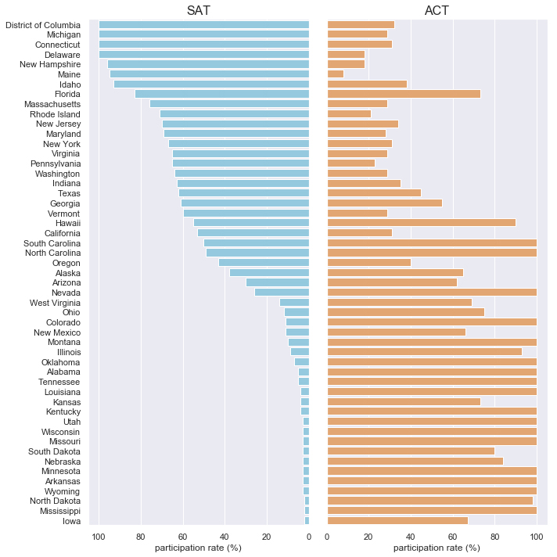
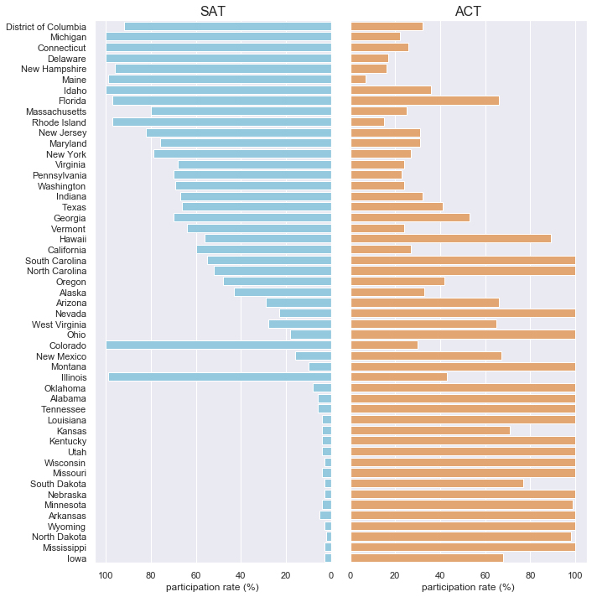
High participation rates in one test usually means low participation rates in the other.
Participation rates (%) 2017
Participation rates (%) 2018
Notes:
Here we can see the inverse relationship between the two tests again. This is the SAT and ACT participation rates by state, in decreasing order of SAT participation rates.
This trend was observed for both years (click for 2018 graph)
And this was especially true in states where the SAT or the ACT is compulsory. So states with 100% participation rates (the ones here for SAT and the ones here for ACT) generally had the lowest participation rates for the other test.
States with compulsory ACT also saw especially low SAT participation rates.
Some states also saw drastic changes in participation rates, like Colorado and Illinois (SAT), and Ohio (ACT)
These are the states that either made the SAT compulsory in 2018 or made the ACT compulsory

Slide 7
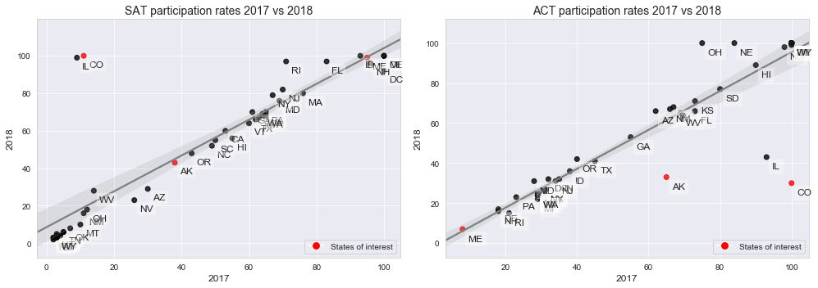
PARTICIPATION RATES PER STATE

Slide 8
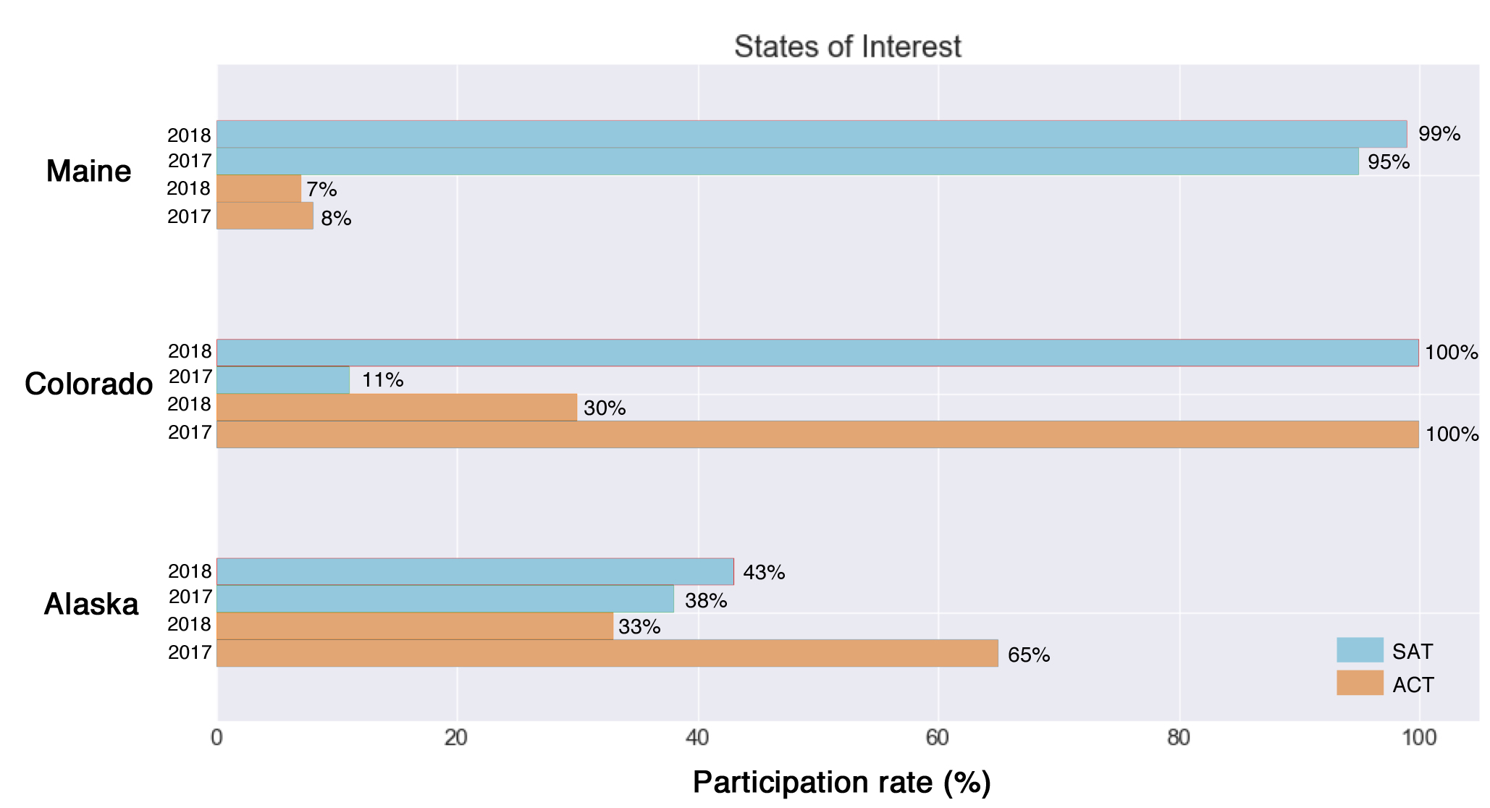

Slide 9
POINTS OF INTEREST
Colorado has a unique graph where it changed from 100% participation in ACT 2017 to 100% participation in SAT 2018.
This is because there was a change in high school testing in 2017 from ACT to SAT.
Alaska has a middling participation rate for both ACT and SAT.
This is because there is no state preferred test for Alaska.
Maine has a high SAT participation
This is because the state has requires SAT.
However, Maine does not have 100% test participation in SAT
Possibility: They might not be in the public school system

Slide 10
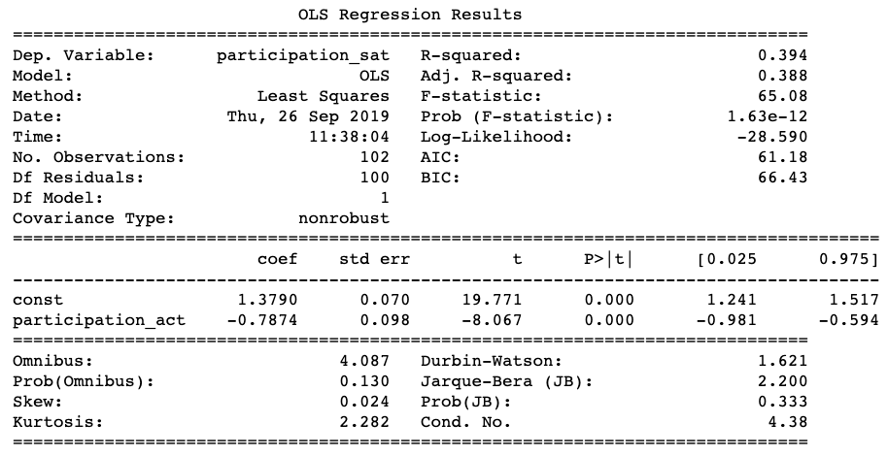
LIMITS OF DATA
Notes:
We shall consider the OLS Regression Results. Our assumption are as follows:
Based on normality tests, we know that our variable ‘participation_act’ is not normal. Therefore, biased.
But, we shall assume that it is a consistent estimator (i.e. variance will reduce as number of samples increases)
The regression is linear
Our errors are idiosyncratic
Expected value of error = 0
Errors are homoscedastic (s = theta and Cov(x,e) = 0)
Errors are independent and identically distributed (Cov(e,e) = 0
Our confidence level is at 95%
P>t for participation_act = 0, means the variable is statistically significant
P>F is almost 0, means some of the participation rate of SAT can be explained by this regression
R-squared is 0.394 means only 39%. That means we have another 60% of variances that have yet to be explained.
Participation rate of ACT is not the only factor
Another 60% is included in the error
So what are other possible factors?

Slide 11
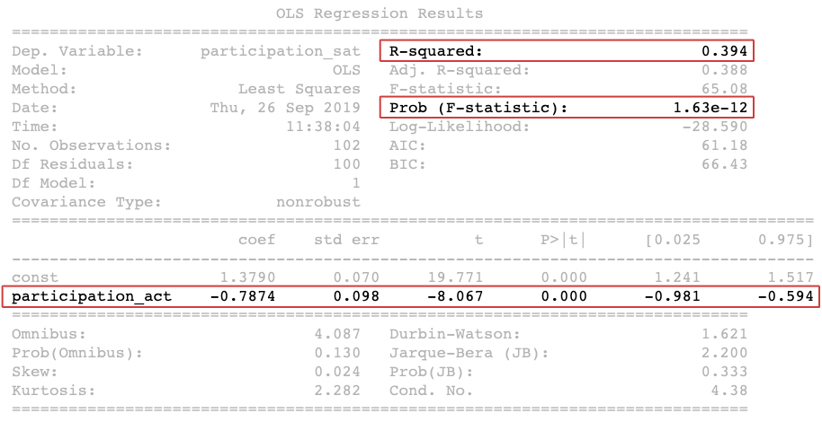
Notes:
We shall consider the OLS Regression Results. Our assumption are as follows:
Based on normality tests, we know that our variable ‘participation_act’ is not normal. Therefore, biased.
But, we shall assume that it is a consistent estimator (i.e. variance will reduce as number of samples increases)
The regression is linear
Our errors are idiosyncratic
Expected value of error = 0
Errors are homoscedastic (s = theta and Cov(x,e) = 0)
Errors are independent and identically distributed (Cov(e,e) = 0
Our confidence level is at 95%
P>t for participation_act = 0, means the variable is statistically significant
P>F is almost 0, means some of the participation rate of SAT can be explained by this regression
R-squared is 0.394 means only 39%. That means we have another 60% of variances that have yet to be explained.
Participation rate of ACT is not the only factor
Another 60% is included in the error
So what are other possible factors?

Slide 12
KEY STATISTICS
participation_act (P>|t|) | 0.000
Prob (F-statistic) | 1.63e-12
R-squared | 0.394

Slide 13
EXTERNAL FACTORS
n
Achievement Levels
Cultural Factors
Socioeconomic Status
Notes:
Students who attend schools that typically achieve high SAT score averages
Schools with a lower teacher-to-student ratio will also perform better

Slide 14
EXTERNAL FACTORS
n
Achievement Levels
Cultural Factors
Socioeconomic Status
Notes:
Researchers have documented performance gaps between races such as African Americans and whites
Issues such as lowered expectations of minority group test-takers and culturally biased questions are some of the possible causes for the comparatively lower scores.

Slide 15
EXTERNAL FACTORS
n
Achievement Levels
Cultural Factors
Socioeconomic Status
Notes:
Students from families that have low socioeconomic status may lack access to adequate material such as practice tests to help them prepare for the exam.
These students are also less likely to receive support to attempt the SAT test and proceeding to college because their parents have in many cases also not gone that far

Slide 16
CONCLUSIONS & RECOMMENDATIONS
n
State Requirement
Availability
Preparatory
Notes:
School districts may require students to take the SAT.
In addition to mandating the tests, some districts automatically enroll students in and expect them to complete online SAT preparation courses.
However, few districts and/or states require all students to take the SAT.

Slide 17
CONCLUSIONS & RECOMMENDATIONS
n
State Requirement
Availability
Preparatory
Notes:
School districts may require students to take the SAT.
In addition to mandating the tests, some districts automatically enroll students in and expect them to complete online SAT preparation courses.
However, few districts and/or states require all students to take the SAT.

Slide 18
CONCLUSIONS & RECOMMENDATIONS
n
State Requirement
Availability
Preparatory
Notes:
States should offer a for‐credit SAT Preparation Course by leveraging online SAT courses.
Students are then exposed to, and able to practice critical new skills while reviewing previously acquired knowledge and skills.
States should also offer credit for the course motivates students at all academic levels, and ensures they are better prepared for the SAT.
The College Board should post a daily / weekly contest on selected questions from the SAT.
Encourage students to participate by submitting them online or school's suggestion box.

Slide 19
THANK YOU
Source: "https://www.testive.com/colorado-sat-change-2017/"
Source: " https://magoosh.com/hs/act/2017/states-that-require-the-act-or-sat/"
Source: "https://magoosh.com/hs/act/2017/states-that-require-the-act-or-sat/"

