Slide 1
What features support housing price in Ames?
Michelle Ng

Slide 2
Data Cleaning
Dropped Columns that had less than 60% of the data:
Alley
Fence
Misc Features
Fireplace Qu
PID was let out as it was a secondary ID no

Slide 3
Data Cleaning
Imputation of Missing Data
Continuous variables:
Opted for replaced with mean, unless the distribution is not normal – Shapiro Wilks test
Those that do not fit normal distribution are replaced with median
Categorical Variables
Replaced with Mode
Reason – retained its distribution

Slide 4
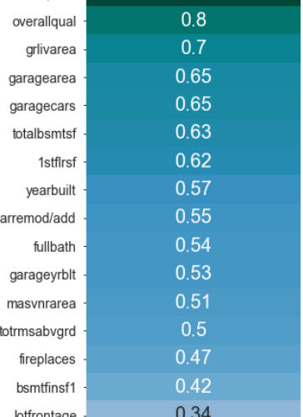
Statistical Inference Tests:
Categorical Variables:
Difference in Variance measure by ANOVA against saleprice
Continuous Variables:
Correlation matched with saleprice

Slide 5
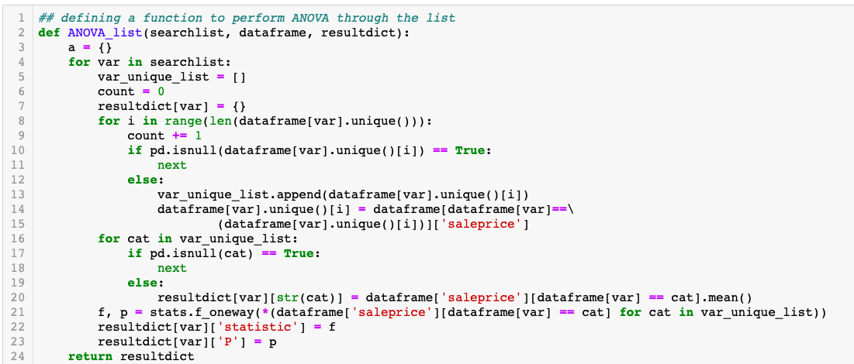

Slide 6
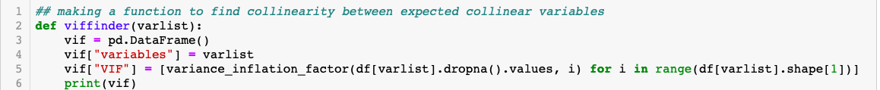
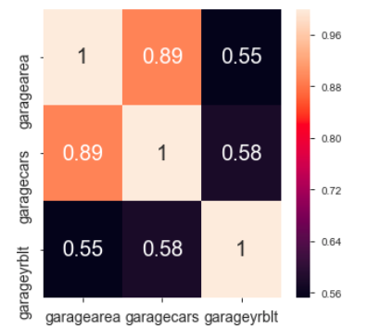

Collinearity
Most collinear variables are removed using variance inflation factor
Variables with a VIF of 5 or more is taken out, with the exception of a highly correlated value (>0.8)

Slide 7
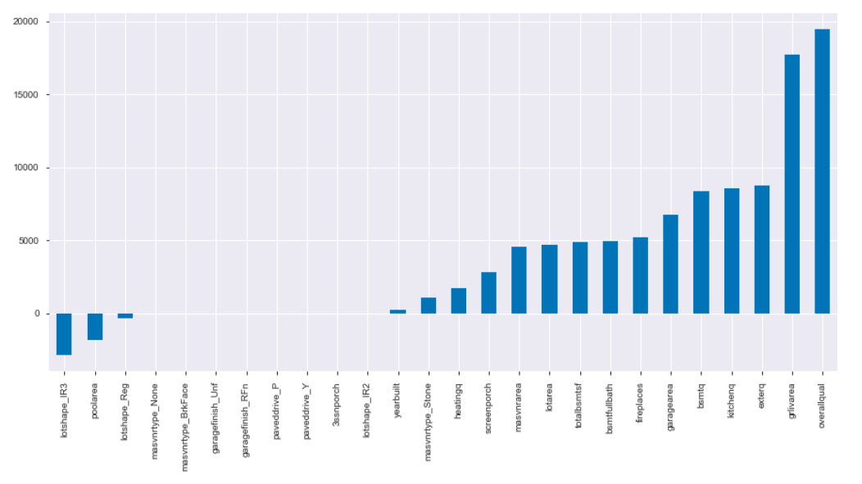
Lasso Regression

Slide 8
Conclusion
Overall quality, masonary area, pool area, no of fireplaces, ground living area, screen porch, lot area, basement full baths, total basement sqft, garage area, year built, exterior quality, heating quality, basement quality, kitchen quality, masonary type, lot shape are all feature that contribute to sale price of the house.

