Slide 1
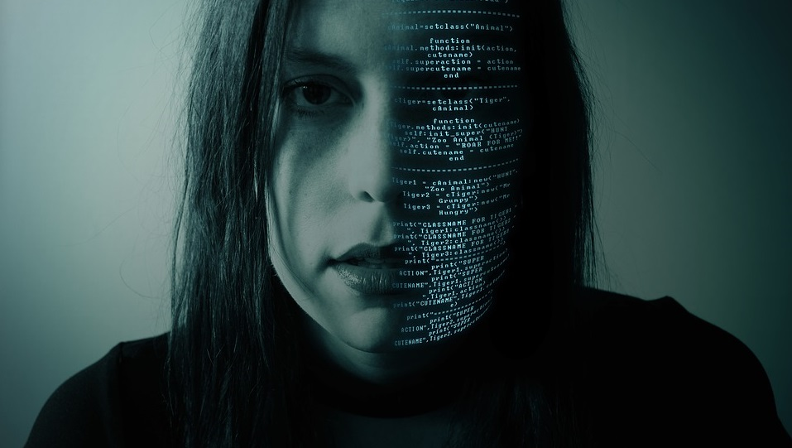
Intimate Data in Personal Informatics
Diana Irmscher
Advanced Seminar in Media Informatics | Munich | 2018-05-15

Slide 2
Intimate data in Personal Informatics

