Slide 1
Intimate Data in Relationships: Tracking, Sharing, Surveillance – Personal Boundaries?
Diana Irmscher
Advanced Seminar in Media Informatics | Munich | 2018-07-27
Notes:
Hello, my name is Diana.
I‘m studying Media Informatics at the University of Munch
Today, I present you my work which is called Intimate Data in Relationships: Tracking, Sharing, Surveillance – Personal Boundaries?

Slide 2

The Quantified Self
Notes:
First or all, I want to explain the term Quantified Self.
Did anybody heard about this before?
So, I want to explain the term Quantified Self with an example.
In this picture, you can see Ellis. Ellis wanted to investigate her body and look at all her skin scars.

Slide 3

The Quantified Self
Notes:
Ellis has experienced quit a lot, for instance a car accident.

Slide 4
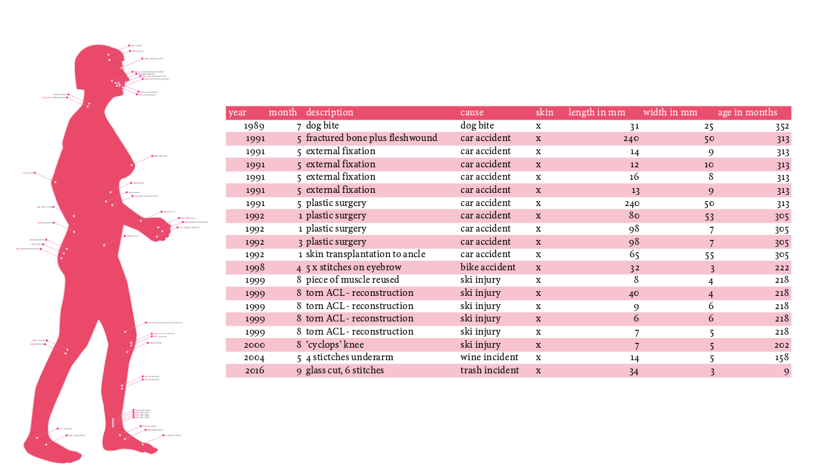
The Quantified Self
Notes:
Over the years, many scars have accumulated.
She measured all her scars in length and came up to about 1m high and 30 cm wide.

Slide 5
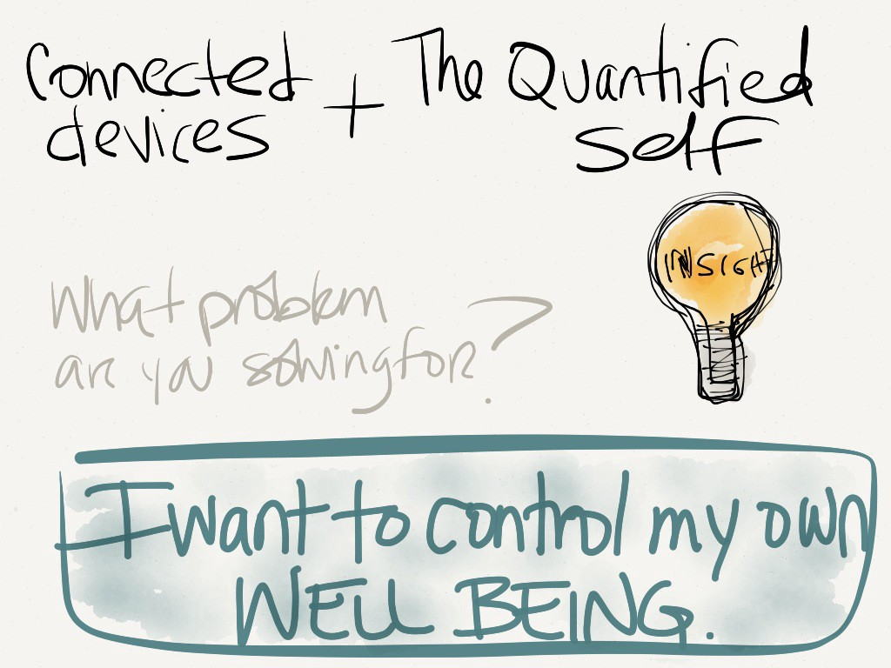
Why do people track data?
Notes:
She reflect this with quantifying her body, to get more insights and control.

Slide 6
Why do people track data?
Nearly everything can be tracked
Kevon Kelly, The inevitable
Notes:
So, nearly everything can be tracked and quantified.

Slide 7
Why do people track intimate data?
But what about intimate data?
Wich data perceived as intimate?
Notes:
But what is about intimate data?
And which data did we perceive as intimate?

Slide 8
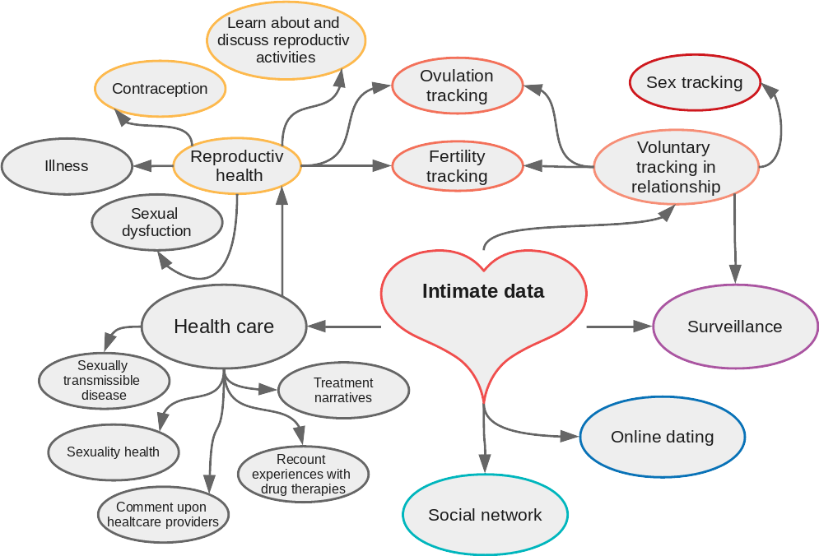
What data are perceived as intimate?
Notes:
To answer this question, I searched for works which are about intimate data in context of collecting, tracking and sharing such data. I came to the result that things that are related to intimate activities are mainly described as intimate.
So I tried to build a cluster of data type which related to intimate data.
We can find such data in Health care, beginning in Treatment narratives, go to Reproduction health, Fertility tracking, to sex tracking.
But we can find intimate data also in Online Dating Platforms and Social Networks, like Tinder or Facebook.
In my work, I considered all colored data types.

Slide 9

The Life Course of Intimate Relationships
defined by Levy, 2014
Notes:
I want to go along the live course of intimate relationships defined by Levy.
Levy defined four conditions which describes the different stats a relationship can be.
I will explain these conditions in the following and give some examples.

Slide 10




A: Dating – Scoping out potential intimates
Notes:
I think neraly everybody here knows how to google someone.
Levy wrote, that many people use Google, Facebook, or the smartphone application Lulu the get information about another person of our interesst.
Also Tinder is well known as a location-based dating service.

Slide 11
A: Dating – Scoping out potential intimates
Data were collected and shared by other users or by using the service (social network, application)
Notes:
I think neraly everybody here knows how to google someone.
Levy wrote, that many people use Google, Facebook, or the smartphone application Lulu the get information about another person of our interesst.
Also Tinder is well known as a location-based dating service.

Slide 12
B: Tracking Intimate and Romantic Practices

Slide 13
C: Monitoring Fertility

Slide 14
What do they do with?

Slide 15
What do they do with?

Slide 16
What do they do with?

Slide 17
Quellen
https://medium.com/re-write/creating-a-quantified-self-how-i-use-data-to-combat-chronic-health-issues-a88af3536020
http://qs17.quantifiedself.com/slides/S2_3_EllisBartholomeus_Scars.pdf
https://de.wikipedia.org/wiki/Datei:Logo-Tinder.svg
https://de.wikipedia.org/wiki/Datei:Facebook_New_Logo_(2015).svg
https://de.wikipedia.org/wiki/Datei:Google_2015_logo.svg
https://en.wikipedia.org/wiki/Lulu_(app)#/media/File:Lulu_app_logo.png

