Slide 1
Intimate Data in Relationships: Tracking, Sharing, Surveillance – Personal Boundaries?
Diana Irmscher
Supervisors: Hanna Schneider | Mariam Hassib
Advanced Seminar in Media Informatics | Munich | 2018-07-27
Notes:
Hello, my name is Diana.
Today, I will present you my work which is called Intimate Data in Relationships: Tracking, Sharing, Surveillance – Personal Boundaries?

Slide 2
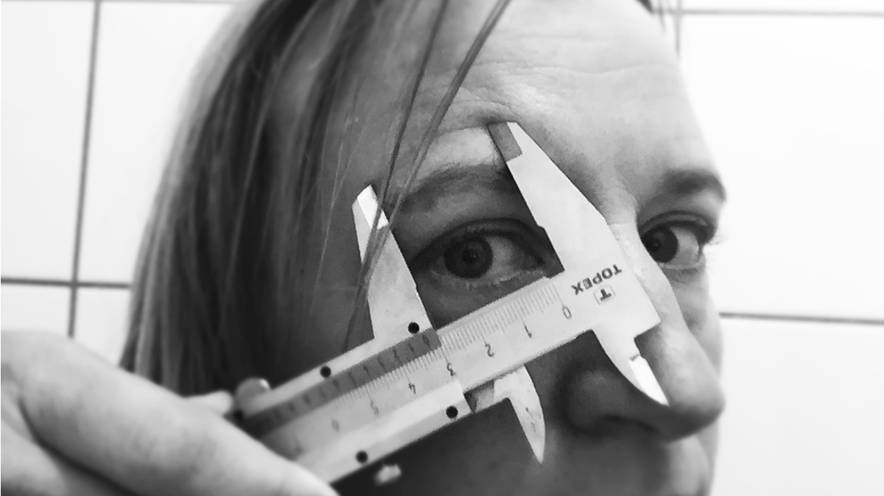
The Quantified Self
Notes:
First or all, I want to explain the term Quantified Self.
Did anybody heard about this before?
I want to explain Quantified Self with this example, which I took from a Meetups of the Quantified Self Group.
In this picture, you can see Ellis. In this project Ellis investigated her body and looked at all her skin scars.

Slide 3

The Quantified Self
Notes:
Because Ellis has experienced a lot over the years, for instance a car accident.

Slide 4
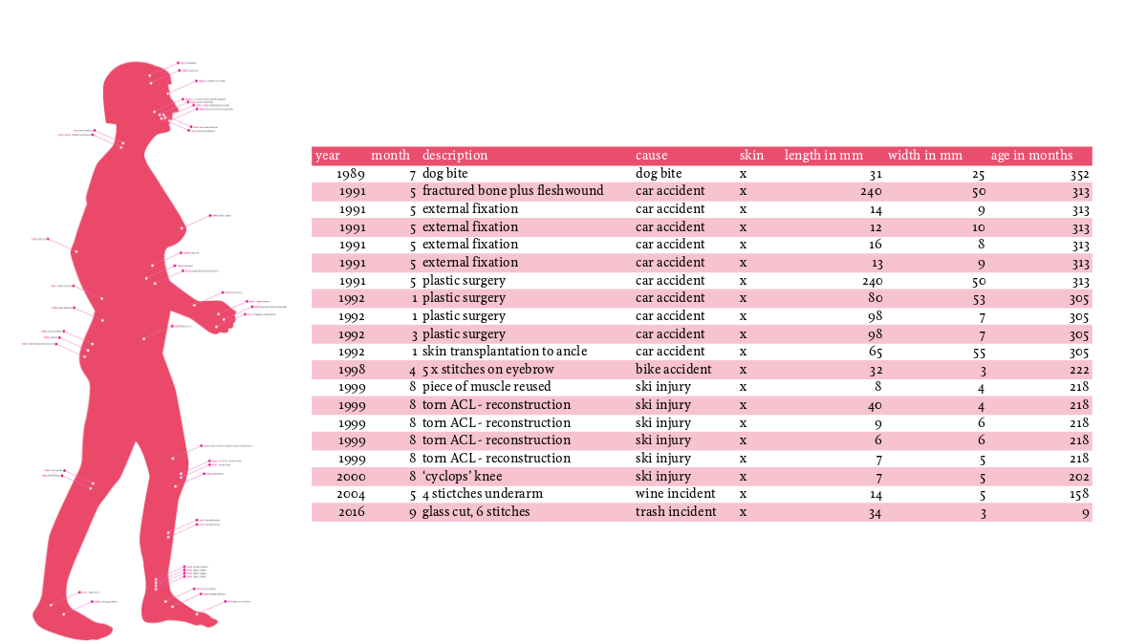
The Quantified Self
Notes:
And over the years, many scars have accumulated.
She measured all her scars in length and wide and came up to about 1m length and 30 cm wide.
She collected also even more information, e.g. on which day the scars are occurred, and found that 28% of the accidents are in May.
Ellis was asked by many people why she does that.

Slide 5
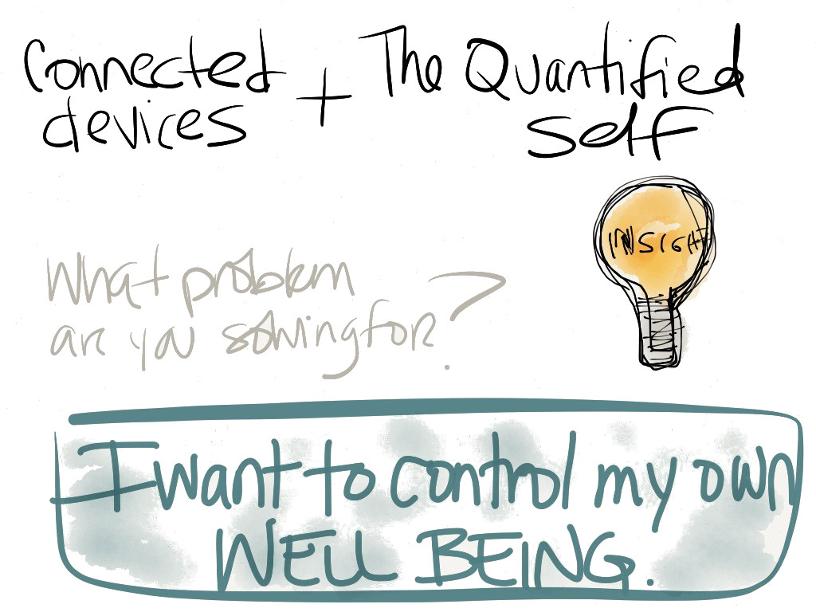
Why do people track themself?
Notes:
Ellis said that in this way she is able to reflect herself by quantifying her body, and to get more insights and control. With these knowledge, she can influence her behavior in a positive way, for instance be more carefully in May :-)

Slide 6
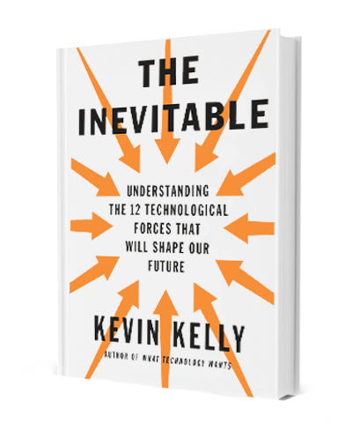
What data can be tracked?
[Kelly, 2016]
Notes:
So, which data can be tracked at all?
Kevin Kelly, the author of the book “The Inevitable”, wrote that “[…] anything that can be tracked is being tracked by someone somewhere” and that “Self-tracking is much broader than health. It is as big as our life itself”.

Slide 7
What data can be tracked?
“I can honestly say that
anything that can be tracked
is being tracked by someone somewhere.“
[Kelly, 2016]
Notes:
So, which data can be tracked at all?
Kevin Kelly, the author of the book “The Inevitable”, wrote that “[…] anything that can be tracked is being tracked by someone somewhere” and that “Self-tracking is much broader than health. It is as big as our life itself”.

Slide 8
What data can be tracked?
“I can honestly say that
anything that can be tracked
is being tracked by someone somewhere.“
“Self-tracking is much
broader than health.
It is as big as our life itself.”
[Kelly, 2016]
Notes:
So, which data can be tracked at all?
Kevin Kelly, the author of the book “The Inevitable”, wrote that “[…] anything that can be tracked is being tracked by someone somewhere” and that “Self-tracking is much broader than health. It is as big as our life itself”.

Slide 9

What is about intimate data?
Notes:
But tracking almost anything that is possible also captures intimate data which are sure to emerge in our lives.
So what is about this? How can we track our relationship?
And which data did we perceive as intimate? And are there personal boundaries? I would like to address these questions in the next slides.

Slide 10
What is about intimate data?
Which data are perceived as intimate?
Notes:
But tracking almost anything that is possible also captures intimate data which are sure to emerge in our lives.
So what is about this? How can we track our relationship?
And which data did we perceive as intimate? And are there personal boundaries? I would like to address these questions in the next slides.

Slide 11
What is about intimate data?
Which data are perceived as intimate?
How can we track our relationship?
Notes:
But tracking almost anything that is possible also captures intimate data which are sure to emerge in our lives.
So what is about this? How can we track our relationship?
And which data did we perceive as intimate? And are there personal boundaries? I would like to address these questions in the next slides.

Slide 12
What is about intimate data?
Which data are perceived as intimate?
How can we track our relationship?
Why do people track intimate data in relationships?
Notes:
But tracking almost anything that is possible also captures intimate data which are sure to emerge in our lives.
So what is about this? How can we track our relationship?
And which data did we perceive as intimate? And are there personal boundaries? I would like to address these questions in the next slides.

Slide 13
What is about intimate data?
Which data are perceived as intimate?
How can we track our relationship?
Why do people track intimate data in relationships?
What do they do with it?
Notes:
But tracking almost anything that is possible also captures intimate data which are sure to emerge in our lives.
So what is about this? How can we track our relationship?
And which data did we perceive as intimate? And are there personal boundaries? I would like to address these questions in the next slides.

Slide 14
What is about intimate data?
Which data are perceived as intimate?
How can we track our relationship?
Why do people track intimate data in relationships?
What do they do with it?
  Do they over-trust the tracked data?
Notes:
But tracking almost anything that is possible also captures intimate data which are sure to emerge in our lives.
So what is about this? How can we track our relationship?
And which data did we perceive as intimate? And are there personal boundaries? I would like to address these questions in the next slides.

Slide 15
What is about intimate data?
Which data are perceived as intimate?
How can we track our relationship?
Why do people track intimate data in relationships?
What do they do with it?
  Do they over-trust the tracked data?
  How do they perceive their tracked data?
Notes:
But tracking almost anything that is possible also captures intimate data which are sure to emerge in our lives.
So what is about this? How can we track our relationship?
And which data did we perceive as intimate? And are there personal boundaries? I would like to address these questions in the next slides.

Slide 16
What data are perceived as intimate?
[Levy, 2014], [Lupton, 2015], [Danaher et al., 2018]
Notes:
What data are perceived as intimate at all?
This question was not as easy to answer as it seems at first glance, because it depends on several factors. In general it has to be differentiated between the culture and which factors are shaping the socio-cultural live. And what is perceived as intimate is subjective, at all.
I tried to cluster some terms that came from others work which includes topics related to intimate data. Here we can see this topics. It is related to Health care, Reproduction health, Fertility tracking, Sex tracking, but it arise also by using social media and online dating services.
I colored the terms that I will address.

Slide 17

What data are perceived as intimate?
Health Care
[Levy, 2014], [Lupton, 2015], [Danaher et al., 2018]
Notes:
What data are perceived as intimate at all?
This question was not as easy to answer as it seems at first glance, because it depends on several factors. In general it has to be differentiated between the culture and which factors are shaping the socio-cultural live. And what is perceived as intimate is subjective, at all.
I tried to cluster some terms that came from others work which includes topics related to intimate data. Here we can see this topics. It is related to Health care, Reproduction health, Fertility tracking, Sex tracking, but it arise also by using social media and online dating services.
I colored the terms that I will address.

Slide 18

What data are perceived as intimate?
Health Care
Tracking
[Levy, 2014], [Lupton, 2015], [Danaher et al., 2018]
Notes:
What data are perceived as intimate at all?
This question was not as easy to answer as it seems at first glance, because it depends on several factors. In general it has to be differentiated between the culture and which factors are shaping the socio-cultural live. And what is perceived as intimate is subjective, at all.
I tried to cluster some terms that came from others work which includes topics related to intimate data. Here we can see this topics. It is related to Health care, Reproduction health, Fertility tracking, Sex tracking, but it arise also by using social media and online dating services.
I colored the terms that I will address.

Slide 19

What data are perceived as intimate?
Health Care
Tracking
Social Network
[Levy, 2014], [Lupton, 2015], [Danaher et al., 2018]
Notes:
What data are perceived as intimate at all?
This question was not as easy to answer as it seems at first glance, because it depends on several factors. In general it has to be differentiated between the culture and which factors are shaping the socio-cultural live. And what is perceived as intimate is subjective, at all.
I tried to cluster some terms that came from others work which includes topics related to intimate data. Here we can see this topics. It is related to Health care, Reproduction health, Fertility tracking, Sex tracking, but it arise also by using social media and online dating services.
I colored the terms that I will address.

Slide 20

What data are perceived as intimate?
Health Care
Tracking
Social Network
Online Dating
[Levy, 2014], [Lupton, 2015], [Danaher et al., 2018]
Notes:
What data are perceived as intimate at all?
This question was not as easy to answer as it seems at first glance, because it depends on several factors. In general it has to be differentiated between the culture and which factors are shaping the socio-cultural live. And what is perceived as intimate is subjective, at all.
I tried to cluster some terms that came from others work which includes topics related to intimate data. Here we can see this topics. It is related to Health care, Reproduction health, Fertility tracking, Sex tracking, but it arise also by using social media and online dating services.
I colored the terms that I will address.

Slide 21

What data are perceived as intimate?
Health Care
Tracking
Social Network
Online Dating
Surveillance
[Levy, 2014], [Lupton, 2015], [Danaher et al., 2018]
Notes:
What data are perceived as intimate at all?
This question was not as easy to answer as it seems at first glance, because it depends on several factors. In general it has to be differentiated between the culture and which factors are shaping the socio-cultural live. And what is perceived as intimate is subjective, at all.
I tried to cluster some terms that came from others work which includes topics related to intimate data. Here we can see this topics. It is related to Health care, Reproduction health, Fertility tracking, Sex tracking, but it arise also by using social media and online dating services.
I colored the terms that I will address.

Slide 22
The Life Course of Intimate Relationships
A:
Dating –
Scoping
out potential
intimates
B:
Tracking
intimate
and
romantic
practices
C:
Monitoring
fertility
D:
Surveillance,
Abuse
And revenge
[Levy, 2014]
Notes:
To bring all these terms in order I want to go along the so called live course of intimate relationships defined by Levy.
In her work Levy defined four conditions which describes the different stats a relationship can be.
I will explain these conditions in the following and give some examples which intimate data can be collected, tracked and shared.

Slide 23
A: Dating – Scoping out potential intimates
[Levy, 2014]
Notes:
Condition A stands for the beginning of a potential relationship. The partner know each other or would like to know each other. The aim is to learn more about the other person.
In this slide I give some well-known examples for technologies or applications that are used for this, like Google or Facebook and Tinder.
Or the Lulu application, I think this is not so well known. The Luliu application gives young women the opportunity to review male students and friends, with with they are connected on Facebook.

Slide 24

A: Dating – Scoping out potential intimates
Google someone
Find information in the web
[Levy, 2014]
Notes:
Condition A stands for the beginning of a potential relationship. The partner know each other or would like to know each other. The aim is to learn more about the other person.
In this slide I give some well-known examples for technologies or applications that are used for this, like Google or Facebook and Tinder.
Or the Lulu application, I think this is not so well known. The Luliu application gives young women the opportunity to review male students and friends, with with they are connected on Facebook.

Slide 25

A: Dating – Scoping out potential intimates
Google someone
Find information in the web
Facebook stalking
Search for public entries, mutual friends, likes, etc.
[Levy, 2014]
Notes:
Condition A stands for the beginning of a potential relationship. The partner know each other or would like to know each other. The aim is to learn more about the other person.
In this slide I give some well-known examples for technologies or applications that are used for this, like Google or Facebook and Tinder.
Or the Lulu application, I think this is not so well known. The Luliu application gives young women the opportunity to review male students and friends, with with they are connected on Facebook.

Slide 26

A: Dating – Scoping out potential intimates
Google someone
Find information in the web
Facebook stalking
Search for public entries, mutual friends, likes, etc.
Information about education
Age-rank of matches
When/where online conversation with matched happens
Interesst and jobs
Pictures (Instagram)
Sexual preferences
[Levy, 2014]
Notes:
Condition A stands for the beginning of a potential relationship. The partner know each other or would like to know each other. The aim is to learn more about the other person.
In this slide I give some well-known examples for technologies or applications that are used for this, like Google or Facebook and Tinder.
Or the Lulu application, I think this is not so well known. The Luliu application gives young women the opportunity to review male students and friends, with with they are connected on Facebook.

Slide 27

A: Dating – Scoping out potential intimates
[Nandwani et al., 2018]
Notes:
The problem also is that users disclose information quickly to strangers.
Most published data are personal data: full name, date of birth, phone numbers, work detail, the complete home address.
Nandwani et al. showed in a study that users disclosured their data because they trust in the authenticity of the other with an active profile account.

Slide 28
A: Dating – Scoping out potential intimates
Users disclosed information quickly to strangers
[Nandwani et al., 2018]
Notes:
The problem also is that users disclose information quickly to strangers.
Most published data are personal data: full name, date of birth, phone numbers, work detail, the complete home address.
Nandwani et al. showed in a study that users disclosured their data because they trust in the authenticity of the other with an active profile account.

Slide 29
A: Dating – Scoping out potential intimates
Users disclosed information quickly to strangers
Most published data were personal data: full name, date of birth, phone numbers, work detail, email-addresses, complete home address
[Nandwani et al., 2018]
Notes:
The problem also is that users disclose information quickly to strangers.
Most published data are personal data: full name, date of birth, phone numbers, work detail, the complete home address.
Nandwani et al. showed in a study that users disclosured their data because they trust in the authenticity of the other with an active profile account.

Slide 30

B: Tracking Intimate and Romantic Practices
[Danaher et al., 2018]
Notes:
Next, in Condition B the partners are already in a relationship or something appropriate. The partners known each other better and have an mutual interest, possibly sexual interests.
There is a very large and growing market in this area, offering new wearable devices with internet connectivity and applications for evaluation.

Slide 31
B: Tracking Intimate and Romantic Practices
Intimate tracking
[Danaher et al., 2018]
Notes:
Next, in Condition B the partners are already in a relationship or something appropriate. The partners known each other better and have an mutual interest, possibly sexual interests.
There is a very large and growing market in this area, offering new wearable devices with internet connectivity and applications for evaluation.

Slide 32
B: Tracking Intimate and Romantic Practices
Intimate tracking
Intimate Gamification
[Danaher et al., 2018]
Notes:
Next, in Condition B the partners are already in a relationship or something appropriate. The partners known each other better and have an mutual interest, possibly sexual interests.
There is a very large and growing market in this area, offering new wearable devices with internet connectivity and applications for evaluation.

Slide 33
B: Tracking Intimate and Romantic Practices
Intimate tracking
Intimate Gamification
wearable sex toys/devices
  Lovely
  kGoal
[Danaher et al., 2018]
Notes:
Next, in Condition B the partners are already in a relationship or something appropriate. The partners known each other better and have an mutual interest, possibly sexual interests.
There is a very large and growing market in this area, offering new wearable devices with internet connectivity and applications for evaluation.

Slide 34
B: Tracking Intimate and Romantic Practices
Intimate tracking
Intimate Gamification
wearable sex toys/devices
  Lovely
  kGoal
Tracking application
  SexTracker
[Danaher et al., 2018]
Notes:
Next, in Condition B the partners are already in a relationship or something appropriate. The partners known each other better and have an mutual interest, possibly sexual interests.
There is a very large and growing market in this area, offering new wearable devices with internet connectivity and applications for evaluation.

Slide 35
B: Tracking Intimate and Romantic Practices
Risks that may arise:
[Danaher et al., 2018]
Notes:
There are some potential risks that came up by using such technologies.
First, this are really intimate data which can be tracked.
It is not always guaranteed that the data are anonymous.
The data can be resold, because companies have a commercial interest on these kind of data, for example insurance companies.
There is also the problem of quantification the activity, similar to a sport activity like swimming. This supports gender stereotypes and gamification.

Slide 36
B: Tracking Intimate and Romantic Practices
Risks that may arise:
Really intimate data stored on servers
[Danaher et al., 2018]
Notes:
There are some potential risks that came up by using such technologies.
First, this are really intimate data which can be tracked.
It is not always guaranteed that the data are anonymous.
The data can be resold, because companies have a commercial interest on these kind of data, for example insurance companies.
There is also the problem of quantification the activity, similar to a sport activity like swimming. This supports gender stereotypes and gamification.

Slide 37
B: Tracking Intimate and Romantic Practices
Risks that may arise:
Really intimate data stored on servers
Not always guaranteed that the data are anonymous
[Danaher et al., 2018]
Notes:
There are some potential risks that came up by using such technologies.
First, this are really intimate data which can be tracked.
It is not always guaranteed that the data are anonymous.
The data can be resold, because companies have a commercial interest on these kind of data, for example insurance companies.
There is also the problem of quantification the activity, similar to a sport activity like swimming. This supports gender stereotypes and gamification.

Slide 38
B: Tracking Intimate and Romantic Practices
Risks that may arise:
Really intimate data stored on servers
Not always guaranteed that the data are anonymous
Data can be resold
[Danaher et al., 2018]
Notes:
There are some potential risks that came up by using such technologies.
First, this are really intimate data which can be tracked.
It is not always guaranteed that the data are anonymous.
The data can be resold, because companies have a commercial interest on these kind of data, for example insurance companies.
There is also the problem of quantification the activity, similar to a sport activity like swimming. This supports gender stereotypes and gamification.

Slide 39
B: Tracking Intimate and Romantic Practices
Risks that may arise:
Really intimate data stored on servers
Not always guaranteed that the data are anonymous
Data can be resold
Automatic recording by application
[Danaher et al., 2018]
Notes:
There are some potential risks that came up by using such technologies.
First, this are really intimate data which can be tracked.
It is not always guaranteed that the data are anonymous.
The data can be resold, because companies have a commercial interest on these kind of data, for example insurance companies.
There is also the problem of quantification the activity, similar to a sport activity like swimming. This supports gender stereotypes and gamification.

Slide 40
B: Tracking Intimate and Romantic Practices
Risks that may arise:
Really intimate data stored on servers
Not always guaranteed that the data are anonymous
Data can be resold
Automatic recording by application
Quantification of act, similar to a sport activity
[Danaher et al., 2018]
Notes:
There are some potential risks that came up by using such technologies.
First, this are really intimate data which can be tracked.
It is not always guaranteed that the data are anonymous.
The data can be resold, because companies have a commercial interest on these kind of data, for example insurance companies.
There is also the problem of quantification the activity, similar to a sport activity like swimming. This supports gender stereotypes and gamification.

Slide 41
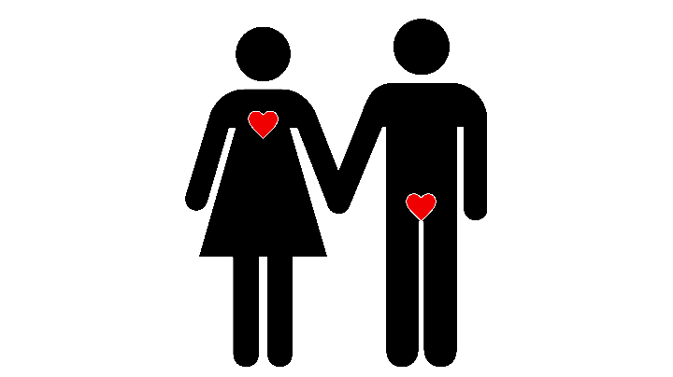
B: Tracking Intimate and Romantic Practices
Risks that may arise:
Really intimate data stored on servers
Not always guaranteed that the data are anonymous
Data can be resold
Automatic recording by application
Quantification of act, similar to a sport activity
Supports gender stereotypes
[Danaher et al., 2018]
Notes:
There are some potential risks that came up by using such technologies.
First, this are really intimate data which can be tracked.
It is not always guaranteed that the data are anonymous.
The data can be resold, because companies have a commercial interest on these kind of data, for example insurance companies.
There is also the problem of quantification the activity, similar to a sport activity like swimming. This supports gender stereotypes and gamification.

Slide 42
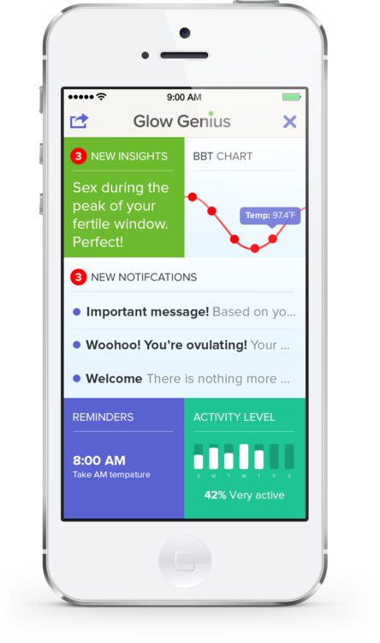
C: Monitoring Fertility
[Lupton, 2018]
Notes:
In Conduction B with Sex tracking, the focus was more on man, with comparison with others and gamification.
In Condition C, the woman is being tracked and monitored, or rahter her menstrual cycle and her body.
The Glow application is well known in this area. This app collects a huge amount of data, which the user can entered. That’s are typical data to predict ovulation and fertile days.
These data are further processed and evaluated by the provider in order to make better predictions. And this works really good, even if you do not enter data every day.

Slide 43
C: Monitoring Fertility
These types of data make woman to an object of surveillance and quantification
[Lupton, 2018]
Notes:
In Conduction B with Sex tracking, the focus was more on man, with comparison with others and gamification.
In Condition C, the woman is being tracked and monitored, or rahter her menstrual cycle and her body.
The Glow application is well known in this area. This app collects a huge amount of data, which the user can entered. That’s are typical data to predict ovulation and fertile days.
These data are further processed and evaluated by the provider in order to make better predictions. And this works really good, even if you do not enter data every day.

Slide 44
C: Monitoring Fertility
These types of data make woman to an object of surveillance and quantification
Gives the impression that the cycle of a woman is unsupervised chaotic
[Lupton, 2018]
Notes:
In Conduction B with Sex tracking, the focus was more on man, with comparison with others and gamification.
In Condition C, the woman is being tracked and monitored, or rahter her menstrual cycle and her body.
The Glow application is well known in this area. This app collects a huge amount of data, which the user can entered. That’s are typical data to predict ovulation and fertile days.
These data are further processed and evaluated by the provider in order to make better predictions. And this works really good, even if you do not enter data every day.

Slide 45
C: Monitoring Fertility
These types of data make woman to an object of surveillance and quantification
Gives the impression that the cycle of a woman is unsupervised chaotic
Promote the enhancement of gender stereotypes
[Lupton, 2018]
Notes:
In Conduction B with Sex tracking, the focus was more on man, with comparison with others and gamification.
In Condition C, the woman is being tracked and monitored, or rahter her menstrual cycle and her body.
The Glow application is well known in this area. This app collects a huge amount of data, which the user can entered. That’s are typical data to predict ovulation and fertile days.
These data are further processed and evaluated by the provider in order to make better predictions. And this works really good, even if you do not enter data every day.

Slide 46
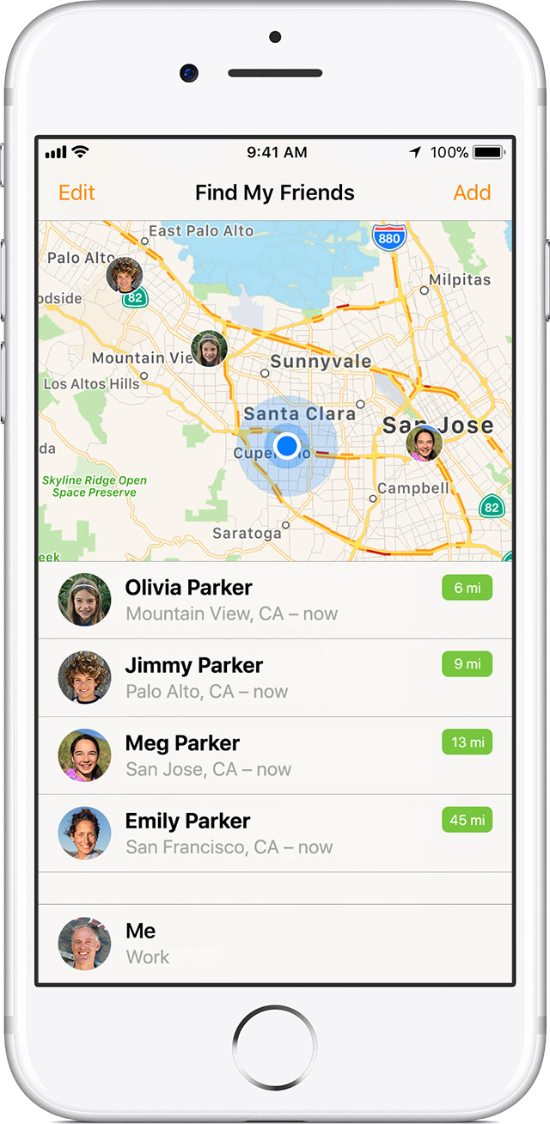
D: Surveilance, Abuse and Revenge
[Danaher et al., 2018]
Notes:
Condition D is about Surveillance, Abuse and Revenge.
Today, surveillance can take place in relationships, because there are several possibilities trough location-based tracking, for instance with the application FindMyFriend.
People track their location with the partner, family and friends. However, it is not enough explored what impact this has on a relationships and, above all, the mutual trust in relationship.

Slide 47
D: Surveilance, Abuse and Revenge
Surveillance trough location-based tracking
[Danaher et al., 2018]
Notes:
Condition D is about Surveillance, Abuse and Revenge.
Today, surveillance can take place in relationships, because there are several possibilities trough location-based tracking, for instance with the application FindMyFriend.
People track their location with the partner, family and friends. However, it is not enough explored what impact this has on a relationships and, above all, the mutual trust in relationship.

Slide 48
D: Surveilance, Abuse and Revenge
Surveillance trough location-based tracking
People track their location with the partner, family and friends
[Danaher et al., 2018]
Notes:
Condition D is about Surveillance, Abuse and Revenge.
Today, surveillance can take place in relationships, because there are several possibilities trough location-based tracking, for instance with the application FindMyFriend.
People track their location with the partner, family and friends. However, it is not enough explored what impact this has on a relationships and, above all, the mutual trust in relationship.

Slide 49
D: Surveilance, Abuse and Revenge
Surveillance trough location-based tracking
People track their location with the partner, family and friends
Urge for control
[Danaher et al., 2018]
Notes:
Condition D is about Surveillance, Abuse and Revenge.
Today, surveillance can take place in relationships, because there are several possibilities trough location-based tracking, for instance with the application FindMyFriend.
People track their location with the partner, family and friends. However, it is not enough explored what impact this has on a relationships and, above all, the mutual trust in relationship.

Slide 50

D: Surveilance, Abuse and Revenge
Surveillance trough location-based tracking
People track their location with the partner, family and friends
Urge for control
Does location tracking influences the love in a relationship?
[Danaher et al., 2018]
Notes:
Condition D is about Surveillance, Abuse and Revenge.
Today, surveillance can take place in relationships, because there are several possibilities trough location-based tracking, for instance with the application FindMyFriend.
People track their location with the partner, family and friends. However, it is not enough explored what impact this has on a relationships and, above all, the mutual trust in relationship.

Slide 51

D: Surveilance, Abuse and Revenge
[Freed et al., 2018]
Notes:
Freed et al. conducted in a study how technologies are used today to harm partners or ex-partners.
For example, they found out that victims are often not aware that they were monitored by their abuser, and they did not know how to turn this surveillance.
In general, one can say that system security is not
adequate for this type of attack, since these people were really close, and, for example, security questions can be answered or passwords are guessed. In this way, the abuser get access to the smartphone or the Facebook account.

Slide 52
D: Surveilance, Abuse and Revenge
Technologies can be misused for other purposes
[Freed et al., 2018]
Notes:
Freed et al. conducted in a study how technologies are used today to harm partners or ex-partners.
For example, they found out that victims are often not aware that they were monitored by their abuser, and they did not know how to turn this surveillance.
In general, one can say that system security is not
adequate for this type of attack, since these people were really close, and, for example, security questions can be answered or passwords are guessed. In this way, the abuser get access to the smartphone or the Facebook account.

Slide 53
D: Surveilance, Abuse and Revenge
Technologies can be misused for other purposes
People exploit technologies to intimidate, threaten, monitor or harass the partner, ex-partner...
[Freed et al., 2018]
Notes:
Freed et al. conducted in a study how technologies are used today to harm partners or ex-partners.
For example, they found out that victims are often not aware that they were monitored by their abuser, and they did not know how to turn this surveillance.
In general, one can say that system security is not
adequate for this type of attack, since these people were really close, and, for example, security questions can be answered or passwords are guessed. In this way, the abuser get access to the smartphone or the Facebook account.

Slide 54
D: Surveilance, Abuse and Revenge
Technologies can be misused for other purposes
People exploit technologies to intimidate, threaten, monitor or harass the partner, ex-partner...
Security measures are often not enough in this case
[Freed et al., 2018]
Notes:
Freed et al. conducted in a study how technologies are used today to harm partners or ex-partners.
For example, they found out that victims are often not aware that they were monitored by their abuser, and they did not know how to turn this surveillance.
In general, one can say that system security is not
adequate for this type of attack, since these people were really close, and, for example, security questions can be answered or passwords are guessed. In this way, the abuser get access to the smartphone or the Facebook account.

Slide 55
Risks
Notes:
So, now we are finished with all condition in the life course of a relationship. In each condition I gave an example, but I will summarize the risks in this slide.
First, there can be a problem by quantifung the relationship, because there is a risk that the user can be lost in numbers and lose the relation. The user should always be aware of why he or she uses technology in the relationship and what the benefits are.
Second by tracking the partner all the time with location-based tracking applications like FindMyFriends, it is questionable how that affects the trust in a relationship. What is, if, the location data are not always available? Or if one of the partner does not want to be tracked anymore?
And last, the privacy and data security is a big topic, which people often do not care about it. It is not only a problem of one person, but also an interpersonal issue in a relationship.

Slide 56
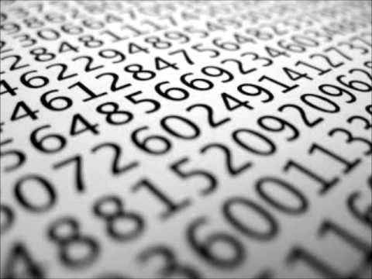
Risks
Quantification
Risk of losing the reference to the data
User should be aware of purpose
Notes:
So, now we are finished with all condition in the life course of a relationship. In each condition I gave an example, but I will summarize the risks in this slide.
First, there can be a problem by quantifung the relationship, because there is a risk that the user can be lost in numbers and lose the relation. The user should always be aware of why he or she uses technology in the relationship and what the benefits are.
Second by tracking the partner all the time with location-based tracking applications like FindMyFriends, it is questionable how that affects the trust in a relationship. What is, if, the location data are not always available? Or if one of the partner does not want to be tracked anymore?
And last, the privacy and data security is a big topic, which people often do not care about it. It is not only a problem of one person, but also an interpersonal issue in a relationship.

Slide 57
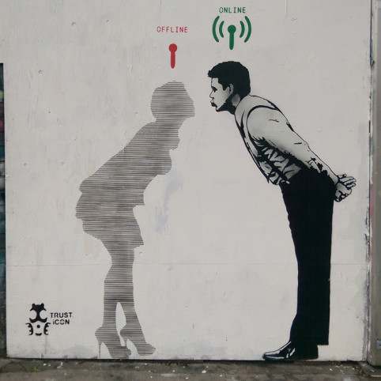
Risks
Quantification
Risk of losing the reference to the data
User should be aware of purpose
Trust
Focus can be solely on data
Trust can be lost
Notes:
So, now we are finished with all condition in the life course of a relationship. In each condition I gave an example, but I will summarize the risks in this slide.
First, there can be a problem by quantifung the relationship, because there is a risk that the user can be lost in numbers and lose the relation. The user should always be aware of why he or she uses technology in the relationship and what the benefits are.
Second by tracking the partner all the time with location-based tracking applications like FindMyFriends, it is questionable how that affects the trust in a relationship. What is, if, the location data are not always available? Or if one of the partner does not want to be tracked anymore?
And last, the privacy and data security is a big topic, which people often do not care about it. It is not only a problem of one person, but also an interpersonal issue in a relationship.

Slide 58
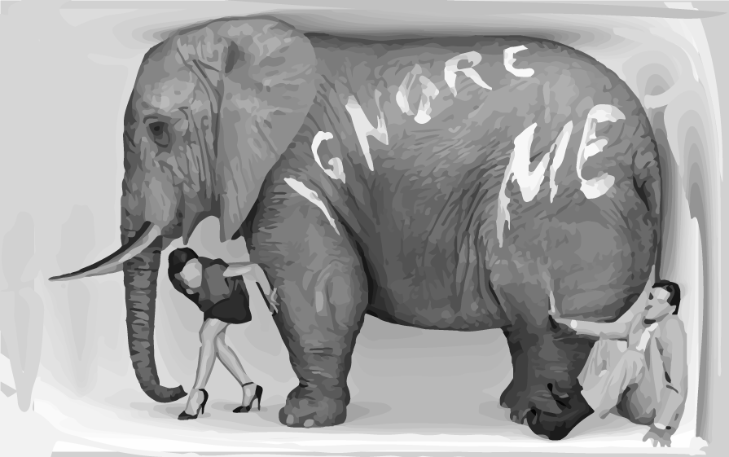
Risks
Quantification
Risk of losing the reference to the data
User should be aware of purpose
Trust
Focus can be solely on data
Trust can be lost
Privacy
Privacy is important and should not be forgotten
Interpersonal issues also play a role
Notes:
So, now we are finished with all condition in the life course of a relationship. In each condition I gave an example, but I will summarize the risks in this slide.
First, there can be a problem by quantifung the relationship, because there is a risk that the user can be lost in numbers and lose the relation. The user should always be aware of why he or she uses technology in the relationship and what the benefits are.
Second by tracking the partner all the time with location-based tracking applications like FindMyFriends, it is questionable how that affects the trust in a relationship. What is, if, the location data are not always available? Or if one of the partner does not want to be tracked anymore?
And last, the privacy and data security is a big topic, which people often do not care about it. It is not only a problem of one person, but also an interpersonal issue in a relationship.

Slide 59
Benefits
Notes:
So, now we are finished with all condition in the life course of a relationship. In each condition I gave an example, but I will summarize the risks in this slide.
First, there can be a problem by quantifung the relationship, because there is a risk that the user can be lost in numbers and lose the relation. The user should always be aware of why he or she uses technology in the relationship and what the benefits are.
Second by tracking the partner all the time with location-based tracking applications like FindMyFriends, it is questionable how that affects the trust in a relationship. What is, if, the location data are not always available? Or if one of the partner does not want to be tracked anymore?
And last, the privacy and data security is a big topic, which people often do not care about it. It is not only a problem of one person, but also an interpersonal issue in a relationship.

Slide 60

Benefits
Quantification
Reflect oneself
Get more insights and control
Notes:
So, now we are finished with all condition in the life course of a relationship. In each condition I gave an example, but I will summarize the risks in this slide.
First, there can be a problem by quantifung the relationship, because there is a risk that the user can be lost in numbers and lose the relation. The user should always be aware of why he or she uses technology in the relationship and what the benefits are.
Second by tracking the partner all the time with location-based tracking applications like FindMyFriends, it is questionable how that affects the trust in a relationship. What is, if, the location data are not always available? Or if one of the partner does not want to be tracked anymore?
And last, the privacy and data security is a big topic, which people often do not care about it. It is not only a problem of one person, but also an interpersonal issue in a relationship.

Slide 61
Benefits
Quantification
Reflect oneself
Get more insights and control
Trust
New possibilities of trust
More spontaneity in relationship
Notes:
So, now we are finished with all condition in the life course of a relationship. In each condition I gave an example, but I will summarize the risks in this slide.
First, there can be a problem by quantifung the relationship, because there is a risk that the user can be lost in numbers and lose the relation. The user should always be aware of why he or she uses technology in the relationship and what the benefits are.
Second by tracking the partner all the time with location-based tracking applications like FindMyFriends, it is questionable how that affects the trust in a relationship. What is, if, the location data are not always available? Or if one of the partner does not want to be tracked anymore?
And last, the privacy and data security is a big topic, which people often do not care about it. It is not only a problem of one person, but also an interpersonal issue in a relationship.

Slide 62
Benefits
Quantification
Reflect oneself
Get more insights and control
Trust
New possibilities of trust
More spontaneity in relationship
Health Care
Insights into health and activity
More awareness
Better perception
Notes:
So, now we are finished with all condition in the life course of a relationship. In each condition I gave an example, but I will summarize the risks in this slide.
First, there can be a problem by quantifung the relationship, because there is a risk that the user can be lost in numbers and lose the relation. The user should always be aware of why he or she uses technology in the relationship and what the benefits are.
Second by tracking the partner all the time with location-based tracking applications like FindMyFriends, it is questionable how that affects the trust in a relationship. What is, if, the location data are not always available? Or if one of the partner does not want to be tracked anymore?
And last, the privacy and data security is a big topic, which people often do not care about it. It is not only a problem of one person, but also an interpersonal issue in a relationship.

Slide 63


Open Questions...
Notes:
So, now we are finished with all condition in the life course of a relationship. In each condition I gave an example, but I will summarize the risks in this slide.
First, there can be a problem by quantifung the relationship, because there is a risk that the user can be lost in numbers and lose the relation. The user should always be aware of why he or she uses technology in the relationship and what the benefits are.
Second by tracking the partner all the time with location-based tracking applications like FindMyFriends, it is questionable how that affects the trust in a relationship. What is, if, the location data are not always available? Or if one of the partner does not want to be tracked anymore?
And last, the privacy and data security is a big topic, which people often do not care about it. It is not only a problem of one person, but also an interpersonal issue in a relationship.

Slide 64
Open Questions...
Is location-based tracking already used in relationships today, and to what extent?
Notes:
So, now we are finished with all condition in the life course of a relationship. In each condition I gave an example, but I will summarize the risks in this slide.
First, there can be a problem by quantifung the relationship, because there is a risk that the user can be lost in numbers and lose the relation. The user should always be aware of why he or she uses technology in the relationship and what the benefits are.
Second by tracking the partner all the time with location-based tracking applications like FindMyFriends, it is questionable how that affects the trust in a relationship. What is, if, the location data are not always available? Or if one of the partner does not want to be tracked anymore?
And last, the privacy and data security is a big topic, which people often do not care about it. It is not only a problem of one person, but also an interpersonal issue in a relationship.

Slide 65
Open Questions...
Is location-based tracking already used in relationships today, and to what extent?
Does mutual location-based tracking of the partners influence the trust in the relationship?
Notes:
So, now we are finished with all condition in the life course of a relationship. In each condition I gave an example, but I will summarize the risks in this slide.
First, there can be a problem by quantifung the relationship, because there is a risk that the user can be lost in numbers and lose the relation. The user should always be aware of why he or she uses technology in the relationship and what the benefits are.
Second by tracking the partner all the time with location-based tracking applications like FindMyFriends, it is questionable how that affects the trust in a relationship. What is, if, the location data are not always available? Or if one of the partner does not want to be tracked anymore?
And last, the privacy and data security is a big topic, which people often do not care about it. It is not only a problem of one person, but also an interpersonal issue in a relationship.

Slide 66
Open Questions...
Is location-based tracking already used in relationships today, and to what extent?
Does mutual location-based tracking of the partners influence the trust in the relationship?
What are the long-term benefits or consequences of tracking each other?
Notes:
So, now we are finished with all condition in the life course of a relationship. In each condition I gave an example, but I will summarize the risks in this slide.
First, there can be a problem by quantifung the relationship, because there is a risk that the user can be lost in numbers and lose the relation. The user should always be aware of why he or she uses technology in the relationship and what the benefits are.
Second by tracking the partner all the time with location-based tracking applications like FindMyFriends, it is questionable how that affects the trust in a relationship. What is, if, the location data are not always available? Or if one of the partner does not want to be tracked anymore?
And last, the privacy and data security is a big topic, which people often do not care about it. It is not only a problem of one person, but also an interpersonal issue in a relationship.

Slide 67


Conclusion
Notes:
The use of technologies in relationships can be useful, but should always be considered. In a relationship, a lot of intimate data comes up. Everyone has to decide for themselves where their personal boundaries lie.
Love and relationships have changed with the advent of new technologies. Today a relationship is influenced by the Internet and the desire for self-optimization. Time will tell where this leads to and how our relationships will look in the future.

Slide 68
Conclusion
Intimate data arise predominantly from intimate activities.
Notes:
The use of technologies in relationships can be useful, but should always be considered. In a relationship, a lot of intimate data comes up. Everyone has to decide for themselves where their personal boundaries lie.
Love and relationships have changed with the advent of new technologies. Today a relationship is influenced by the Internet and the desire for self-optimization. Time will tell where this leads to and how our relationships will look in the future.

Slide 69
Conclusion
Intimate data arise predominantly from intimate activities.
View of which data is intimate can change, depending on circumstances.
Notes:
The use of technologies in relationships can be useful, but should always be considered. In a relationship, a lot of intimate data comes up. Everyone has to decide for themselves where their personal boundaries lie.
Love and relationships have changed with the advent of new technologies. Today a relationship is influenced by the Internet and the desire for self-optimization. Time will tell where this leads to and how our relationships will look in the future.

Slide 70
Conclusion
Intimate data arise predominantly from intimate activities.
View of which data is intimate can change, depending on circumstances.
What is intimate is partially perceived subjectivly.
Notes:
The use of technologies in relationships can be useful, but should always be considered. In a relationship, a lot of intimate data comes up. Everyone has to decide for themselves where their personal boundaries lie.
Love and relationships have changed with the advent of new technologies. Today a relationship is influenced by the Internet and the desire for self-optimization. Time will tell where this leads to and how our relationships will look in the future.

Slide 71
Conclusion
Intimate data arise predominantly from intimate activities.
View of which data is intimate can change, depending on circumstances.
What is intimate is partially perceived subjectivly.
Love and Relationships are influenced by the internet and self-optimization.
Notes:
The use of technologies in relationships can be useful, but should always be considered. In a relationship, a lot of intimate data comes up. Everyone has to decide for themselves where their personal boundaries lie.
Love and relationships have changed with the advent of new technologies. Today a relationship is influenced by the Internet and the desire for self-optimization. Time will tell where this leads to and how our relationships will look in the future.

Slide 72
Sources for images
Slide 2,3,4: http://qs17.quantifiedself.com/slides/S2_3_EllisBartholomeus_Scars.pdf
Slide 5,18: https://medium.com/re-write/creating-a-quantified-self-how-i-use-data-to-combat-chronic-health-issues-a88af3536020
Slide 6: https://de.wikipedia.org/wiki/Datei:Vitruvianischer_Mann.jpg
Slide 6: https://www.amazon.de/Inevitable-Understanding-Technological-Forces-Future/dp/0525428089
Slide 7, 18: https://www.kisspng.com/png-kiss-silhouette-intimate-relationship-couple-717250/
Slide 8: https://www.kisspng.com/png-heart-stethoscope-nursing-medicine-registered-nurs-1531150
Slide 8: https://www.kisspng.com/png-facebook-like-button-computer-icons-youtube-facebo-1540692
Slide 8: https://www.kisspng.com/png-national-rifle-association-self-defense-violence-g-1365552
Slide 8: https://www.kisspng.com/png-gps-navigation-systems-globe-computer-icons-gps-tr-831797
Slide 8: https://www.kisspng.com/png-silhouette-couple-sitting-romantic-728355
Slide 10: https://de.wikipedia.org/wiki/Datei:Logo-Tinder.svg
Slide 10: https://de.wikipedia.org/wiki/Datei:Facebook_New_Logo_(2015).svg
Slide 10: https://de.wikipedia.org/wiki/Datei:Google_2015_logo.svg
Slide 11: https://europensblog.wordpress.com/2015/03/23/the-future-of-personal-data-protection-in-the-eu-should-we-be-afraid-of-it/
Slide 12, 18: https://www.medicaldaily.com/lovely-wearable-sex-toy-boosts-intimacy-prolonging-erection-fitbit-your-penis-337074
Slide 13: http://lovequestionlifeanswer.org/en/gender/what-are-gender-roles-and-stereotypes
Slide 14: http://blog.glowing.com/post/61992140764/introducing-glow-genius
Slide 15: https://support.apple.com/en-us/ht201087
Slide 15: https://de.depositphotos.com/80120008/stock-illustration-broken-heart-icon-divorce-sign.html
Slide 16: https://es.kisspng.com/png-anger-divorce-silhouette-screaming-interpersonal-r-655724/
Slide 17: https://www.youtube.com/watch?v=QP5J9-D7_jw
Slide 17: https://thegiftshed.wordpress.com/tag/queens-park/page/1/
Slide 17: https://thinkhighlands.com/blog-posts
Slide 19: https://www.flaticon.com/free-icon/broadcast_89571
Slide 20: https://icons8.de/icon/53372/internet
Slide 20: https://www.shareicon.net/tag/success?p=5

