Slide 1
Intimate Data in Relationships: Tracking, Sharing, Surveillance – Personal Boundaries?
Diana Irmscher
Advanced Seminar in Media Informatics | Munich | 2018-07-27
Notes:
Hello, my name is Diana.
I‘m studying Media Informatics at the University of Munch
Today, I present you my work which is called Intimate Data in Relationships: Tracking, Sharing, Surveillance – Personal Boundaries?

Slide 2

The Quantified Self
Notes:
First or all, I want to explain the term Quantified Self.
Did anybody heard about this before?
So, I want to explain the term Quantified Self with an example.
In this picture, you can see Ellis. Ellis is a fan of quantifying the herself.
In this project Ellis investigated her body and look at all her skin scars.

Slide 3

The Quantified Self
Notes:
Because Ellis has experienced a lot over the years, for instance a car accident.

Slide 4
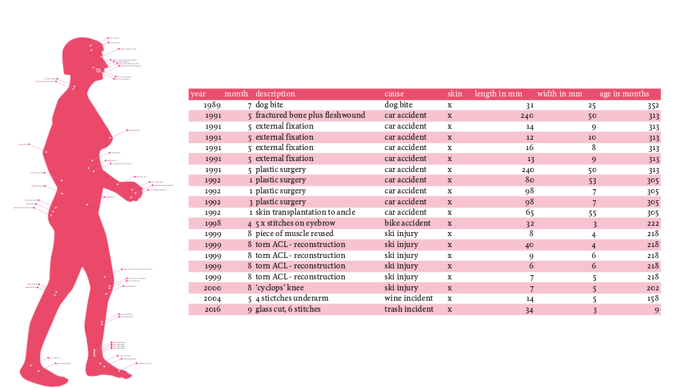
The Quantified Self
Notes:
And over the years, many scars have accumulated.
She measured all her scars in length and wide and came up to about 1m length and 30 cm wide.
She captured even more information, e.g. also on which day the scars are occurred, and found that 28% of the accidents are in May.
Ellis is asked by many people why she does that.

Slide 5
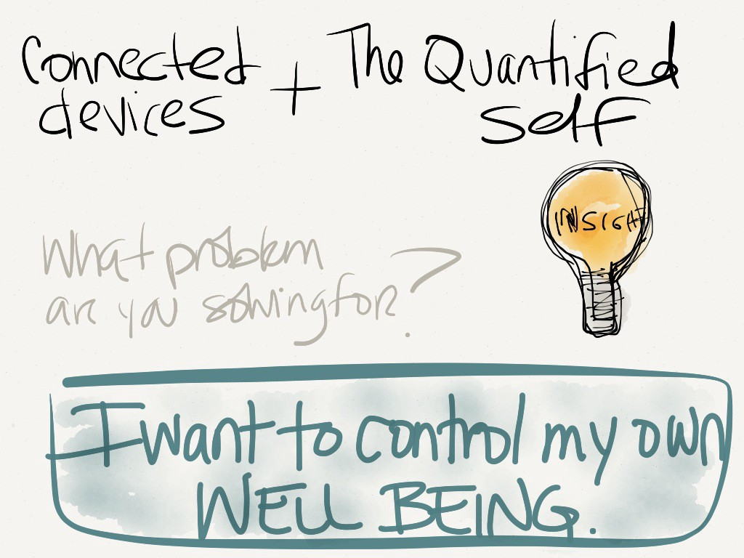
Why do people track themself?
Notes:
Ellis is reflecting herself by quantifying her body, to get more insights and control. With these knowledge, she can influence her behavior in a positive way, for instance be more carefully in May :-)

Slide 6

Why do people track data?
„I can honestly say that
anything that can be tracked is
being tracked by
someone somewhere.“
K. Kelly, The Inevitable, 2016
“A way of organizing,
shaping, and „reading“
your own life.“
“Self-tracking is much
broader than health.
It is as big as our life itself.”
Notes:
So, nearly everything can be tracked and quantified.

Slide 7

Why do people track intimate data?
But what about intimate data?
How can we track our relationship?
Wich data are perceived as intimate?
Notes:
But what is about intimate data?
And which data did we perceive as intimate?

Slide 8
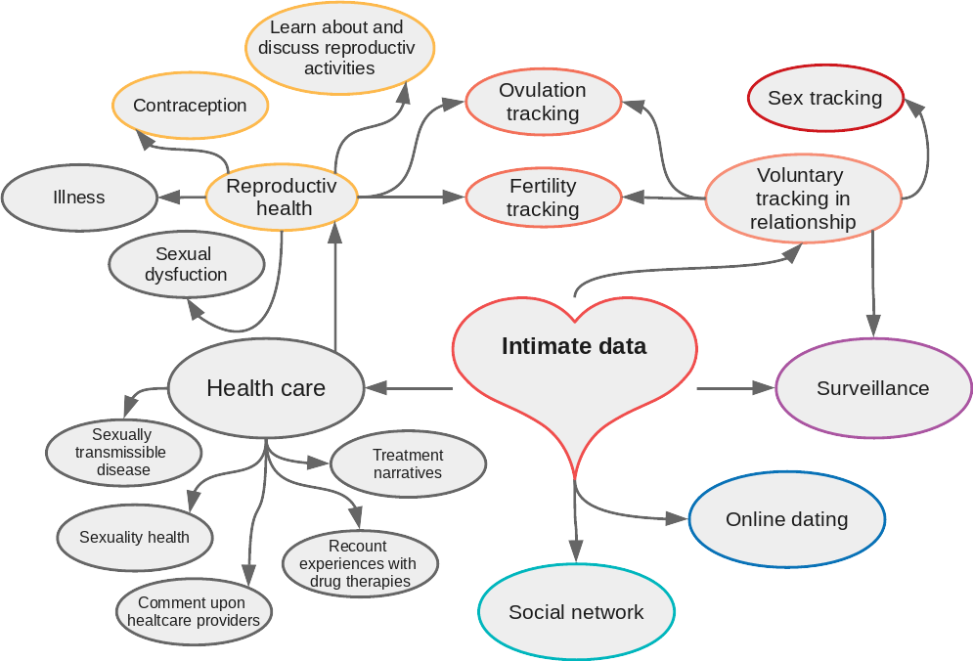
What data are perceived as intimate?
collected by Levy, 2014; Danaher et al., 2018; Lupton, 2015 a. 2016
Notes:
Data arising from an romantic relationship

Slide 9

The Life Course of Intimate Relationships
defined by Levy, 2014
Notes:
I want to go along the live course of intimate relationships defined by Levy.
Levy defined four conditions which describes the different stats a relationship can be.
I will explain these conditions in the following and give some examples.

Slide 10




A: Dating – Scoping out potential intimates
Notes:
I think neraly everybody here knows how to google someone.
Levy wrote, that many people use Google, Facebook, or the smartphone application Lulu the get information about another person of our interesst.
Also Tinder is well known as a location-based dating service.

Slide 11
A: Dating – Scoping out potential intimates
Data were provided by using services (social networks)
Data were collected and shared by other users
Tinder collects data about:
Facebook likes
Information about education
Age-rank of matches
When and where every online conversation with matched happens
Interesst and jobs
Pictures (Instagram)
Sexual preferences
Facebook stalking
Google someone
Levy, 2014
Notes:
I think neraly everybody here knows how to google someone.
Levy wrote, that many people use Google, Facebook, or the smartphone application Lulu the get information about another person of our interesst.
Also Tinder is well known as a location-based dating service.

Slide 12

A: Dating – Scoping out potential intimates
Users disclose information quickly to strangers
Most published data were personal data: full name, date of birth, phone numbers, work detail, email-addresses, complete home address
Nandwani et al., 2018
Notes:
Users disclose information quickly to strangers
Most published data were personal data: full name, date of birth, phone numbers, work detail

Slide 13
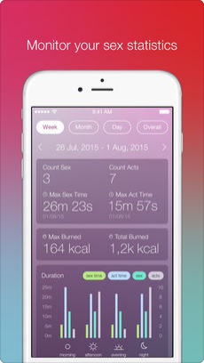
B: Tracking Intimate and Romantic Practices
Intimate tracking
Intimate Gamification
wearable sex toy
wearable devices
application for tracking
Lovely
kGoal
SexTracker
Danaher et al., 2018

Slide 14

B: Tracking Intimate and Romantic Practices
Risks that may arise:
Really intimate data stored on servers
Not always guaranteed that the data is anonymous
Data can be resold
Automatic recording by application
Quantification of act, similar to a sport activity
Supports gender stereotypes

Slide 15
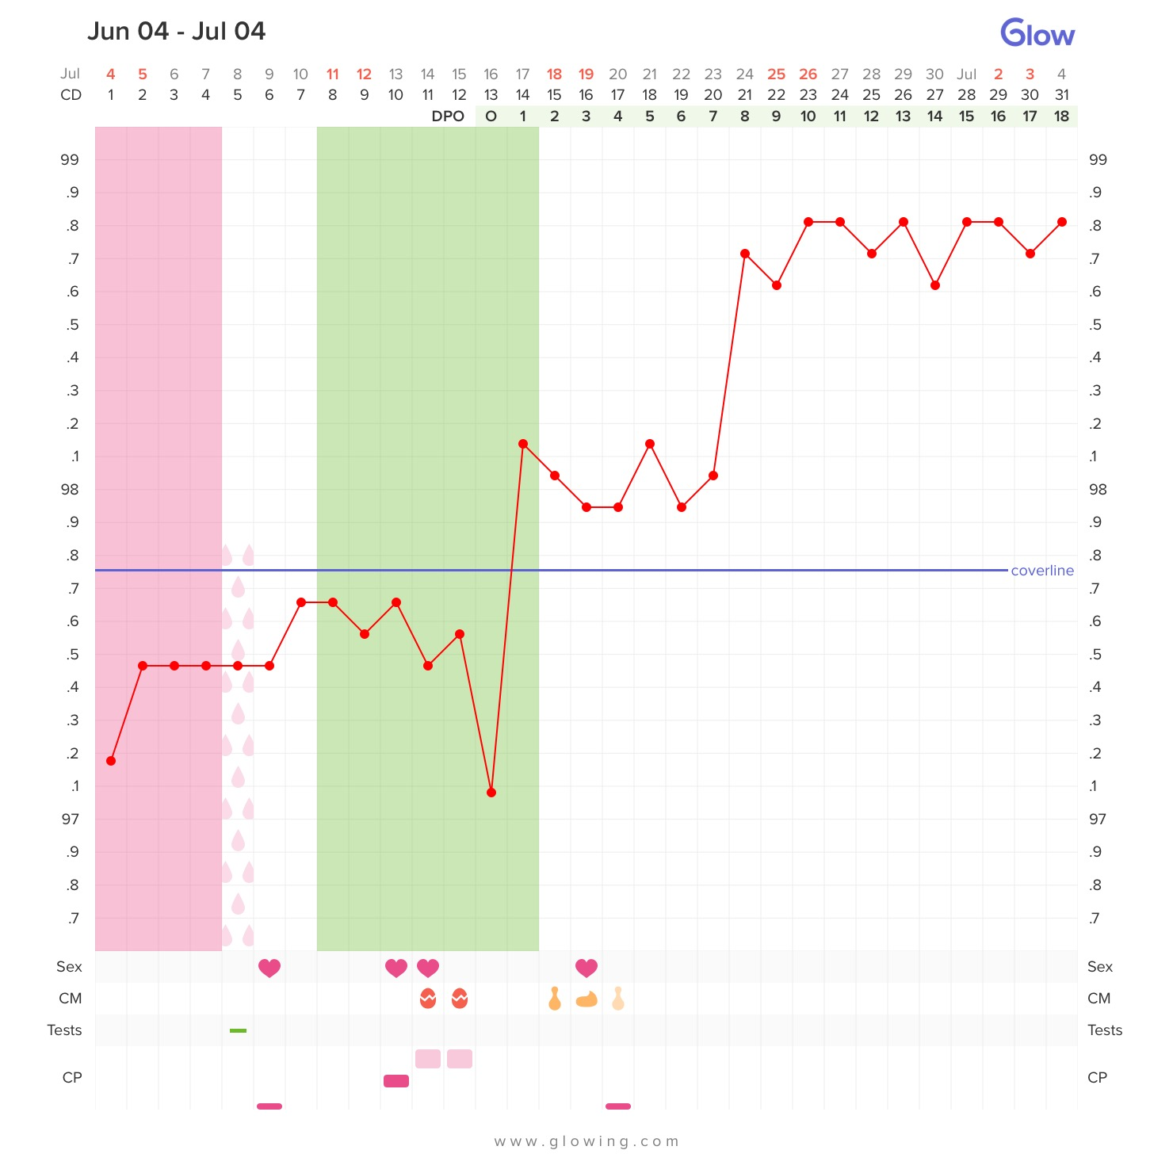
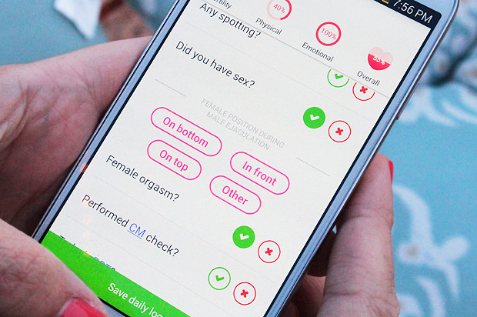
C: Monitoring Fertility

Slide 16
C: Monitoring Fertility
These types of data make woman to an object of surveillance and quantification
Gives the impression that the cycle of a woman is unsupervised chaotic
Promote the enhancement of gender stereotypes

Slide 17
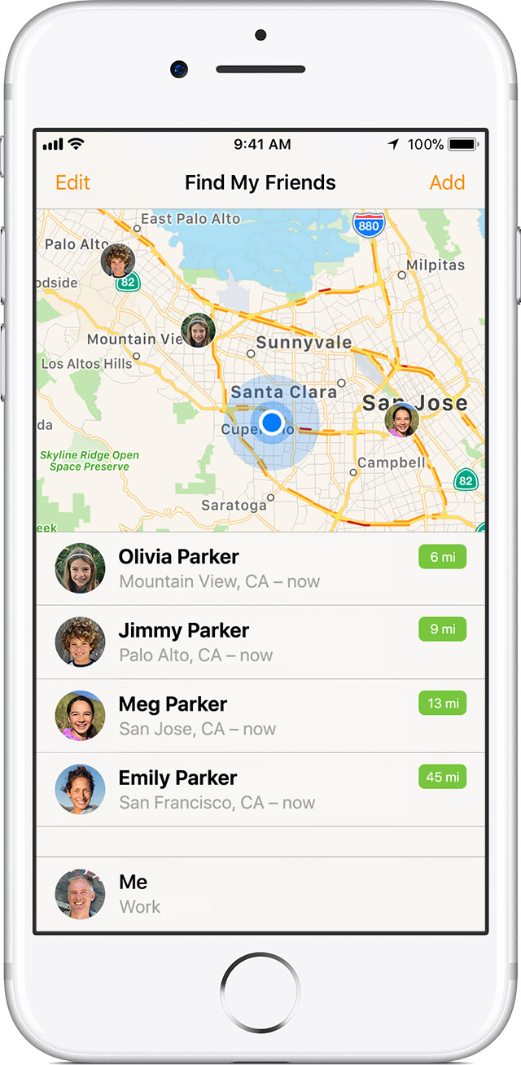

D: Surveilance, Abuse and Revenge
Surveillance trough location-based tracking
People track their location with the partner, family and friends
Urge for control
Does location tracking corrode the love in a relationship?

Slide 18

D: Surveilance, Abuse and Revenge
Technologies can be misused for other purposes
People exploit technologies to intimidate, threaten, monitor or harass the partner, ex-partner...
usual security measures are often not enough in this case

Slide 19
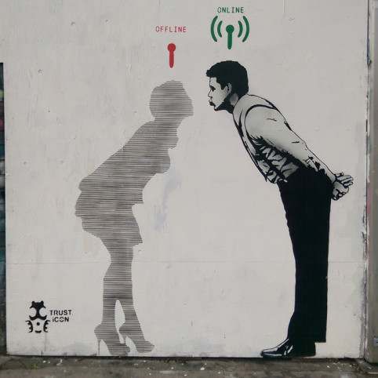

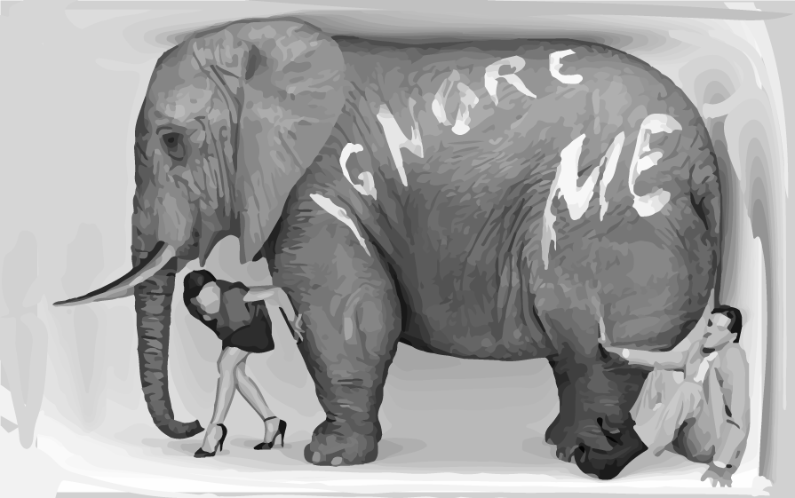
Risks?
Quantification
Risk of losing the reference to the data
User should be aware of purpose
Trust
Focus can be soley on data
Trust can be lost
Privacy
Privacy-invading elephant lurking in the room
Also Interpersonal issues

Slide 20


Conclusion
Intimate data arise predominantly from intimate activities
View of which data is intimate can change, depending on circumstances
Intimate is partially perceived subjectivly
Love and Relationships are influenced by the internet and self-optimization

Slide 21
Sources for images
https://medium.com/re-write/creating-a-quantified-self-how-i-use-data-to-combat-chronic-health-issues-a88af3536020
http://qs17.quantifiedself.com/slides/S2_3_EllisBartholomeus_Scars.pdf
https://de.wikipedia.org/wiki/Datei:Logo-Tinder.svg
https://de.wikipedia.org/wiki/Datei:Facebook_New_Logo_(2015).svg
https://de.wikipedia.org/wiki/Datei:Google_2015_logo.svg
https://en.wikipedia.org/wiki/Lulu_(app)#/media/File:Lulu_app_logo.png
https://www.kisspng.com/png-kiss-silhouette-intimate-relationship-couple-717250/
https://www.simplyscience.ch/teens-liesnach-archiv/articles/je-mehr-daten-wir-von-uns-preisgeben-desto-angreifbarer-werden-wir.html
https://itunes.apple.com/de/app/sex-keeper-calorie-counter-and-sex-tracker/id1061374235?mt=8
http://lovequestionlifeanswer.org/en/gender/what-are-gender-roles-and-stereotypes
https://lh4.googleusercontent.com/IIcabntgXLFbyPaIzJvFh72TntnWapcC4HQQLGJU_EPlSVzAF8It1W13eRss4w40oF89v3bz8RK8oP6ayu40NDsn0VVb2y7fzy34IxfTUpjh-ttDtN8mXDur_EdMJXXG1o_brGWs
https://support.apple.com/en-us/ht201087
https://de.depositphotos.com/80120008/stock-illustration-broken-heart-icon-divorce-sign.html
https://es.kisspng.com/png-anger-divorce-silhouette-screaming-interpersonal-r-655724/
https://thegiftshed.wordpress.com/tag/queens-park/page/1/
https://thinkhighlands.com/blog-posts
https://icons8.de/icon/53372/internet
https://www.shareicon.net/tag/success?p=5

