Slide 1
INFORMATIONSVISUALIZATION, WINTER TERM 2017/18
Project
Does the Oktoberfest influence the birth rate in Munich?
Katrin Kolb
Diana Irmscher
LMU Munich
16.11.2017

Slide 2
INFORMATIONSVISUALIZATION, WINTER TERM 2017/18
What would we do?
combine the datasets Oktoberfest and Geburtenrate with each other
combine the datasets Oktoberfest and Tourismus with each ohter
finding good combination of data
incorporate interaction options that have a high information effect
LMU Munich
16.11.2017

Slide 3
INFORMATIONSVISUALIZATION, WINTER TERM 2017/18
What questions should be ansered with the visualisation?
Does the number of visitors to the Oktoberfest influence the birth rate?
Does the number of tourists influence the number of Oktoberfest visitors?
Does the rising beer price influence the Oktoberfest visitors?
LMU Munich
16.11.2017

Slide 4
INFORMATIONSVISUALIZATION, WINTER TERM 2017/18
What questions should be ansered with the visualisation?
Do other aspects (security risk) influence Oktoberfest visitors?
Does alcohol consumption influence Oktoberfest visitors and the birth rate in Munich? How do alcohol consumption and birth rate in Munich in recent years?
LMU Munich
16.11.2017

Slide 5
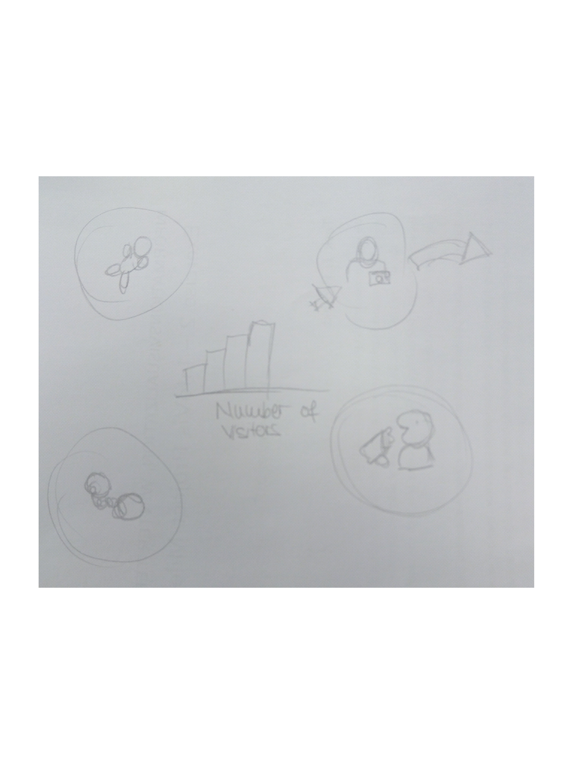
INFORMATIONSVISUALIZATION, WINTER TERM 2017/18
LMU Munich
16.11.2017

Slide 6
INFORMATIONSVISUALIZATION, WINTER TERM 2017/18
Thanks for the attention!
LMU Munich
16.11.2017

