Slide 1

寫作活動分享
人物：高二1學生
來源：三民版第四冊第一課
A Love Coach’s Game Plan
日期：2025.2.10

Slide 2
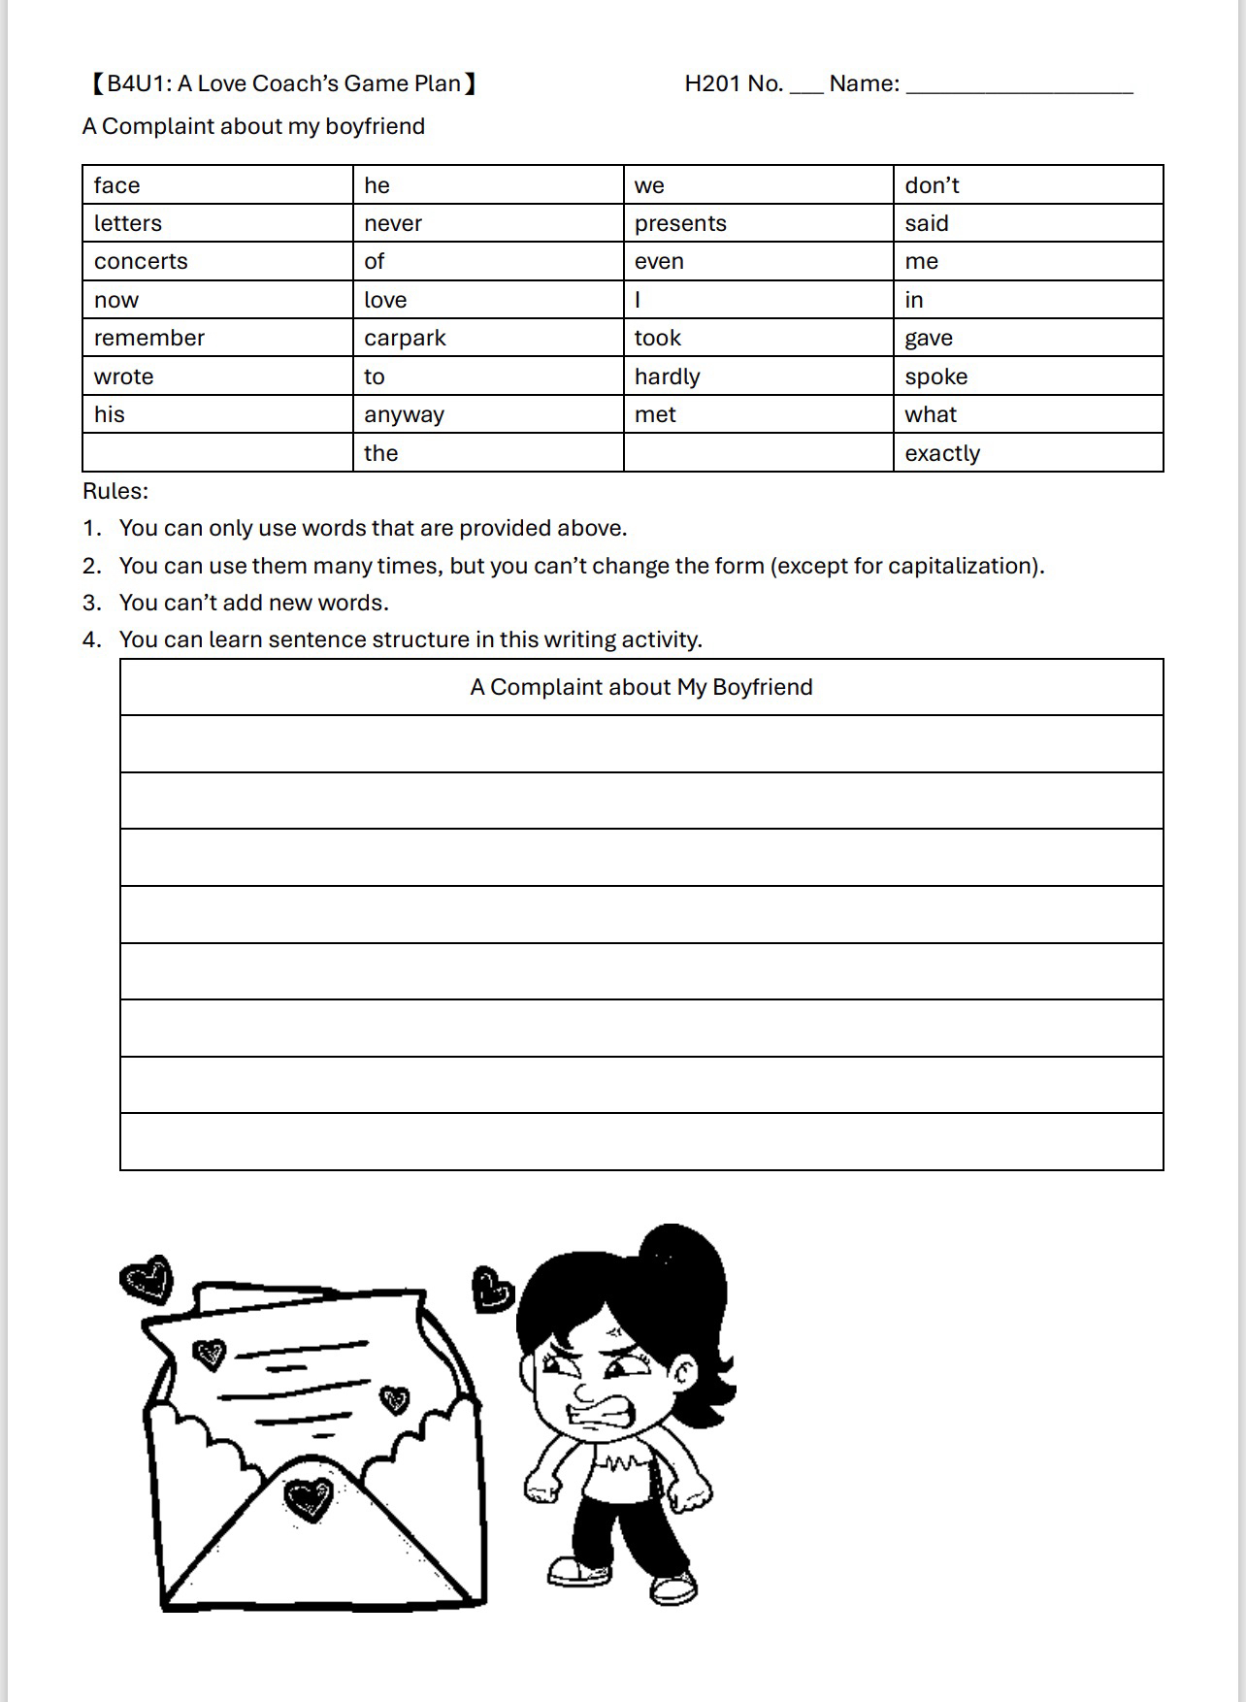
課文衍伸出的寫作活動-練習寫出文法正確、結構完整的句子，成為一篇作文
寫作活動說明
學生作品發表
Introduction

Slide 3
A Complaint About Ｍy Boyfriend
寫作活動分享
學生作品發表
抱怨男友
周〇宸 | He never wrote love letters to me. He never said love to me. We never met in carpark. He never took me to concerts. He never gave me presents face to face. I don't remember his face now. He said he never gave me love. I don't love he.

Slide 4
A Complaint About Ｍy Boyfriend
寫作活動分享
學生作品發表
抱怨男友
徐〇恩 | He never wrote love letters to me He never took me to concerts He never said love to me

Slide 5
A Complaint About Ｍy Boyfriend
寫作活動分享
學生作品發表
抱怨男友
許〇棋 | I never love his face. I don't remember what present he gave me. He never said love to me. We hardly met face to face.

Slide 6
A Complaint About Ｍy Boyfriend
寫作活動分享
學生作品發表
抱怨男友
湯〇澔 | He don‘t love me now,we hardly talk anyway. He never wrote love letters to me.He never said love to me.He never took me to concerts.He never gave me presents.He don't remember me.

Slide 7
A Complaint About Ｍy Boyfriend
寫作活動分享
學生作品發表
抱怨男友
張〇誠 | He never wrote love letters to me. He never said love to me. We never met in carpark. He never took me to concerts.

Slide 8
A Complaint About Ｍy Boyfriend
寫作活動分享
學生作品發表
抱怨男友
方〇貿 | He never wrote love letters to me He never took me to concerts He never gave me presents He never said love to me I don't remember his face

Slide 9
A Complaint About Ｍy Boyfriend
寫作活動分享
學生作品發表
抱怨男友
王〇姍 | He never love me and never gave me presents. He never said love me in face to face. He never took me to the concerts. He didn’t gave me love.

Slide 10
A Complaint About Ｍy Boyfriend
寫作活動分享
學生作品發表
抱怨男友
王〇翊 | He never wrote letters to me. He said he never gave me love. He never said love to me.

Slide 11
A Complaint About Ｍy Boyfriend
寫作活動分享
學生作品發表
抱怨男友
甘〇瑜 | He never wrote letters to me. He hardly spoke. He never remember concerts of love. He never gave me presents.

Slide 12
A Complaint About Ｍy Boyfriend
寫作活動分享
學生作品發表
抱怨男友
李〇萱 | He never said he love me. He never wrote me letters. He never took me to the concerts. He never said love me in face to face. He never gave me presents.

Slide 13
A Complaint About Ｍy Boyfriend
寫作活動分享
學生作品發表
抱怨男友
李〇柔 | He doesn't remember me said.He doesn't wrote letters to me.He doesn't gave me presents.He doesn't remember carpark anyway.He never took me to the concerts.He hardly met to me.Exactly,he never love me,now.

Slide 14
A Complaint About Ｍy Boyfriend
寫作活動分享
學生作品發表
抱怨男友
林〇柔 | He never gave the love presents to me, even wrote the letters.He don't remember to met me in the concerts. Never said he love me even spoke hardly to me.

Slide 15
A Complaint About Ｍy Boyfriend
寫作活動分享
學生作品發表
抱怨男友
林〇妤 | He never said he love me He never wrote love letters to me He never gave me presents

Slide 16
A Complaint About Ｍy Boyfriend
寫作活動分享
學生作品發表
抱怨男友
林〇微 | He never gave me presents. He never said he love me exactly. I don't remember his face now. We hardly met face to face. He never wrote letters to me. I don't remember what he said.

Slide 17
A Complaint About Ｍy Boyfriend
寫作活動分享
學生作品發表
抱怨男友
洪〇蕎 | He never love me. He don't remember what I love. He never wrote letters to me.

Slide 18
A Complaint About Ｍy Boyfriend
寫作活動分享
學生作品發表
抱怨男友
張〇慈 | He never wrote letters to me. We hardly met face to face. He never gave me presents. He never gave me his love. He never said love me. I don't remember his face now. I don't remember what he said. He never took me to the concerts.

Slide 19
A Complaint About Ｍy Boyfriend
寫作活動分享
學生作品發表
抱怨男友
莊〇喬 | He never wrote love letters to me. He never said love to me. We never met in carpark. He never remember what I said.

Slide 20
A Complaint About Ｍy Boyfriend
寫作活動分享
學生作品發表
抱怨男友
莊〇棋 | He never said love to me.He never met me in face to face. He don’t remember what I said. He never gave me presents.

Slide 21
A Complaint About Ｍy Boyfriend
寫作活動分享
學生作品發表
抱怨男友
郭〇耘 | I don't remember his face . He never gave me presents. He never write letters to me. He never said love to me. He never took me to comcerts. He never said he love me exactly. We hardly met face to face. He never remember met me in carpark.

Slide 22
A Complaint About Ｍy Boyfriend
寫作活動分享
學生作品發表
抱怨男友
陳〇榆 | He never said love to me.He never wrote love letters to me.He never took me to concerts.He never gave me presents face to face.I don't remember his face.

Slide 23
A Complaint About Ｍy Boyfriend
寫作活動分享
學生作品發表
抱怨男友
陳〇畇 | He never said love to me. He never wrote letters to me. He said he never gave me love.

Slide 24
A Complaint About Ｍy Boyfriend
寫作活動分享
學生作品發表
抱怨男友
陳〇語 | He doesn't remember what I spoke, he never wrote letters to me, he gave me the present whatI don't love

Slide 25
A Complaint About Ｍy Boyfriend
寫作活動分享
學生作品發表
抱怨男友
黃〇瑜 | He never took me to the concerts.He never wrote letters to me.We hardly met face to face.He never gave me presents.He never remember what I said.

Slide 26
A Complaint About Ｍy Boyfriend
寫作活動分享
學生作品發表
抱怨男友
黃〇育 | He never wrote letters to me .He doesn't gave me present.He doesn't remember his carpark.He said he doesn't love the preaest I gave.He never took me to the concerts. He said he doesn't love me now.

Slide 27
A Complaint About Ｍy Boyfriend
寫作活動分享
學生作品發表
抱怨男友
黃〇瑢 | He never wrote letters to me. He met me hardly. He never gave love of me.

Slide 28
A Complaint About Ｍy Boyfriend
寫作活動分享
學生作品發表
抱怨男友
黃〇儀 | He never gave me presents. He never wrote letters to me. He never said love to me.

Slide 29
A Complaint About Ｍy Boyfriend
寫作活動分享
學生作品發表
抱怨男友
楊〇儀 | He never said love to me.He never took me to concerts. He never wrote love letters to me.He never gave me presents face to face. He doesn't remember me.I don't remember his face.

Slide 30
A Complaint About Ｍy Boyfriend
寫作活動分享
學生作品發表
抱怨男友
楊〇姍 | He don't remember what present I gave. We met hardly in face .He never wrote love letters to me.He never said he love me . He never miss me even in concert.

Slide 31
A Complaint About Ｍy Boyfriend
寫作活動分享
學生作品發表
抱怨男友
蔡〇恬 | He never wrote letters to me even gave me presents.He never took me to concerts.He said he never love me.

Slide 32
A Complaint About Ｍy Boyfriend
寫作活動分享
學生作品發表
抱怨男友
譚〇棋 | He never wrote love letters to me. He never said love to me. He never took me to concerts. He never gave me presents.

Slide 33
A Complaint About Ｍy Boyfriend
寫作活動分享
學生作品發表
抱怨男友
周〇庭 | He never love me. He never gave me presents. He never remember me. He never remember l gave he presents.

Slide 34
A Complaint About Ｍy Boyfriend
寫作活動分享
學生作品發表
抱怨男友
陳〇錞 | He don't love me. He never remember what I said. He never gave me presents, even never wrote love letters to me. We hardly to met anyway.

Slide 35
A Complaint About Ｍy Boyfriend
寫作活動分享
學生作品發表
抱怨男友
陳〇彤 | He never took me to concerts.He never said love to me.He never took me to concerts.He never wrote love letters to me .He never gave me presents .

Slide 36
A Complaint About Ｍy Boyfriend
寫作活動分享
學生作品發表
抱怨男友
張〇沂 | We hardly met face to face. He never wrote letters to me. I don't remember what he said. He never said he love me.

Slide 37
A Complaint About Ｍy Boyfriend
寫作活動分享
學生作品發表
抱怨男友
傅〇雅 | He never gave me presents. He never gave me his love. He never said love me. I don't remember his face now. I don't remember what he said. He never took me to the concerts.

Slide 38
A Complaint About Ｍy Boyfriend
寫作活動分享
學生作品發表
抱怨男友
胡〇瑄 | He never said he love me. He never gave me presents. He never give me love He never wort letters to me

Slide 39
The Best of Us!

